Slide 1
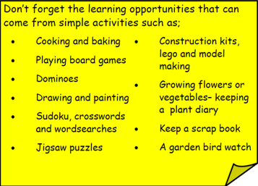
Year 3 Home School Provision Day 50
The following slides will be split into 3 separate activities. Each slide will be daily activities for you and your child to do at home. Due to a partial reopening of NJS, Miss Watson is undertaking the alternative provision for Year 3. Please email – chloe.watson@taw.org.uk if you need to contact her or would like to share a piece of home learning for the website. Thank you for your continuing support.
Useful websites for Home learning
Year 2 and 3 free resources for parents for Home Learning: https://www.twinkl.co.uk/resources/parents/wellbeing-parents/school-closures-category-free-resources-parents
Classroom Secrets free resources – laptop or PC needed
https://classroomsecrets.co.uk/free-home-learning-packs/
BBC Bitesize - https://www.bbc.co.uk/bitesize/levels/zbr9wmn
Pobble365 – website with inspiring pictures for Storywriting or Art https://www.pobble365.com/
White Rose Maths – Home Learning activities – great for home learning as we use these ideas in school. https://whiterosemaths.com/homelearning/
Children also have logins in their homelink books for Shropshire Schools Library Service e-Library – books can be borrowed fro up to 3 weeks at a time. https://shropshiresls.wheelers.co/

Slide 2
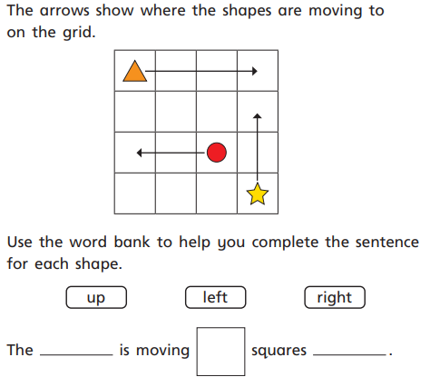
Daily Provision Pack – Day 50
Maths:
Objective: To be able to describe movement.
English:
Objective: To design a poster based on a story.
Watch the video using the link above.
English continued on following slides.
TTRS and Guided Reading:
TTRS:
Objective: To participate in the boys vs girls whole school battle. Who will win?!
Challenge yourself to as many games as you can. Continue to use TTRS throughout the week to give your team the best chance!
Fiction Express:
New book: MAYFLOWER STOWAWAYS by Jan Burchett and Sara Vogler.
Objective: To read Chapter 2, vote by Tuesday 4pm and complete the questions. Leave a review of the chapter for your teacher to read.
Complete the reading of chapter 1, vote, and then complete the quiz on the following page
1* - complete with an adult to support
2* - try to complete independently but ask your adult if you need support
3* - complete independently
EXT: Write 5 questions of your own about the book.
https://www.youtube.com/watch?time_continue=4&v=6HfBbSUORvo&feature=emb_logo
Maths continued on the following slide

Slide 3
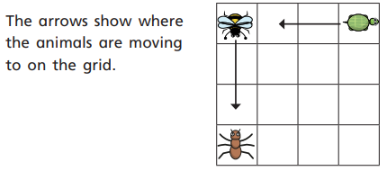
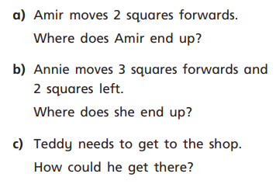
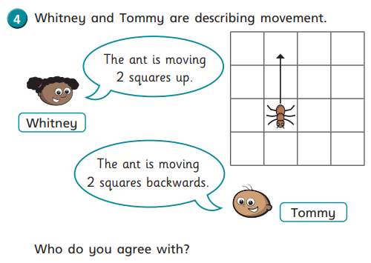
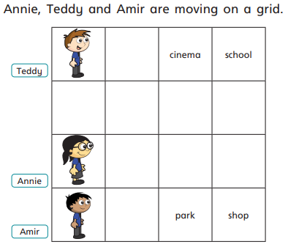
Maths continued

Slide 4
1 Star:
Watch the video using the following link:
https://www.youtube.com/watch?time_continue=4&v=6HfBbSUORvo&feature=emb_logo
Discussing with an adult to help you, answer the following questions;
1) What do you think is going to happen?
2) What do you think the lighthouse keeper is thinking? How is he feeling?
3) How did the lighthouse keeper need the people to help? Why? What happened?
4) Which of NJS’ 3 C’s did the villagers show? Compassion, community or courage? Explain why.
2 Star:
Watch the video using the following link:
https://www.youtube.com/watch?time_continue=4&v=6HfBbSUORvo&feature=emb_logo
Answer the following questions. Remember to use full stops and capital letters.
1) What do you think is going to happen?
2) What do you think the lighthouse keeper is thinking? How is he feeling?
3) How did the lighthouse keeper need the people to help? Why? What happened?
4) Which of NJS’ 3 C’s did the villagers show? Compassion, community or courage? Explain why.
5) Why does there need to be a light at all times?
English continued
3 Star:
Watch the video using the following link:
https://www.youtube.com/watch?time_continue=4&v=6HfBbSUORvo&feature=emb_logo
Answer the following questions. Remember to use full stops and capital letters and use full sentences (using words from the question).
1) What do you think is going to happen?
2) What do you think the lighthouse keeper is thinking? How is he feeling?
3) How did the lighthouse keeper need the people to help? Why? What happened?
4) Which of NJS’ 3 C’s did the villagers show? Compassion, community or courage? Explain why.
5) Why does there need to be a light at all times?
6) What could have happened if the villagers didn’t come to the rescue? (Creative writing, no less than half a page, what do you think could have happened? No right or wrong! Use description, this is your extension of the story)

