Slide 1
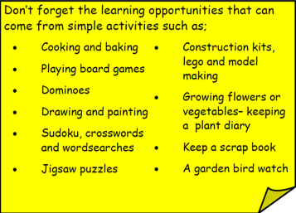
Year 3 Home School Provision Day 52
The following slides will be split into 3 separate activities. Each slide will be daily activities for you and your child to do at home. Due to a partial reopening of NJS, Miss Watson is undertaking the alternative provision for Year 3. Please email – chloe.watson@taw.org.uk if you need to contact her or would like to share a piece of home learning for the website. Thank you for your continuing support.
Useful websites for Home learning
Year 2 and 3 free resources for parents for Home Learning: https://www.twinkl.co.uk/resources/parents/wellbeing-parents/school-closures-category-free-resources-parents
Classroom Secrets free resources – laptop or PC needed
https://classroomsecrets.co.uk/free-home-learning-packs/
BBC Bitesize - https://www.bbc.co.uk/bitesize/levels/zbr9wmn
Pobble365 – website with inspiring pictures for Storywriting or Art https://www.pobble365.com/
White Rose Maths – Home Learning activities – great for home learning as we use these ideas in school. https://whiterosemaths.com/homelearning/
Children also have logins in their homelink books for Shropshire Schools Library Service e-Library – books can be borrowed fro up to 3 weeks at a time. https://shropshiresls.wheelers.co/

Slide 2
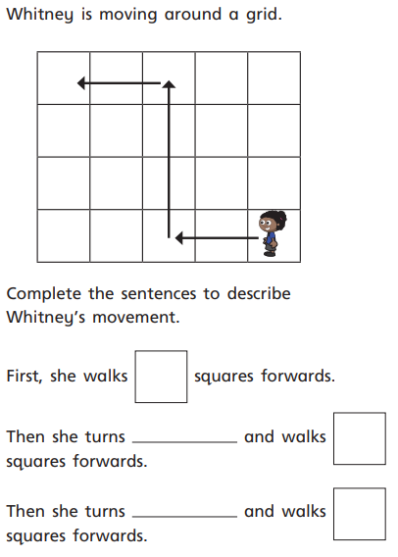
Daily Provision Pack – Day 52
Maths:
Objective: To be able to describe movement and turns.
English:
Objective: To create a storyboard of the lighthouse story.
Watch the video again and make notes about what you think are the most important events. Turn these events into a storyboard.
English continued on the following slide.
Geography:
Objective: To identify major cities on the UK map.
Using the UK map on the following slides, identify the major cities and label them on your map.
Have a go at drawing the UK OR do the activity verbally like a game with an adult.
Please remember there is no need to print worksheets.
Geography continued on the following slide.
https://www.youtube.com/watch?time_continue=4&v=6HfBbSUORvo&feature=emb_logo
Maths continued on the following slide

Slide 3
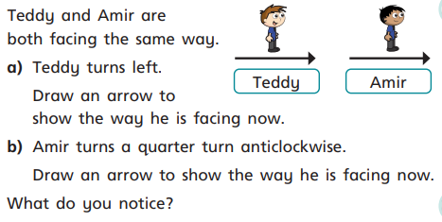
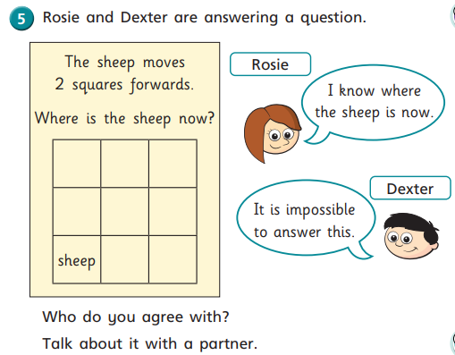
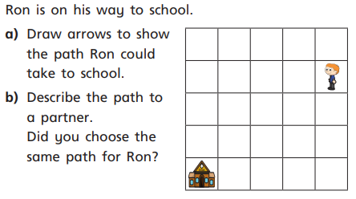
Maths continued

Slide 4
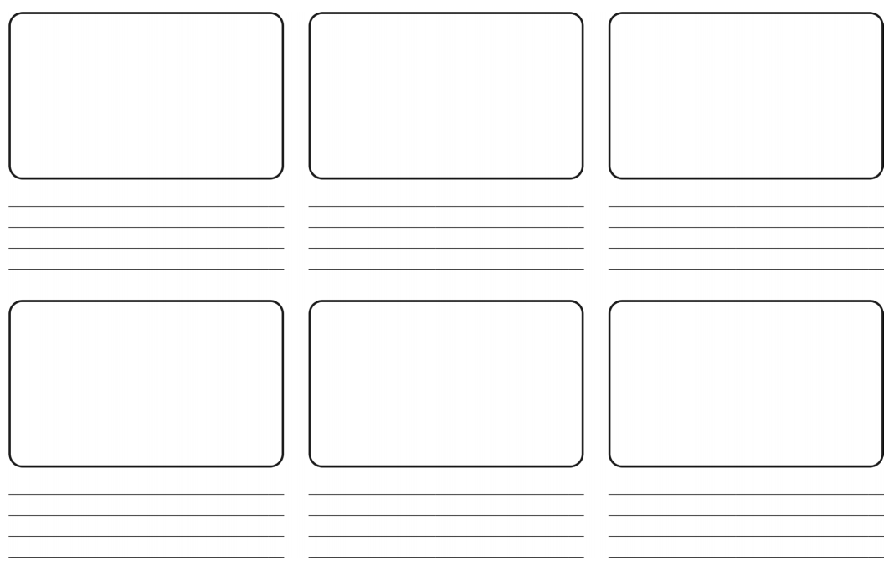
English continued
https://www.youtube.com/watch?time_continue=4&v=6HfBbSUORvo&feature=emb_logo
Watch the video again and make notes about what you think are the most important events. Turn these events into a storyboard.
1 Star: To complete the storyboard writing a sentence for each event using a capital letter and a full stop.
2 Star: To complete the storyboard writing a sentence for each event using a capital letter and a full stop. Also use an expanded noun phrase (adjective, adjective noun eg. Tall, dark lighthouse)
3 Star: To complete the storyboard writing a sentence for each event using a capital letter and a full stop. Also use a comma in your sentence to add detail.

Slide 5
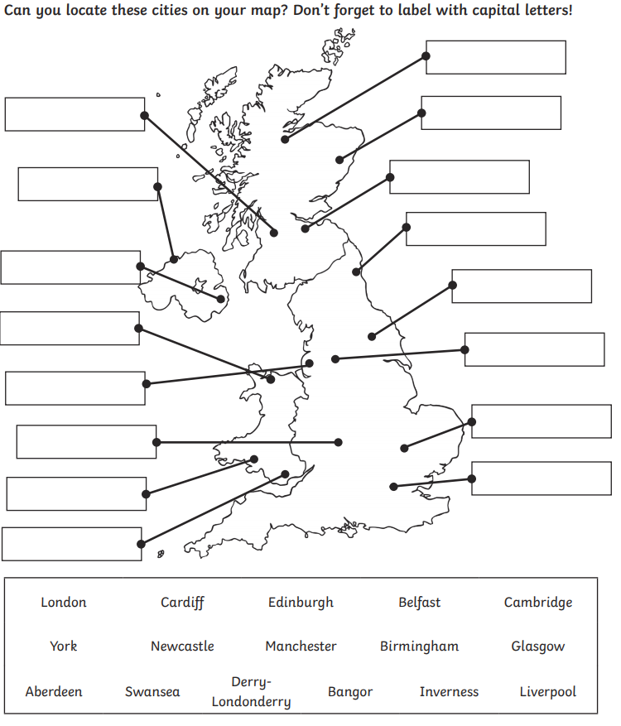
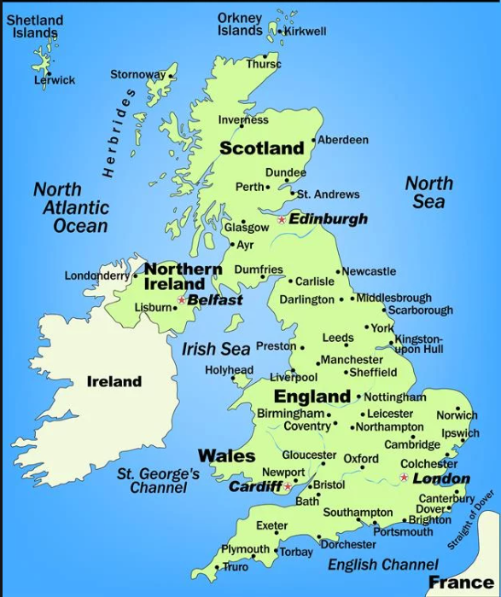
Geography continued
Answers on following slide.

Slide 6
