Slide 1
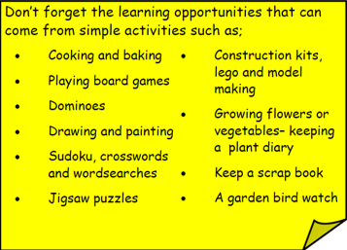
Year 3 Home School Provision Day 54
The following slides will be split into 3 separate activities. Each slide will be daily activities for you and your child to do at home. Due to a partial reopening of NJS, Miss Watson is undertaking the alternative provision for Year 3. Please email – chloe.watson@taw.org.uk if you need to contact her or would like to share a piece of home learning for the website. Thank you for your continuing support.
Useful websites for Home learning
Year 2 and 3 free resources for parents for Home Learning: https://www.twinkl.co.uk/resources/parents/wellbeing-parents/school-closures-category-free-resources-parents
Classroom Secrets free resources – laptop or PC needed
https://classroomsecrets.co.uk/free-home-learning-packs/
BBC Bitesize - https://www.bbc.co.uk/bitesize/levels/zbr9wmn
Pobble365 – website with inspiring pictures for Storywriting or Art https://www.pobble365.com/
White Rose Maths – Home Learning activities – great for home learning as we use these ideas in school. https://whiterosemaths.com/homelearning/
Children also have logins in their homelink books for Shropshire Schools Library Service e-Library – books can be borrowed fro up to 3 weeks at a time. https://shropshiresls.wheelers.co/

Slide 2
Daily Provision Pack – Day 54
Maths:
Objective: To be able to follow compass movements.
Choose 1, 2 or 3 Star activity
English:
Objective: To write your own story where the problem is solved in a different way
Watch the video using the link above.
Using the lighthouse keeper video write your own story where the problem is solved in a different way. Think about what could happen next? Where could the ship go when it has sailed away? What could happen to the villagers?
PE:
Objective: To complete cosmic yoga.
https://www.youtube.com/user/CosmicKidsYoga
Using comic yoga from Youtube, select a theme and follow the instructions.
Remember to make sure you have enough room and sensible clothing while you do your PE lesson.
https://www.youtube.com/watch?time_continue=4&v=6HfBbSUORvo&feature=emb_logo
Maths continued on the following slide
English continued on the following slide

Slide 3
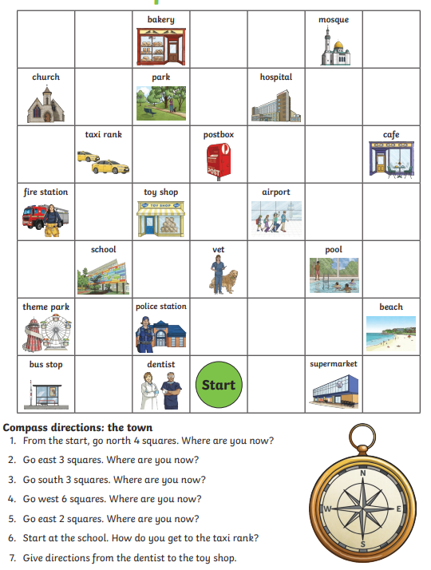
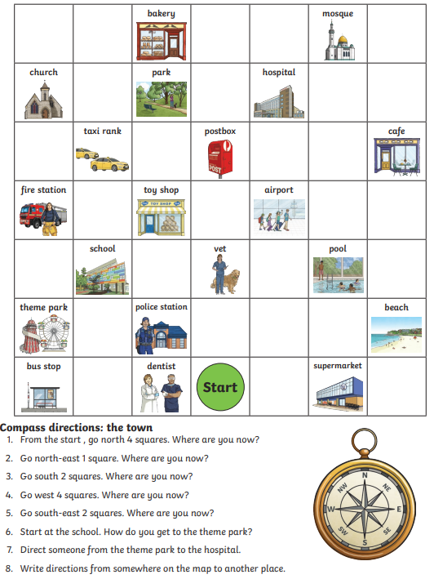
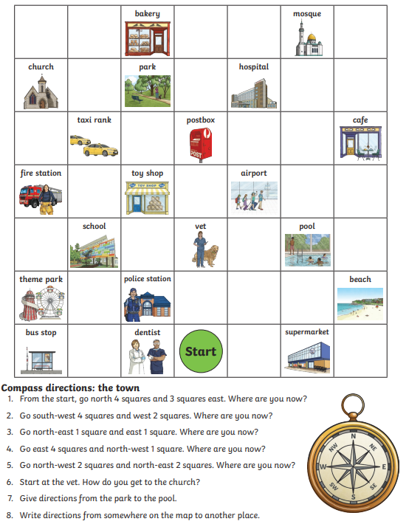
Maths continued
1 star
2 star
3 star

Slide 4
English continued
1 Star
Using the video:
https://www.youtube.com/watch?time_continue=4&v=6HfBbSUORvo&feature=emb_logo
Write your own ending to the story. What could happen next? Where could the ship go when it has sailed away? What could happen to the villagers?
You could type or ask your adult to scribe for you.
You must include adjectives to describe. E.g the rough sea
2 Star
Using the video:
https://www.youtube.com/watch?time_continue=4&v=6HfBbSUORvo&feature=emb_logo
Write your own ending to the story. What could happen next? Where could the ship go when it has sailed away? What could happen to the villagers?
Handwrite your work trying to remember your spellings and handwriting.
You must include expanded noun phrases. E.g the dark, rough sea. Adjective comma adjective noun
3 Star
Using the video:
https://www.youtube.com/watch?time_continue=4&v=6HfBbSUORvo&feature=emb_logo
Write your own ending to the story. What could happen next? Where could the ship go when it has sailed away? What could happen to the villagers?
Handwrite your work trying to remember your spellings and handwriting.
You must include expanded noun phrases. E.g the dark, rough sea. Adjective comma adjective noun
As well as fronted adverbials (who, where, when). E.g On the rough sea, the ship rocked viciously side to side.

