Slide 2
Thursday’s Maths for Year 4
https://newportjuniorschool.org.uk/home/key-info/policies/
Today you are going to decide the ticket prices you will charge for entry. Look at the three examples given and then decide what prices you are going to charge. You may decide to have a day rate, half day rate or maybe even a different price for people who come in after three o clock in the afternoon. You may want to have ‘saver’ rates for those who come in for more than one day or charge extra at holiday times. Work out your pricing structure and then display it so it is clear for everyone to read.

Slide 3
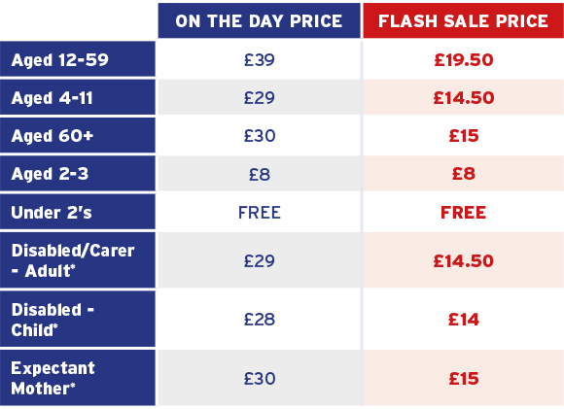
Drayton Manor Pricing policy

Slide 4
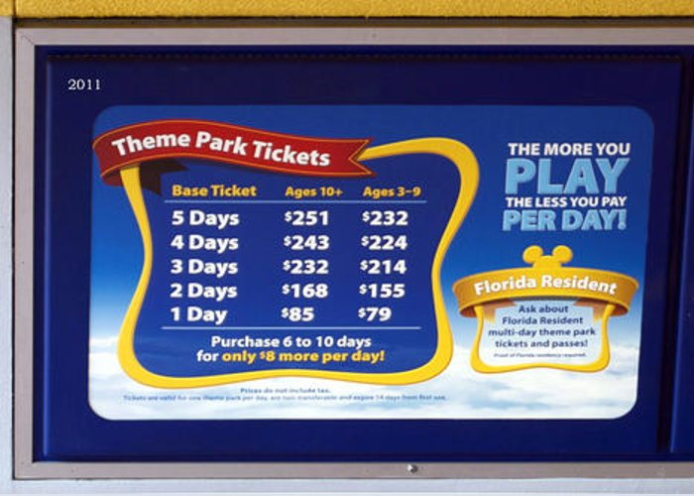

Slide 6
Thursday’s English for Year 4
This week we have be doing some English work on theme parks.
Today you are going to write a play script to be used for a television advert. Look at the play script saved in today’s folder explaining the features and giving you an example. You need to decide how main characters you are going to include (and any costumes they may need to wear if they are going to play a character.) What you want them to say to advertise your theme park – how are they going to ’sell’ it? Any stage directions that you think you’ll need. Any particular ways you want your characters to say something – like quietly, shouting. Don’t make it too long. Think of the television adverts you have seen. They are short, snappy and to the point. Definitely not more than one page of your book. Remember time is money when you advertise. The longer the advertisement the more money it will cost you!

Slide 7
Todays other activity:
Music
Listen to these songs from the Disney Theme parks
https://www.youtube.com/watch?v=zA4l_pHxbI8
Today you are going to think about what music you would like to play at your theme parks.
Think of all the songs you know. Are there any that you would think are suitable to play?
Could you compose a piece of music using things around you to make sounds?
If you do and you can record it I would love to hear it. Email it to me at the usual address.

