Slide 1
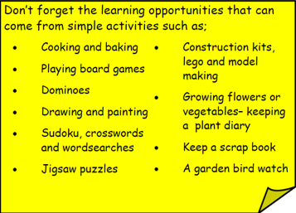
Year 3 Home School Provision Day 59
The following slides will be split into 3 separate activities. Each slide will be daily activities for you and your child to do at home. Due to a partial reopening of NJS, Miss Watson is undertaking the alternative provision for Year 3. Please email – chloe.watson@taw.org.uk if you need to contact her or would like to share a piece of home learning for the website. Thank you for your continuing support.
Useful websites for Home learning
Year 2 and 3 free resources for parents for Home Learning: https://www.twinkl.co.uk/resources/parents/wellbeing-parents/school-closures-category-free-resources-parents
Classroom Secrets free resources – laptop or PC needed
https://classroomsecrets.co.uk/free-home-learning-packs/
BBC Bitesize - https://www.bbc.co.uk/bitesize/levels/zbr9wmn
Pobble365 – website with inspiring pictures for Storywriting or Art https://www.pobble365.com/
White Rose Maths – Home Learning activities – great for home learning as we use these ideas in school. https://whiterosemaths.com/homelearning/
Children also have logins in their homelink books for Shropshire Schools Library Service e-Library – books can be borrowed fro up to 3 weeks at a time. https://shropshiresls.wheelers.co/

Slide 2
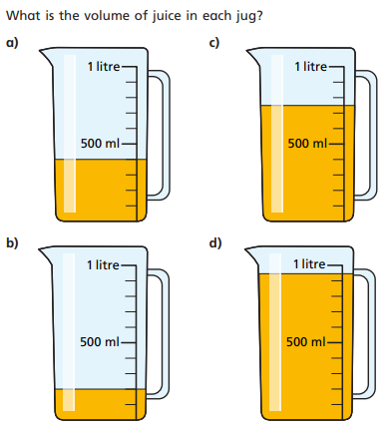
Daily Provision Pack – Day 59
Maths:
Objective: To be able to measure capacity using correct vocabulary.
English:
Objective: To finish writing your newspaper report.
Using your plan you made on Wednesday, you should write the remaining paragraphs and include a picture with a caption.
Use the checklist to ensure you have included all the features of a newspaper.
English continued on the following slides.
Geography:
Objective: To research a city of your choice.
Using the template provided (copy out into your book) research a city of your choice.
You could use subheading such as the following to create your paragraphs;
What is the population?
Where is the city?
When was the city founded?
What is it famous for?
What makes it a city?
What are some of its features?
What makes a city?
Geography continued on the following slides
Maths continued on the following slide

Slide 3
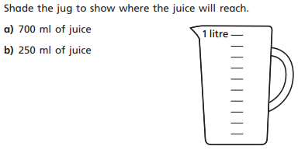
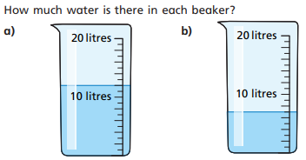
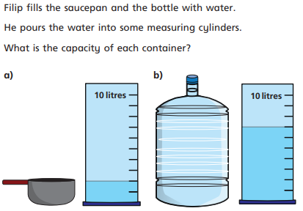
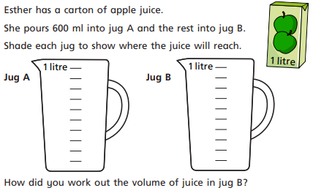
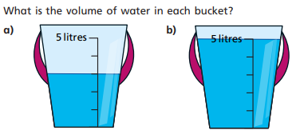
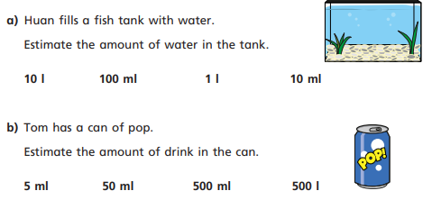
Maths continued

Slide 4
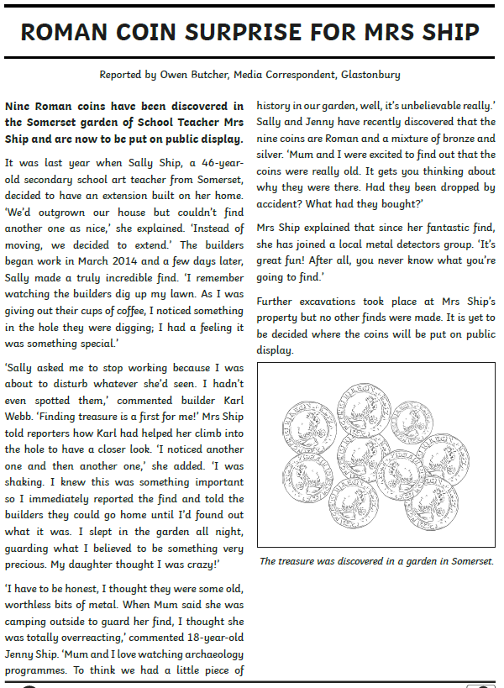
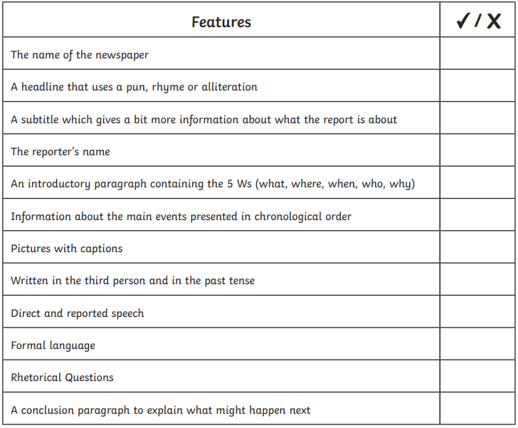
English continued
Using your plan you made on Wednesday, you should write the remaining paragraphs and include a picture with a caption (everything in the red boxes).
1 Star – complete with adult support like in school including as many details as possible. You could dictate for your adult to scribe, type or you could copy what your adult has written down. These are all different strategies used in school to support.
2/3 Star – complete independently including as many details as possible. Remember to be mindful of your spellings, punctuation and the features of a newspaper.
Share any completed work with me at;
chloe.watson@taw.org.uk

Slide 5
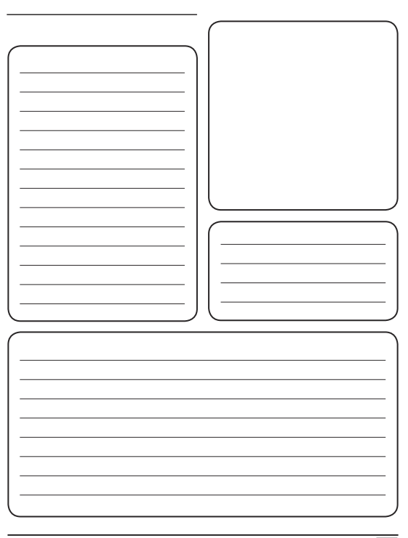
Geography continued
Using the template provided (copy out into your book) research a city of your choice.
You could use subheading such as the following to create your paragraphs;
What is the population?
Where is the city?
When was the city founded?
What is it famous for?
What makes it a city?
What are some of its features?
What makes a city?
Or you could write your own questions!

