Slide 1
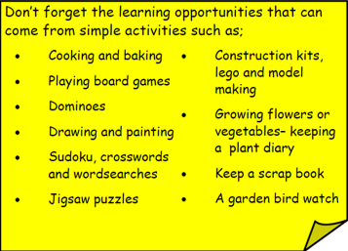
Year 3 Home School Provision Day 61
The following slides will be split into 3 separate activities. Each slide will be daily activities for you and your child to do at home. Due to a partial reopening of NJS, Miss Watson is undertaking the alternative provision for Year 3. Please email – chloe.watson@taw.org.uk if you need to contact her or would like to share a piece of home learning for the website. Thank you for your continuing support.
Useful websites for Home learning
Year 2 and 3 free resources for parents for Home Learning: https://www.twinkl.co.uk/resources/parents/wellbeing-parents/school-closures-category-free-resources-parents
Classroom Secrets free resources – laptop or PC needed
https://classroomsecrets.co.uk/free-home-learning-packs/
BBC Bitesize - https://www.bbc.co.uk/bitesize/levels/zbr9wmn
Pobble365 – website with inspiring pictures for Storywriting or Art https://www.pobble365.com/
White Rose Maths – Home Learning activities – great for home learning as we use these ideas in school. https://whiterosemaths.com/homelearning/
Children also have logins in their homelink books for Shropshire Schools Library Service e-Library – books can be borrowed fro up to 3 weeks at a time. https://shropshiresls.wheelers.co/

Slide 2
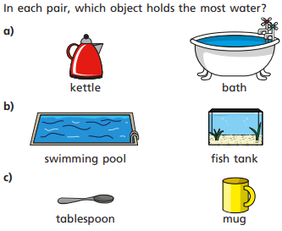
Daily Provision Pack – Day 61
Maths:
Objective: To be able to compare capacity.
English:
Objective: To map the story ‘Taking Flight’
http://takingflightfilm.com/
Watch the video clip and use the story mapping template to map out the ‘Taking Flight’ story.
Include as many details as you can as you will use it to help you tomorrow!
B&V:
Objective: To reflect on how you can help the Earth.
Think back to the Creation Story from the Bible. We know that the Earth is one of God’s biggest gifts to us.
Have a think about what you can do/what you already do to help look after the Earth.
Template on following slides.
Maths continued on the following slide
English continued on the following slide

Slide 3
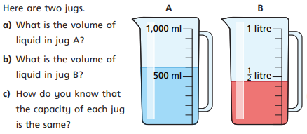
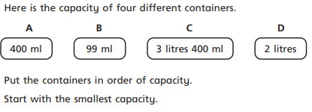
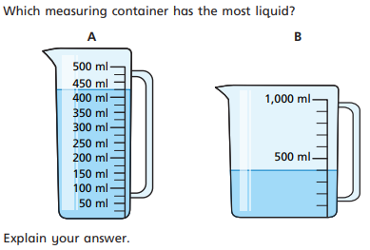
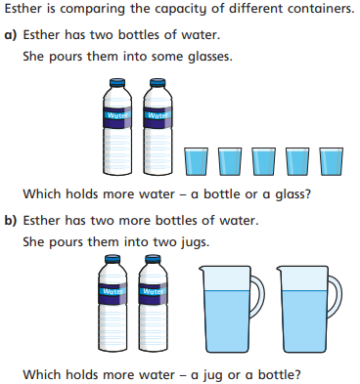
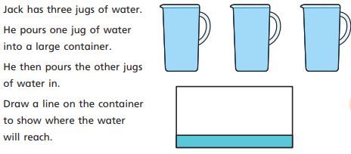
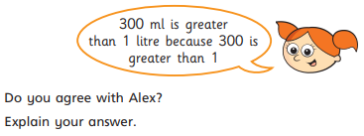
Maths continued

Slide 4
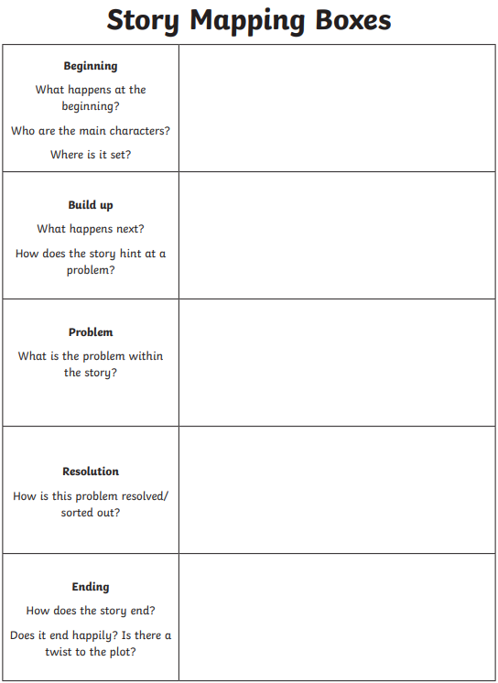
English continued
http://takingflightfilm.com/
Watch the video clip and use the story mapping template to map out the ‘Taking Flight’ story.
Include as many details as you can as you will use it to help you tomorrow!
Draw the template out into your book for you to record your notes in.
1 Star: Dictate to an adult who can scribe your ideas for you just like at school.
2 and 3 Star: Complete the template independently including as many details as possible.

Slide 5
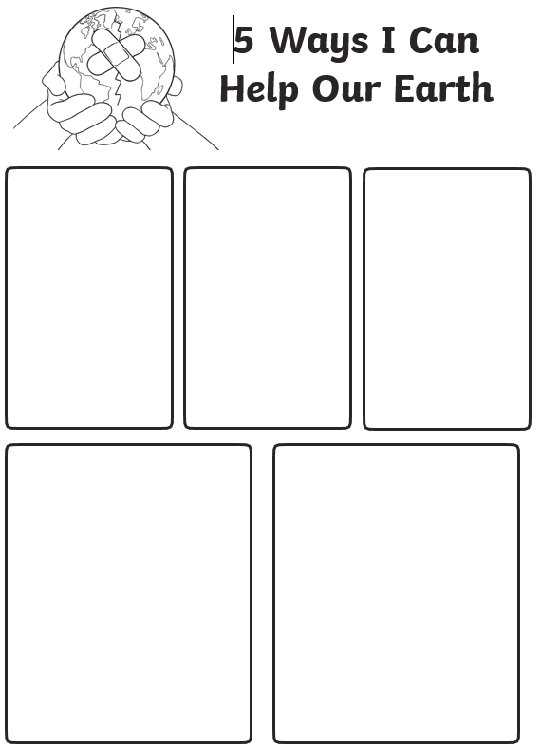
B&V continued
Think back to the Creation Story from the Bible. We know that the Earth is one of God’s biggest gifts to us.
Have a think about what you can do/what you already do to help look after the Earth.
Write about and illustrate five different things you already do or could do to help look after God’s gift.

