Slide 1
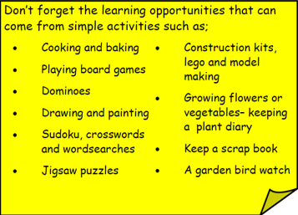
Year 3 Home School Provision Day 63
The following slides will be split into 3 separate activities. Each slide will be daily activities for you and your child to do at home. Due to a partial reopening of NJS, Miss Watson is undertaking the alternative provision for Year 3. Please email – chloe.watson@taw.org.uk if you need to contact her or would like to share a piece of home learning for the website. Thank you for your continuing support.
Useful websites for Home learning
Year 2 and 3 free resources for parents for Home Learning: https://www.twinkl.co.uk/resources/parents/wellbeing-parents/school-closures-category-free-resources-parents
Classroom Secrets free resources – laptop or PC needed
https://classroomsecrets.co.uk/free-home-learning-packs/
BBC Bitesize - https://www.bbc.co.uk/bitesize/levels/zbr9wmn
Pobble365 – website with inspiring pictures for Storywriting or Art https://www.pobble365.com/
White Rose Maths – Home Learning activities – great for home learning as we use these ideas in school. https://whiterosemaths.com/homelearning/
Children also have logins in their homelink books for Shropshire Schools Library Service e-Library – books can be borrowed fro up to 3 weeks at a time. https://shropshiresls.wheelers.co/

Slide 2
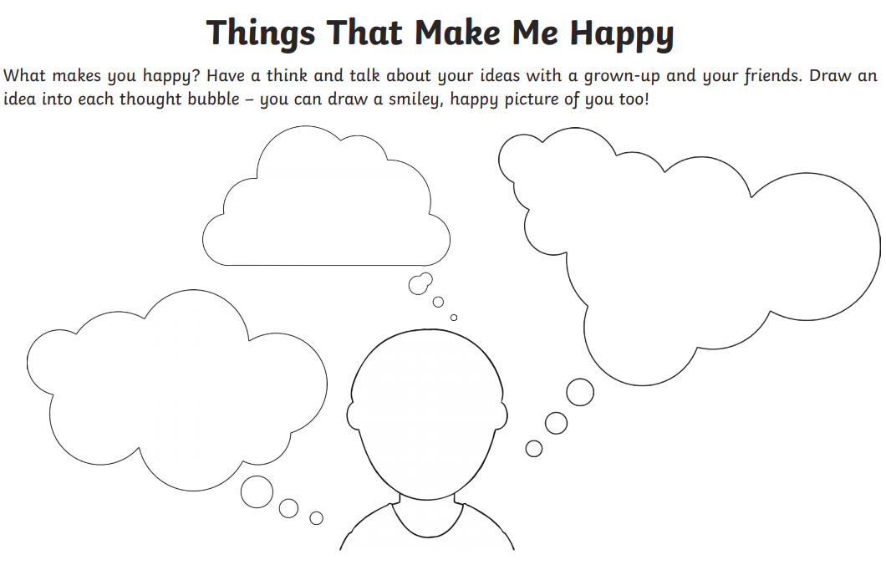
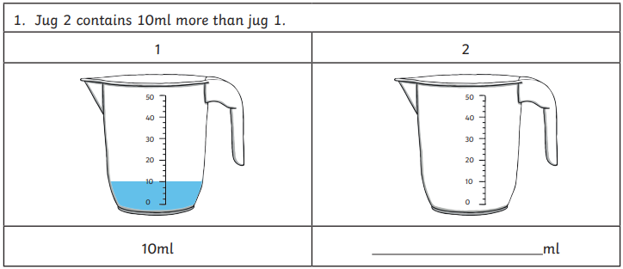
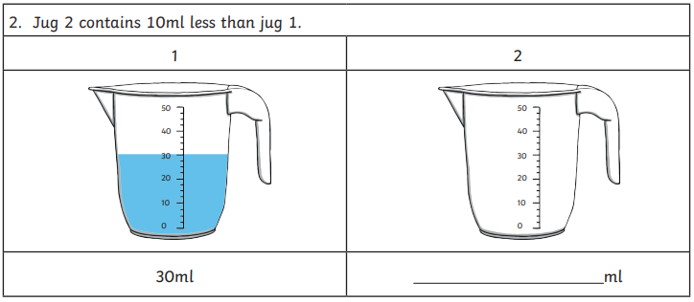
Daily Provision Pack – Day 63
Maths:
Objective: To be able to draw a scale accurately using equal intervals
English:
Objective: To write the middle of the story.
You are going to continue rewriting the middle of the story of Tony and Grandpa.
Today you should work on the middle of the story. You have collected lots of details over the week so make sure you include all your details!
PSHE:
Objective: To understand and reflect on things that make you happy.
Draw out the template in your book and reflect on things that make you happy.
PSHE continued on the following slides
Maths continued on the following slide
English continued on the following slide

Slide 3
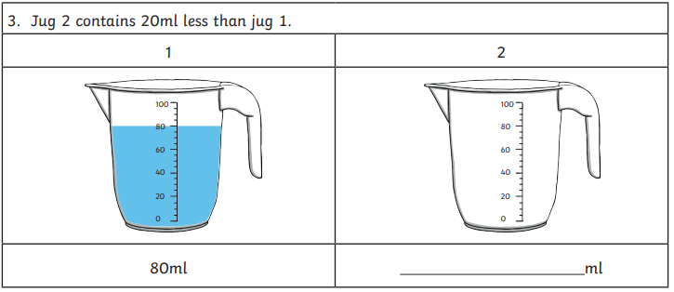
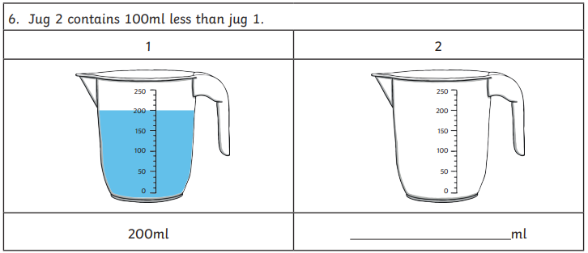
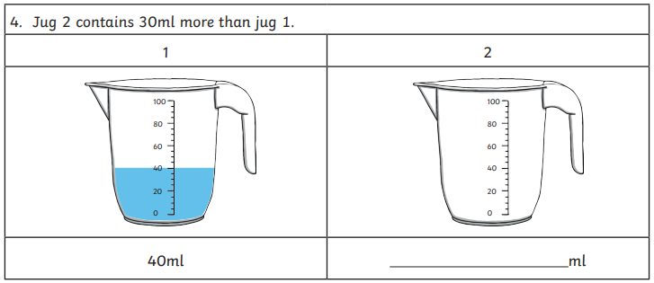
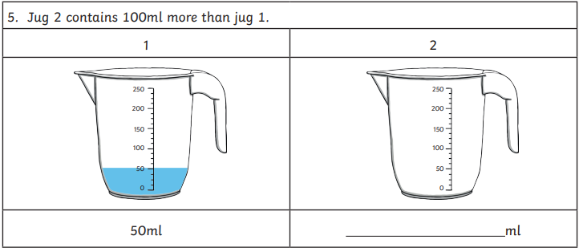
Maths continued

Slide 4
English continued
You are going to continue writing the story of Grandpa and Tony using the character description, story mapping and beginning that you have created this week.
Today you should work on the middle of the story. You have collected lots of details over the week so make sure you include all your details!
1 Star:
Using all the work you have created so far this week, you should write the middle of your story which includes the build up and the problem. You should include adjectives to describe throughout.
You can type, dictate to your adult (and copy out again if you would like to) to record your work.
2 Star:
Using all the work you have created so far this week, you should write the middle of your story which includes the build up and the problem. You should include adverbs and adjectives.
You should handwrite your work, thinking about capitals and full stops as well as adverbs and adjectives to add to your description. You should start to include some speech.
3 Star:
Using all the work you have created so far this week, you should write the middle of your story which includes the build up and the problem. You should include adverbs and adjectives.
You should handwrite your work, thinking about capitals and full stops as well as adverbs and adjectives to add to your description. You should also use speech that is perfectly punctuated (we covered this in school).

Slide 5
PSHE continued

