Slide 1
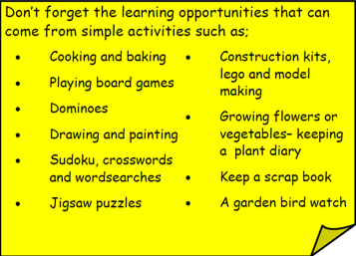
Year 3 Home School Provision Day 68
The following slides will be split into 3 separate activities. Each slide will be daily activities for you and your child to do at home. Due to a partial reopening of NJS, Miss Watson is undertaking the alternative provision for Year 3. Please email – chloe.watson@taw.org.uk if you need to contact her or would like to share a piece of home learning for the website. Thank you for your continuing support.
Useful websites for Home learning
Year 2 and 3 free resources for parents for Home Learning: https://www.twinkl.co.uk/resources/parents/wellbeing-parents/school-closures-category-free-resources-parents
Classroom Secrets free resources – laptop or PC needed
https://classroomsecrets.co.uk/free-home-learning-packs/
BBC Bitesize - https://www.bbc.co.uk/bitesize/levels/zbr9wmn
Pobble365 – website with inspiring pictures for Storywriting or Art https://www.pobble365.com/
White Rose Maths – Home Learning activities – great for home learning as we use these ideas in school. https://whiterosemaths.com/homelearning/
Children also have logins in their homelink books for Shropshire Schools Library Service e-Library – books can be borrowed fro up to 3 weeks at a time. https://shropshiresls.wheelers.co/

Slide 2
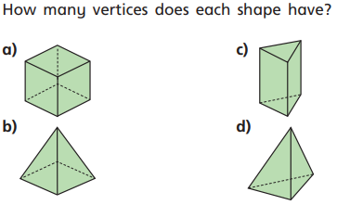
Daily Provision Pack – Day 68
Maths:
Objective: To be able to count vertices on the 3D shapes.
English:
Objective: To complete writing your leaflet.
Using your leaflet from yesterday, on the opposite side you are going to complete your leaflet. You should include all the other information you have gathered. Remember to write in a persuasive way, you want the reader to want to visit! You should also include pictures with a caption. There is an example of the following slides to help you.
Remember to use the opposite side of your leaflet!
Music:
Objective: To look at instruments used in reggae music comparing Caribbean and Western instruments.
Maths continued on the following slide
English continued on the following slide
Music continued on the following slides

Slide 3
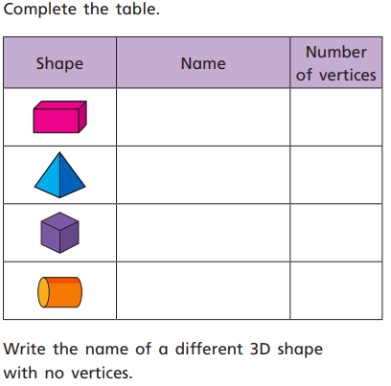
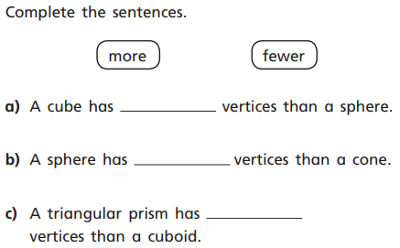
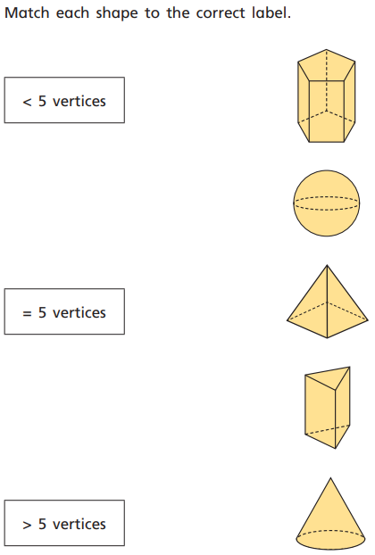
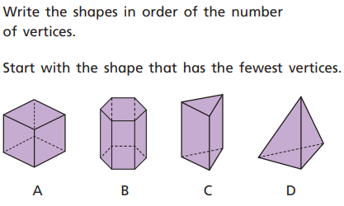
Maths continued

Slide 4
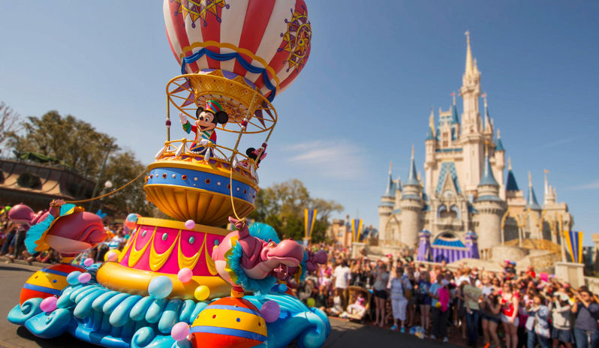
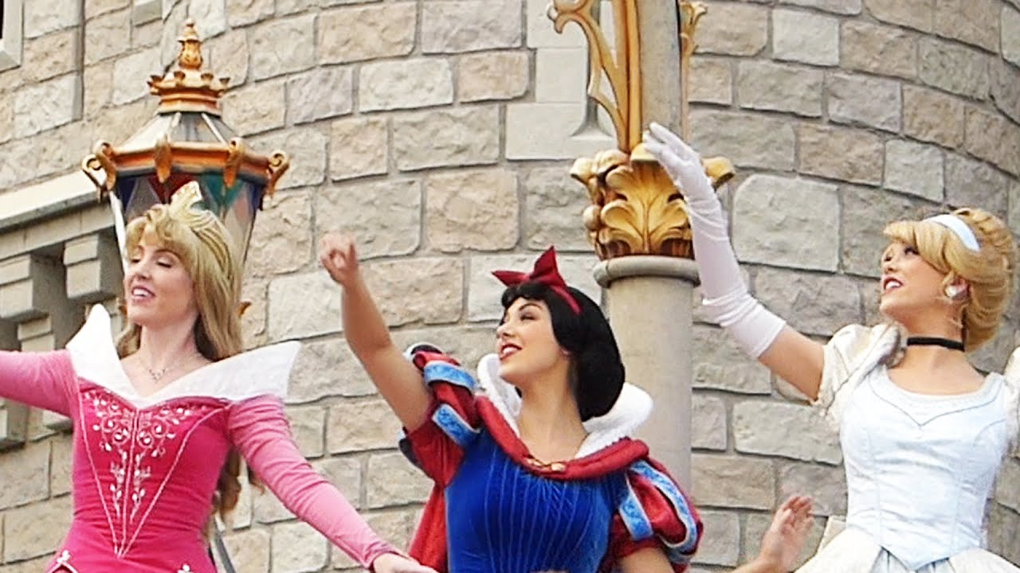
Families choose to visit Walt Disney World for their family holiday. They often book in advance through a travel agent. The agent will help to make sure your flights and hotels are booked as well as your Disney dollars are all sorted. As soon as you arrive, let the magic begin! You could start by visiting the iconic Disney castle or grabbing a show before enjoying a lovely meal prepared and cooked by a top chef. You might even be able to share your meal with your favourite Disney character!
English continued
Disney World, Florida was built in 1965 but it did not open until 1971. It took six years to complete the resort and is still being added to and changed every year. Disney World employs over 77 thousand people some of which the Princes and Princesses we have all come to love!
Come and spent time at one of the biggest theme parks in the world!
This could be a once in a lifetime experience. It really is the place where dreams do come true! You could be walking and talking amongst the Princes or Princesses as well as all the other legendary Disney characters. It would be like stepping into your favourite Disney film!
Remember to use the opposite side of your leaflet!

Slide 5
Task 1 Extras:
Clip 1:
https://www.youtube.com/watch?v=GaNjXwElAUE
Clip 2:
https://www.youtube.com/watch?v=DRfb-AnDo7g
Task 3 Clips:
Clip 1:
https://www.youtube.com/watch?v=ApAth15BXVc
Clip 2:
https://www.youtube.com/watch?v=Zm8Y17r4aPI

