Slide 1
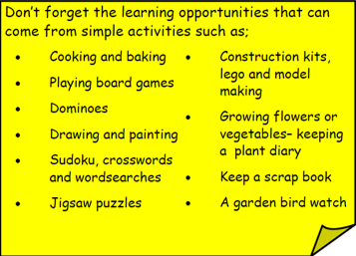
Year 3 Home School Provision Day 69
The following slides will be split into 3 separate activities. Each slide will be daily activities for you and your child to do at home. Due to a partial reopening of NJS, Miss Watson is undertaking the alternative provision for Year 3. Please email – chloe.watson@taw.org.uk if you need to contact her or would like to share a piece of home learning for the website. Thank you for your continuing support.
Useful websites for Home learning
Year 2 and 3 free resources for parents for Home Learning: https://www.twinkl.co.uk/resources/parents/wellbeing-parents/school-closures-category-free-resources-parents
Classroom Secrets free resources – laptop or PC needed
https://classroomsecrets.co.uk/free-home-learning-packs/
BBC Bitesize - https://www.bbc.co.uk/bitesize/levels/zbr9wmn
Pobble365 – website with inspiring pictures for Storywriting or Art https://www.pobble365.com/
White Rose Maths – Home Learning activities – great for home learning as we use these ideas in school. https://whiterosemaths.com/homelearning/
Children also have logins in their homelink books for Shropshire Schools Library Service e-Library – books can be borrowed fro up to 3 weeks at a time. https://shropshiresls.wheelers.co/

Slide 2
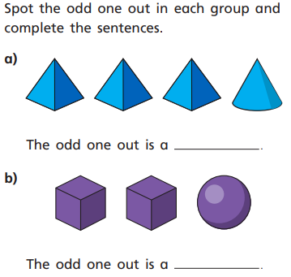
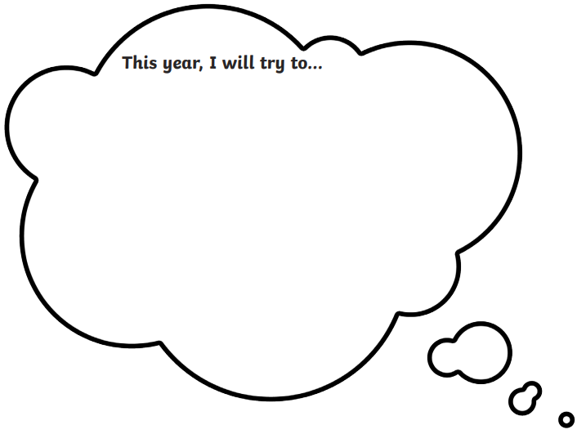
Daily Provision Pack – Day 69
Maths:
Objective: To be able to sort 3D shapes.
English:
Objective: To be able to write about hopes and dreams for Year 4.
Art:
Objective: To draw a self portrait.
Following the instructions on the next few slides, have a go at drawing a self portrait. Use a picture you might have at home or a mirror so you can see your face!
Once you have finished your drawing, write all the things you are good at around your drawing.
Art continued on following slides.
Maths continued on the following slide
English continued on the following slide

Slide 3
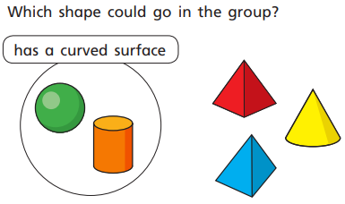
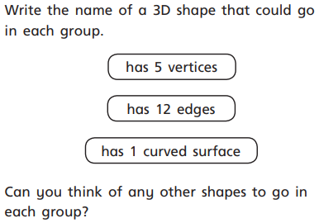
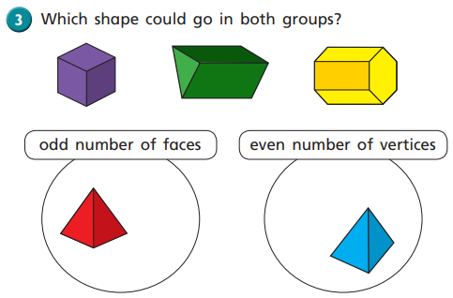
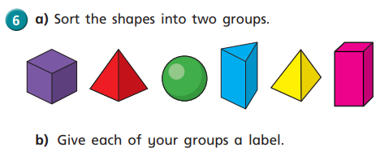
Maths continued

Slide 4
English continued
Think about the three questions above and Year 4.
Think about what you hope to achieve in Year 4.
What will you try to do in Year 4.
What will you do in Year 4.
Here are some examples but you should try to think of your own. Maybe talk to an adult to set some goals with. Try to write in lots of details.
In Year 4 I hope to achieve in maths, I find maths tricky at times so I would like to try really hard and understand it.
I will work on my handwriting because it is something I feel I need to work on so my English can keep improving.
Something I will do in Year 4 is continue to use the 3 C’s everyday.

Slide 5
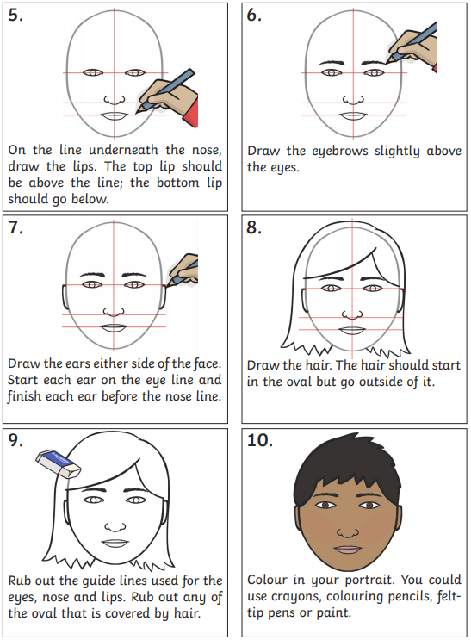
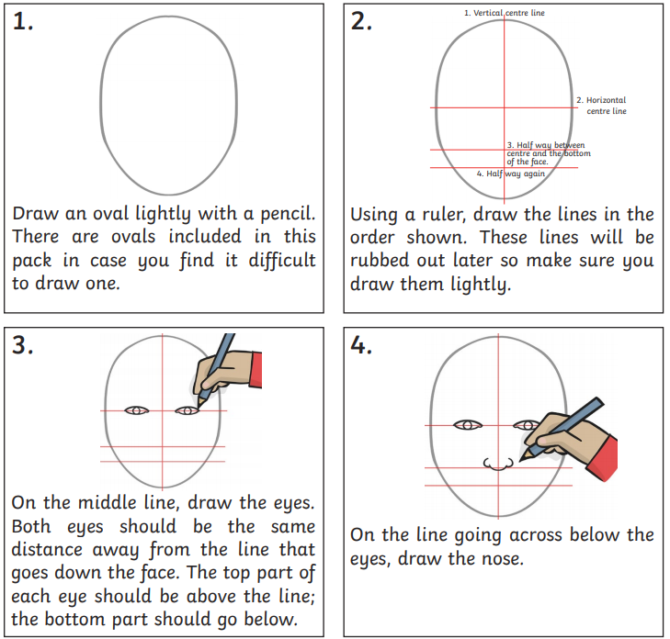
Art continued
Following the instructions, have a go at drawing a self portrait. Use a picture you might have at home or a mirror so you can see your face!
Once you have finished your drawing, write all the things you are good at around your drawing.

Slide 6
Well done for all you have achieved this year!
It’s not been your average year and you have all dealt with so much change. You should all be proud of yourselves – even our adults!
Thank you for all your hard work this year, both at school and at home.
You are ALL amazing!
Enjoy your summer and we look forward to seeing you as soon as we can.

