Slide 1
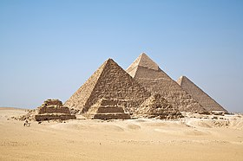
Egyptians

Slide 2
Where were the Egyptians?
The Egyptians lived in Egypt and It is located along the along the river Nile in North-east Africa.

Slide 3
Egyptian calendar
Egyptians had a solar calendars and had the same days in a year.they even invented the 135 days in a year.

Slide 4
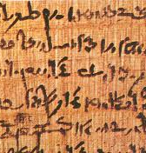
What is a papyrus?
Papyrus is a piece of paper from the time. They wrote hieroglyphics on the piece of paper[how they used to write in] . It is made from a plant’s stem.

Slide 5
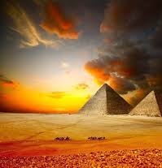
Pyramids
Pyramids were made when king thutmos was the pharaoh. It was built for religious purposes. The pyramids were built in Giza. The pyramids of Giza points to North. They had some small ones near the Nile river.

Slide 6
fun facts
The Egyptian men and women wore makeup.
Tutankhamen died in a young age.
They used mouldy bread to heal infections.
They were one of the first civilians to invent writing
They take a major role in the bible.
Egyptians really mummified their pets!

Slide 7
Fun facts
Wives were sometimes buried alive!
There really was a royal bottom wiper!
Pharoh’s kept there hair covered

