Slide 1
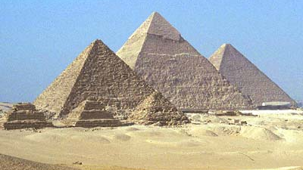
Cleopatra
69 – 30 BC
This Photo by Unknown Author is licensed under CC BY-SA

Slide 2
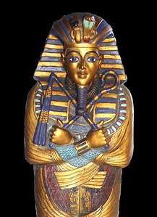
Cleopatra wore a beard disguise because all the pharaohs were meant to be men. Her tomb was found in 2019 by a group of archaeologists. The location of Cleopatra’s tomb is Alexandria, Egypt. She was buried with her husband Mark Antony.
This Photo by Unknown Author is licensed under CC BY-NC

Slide 3
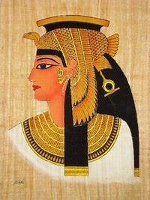
Cleopatra VII Thea Philopator She was born in early 69 BC and died in 30 BC aged 39 She ruled from 51 BC until 30 BC (21 years). Her mother was called Cleopatra V, her father was called Ptolemy XII Auletes. She married her brother Ptolemy XIII (he died), she then married her other brother Ptolemy XIV. She had a relationship with Julius Caesar. She married Mark Antony. She had a pet leopard. She is famous for actively influencing Roman politics. She was especially known for her relationships with Mark Antony and Julius Caesar. She was the last queen/ pharaoh of Egypt. The Romans ruled after her death.

Slide 4
Cleopatra’s timeline
051 BC: After father dies, 18 year-old Cleopatra and her brother become co-rulers of Egypt. Her brother, Ptolemy XIII, is 10 years old.
049 BC: Cleopatra's brother forces her to leave Alexandria and go to Syria.
049 BC: Cleopatra goes to the Roman military leader, Julius Caesar, to ask for help to defeat her brother.
047 BC: Caesar's army defeats Ptolemy XIII, who drowns while trying to escape the battlefield. Caesar says that Cleopatra and another brother, Ptolemy XIV, are the new rulers of Egypt.
046 BC: Cleopatra gives birth to Ptolemy Caesar, the son of Julius Caesar.
044 BC: Caesar is killed when his rivals think he is becoming too powerful. Cleopatra takes their son and returns to Egypt, where she orders Ptolemy XIV poisoned to death so that her son can be a co-ruler.
042 BC: Marc Antony asks Cleopatra to give him money to help pay for an invasion of the Persian Empire. She is interested in him because she needs a new Roman leader to protect her.

Slide 5
Timeline continued
040 BC: Cleopatra gives birth to twins, a boy named Alexander and a girl named Cleopatra. Antony is the father of the children.
037 BC: Even though he is already married, Antony marries Cleopatra. This is illegal and starts a battle with Octavian, Julius Caesar's adopted son and ruler of Rome.
036 BC: Cleopatra gives birth to Ptolemy Philadelphus, Antony's son. It is believed that he died from an illness as a child.
032 BC: After Antony declares Ptolemy Caesar, Cleopatra's son, Caesar's rightful heir instead of Octavian, Octavian says that Antony is being completely controlled by Cleopatra. Ocatavian declares war on Cleopatra.
031 BC: Antony's army loses a battle with Octavian's army and Cleopatra doubts Antony's ability to protect her. Octavian tells her that he will make a deal with her to protect her if she kills Antony.
031 BC: Cleopatra decides that she cannot kill Antony or force him to leave Egypt, so she tries to trick him into thinking she is dead. When he hears that she is dead, Antony falls on his sword and later dies, but not before hearing that Cleopatra was alive.
030 AD: After Antony's death, and the defeat of her forces by Octavian, Cleopatra commits suicide. It is believed that she may have had a poisonous snake smuggled into her room in a basket of figs and that she allowed the snake to bite her.

Slide 6
Horrible Histories

Slide 7
Thank you for listening

