Slide 1
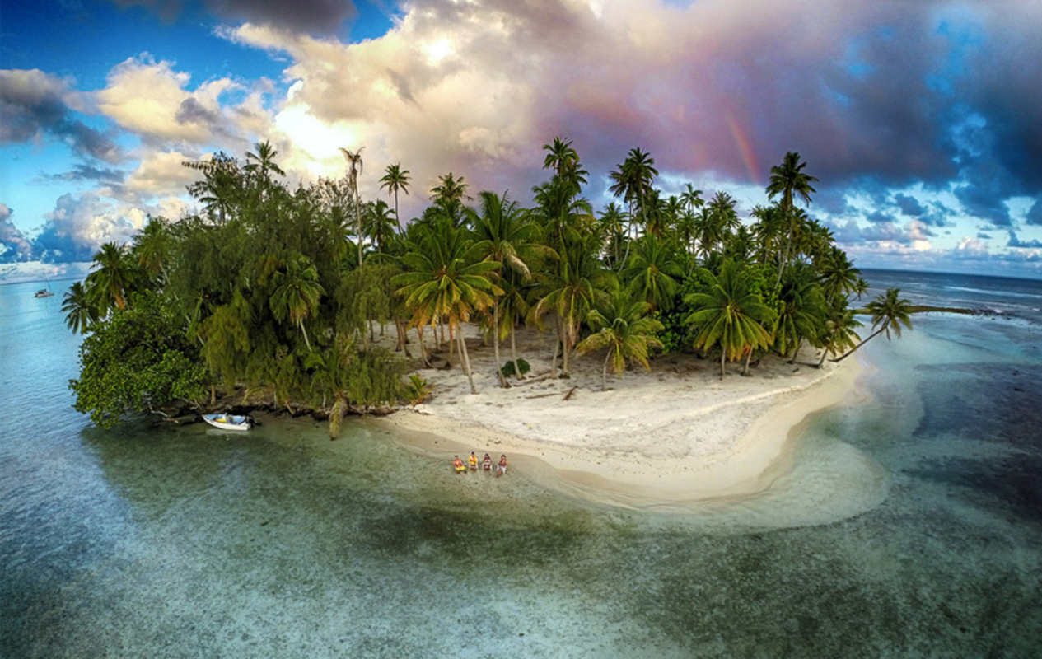
English:
Objective: To write creatively using a picture stimulus.
See the next slide for some ideas on what to write!

Slide 2
Free Writing Friday!
Use the picture as a prompt for your writing today.
Here are some ideas:
You are stranded on an island… write the story of how you got there!
Write a conversation between you and a stranger on the island.
Write a message in a bottle (a letter) that you will put in the water to be rescued!
Write a setting description of the island. What might you find on there?
Imagine, a pirate ship is in the distance and they stop to save you. Write about your time on the pirate ship.

Slide 3
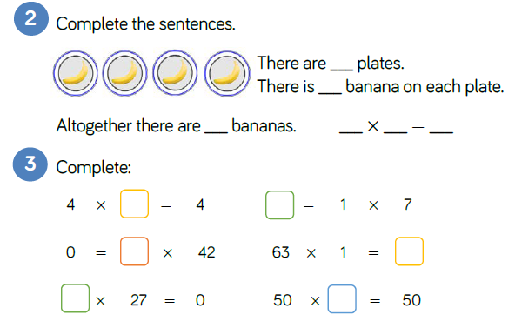
Maths:
Objective: To multiply a number by 1 and 0.
To multiply a number by 1 and 0!
Use objects or draw dots to represent:
9 x 1, 3 x 1, 5 x 1 etc.
What do you notice?
What does zero mean?
What does multiplying by 1 mean?
Write a word problem to show multiplying by 1 and 0.
What is the same and what is different than multiplying by one and zero?
During today’s learning children will explore what happens when you multiply by 1 and 0 and describe what happens to the numbers.
1* - See next slide for multiplying numbers by 0 and 1.
2* - Complete the White Rose Hub Questions.
3* - Complete the White Rose Hub Questions and then complete the reasoning statement focusing on which question could be the odd one out.

Slide 4
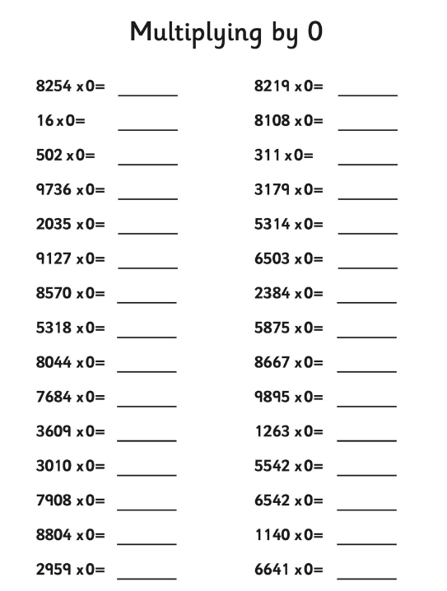
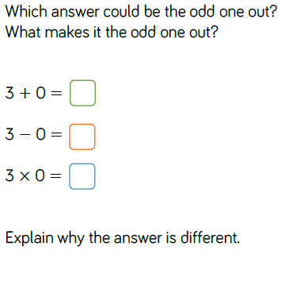
1 STAR TASK: Once you have multiplied by 0, multiply the same numbers by 1!
3 STAR EXTRA TASK!

Slide 5
2/3 STAR TASK!

Slide 7
Reading:
Objective: To write a survival guide for isolation.
Main task...
Tom writes a list of golden rules to follow to survive in the desert (See the next slide for a reminder).
1* - Write a list of golden rules to help someone get through isolation. It might be a list of things to do that will make someone smile or help them keep occupied.
2/3* - Write a survival guide to help someone isolating.
Think of things they could do during their time.
Write down some ideas of things that might make them smile.
You could suggest some books or read or TV/Films to watch?
Write your ideas and add some pictures to make it interesting.

Slide 8
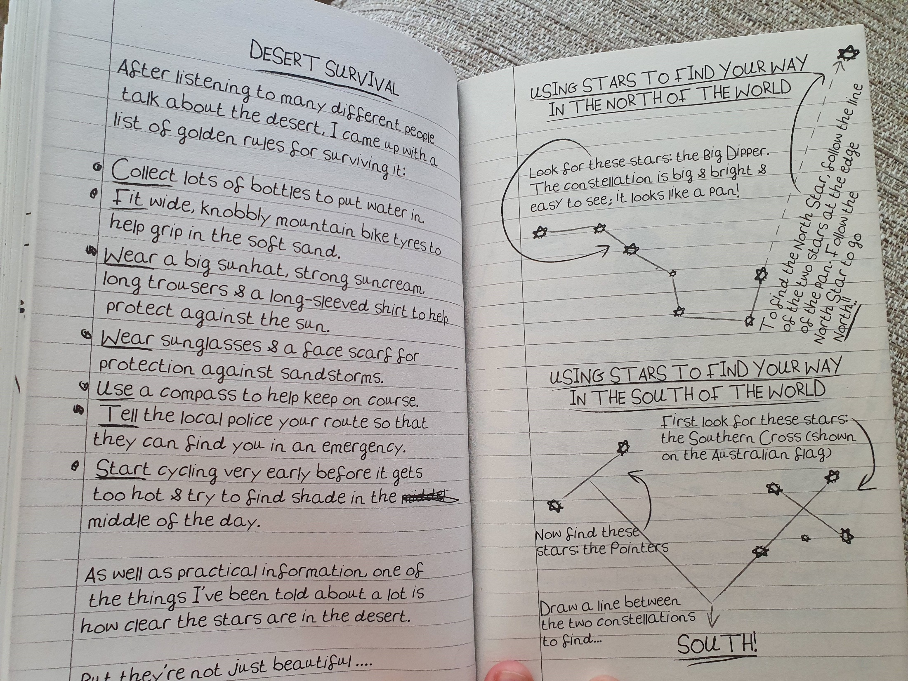

Slide 9
E - SAFETY

