Slide 1
Remote Learning Plan!
Hello Year 4!
During the next few weeks, we will be providing the children with remote learning on a daily basis. The work will be available on the website the day before e.g. Monday’s work will be online Sunday.
Everyday the remote learning will consist of:
English Lesson
Maths Lesson
Reading Lesson
One other curriculum lesson (PSHE, Art etc)
We will be available during the hours of 9am and 4pm so please feel free to contact us!
The some of the work provided will be split into the star levels that the children use everyday in class (1,2 3).
Stay safe everyone!
Miss Jones, Mrs Jukes, Mrs Kuczynska and Mrs Sisson.

Slide 2
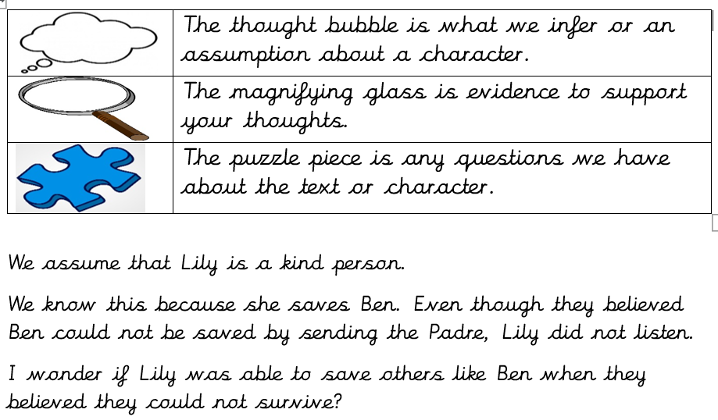
English: Please read the file ‘Peace Lily – Story’. The English lessons will be based on this story.
Objective: To make inferences about a character.
1 Star – After reading the story ‘Peace Lily’ complete the hearts and minds task on the next slide. On one side, write down how you think Lily will feel after different points in the story. On the other side, write down what she might be thinking?
For example:
I think Lily feels sad when Ben and Ray go to war.
Lily is worried about her friends as she doesn’t know if they will survive the war.
2/3 Star – We often make assumptions about character based on what we read.
Use the example opposite to write 3 assumptions about Lily.
You might assume she is brave, loyal, kind, daring, friendly etc.
Start with your assumption. Then explain how you know that and finally, does your assumption make you question anything about her.

Slide 3
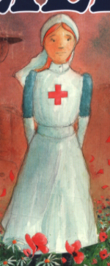
1 STAR TASK!
How is Lily feeling?
What is Lily thinking?

Slide 4
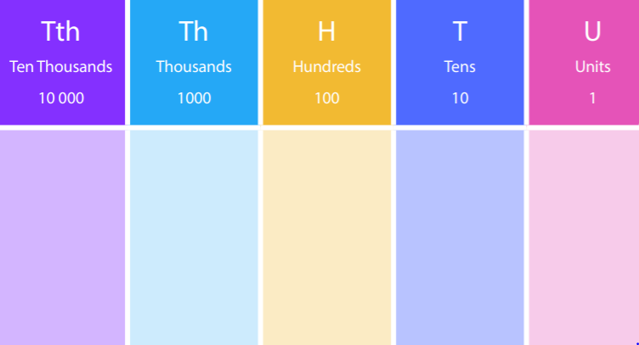
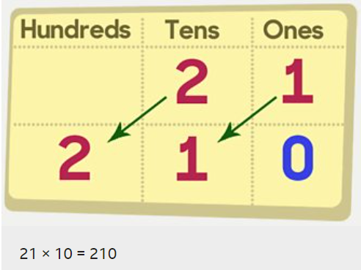
Maths:
Objective: To multiply by 10.
Multiplying by 10!
When you multiply by 10, move all the digits one place to the left, putting a zero in the empty space.
E.G 21 x 10 = 210
3 4 2
3 4 2 0
Place your original digits in the correct place value column. Move all the digits one place to the left, like the example provided.
1* - See next slide for multiplying by 10 questions.
2* - Complete the White Rose Hub Questions.
3* - Complete the White Rose Hub Questions and then the missing number sheet (What number did they start with?)

Slide 5
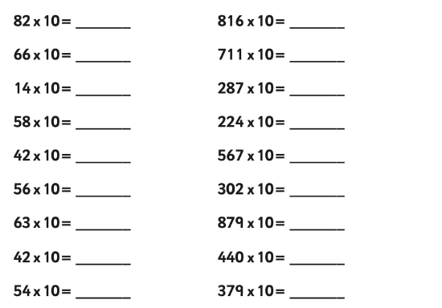
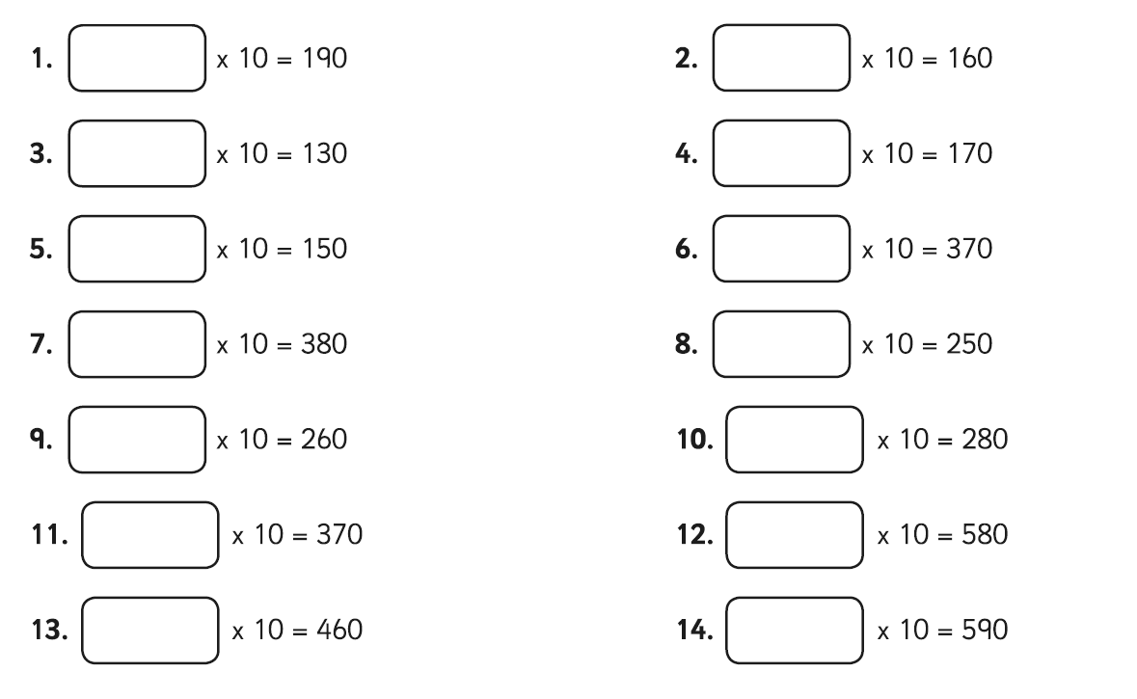
1 STAR TASK!
3 STAR EXTRA TASK!

Slide 6
2/3 STAR TASK!

Slide 8
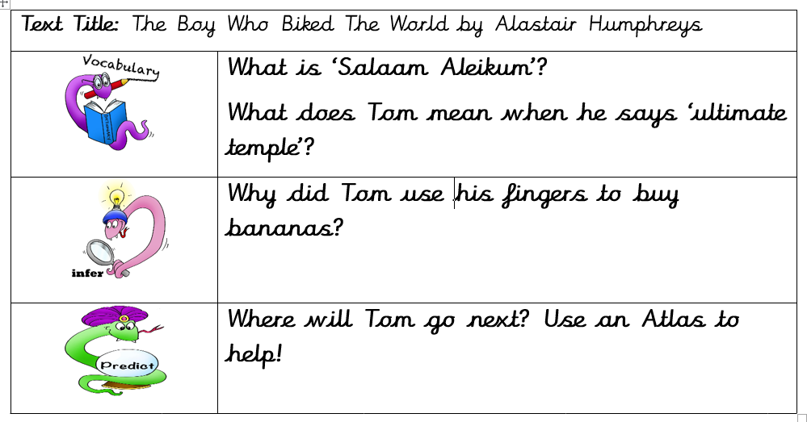
Reading: Every day the children will receive a new chapter from our book ‘The Boy Who Biked the World’. Please complete the following tasks after reading the chapter.
Objective: To write a letter from Tom’s perspective.
Note: For today ONLY, 4S will have a separate task (See other slide). This is due to them completing the original task last week in class. From tomorrow, all classes will have the same task.
Task 2…
Tom has been away from home for a long time now. He has been to France, Germany, Turkey and now The Middle East.
2/3* - Write a letter from Tom to his family. Remember to tell them everything you have done and seen. You can add some images if you like.
REMEMBER – You ARE Tom!
1* - Write a postcard home from either France, Turkey or Germany. What would the picture look like? What would you tell them?
Task 1… Answer the following questions.

Slide 9
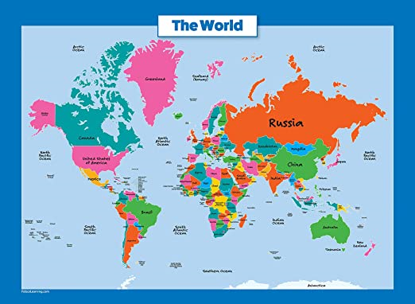
4S ONLY!
Objective: To decide on my own final destination.
Task 1… Answer the following questions.
Task 2…
Imagine that you were going to bike somewhere in the world like Tom. His aim was the bike around the world. Answer the following questions and write a paragraph for your responses.
Where would you like to bike to in the world?
Why would you like to go there?
Can you find 5 interesting facts about your destination?

Slide 10
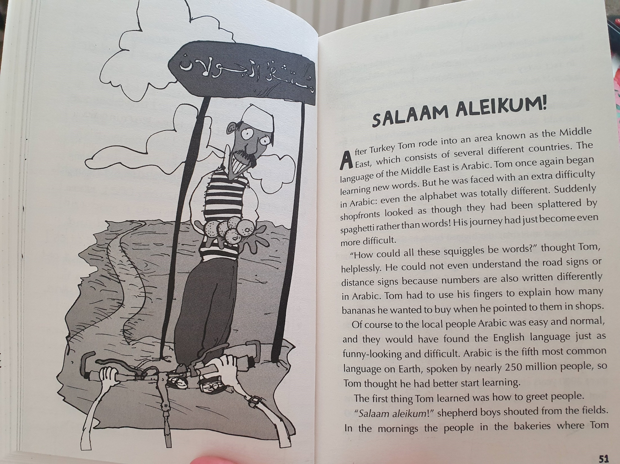

Slide 11
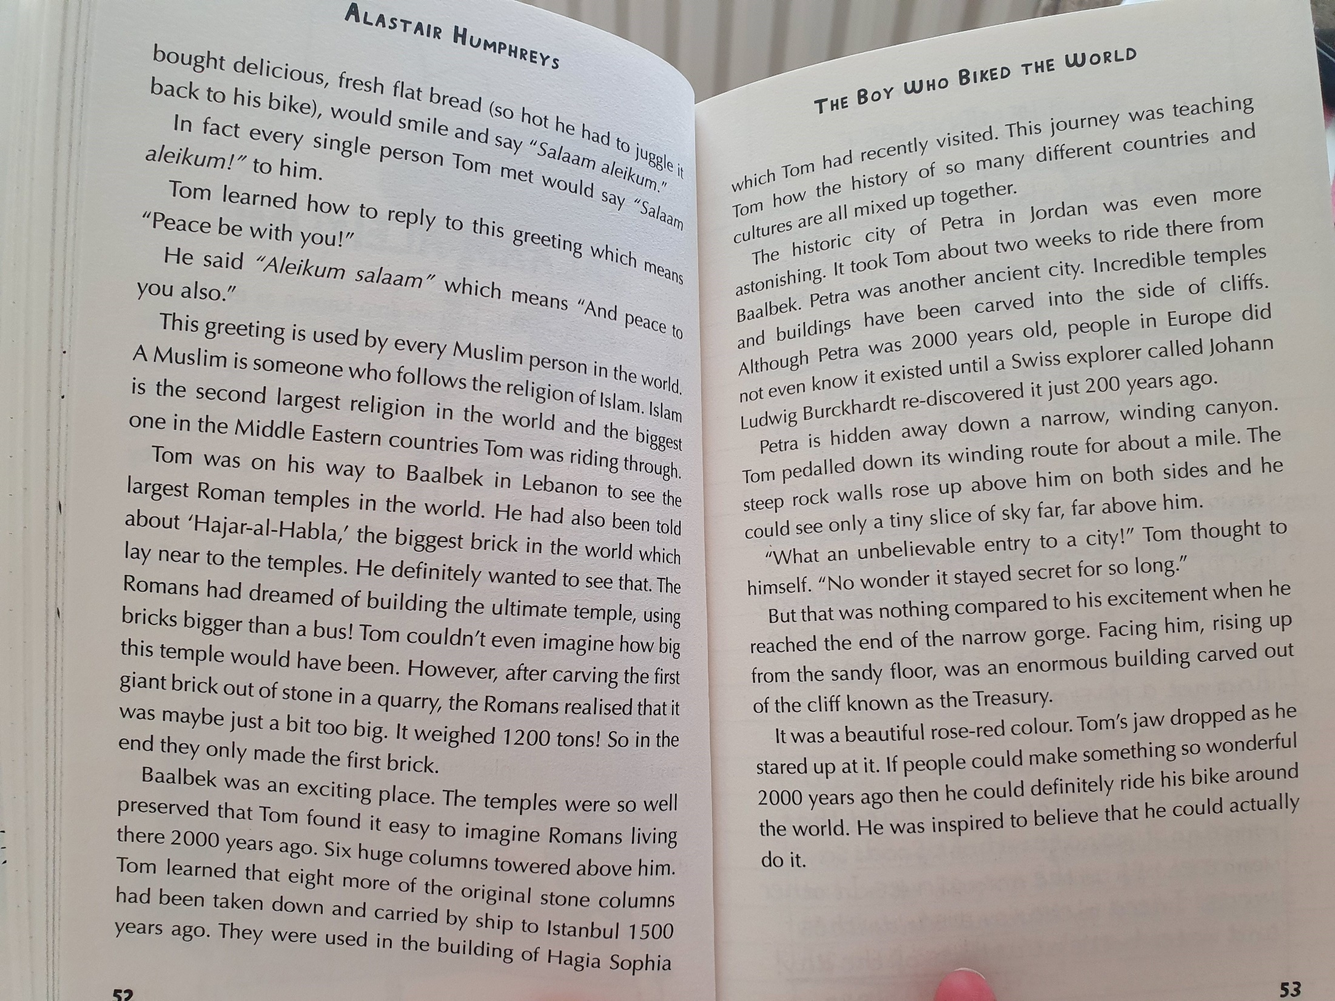
Who discovered Petra?

Slide 12
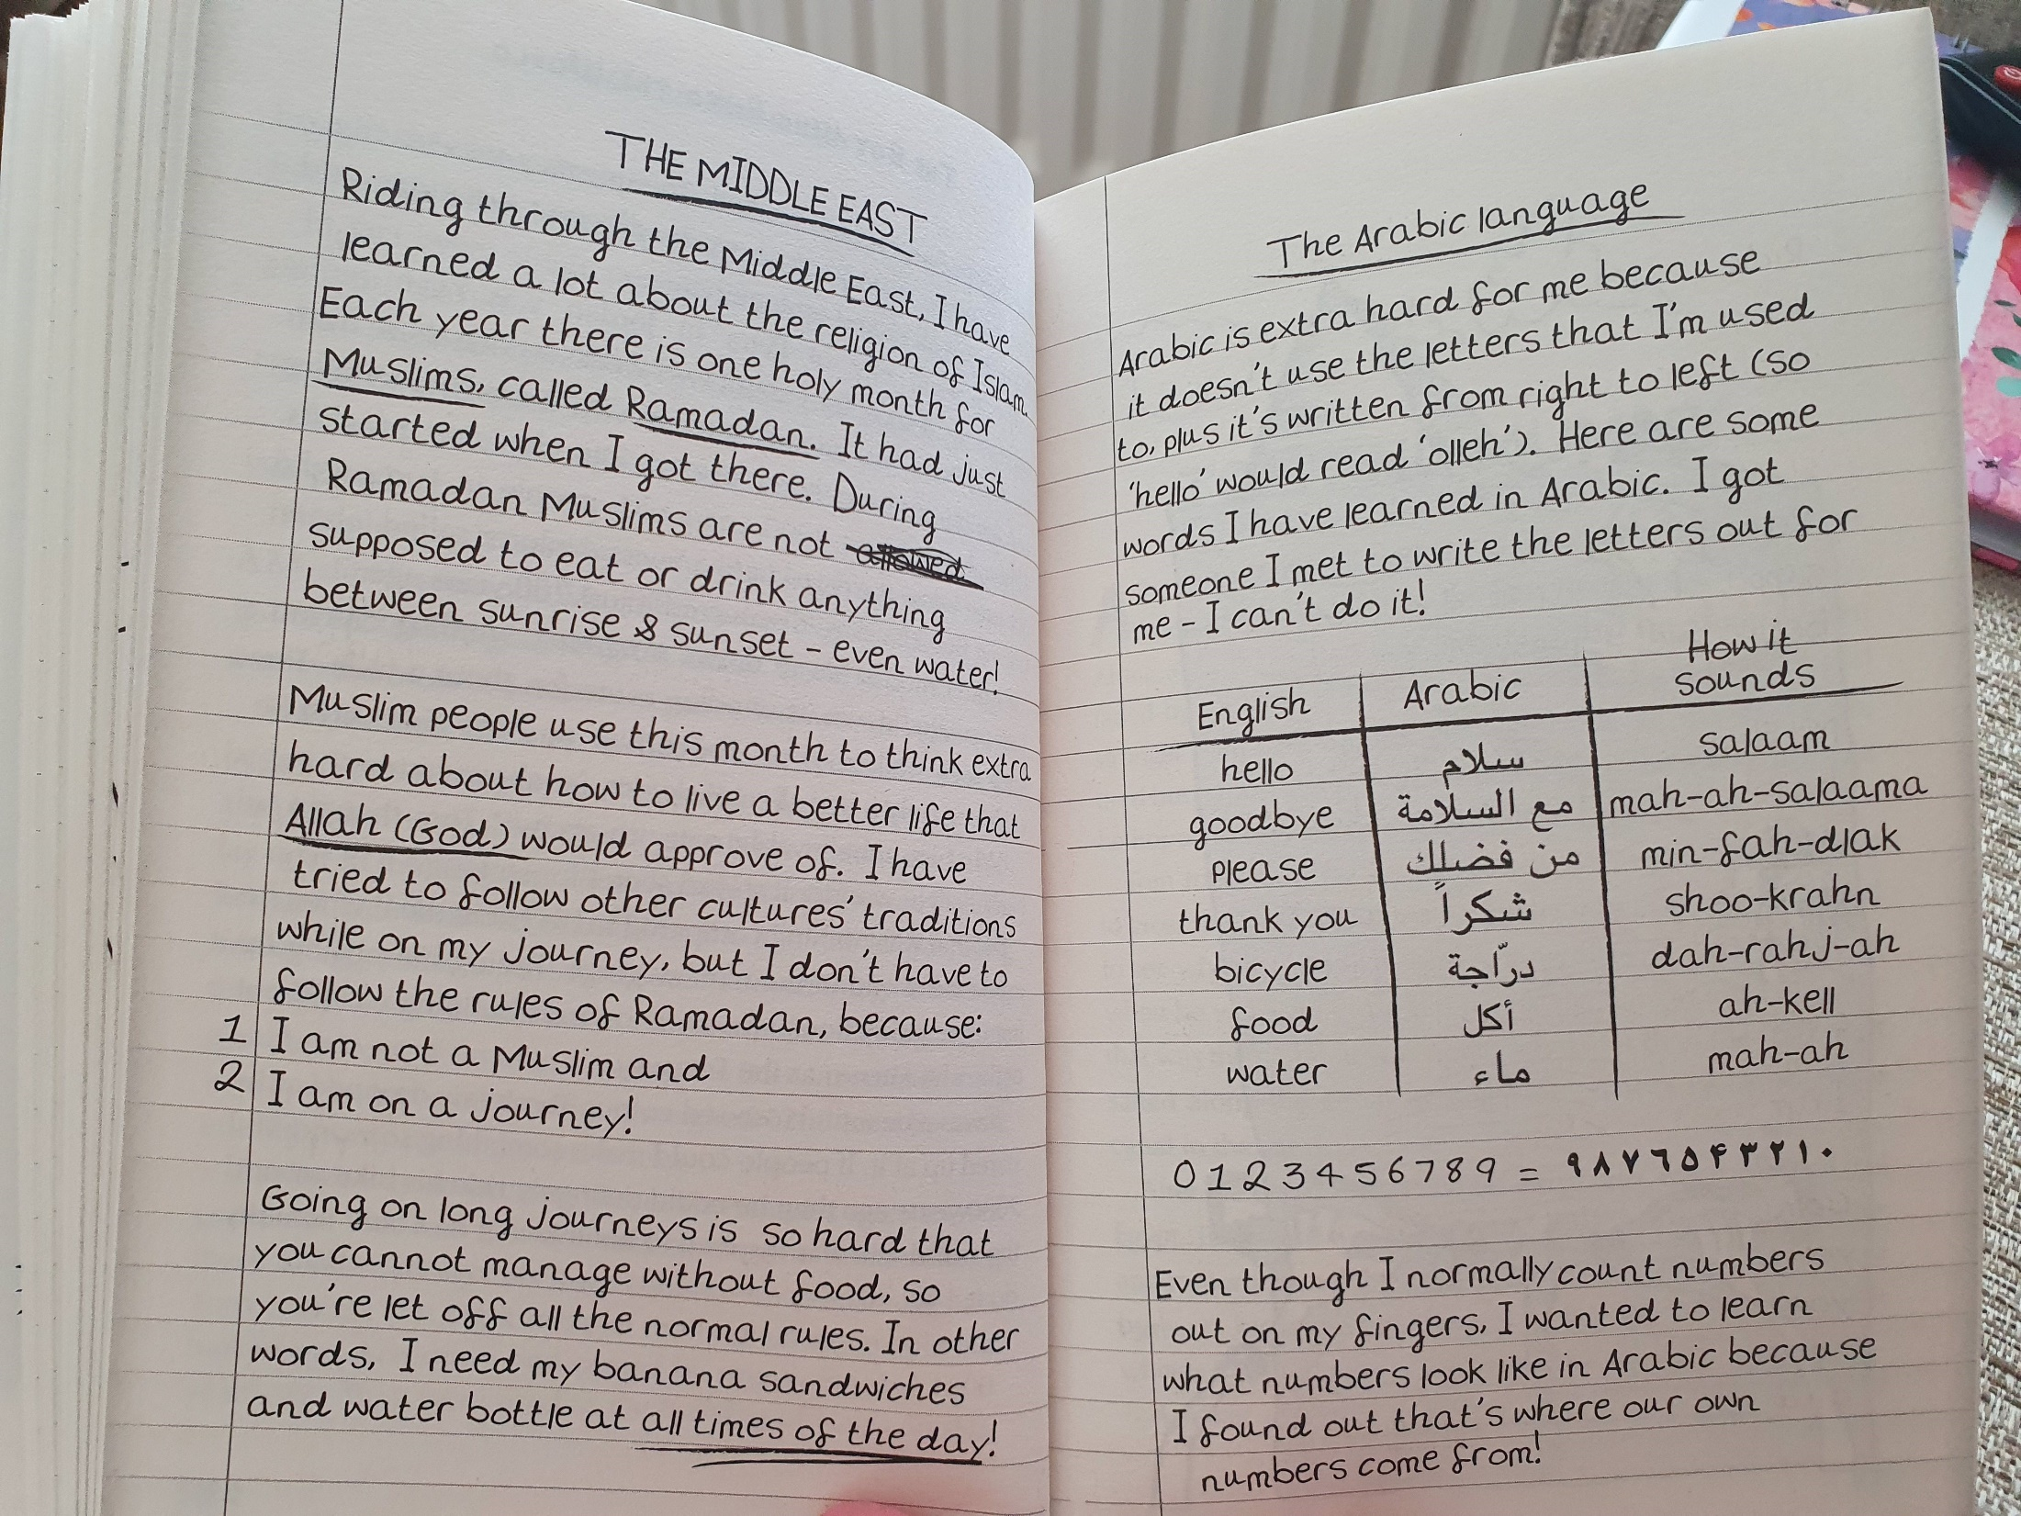

Slide 13
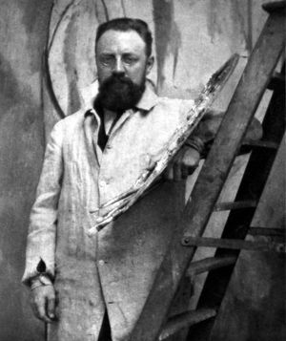
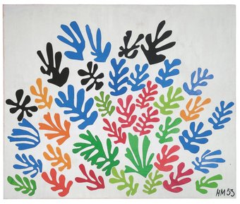
Other Subject: Art
Objective: To research a famous artist.
This half term our art lessons will focus on an artist… Henri Matisse.
1* - Create a fact file about Henri Matisse. Use the template on the next slide to help!
2* and 3* - Create a poster all about Henri Matisse.
You can find your own research about Henri or use any of the links below to help.
https://www.ducksters.com/biography/artists/henri_matisse.php
https://kids.kiddle.co/Henri_Matisse
https://primaryfacts.com/845/10-henri-matisse-facts/

Slide 14
Artist Name:
4 interesting things you’ve learned about this artist:
_______________________________________________________________________________________________________________________________________
_______________________________________________________________________________________________________________________________________
_______________________________________________________________________________________________________________________________________
_______________________________________________________________________________________________________________________________________

