Slide 1
English:
Objective: To punctuate speech using inverted commas.
Next week, you will write the story of ‘Where the Poppies Now Grow’. When we write a story, we sometimes add speech to show what characters would say to each other.
On the next slide is a reminder of how to use speech marks accurately. Read this before attempting your tasks below.
1* - See the slide with your task on.
2* - Write a conversation between Ben and Lily during his time at the hospital. Think about what they would say to each other during Ben’s time in the hospital.
Challenge: You can only use the word SAID once.
3* - Write a conversation between Ray and Lily when Ben is in the hospital. Think about what Ray might say to Lily to help his friend survive.
Challenge: You can only use the world SAID once.
Challenge 2: Can you add description between your speech (See example).
Example:
In the corner of the hospital a small voice was heard. “H..elp. Me.” whispered Ben into what seemed like the darkness. Ben waited and still couldn’t sense any-one near him. He tried again with a slightly louder plea, “Help me! Please”. Ben’s heart rate was starting to climb as he panicked in the dark, falling apart hospital. At least it looked like a hospital. After what felt like years, Ben heard a reply. “Ben… Ben…” she exclaimed urgently, “Can you hear me? It’s your friend Lily”.

Slide 2
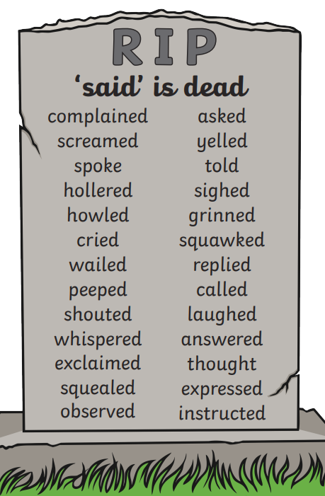

Slide 3
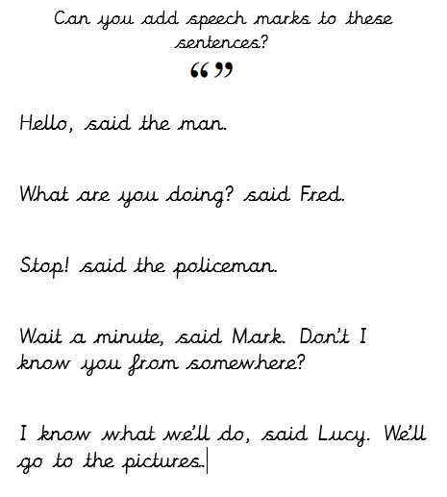
1 STAR TASK
Add the speech marks in the correct places.
Then can you change and improve the word ‘SAID’.

Slide 4
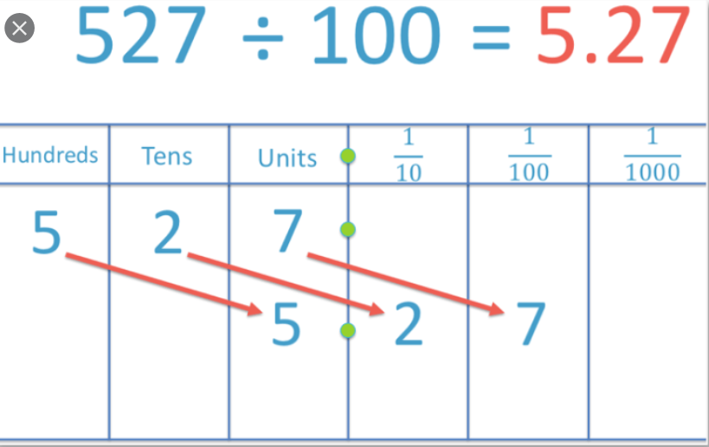
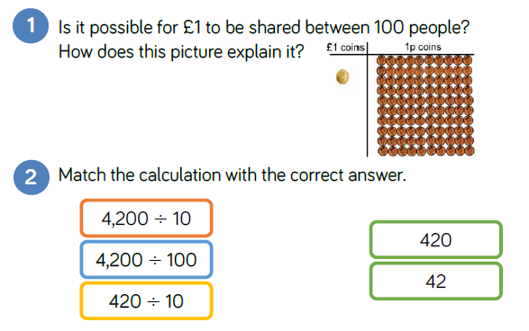
Maths:
Objective: To divide by 100.
Divide by 100!
When you divide by 100, move all the digits two places to the right, remember to check where your zero needs to be placed. If your original number is not a multiple of 100 and is a 3-digit number, think carefully and check that the unit moves into the hundreths column.
E.G 728 divided by 100 = 7.28 Have a go at the questions below.
Place your original digits in the correct place value column. Move all the digits two places to the right when dividing by 100.
1* - See next slide for dividing by 100 questions.
2* - Complete the White Rose Hub Questions.
3* - Complete the White Rose Hub Questions and then complete the true or false statement as an extension activity.

Slide 5
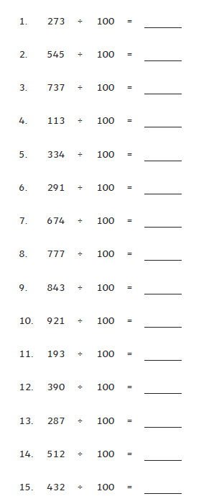
1 STAR TASK!
3 STAR EXTRA TASK!

Slide 6
2/3 STAR TASK!

Slide 8
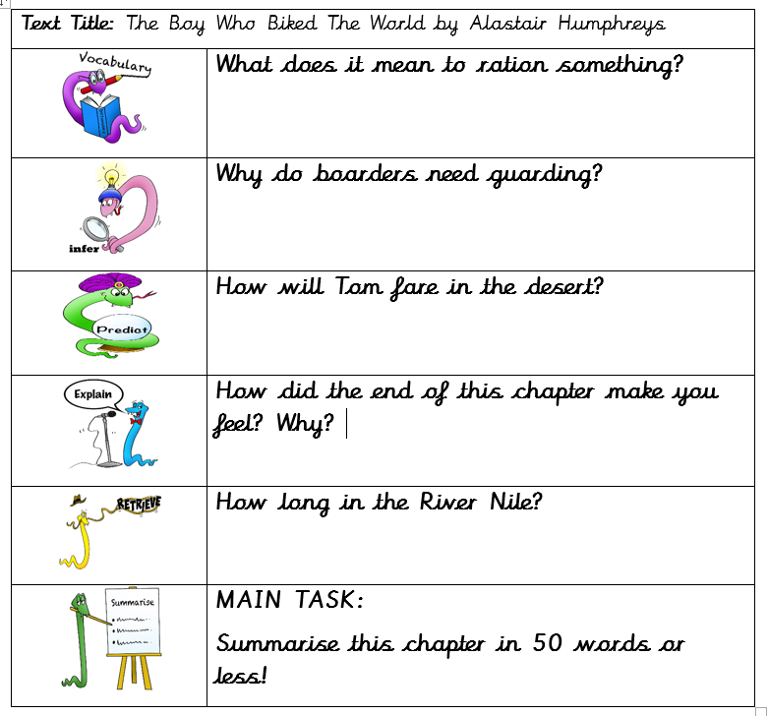
Reading: Every day the children will receive a new chapter from our book ‘The Boy Who Biked the World’. Please complete the following tasks after reading the chapter.
Objective: To write a summary in 50 words or less.
Task 1… Answer the following questions.
Main task… For all children!
Summarise this chapter in 50 words or less.
To write a summary you put the most important information. If you write too much, you will run out of words. On the next slide is a checklist of questions to try and answer in your summary. As long as you answer each question you can write a summary. However, you are limited to 50 words! So make sure you don’t write too much!

Slide 9
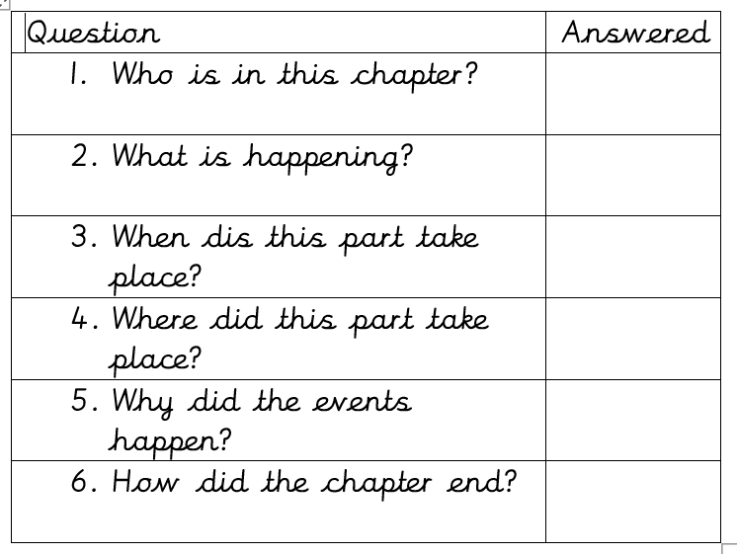
To write your summary, use the checklist on this page. Answer each question but stick to 50 words or less.
Good luck!

Slide 10
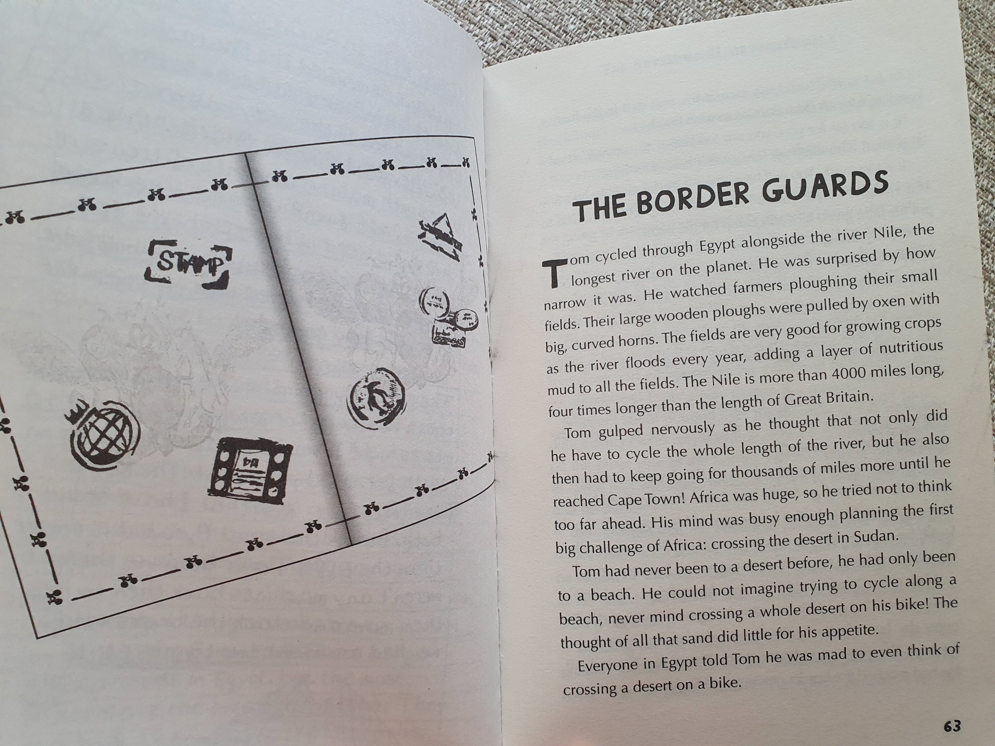

Slide 11
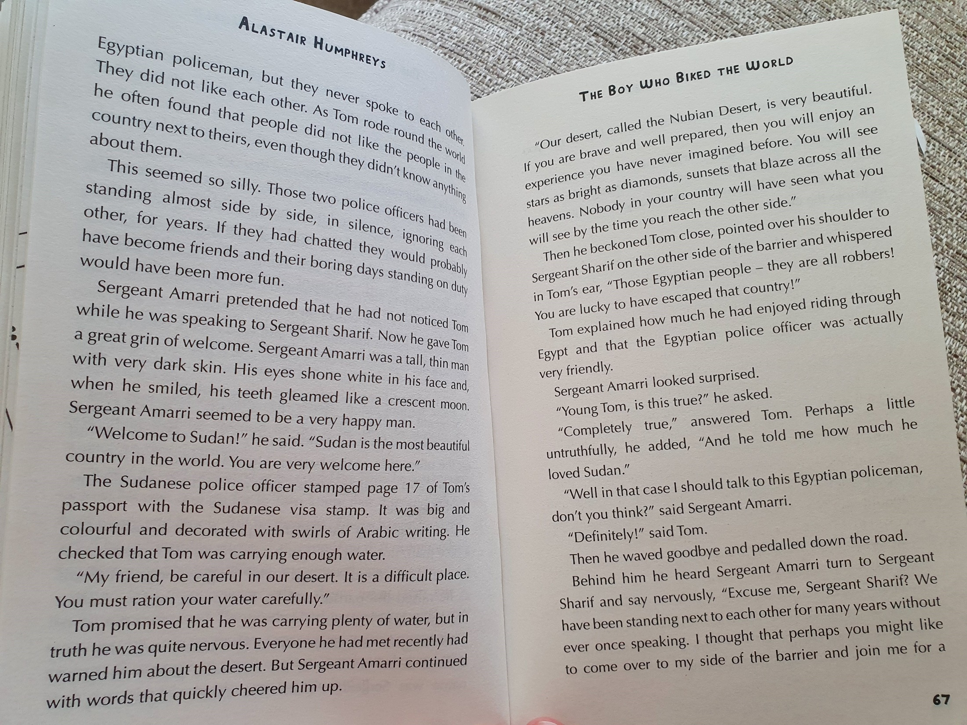

Slide 12
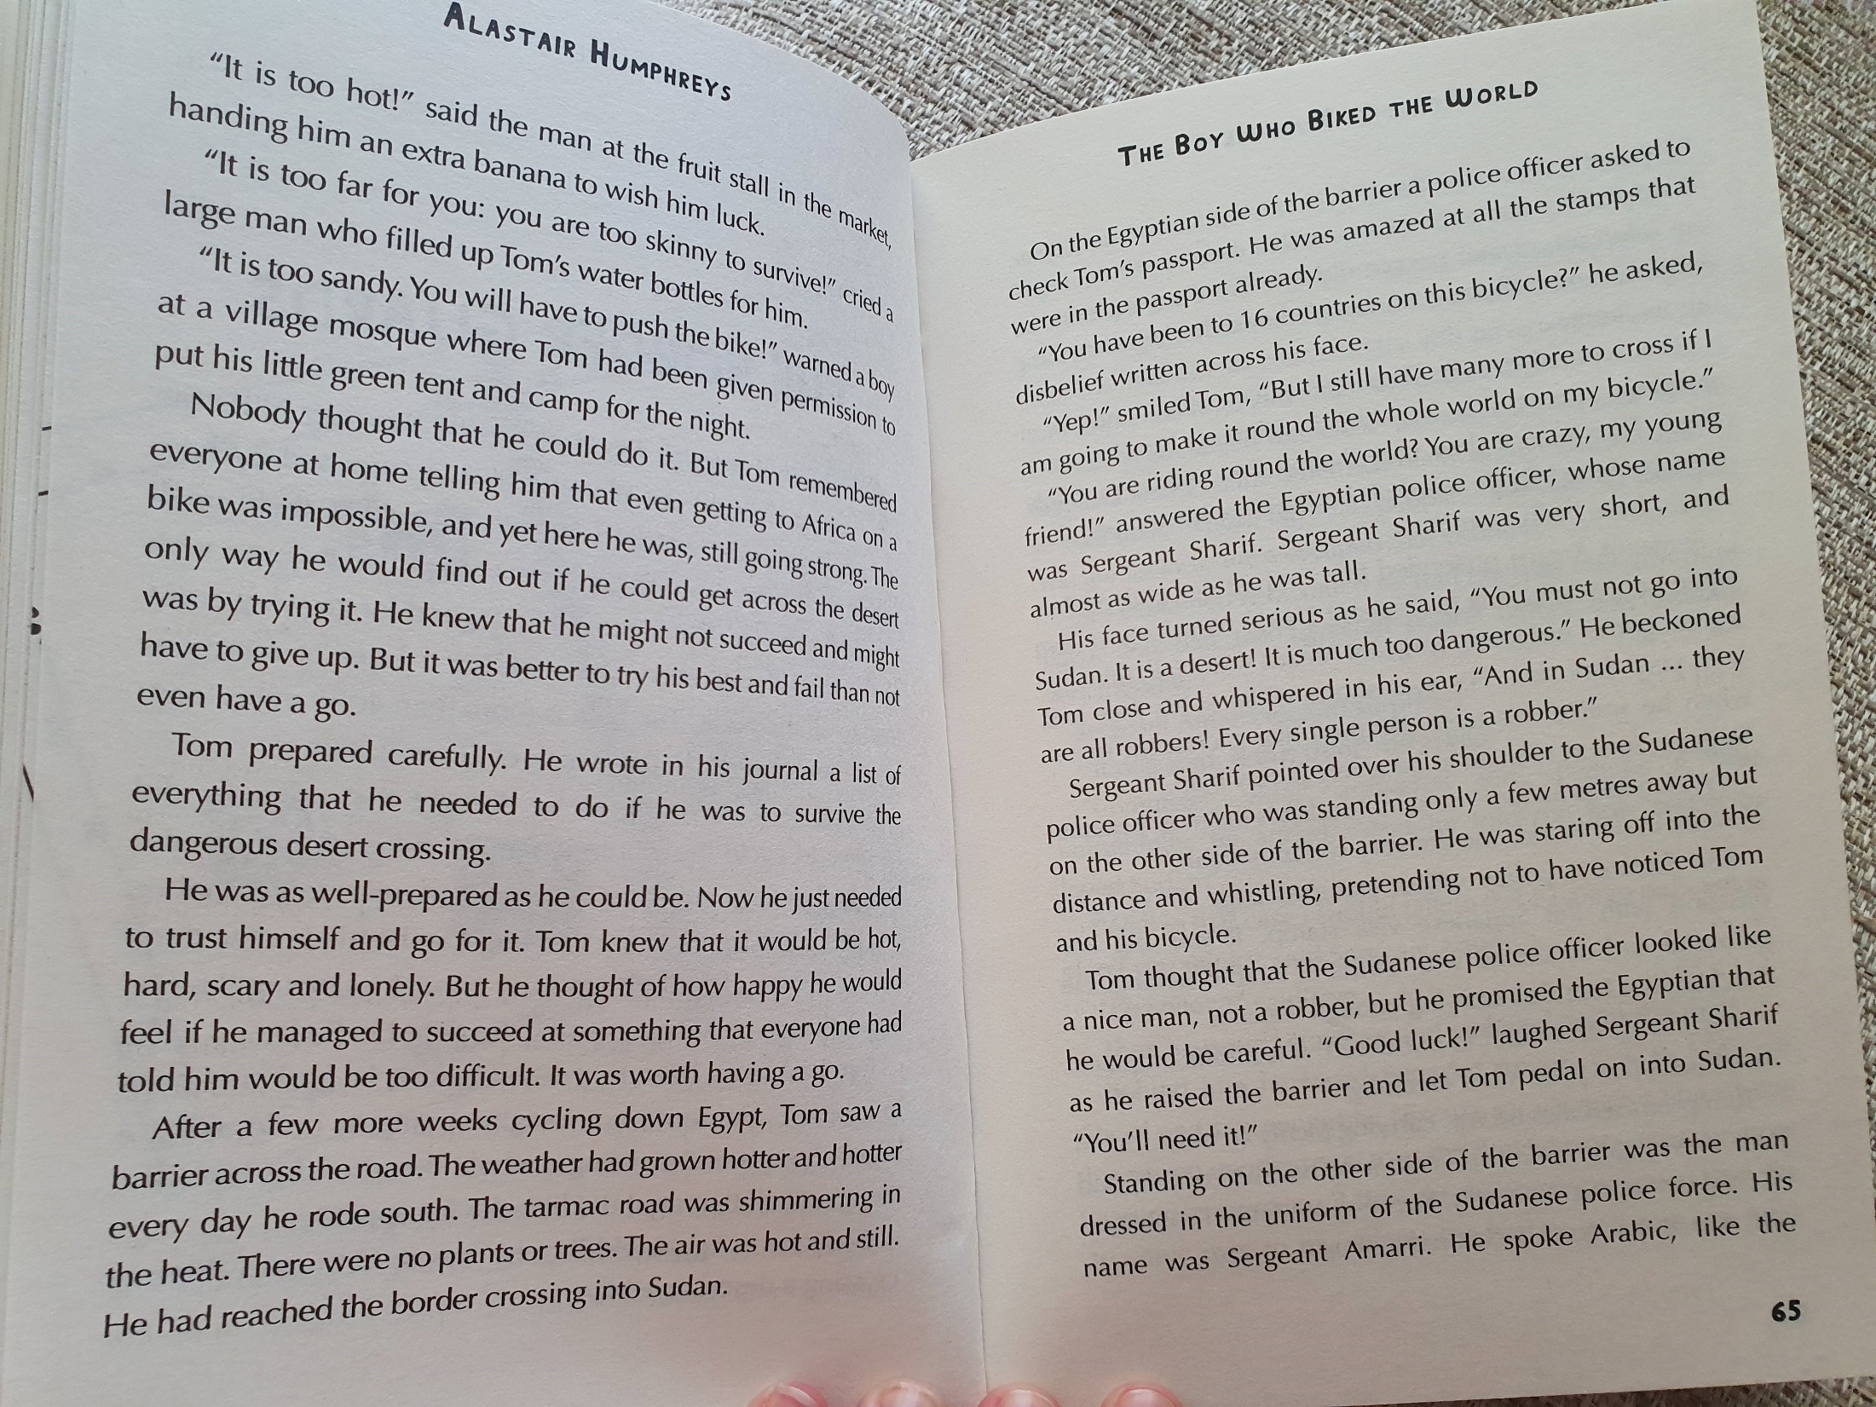

Slide 13
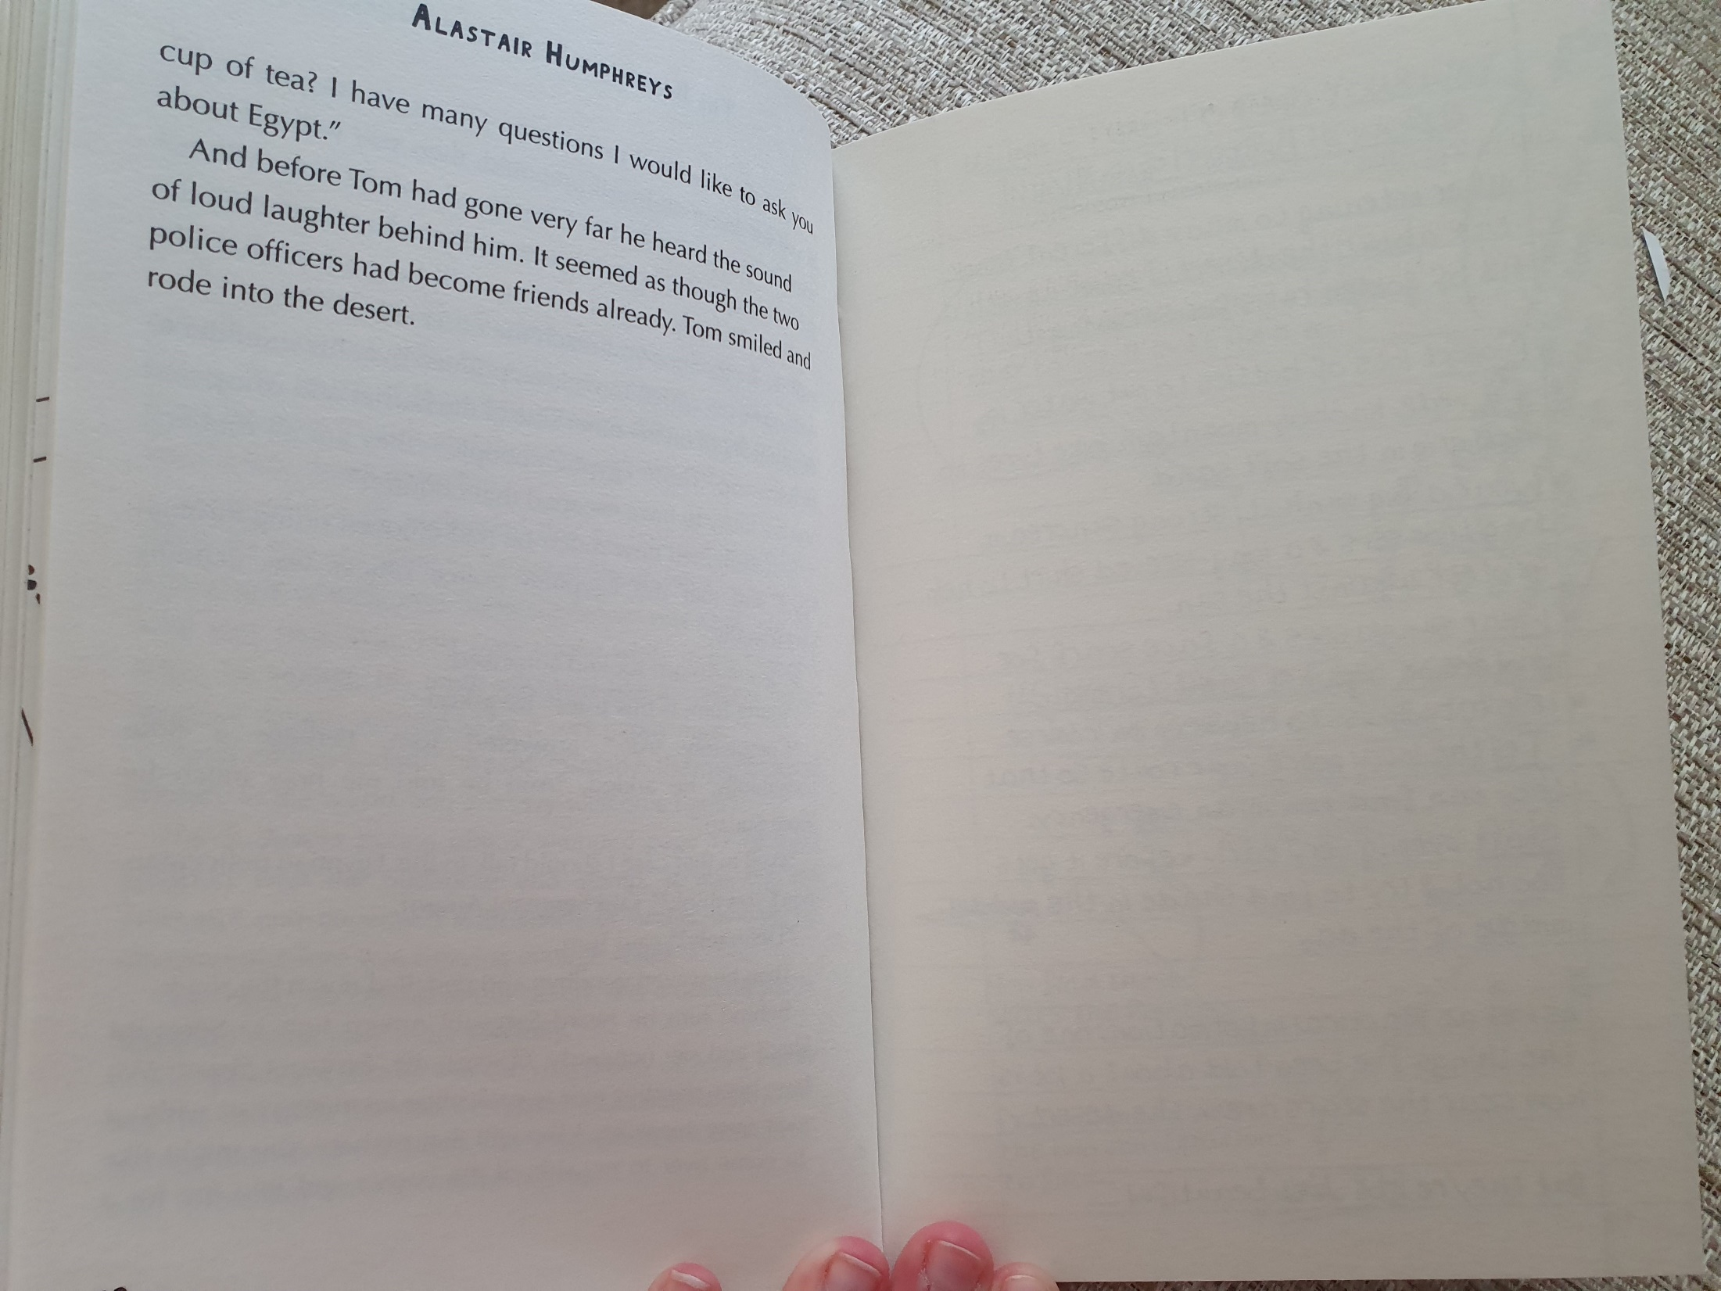
DISCUSS…
What do you think makes something one of the 7 wonders of the world?

Slide 14
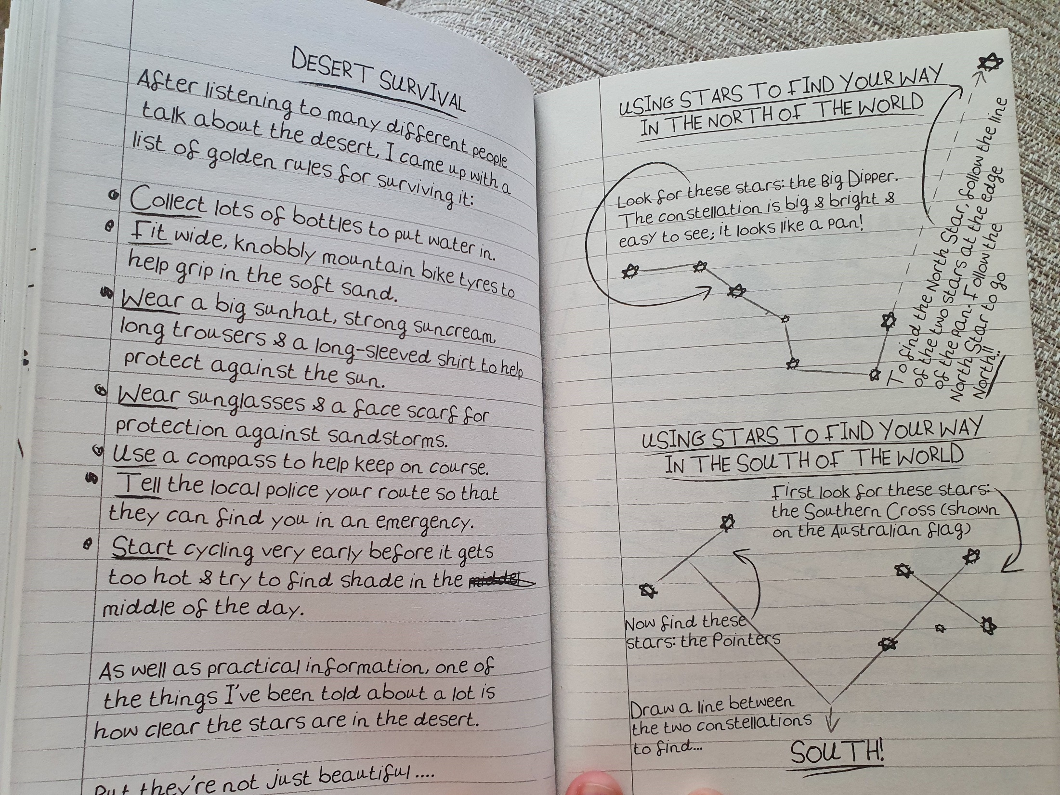

Slide 15
P.S.H.E
Why are we special?

Slide 16
You are very special because you are you. There is no one exactly like you (even if you are a twin) and because of that we all give different things to the world. It is all the different things we bring that make our world such an interesting place to live in (and our classes a special place to be in)

Slide 17
I want to think about what makes you special. What qualities do you have that you can share with others? Maybe think about what other people like about you. What makes you a good friend?

Slide 18
Task:
Draw a self portrait (a picture of yourself) in the middle of your page
Around your portrait write down qualities and special features about yourself.
This could include things you like about your appearance and also your personality/character.
Then in the corners of your page draw pictures of family members (Mum, Dad, brothers and sisters and of course your pets) and write down 1 thing about each of your family that makes them special to you.

