Slide 1
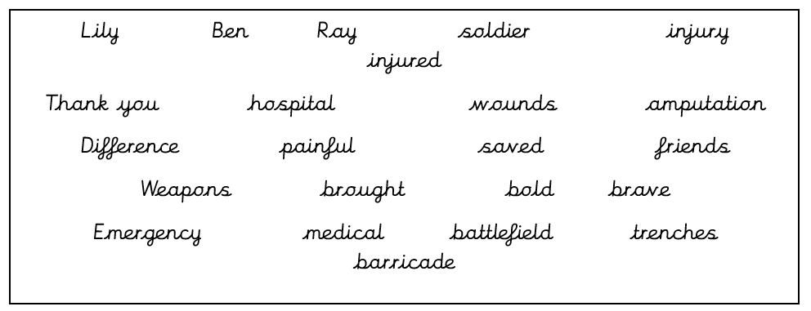
English:
Objective: To write a thank you letter to Lily.
Last week, we read ‘Where the Poppies Now Grow’. Peace Lily shares a few more details about her friendship with Ben and Ray. Essentially, Lily saves Ben’s life when he is brought to her by Ray.
1* - Write a short letter to Lily from Ben. In your letter, explain how you feel now you know she saved your life.
2* - Write a thank you letter from Ben to Lily. Explain what you are thankful for and how you are feeling. Aim for at least 2 paragraphs. Use the word bank below to help.
3* - Write a thank you letter from Ben to Lily. Explain why you are thankful to Lily and how you are feeling. Write about what you are doing now and how you are coping after losing your leg. Aim for at least 3 paragraphs. Use the word bank below to help.
Word Bank!

Slide 2
Example of a Thank-you Letter
1 Christmas Lane
Newtown
Northwood
SA1 NTA
Friday 2nd January 2015
Dear Santa,
I am writing to thank you for the lovely presents you left at my house on Christmas Eve. I couldn’t believe my eyes when I saw them all and so beautifully wrapped. Your elves must have been very busy this year.
I especially loved the bike and have been learning how to ride it, as I haven’t had one without stabilisers before. The pink helmet is a perfect fit and I wear it to protect my head when I’m on my bike in case I fall off.
My brother James loved his train set and has been playing with it everyday since you delivered it. He loves the noises it makes and connecting all of the carriages together.
I hope you and Mrs Claus have a lovely holiday and the elves and reindeers have a well deserved rest.
Love from
Daisy xx

Slide 3
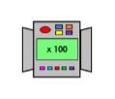
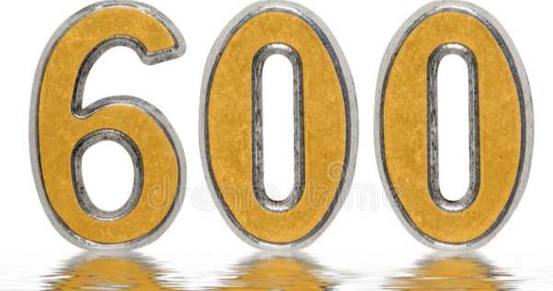
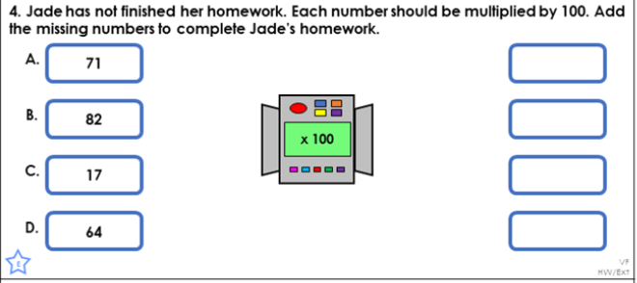
Maths:
Objective: To multiply by 100.
Multiplying by 100!
When you multiply by 100, move all the digits two places to the left, putting a zero in the empty spaces.
E.G 69 x 100 = 6,900 Have a go at the questions below.
Place your original digits in the correct place value column. Move all the digits two places to the left, like the example provided.
1* - See next slide for multiplying by 100 questions.
2* - Complete the White Rose Hub Questions.
3* - Complete the White Rose Hub Questions and then complete the true or false statement as an extension activity.

Slide 4
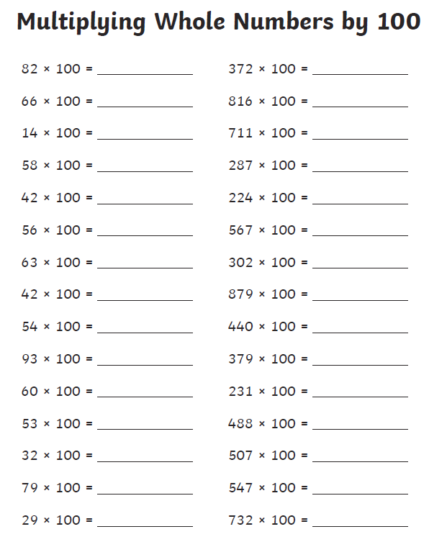
1 STAR TASK!
3 STAR EXTRA TASK!

Slide 5
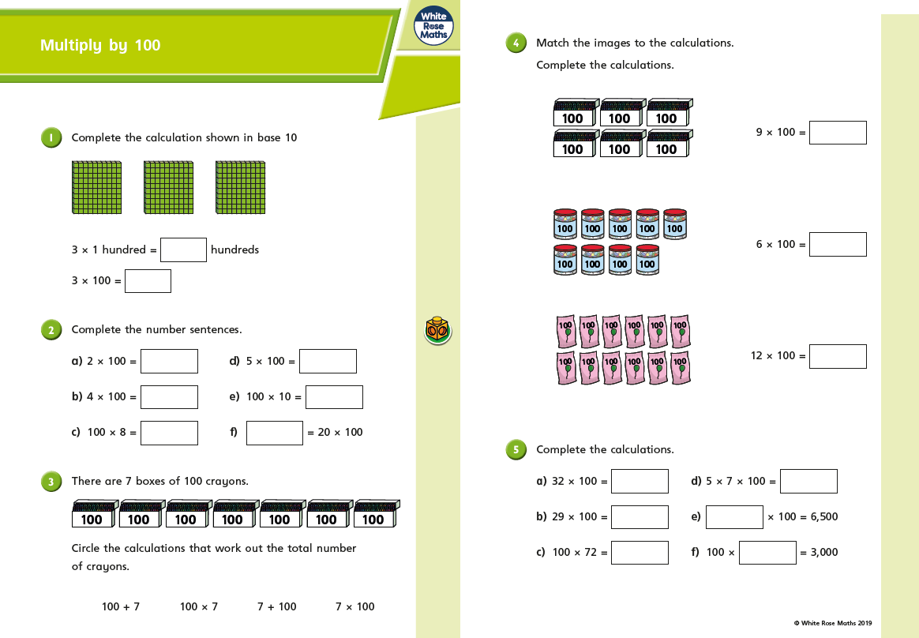
2/3 STAR TASK!

Slide 6
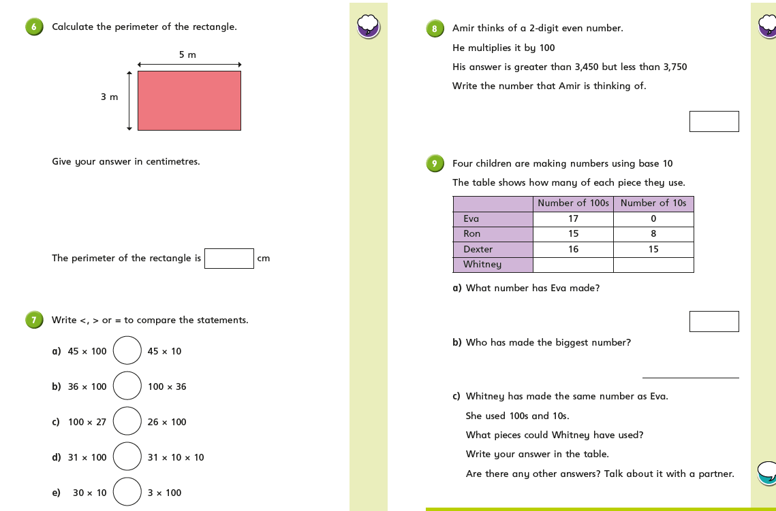

Slide 7
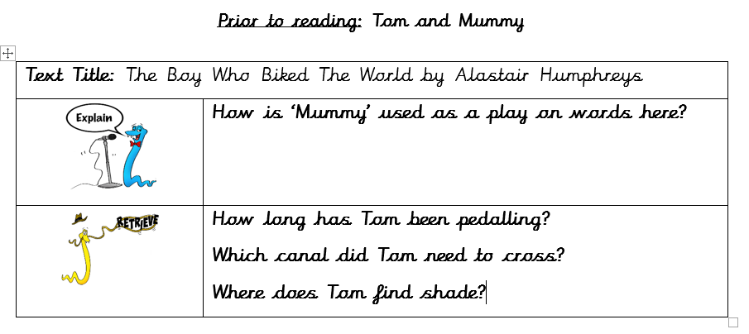
Reading: Every day the children will receive a new chapter from our book ‘The Boy Who Biked the World’. Please complete the following tasks after reading the chapter.
Objective: To create a fact file about the Sahara Desert.
Task 1… Answer the following questions.
Task 2…
For Tom to reach his destination he must travel through the desert.
2/3* - Create a detailed fact file about the Sahara Desert. You must include:
How big is it?
How hot does it get?
Living in the desert.
Interesting facts.
All of your research must NOT be copied!
You can add pictures and even your own added paragraphs (especially 3 stars).
1* - Create a mind-map about the desert using the information provided.

Slide 8
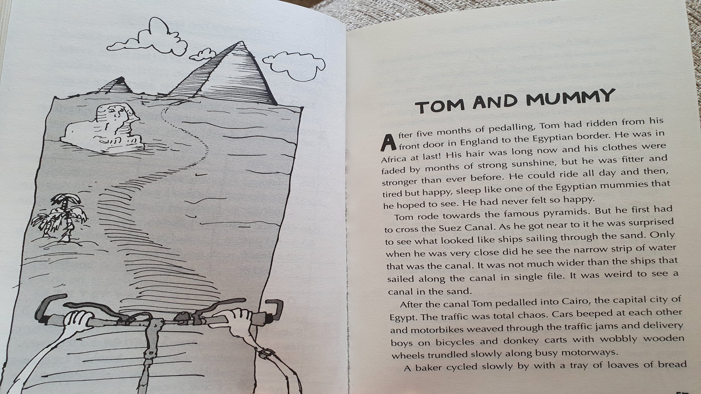

Slide 9
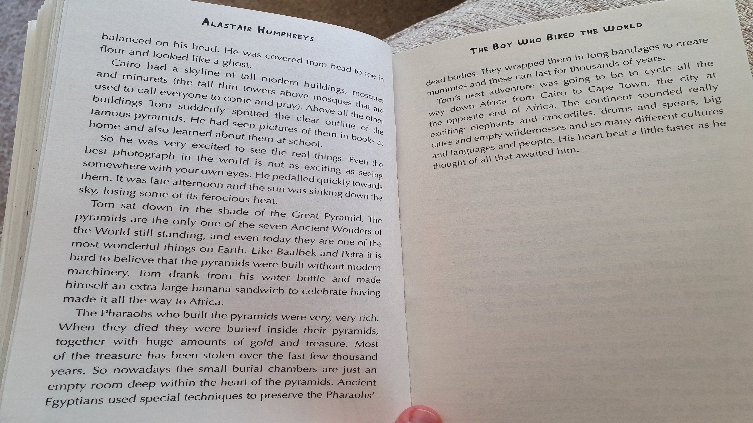
DISCUSS…
What do you think makes something one of the 7 wonders of the world?

Slide 10
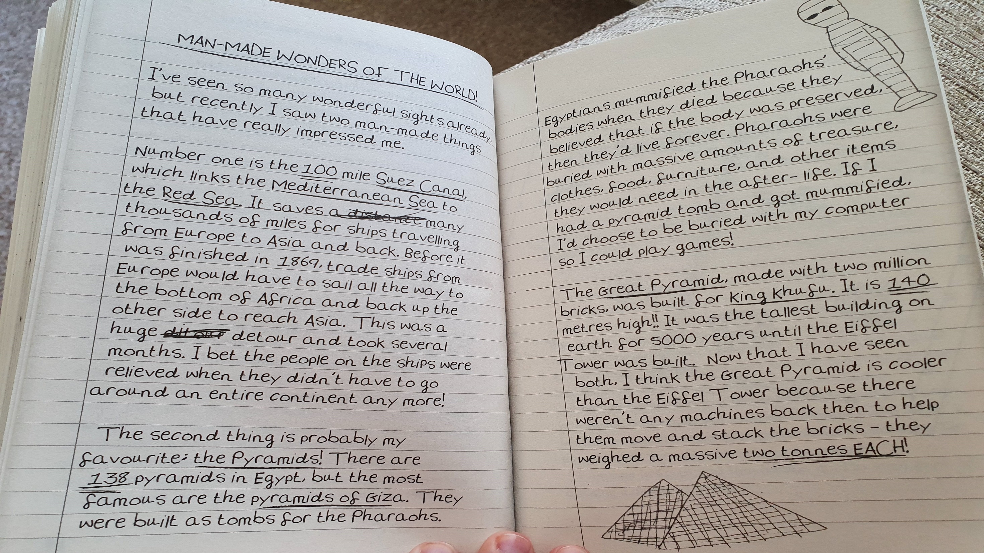

Slide 11
Science

Slide 12
