Slide 1
English:
Objective: To write a story opening.
There are 4 main ways someone could start a story (see next slide). When we read a book, the opening sentence makes us decide if we will like it and want to read on. For example:
1* - Focus on the setting only. Write some sentences that would describe the setting of the story. Try to use your senses… what can you see, hear, smell, touch and taste?
2* - Using the next slide as a guide, choose 2 of the story openers and create your own for the story ‘Where the Poppies Now Grow’.
3* - Write 4 different story openers using the next slide as a guide. Try to add as much detail as possible to make the reader want to read on.
Your story opening is for ‘Where the Poppies Now Grow’.
A copy of the first 2 pages can be found in this presentation!

Slide 2
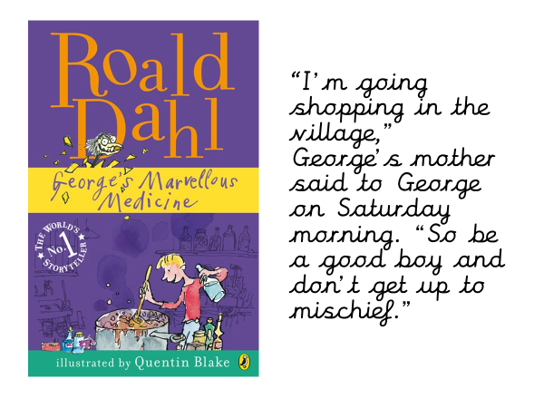
DIALOGUE
ACTION
Examples!
I start with someone talking, perhaps saying something that helps me imagine what could happen in the story.
I describe an action, something that happened, perhaps to the main character.
SETTING
CHARACTER
I describe the setting of the story, perhaps where I am or when. I may describe the weather or something that makes me imagine the scene.
I introduce the characters, their names and maybe some relevant information.

Slide 3
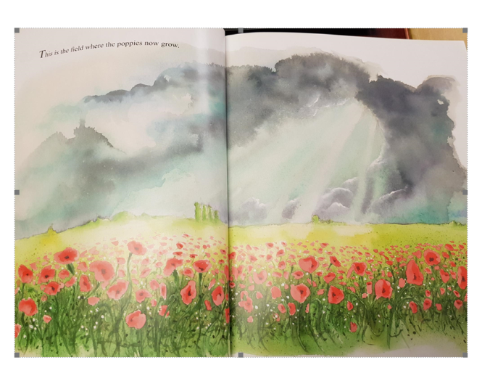
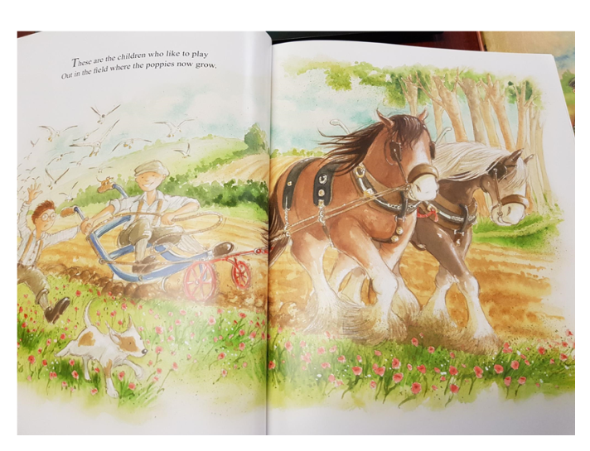
This is the story opening from ‘Where the Poppies Now Grow’.

Slide 4
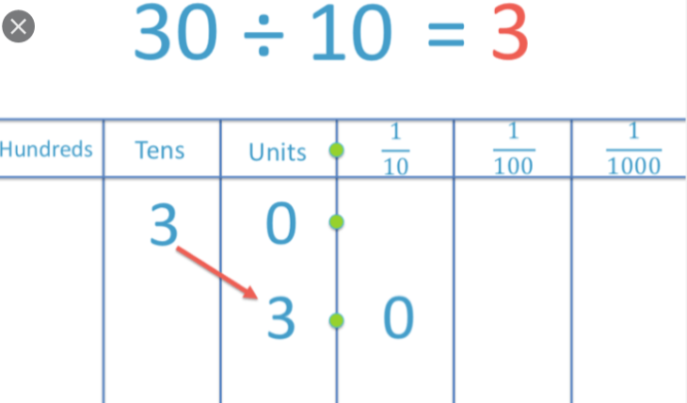
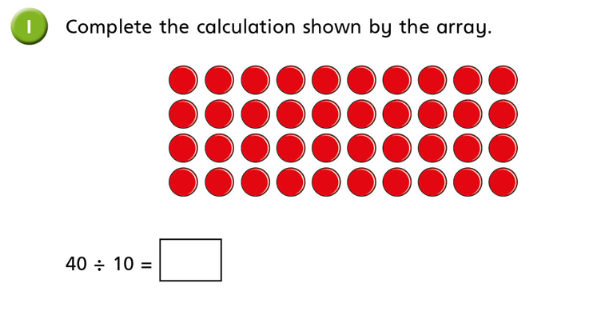
Maths:
Objective: To divide by 10.
Divide by 10!
When you divide by 10, move all the digits one place to the right, remember to check where your zero needs to be placed. If your original number is not a multiple of 10 and is a 2-digit number, think carefully and check that the unit moves into the tenth column.
E.G 46 x 10 = 4.6 Have a go at the questions below.
Place your original digits in the correct place value column. Move all the digits one place to the right when dividing by 10.
1* - See next slide for dividing by 10 questions.
2* - Complete the White Rose Hub Questions.
3* - Complete the White Rose Hub Questions and then complete the true or false statement as an extension activity.

Slide 5
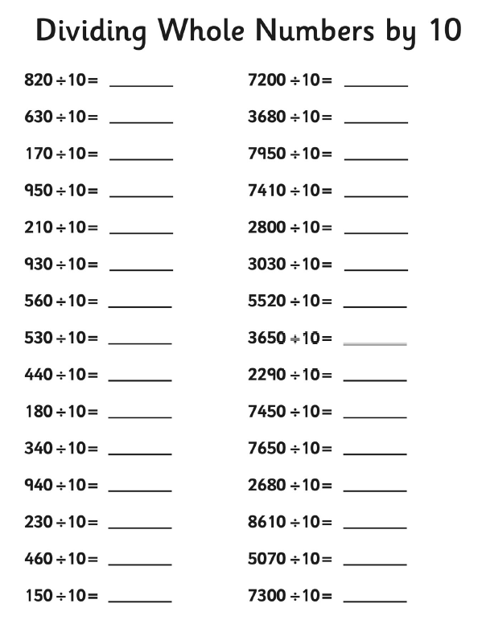
1 STAR TASK!
3 STAR EXTRA TASK!

Slide 6
2/3 STAR TASK!

Slide 8
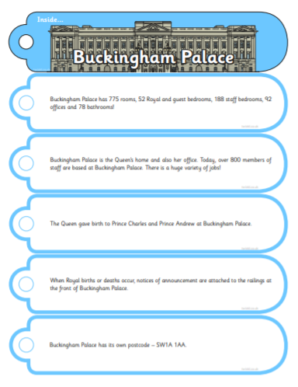
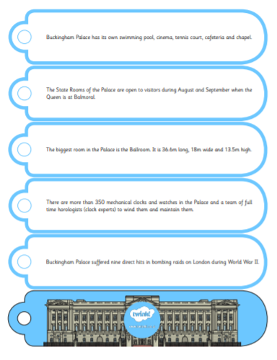
Reading: Every day the children will receive a new chapter from our book ‘The Boy Who Biked the World’. Please complete the following tasks after reading the chapter.
Objective: To research a wonder of the world.
Tom visits the Pyramids in Egypt, which is known as a wonder of the world.
Using the next slide, pick a wonder of the world that intrigues you. Then create a fact fan book (like the one opposite). Start with a picture and then on each slip, write facts about your chosen wonder.
2/3* - You may wish to do two pages like the Buckingham Palace example.
When you have finished, cut them out and pop something (string etc) through the holes to create a fan!
You will find different templates to choose from on the website.

Slide 9
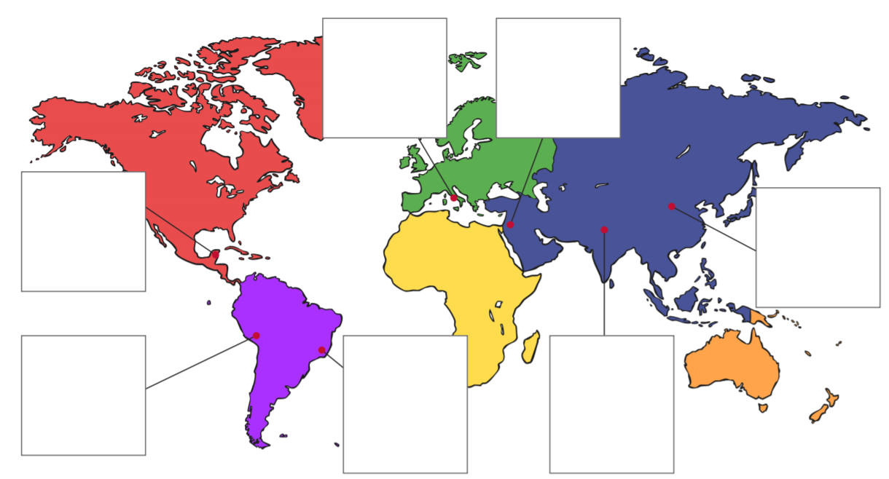
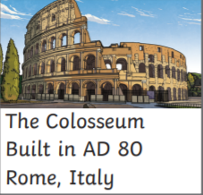
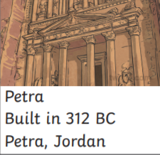
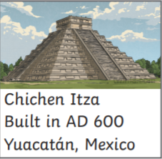
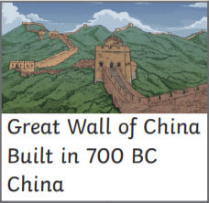
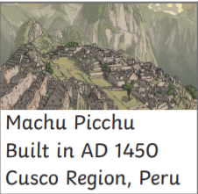

Slide 10
Remembrance day
Following the Remembrance Day assembly that you have seen today we would like you to colour one of the following pages to remind us of this very special day.
If you have not got a printer perhaps you could design a picture of your own that shows what you think is important about Remembrance Day.
Please e mail us with your pictures so we can put some on the website.

Slide 11
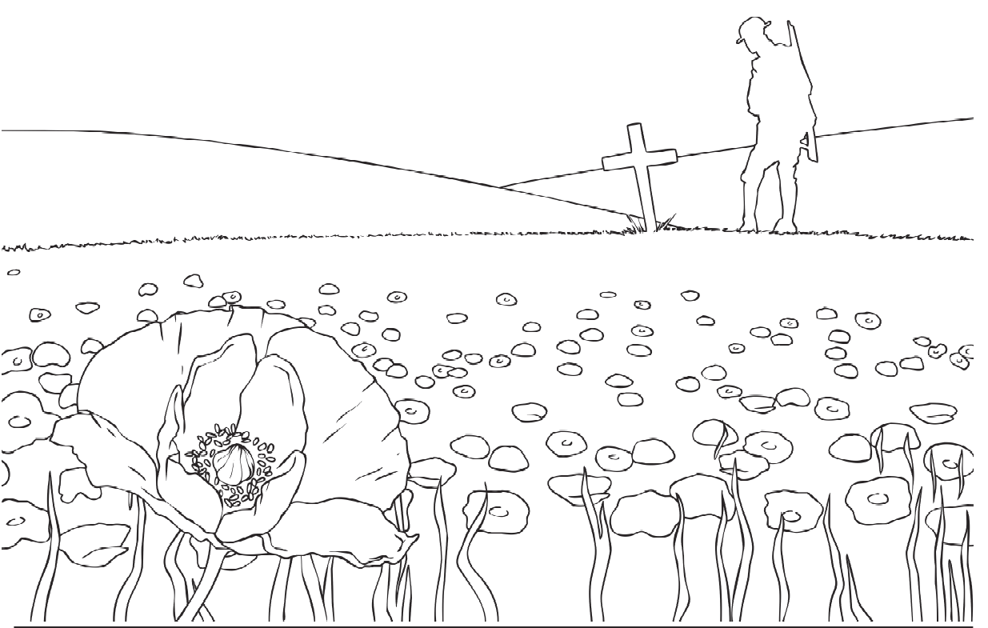

Slide 15
