Slide 1
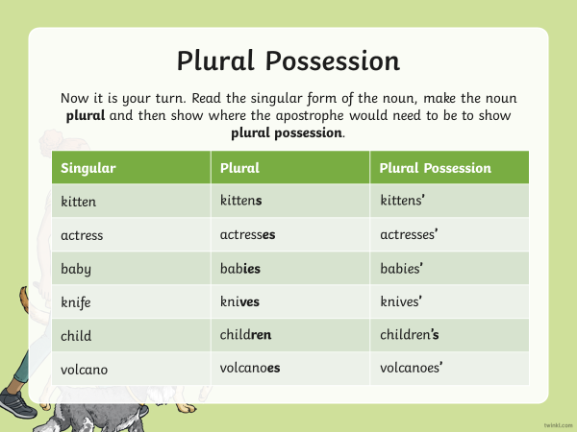
English:
Objective: To use possessive apostrophes.
This week we are going to focus on Spelling, Grammar and Punctuation tasks (SPAG). Each day, the children will look at a new skill for English with a task to support.

Slide 2
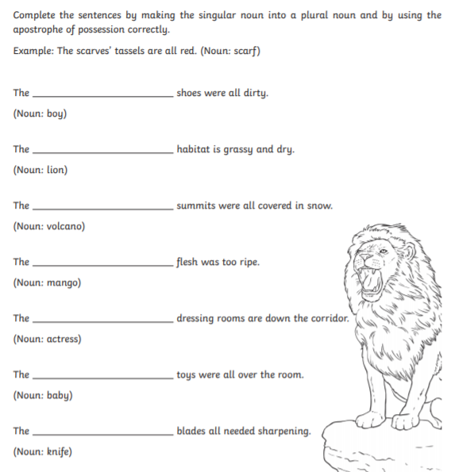
On the website, pick your star level (answers are included)…
Complete the sentences with the correct missing word.

Slide 3
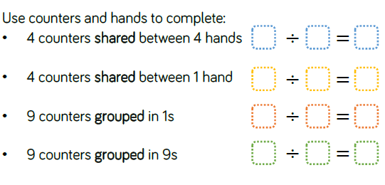
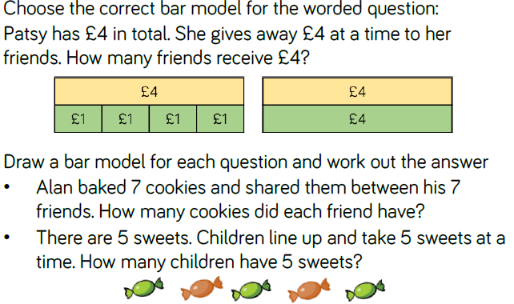
Maths:
Objective: To multiply and divide by 1 and itself.
To multiply and divide by 1 and itself!
What does sharing mean?
What does grouping mean?
During today’s learning children will explore what happens when you divide by 1 and itself. Children can demonstrate how both sharing and grouping can be used to divide by 1.
1* - See next slide for multiplying and dividing numbers by 1 and itself.
2* - Complete the White Rose Hub Questions.
3* - Complete the White Rose Hub Questions and then complete the grids focusing on multiplying and dividing by 1 .

Slide 4
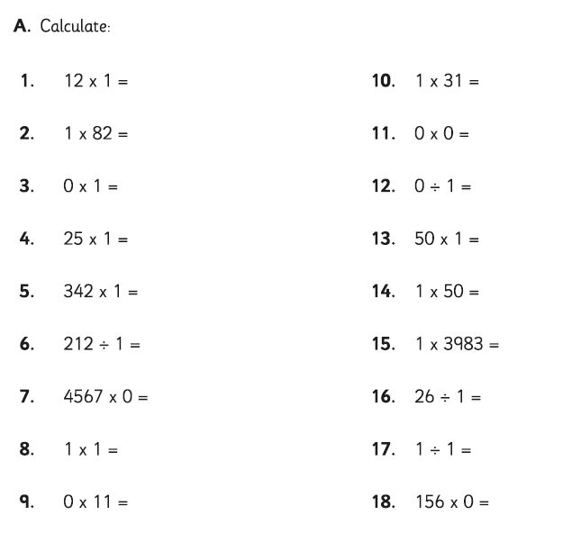
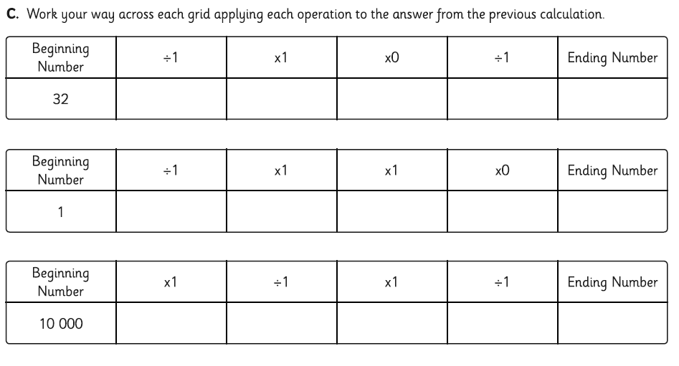
1 STAR TASK: Have a go at multiplying and dividing numbers by 1!
3 STAR EXTRA TASK!

Slide 5
2/3 STAR TASK!

Slide 7
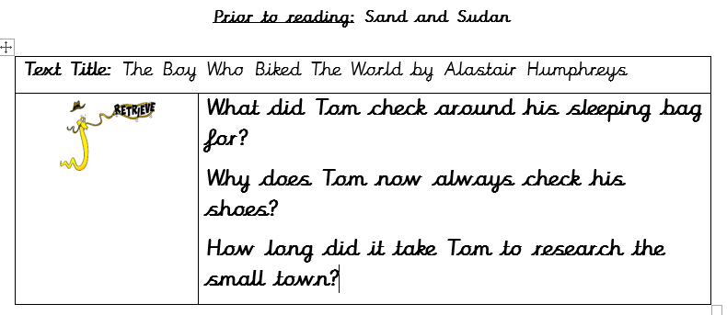
Reading:
Objective: To compare Tom from the start of the story with now.
Task 1… Answer the following questions.
Task 2…
Tom has changed a lot during his trip so far. Physically, his hair has grown and he is dirtier than usual. Tom doesn’t have access to washing facilities all the time. He is fitter with all his biking around the world.
Draw 2 boxes on a page or split your page in half (landscape).
In one box, draw a picture of Tom at the start of his journey.
In the second box, draw a picture of Tom currently.
2/3* - Write a paragraph explaining how he is different.
1* - Write 2 or 3 sentences on what has changed with Tom.

Slide 8
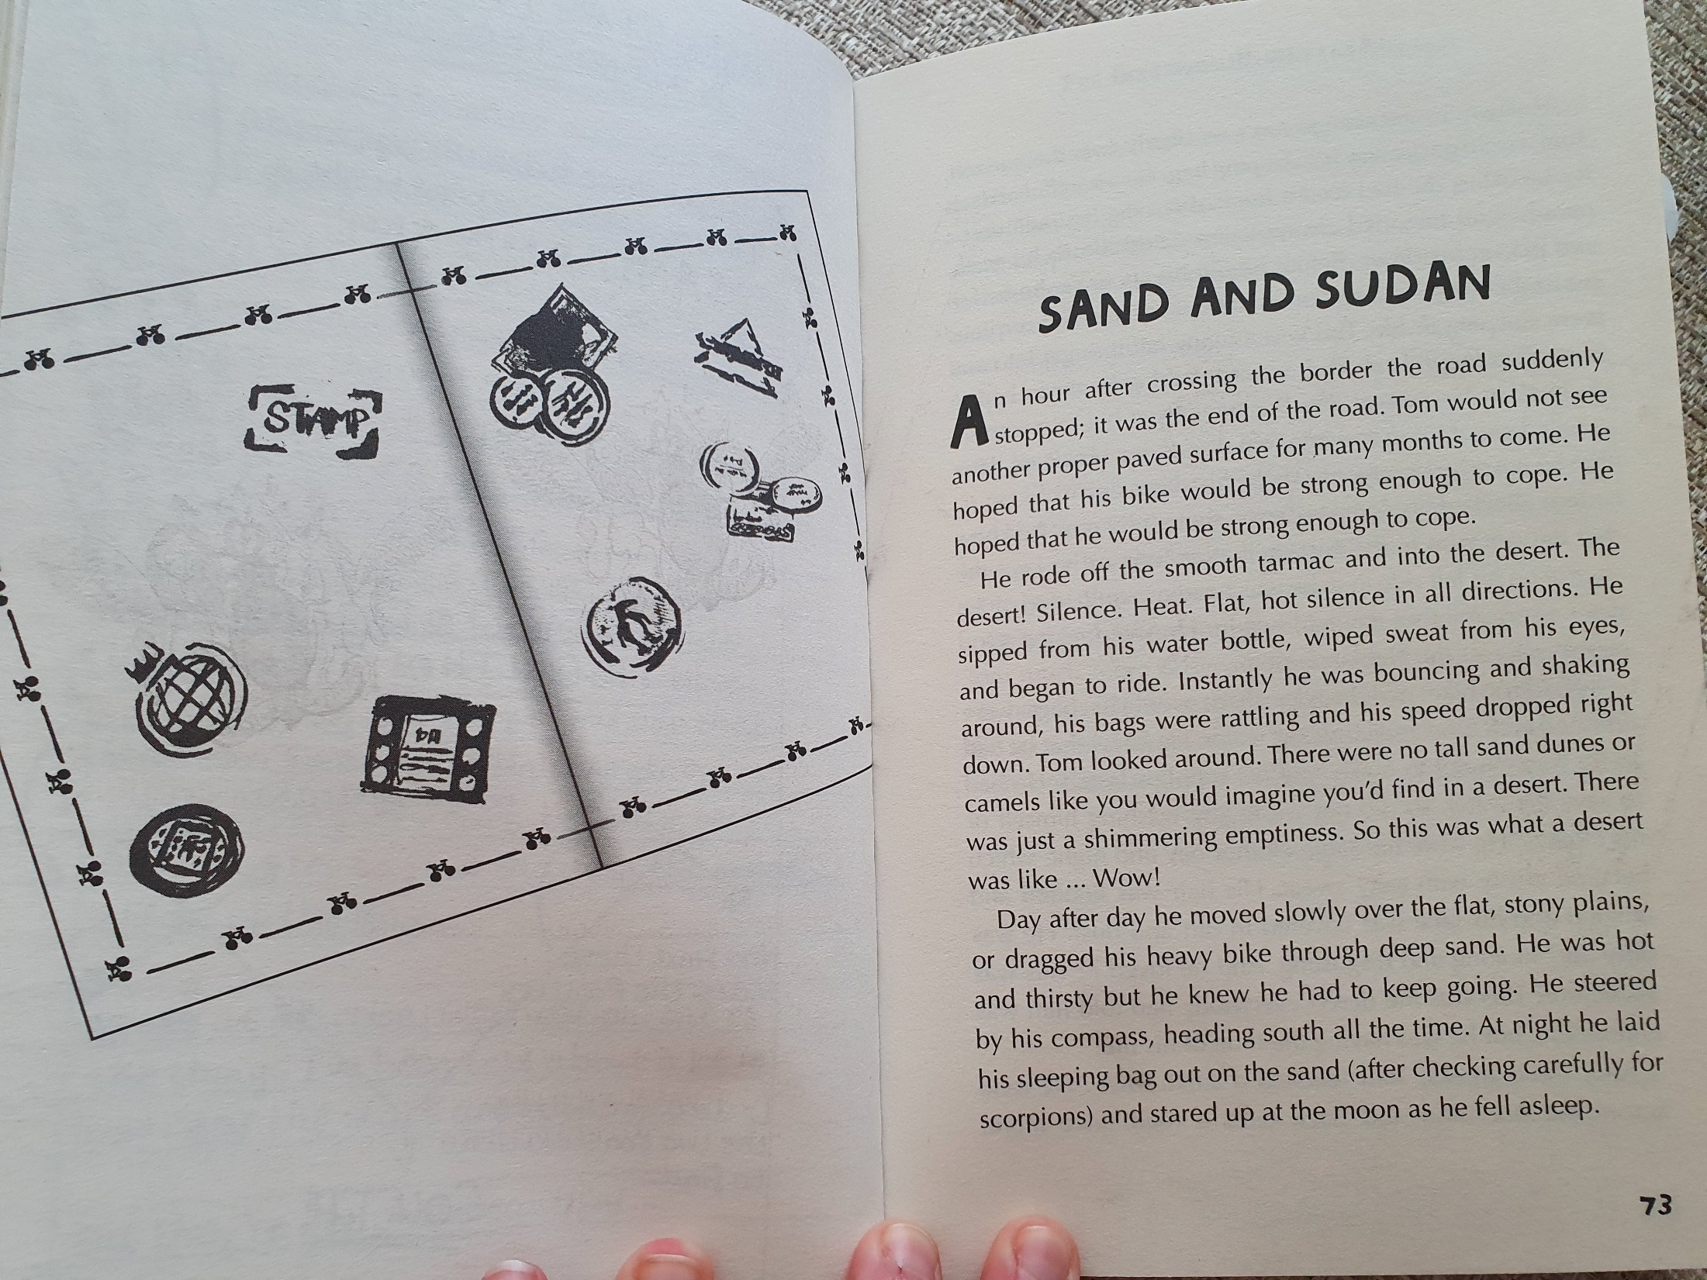

Slide 9
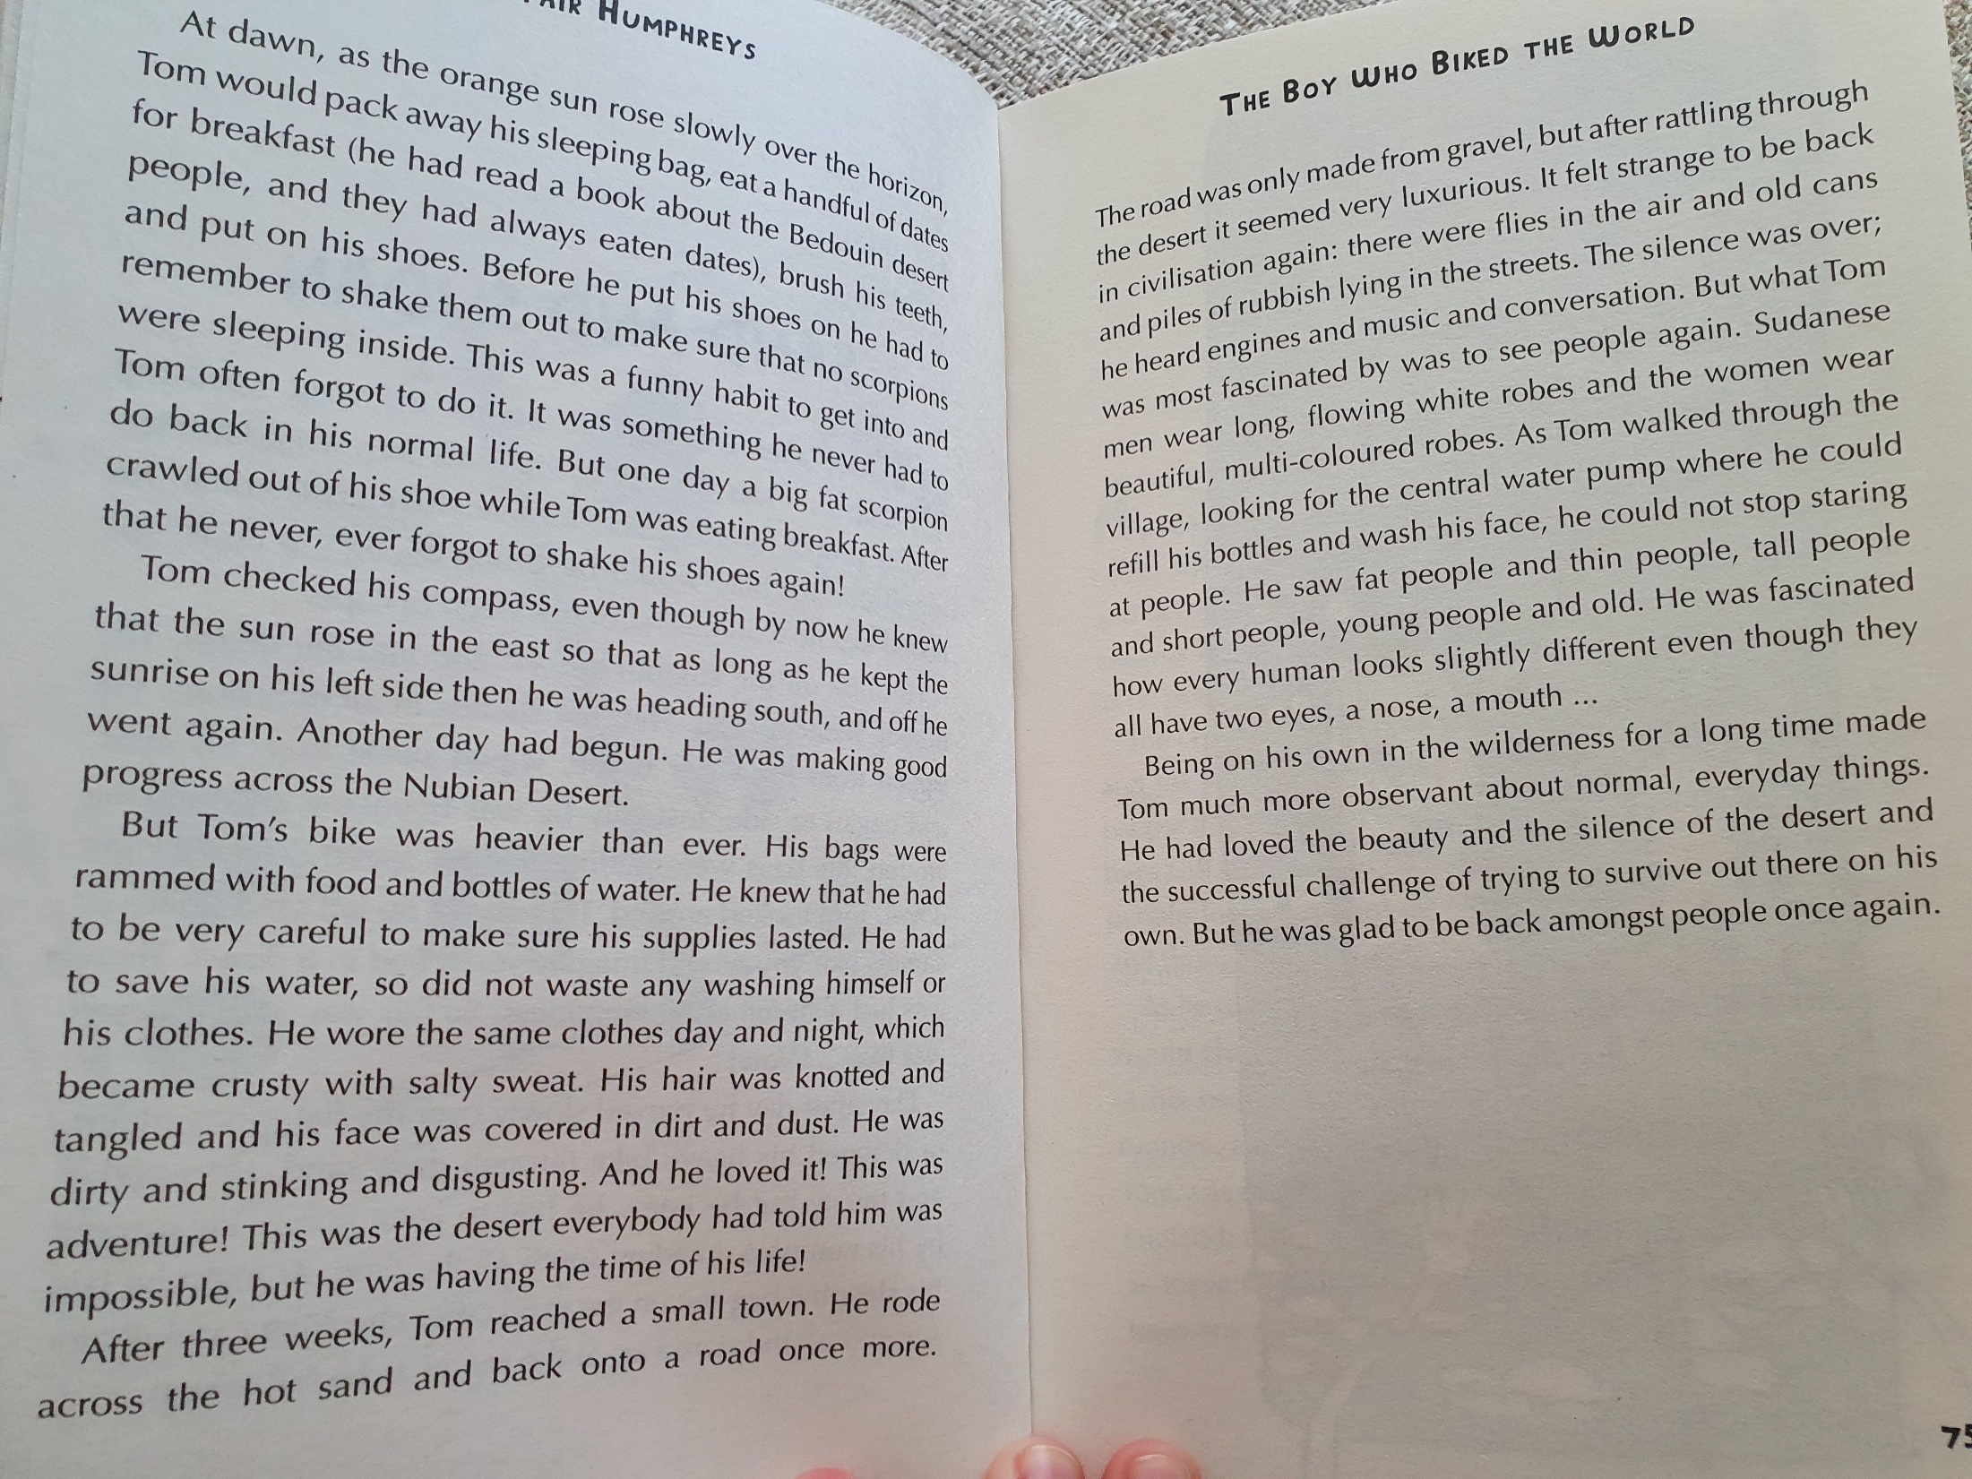
DISCUSS…
Why was his bike heavier?

Slide 10
Tom Before | Tom Now

Slide 13
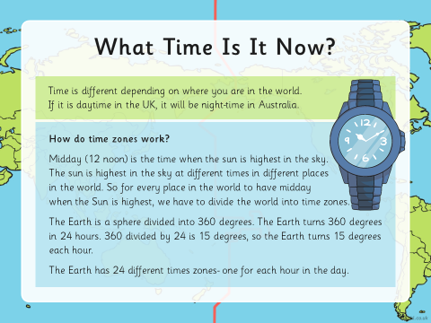

Slide 15
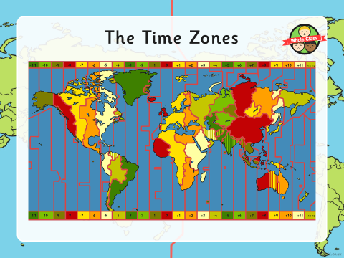

Slide 18
