Slide 1
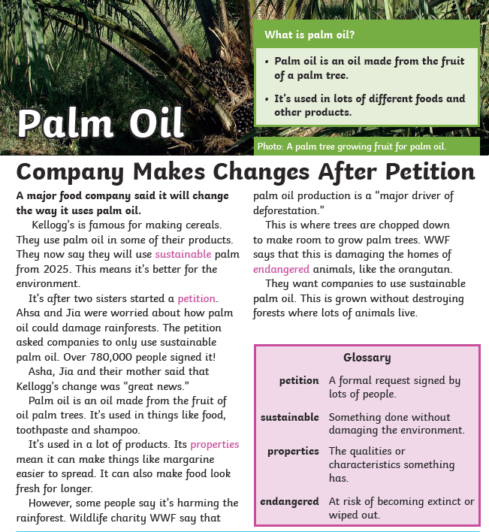
English:
Objective: To make notes for or against.
Yesterday, we had a class debate about the use of palm oil in our goods. For example… shampoo and chocolate.
The children were fantastic at arguing the points!
I would like the children to decide if they are FOR using palm oil or AGAINST it.
Using the research provided and your own research, make a list of points that support your side.
3* - Write 8-10 points that support FOR or AGAINST.
2* - Write 6-8 points that support FOR or AGAINST.
1* - Write 4-6 points that support FOR or AGAINST.
If you pick FOR, you are saying, you are happy to use palm oil.
If you pick AGAINST, you are saying, you are NOT happy to use palm oil.

Slide 2
Why is palm oil so popular?
Palm oil has many advantages. It is the highest-yielding vegetable oil crop, which makes it very efficient, and very popular. It needs less than half the land required by other crops (such as sunflower, soybean or rapeseed) to produce the same amount of oil. This makes palm oil the least expensive vegetable oil in the world.
In most palm oil producing countries, including Nigeria, Thailand, Colombia, Ecuador, Papua New Guinea, Ivory Coast, and Brazil, palm oil trade has contributed significantly to economic growth and poverty reduction.
In Indonesia and Malaysia combined, approximately 4.5 million people earn a living from palm oil. Palm oil is a unique ingredient in many products because it has great cooking properties which are maintained even under high temperatures. It has a smooth and creamy texture and is odourless, making it a perfect ingredient for many recipes. It also has a natural preservative effect which extends the shelf life of food products.
What are the benefits of palm oil compared to other crops?
Oil palm is the most efficient among all oil crops, producing 4 to 10 times more oil per hectare in comparison. Economically, it is also the cheapest vegetable oil to be produced and is highly versatile. Although palm oil is quite often the focus of its many detractors, the fact is that if consumers stop using palm oil, industries will need to switch to alternative oil crops which are likely to cause 4 to 10 times more social and environmental damage, due to the increasing demand for vegetable oil but low yields produced by these other crops. This is where sustainable palm oil plays a major role in lowering or eliminating environmental and social impacts while continuing to produce the world's most demanded and cost-effective vegetable oil.

Slide 3
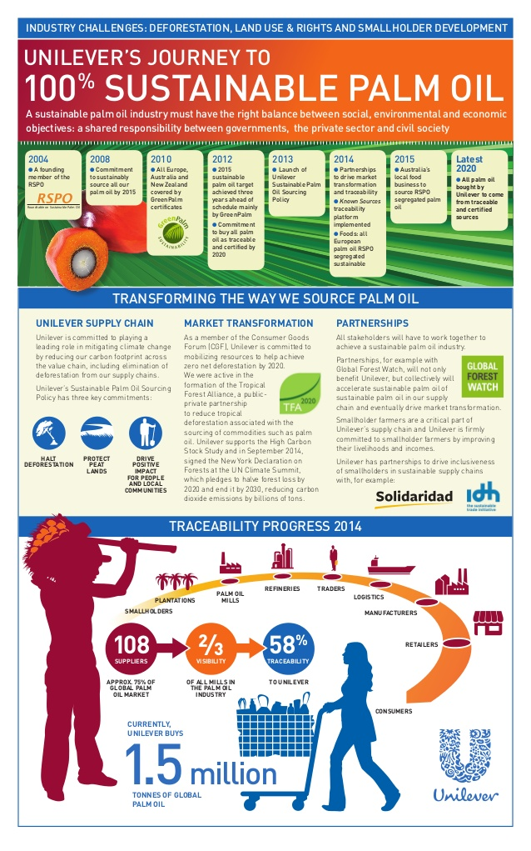
1. Palm oil is cheap – and we’re using way too much of it
Palm oil is a vegetable oil – like sunflower or olive oil. It’s made from the fruit of oil palm trees – Elaeis guineensis – which come from West Africa but were taken to Southeast Asia in the 1960s. Palm oil can be produced sustainably – but a lot of it isn’t.
Palm oil is great for big food and cosmetics companies, because it’s cheap and versatile. It’s used in many of the things we use or eat every day: shampoo, bread, toothpaste, detergent and even snacks and chocolate bars.
Not only do roughly half of the processed goods in the supermarket contain palm oil, but millions of tonnes of palm oil are going into the tanks of people’s cars. More than 50% of palm oil coming into Europe (but not the UK) is for biofuel.

Slide 4
2. Palm oil is a major cause of forest destruction
The palm oil industry has been a disaster for the world’s forests, wildlife and climate. Palm oil is mostly grown in Indonesia and Malaysia, two tropical countries with large areas of rainforest home to tigers, orangutans and other species that are found nowhere else on earth.
Palm oil companies have been destroying these rainforests because they want more land to grow oil palm trees.
Around 24 million hectares of rainforest were destroyed in Indonesia between 1990 and 2015, according to official figures from the Indonesian government. That’s an area the size of the UK. Palm oil and paper companies are the main causes of this destruction.
3. ‘Certified sustainable’ palm oil is a con
In 2004, the palm oil industry set up the Roundtable on Sustainable Palm Oil (RSPO). RSPO members have their palm oil ‘certified sustainable’ and brands using this palm oil get to claim that their palm oil is ‘sustainable’.
Most supermarkets in the UK and many consumer brands like Nestlé and Mondelez use RSPO palm oil in their products.
But the RSPO is about as much use as a chocolate teapot. It took 14 years for the RSPO to ban its members from destroying forests – which it finally did in November 2018. It still hasn’t enforced this new rule – and RSPO members are still destroying forests and getting away with it.
RSPO members were right at the centre of Indonesia’s 2015 forest fires crisis. This year, the fires returned – and roughly three-quarters of the fires linked to palm oil companies were on RSPO members’ land. This means that so-called ‘sustainable’ palm oil growers are – in some cases – at the forefront of Indonesia’s environmental crisis.

Slide 5
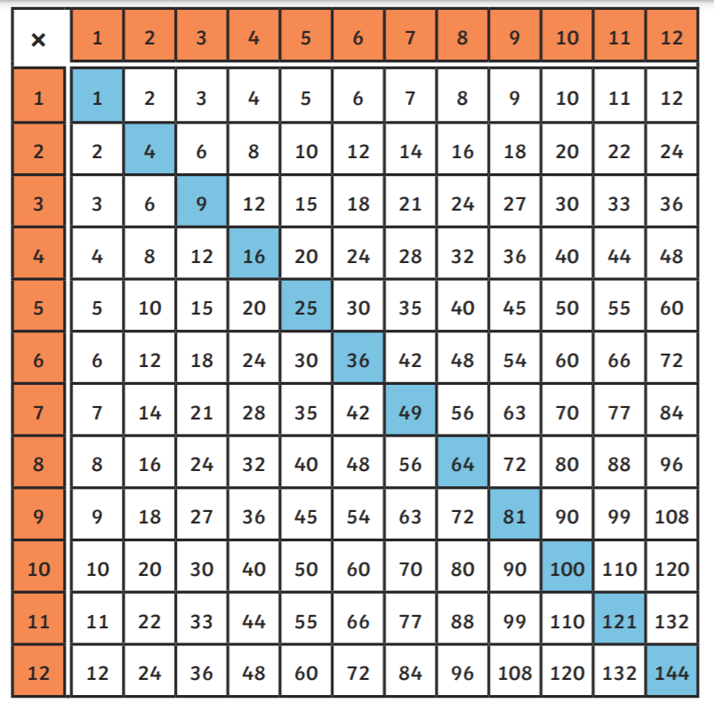
Maths:
Objective: To use a formal method for short multiplication.
The children have been using the method above this week. Complete as many questions on the next slide as you can.
Use the times tables chart on this slide to support you.

Slide 6
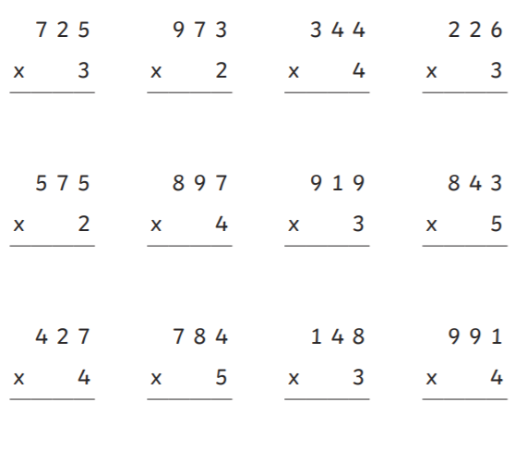
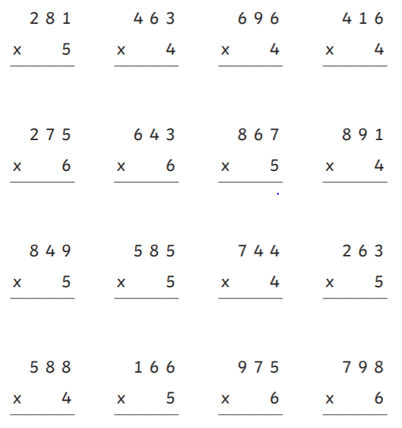
1 STAR
2 STAR

Slide 7
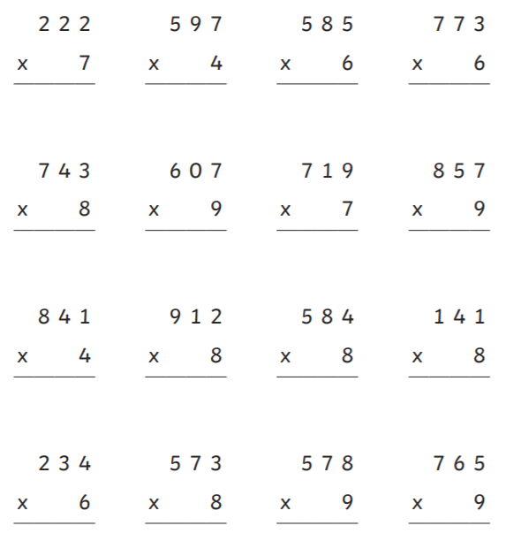
3 STAR
3 STAR CHALLENGE

Slide 8
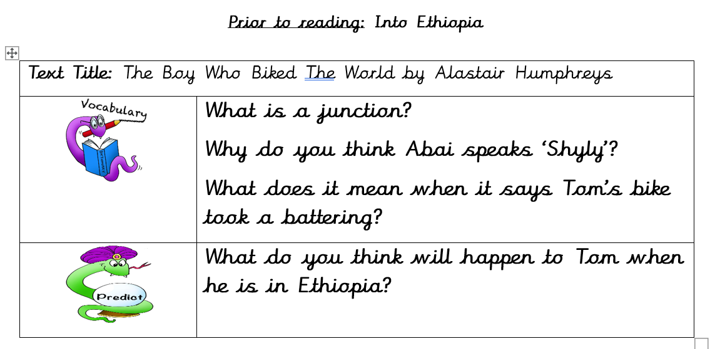
Reading: Read the Chapter… Into Ethiopia.
Objective: To write a diary entry.
Task 1… Answer the following questions.
Task 2…
After every day, Tom writes a diary to explain what he has done that day.
Tom didn’t include a diary for his time in Ethiopia.
2/3* - Write a diary using the chapter for your ideas. Look at the poster for some support on what you need to include.
3 Stars – Aim for 3 paragraphs
2 Stars – Aim for 2-3 paragraphs.
1* - Use the diary scaffold to complete your own diary for Ethiopia.
All – Remember, you are Tom!

Slide 9
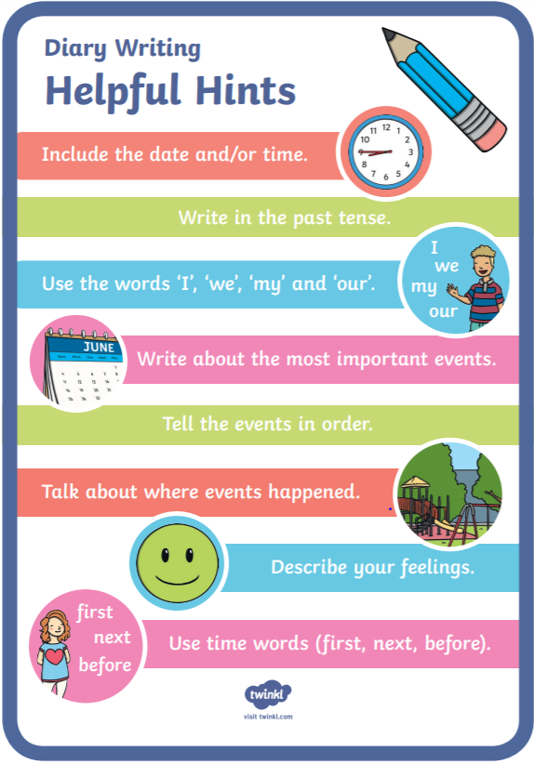
Example Below…
Dear Diary,
I made it to Ethiopia! What a beautiful place… I am almost at the end of Africa. I cannot believe that I made it this far. I was upset today because I really miss my family. Surprisingly, the children of Ethiopia don’t speak English and I don’t speak Amharic. This made trying to ask for anything really difficult.

Slide 10
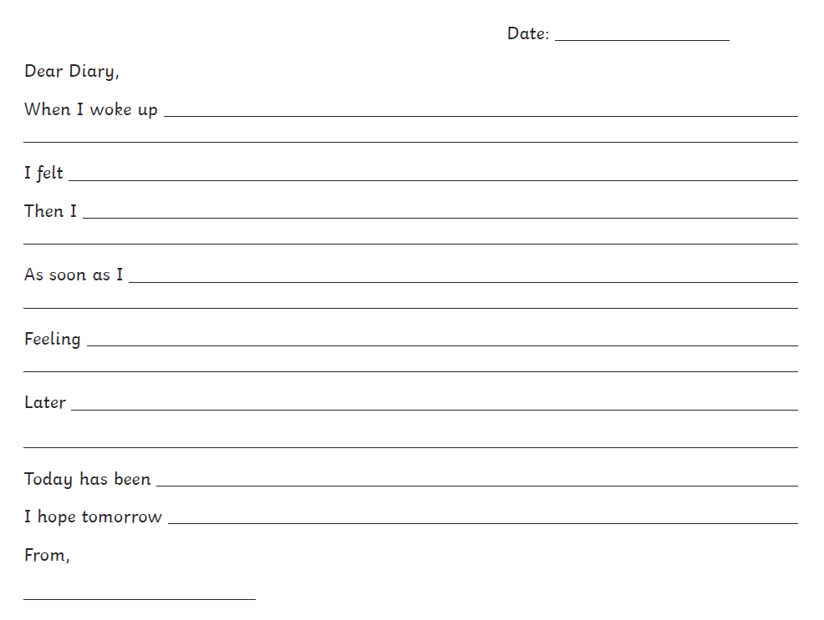
1 Star Scaffold…

Slide 11
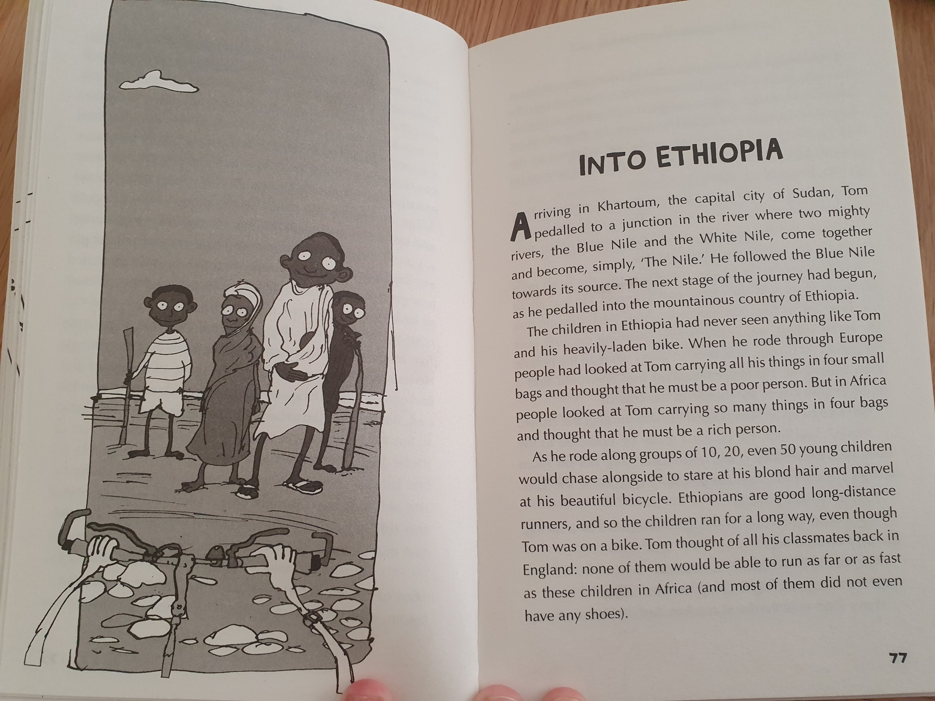

Slide 12
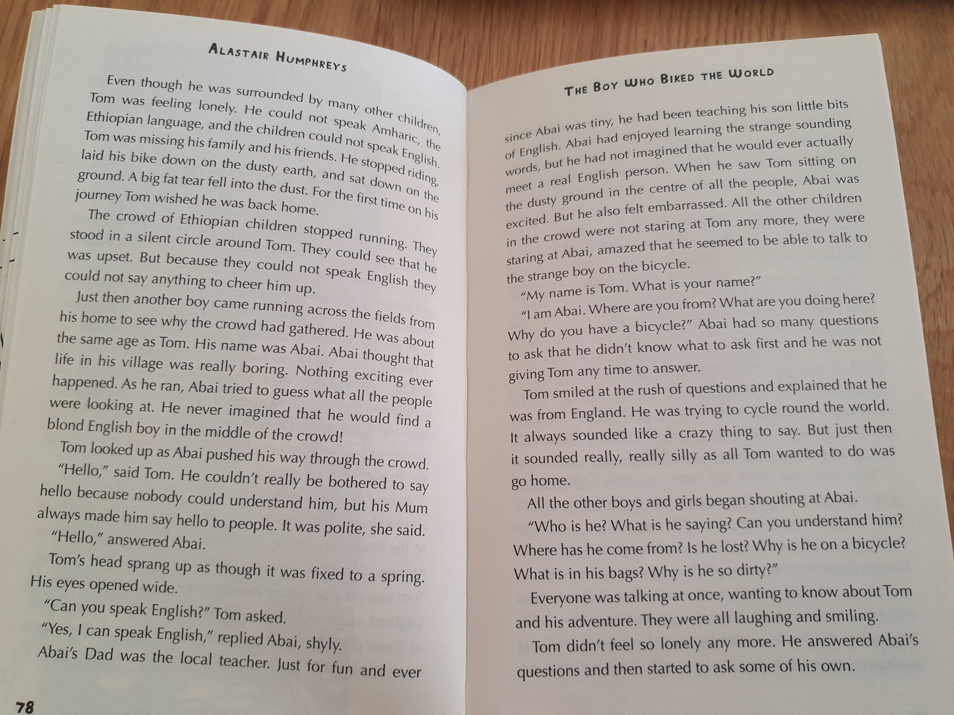

Slide 13
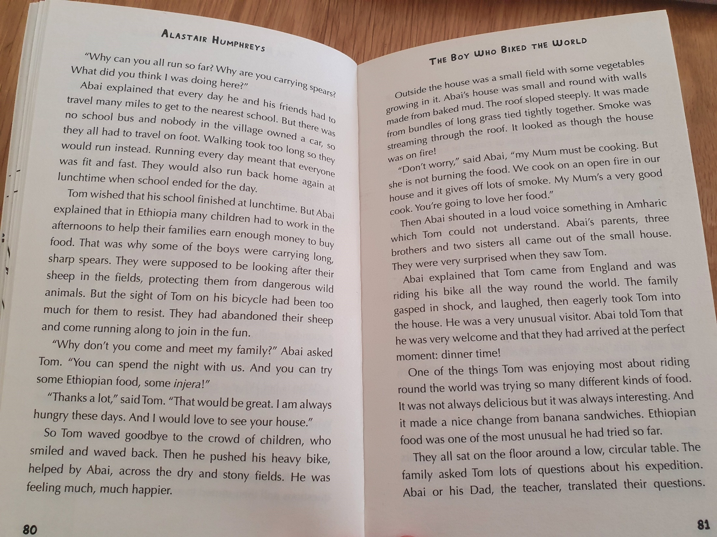

Slide 14
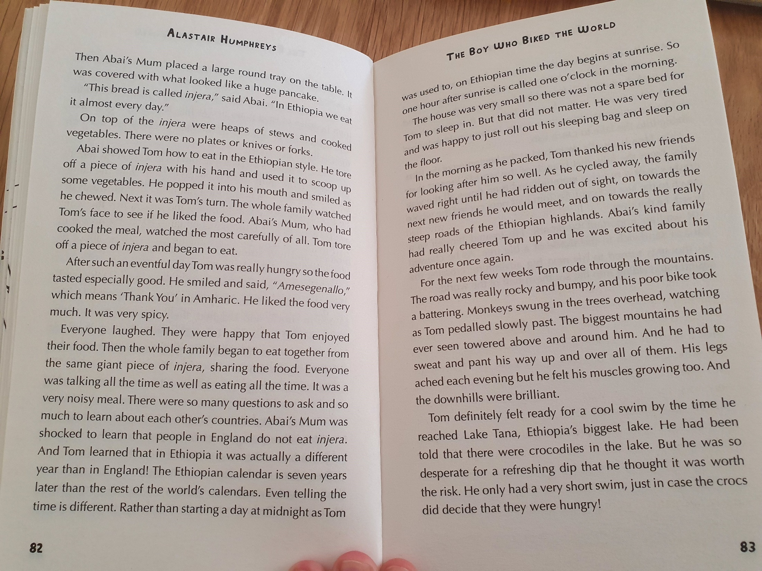

Slide 15
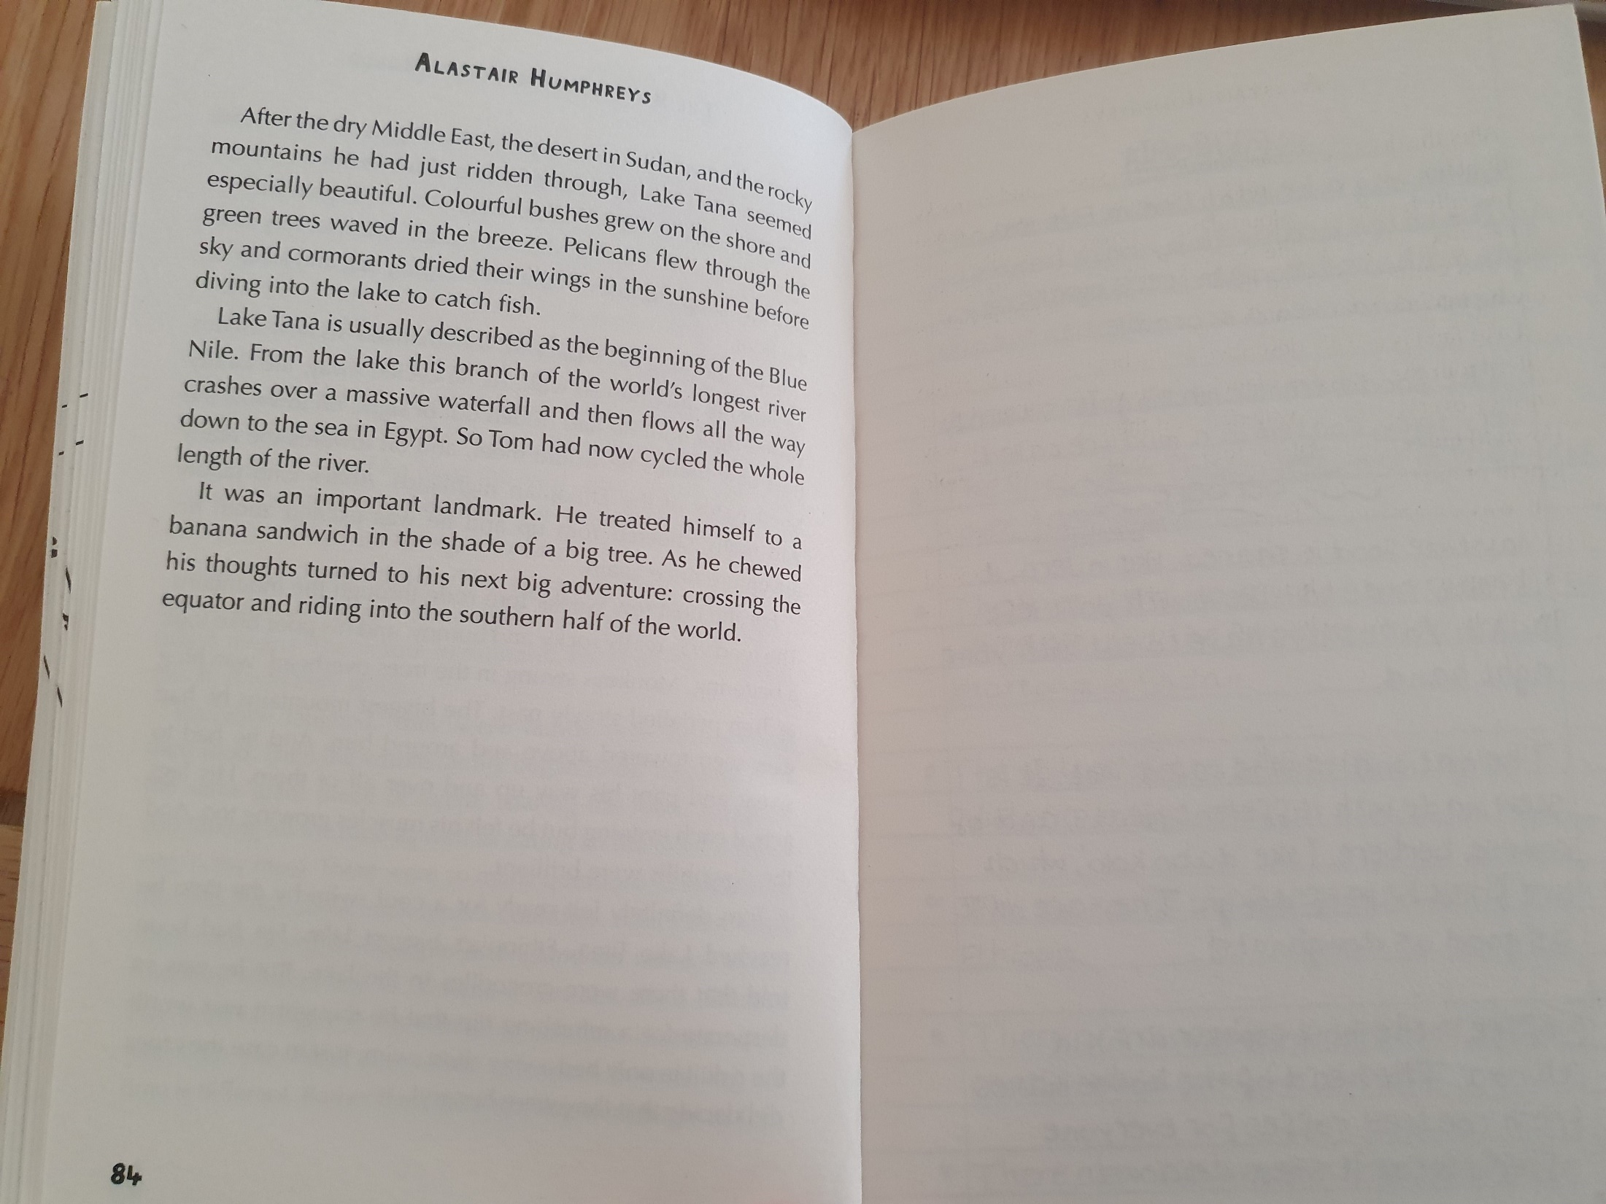
DISCUSS…
What do you know about the equator?

Slide 16
Other:
Objective: To use a stimulus to write creatively.
Look at the next slide for some writing ideas!

Slide 17
Free Writing Friday!
Use the picture as a prompt for your writing today.
Here are some ideas:
Write an explanation for why the moon is egg shaped.
Write a prediction for what will happen to the 3 girls now the moon is a different shape.
Write the story before they noticed the moon was a different shape.
Imagine something woke the girls up, write an alternative image they could see out of the window.

