Slide 1
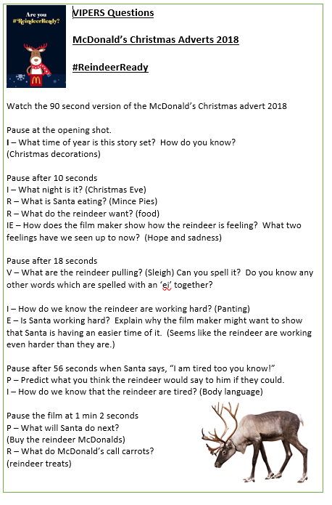
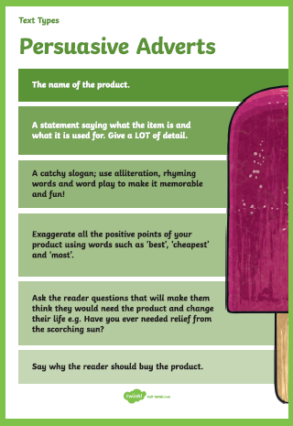
English: Following on from our work this week on persuasive letters, today we are going to focus on adverts and how they are used to persuade us.
Objective: To create a persuasive advert that campaigns and raises awareness that reindeers need treats just as much as Santa.
Please watch the following advert:
Christmas Advert
Use the Vipers questions to get a good understanding
of what the advert is about.

Slide 2
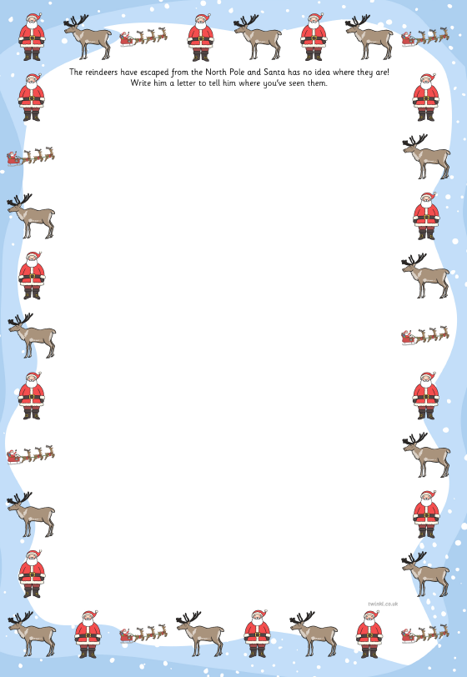
1 Star Task:
Watch the video for the Christmas
Advert.
Design a poster/advert to encourage
home owners and children to leave healthy treats for reindeers at Christmas.
It is important for children and
parents to be aware that reindeers have
a long way to fly on Christmas eve and need the energy to keep them going.
What persuasive words could you use?
My Reindeer Advert

Slide 3
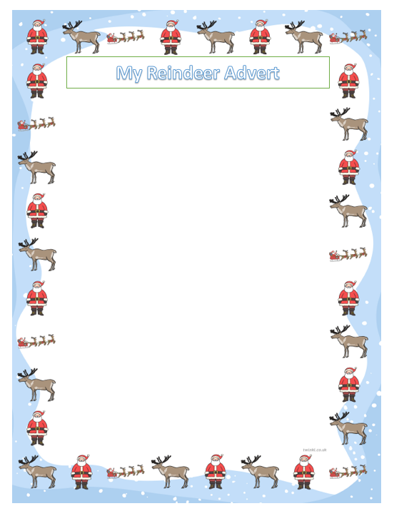
2*/3* Task:
Watch the video for the Christmas
Advert.
Design a poster/advert to encourage
home owners and children to leave healthy treats for reindeers at Christmas.
Research facts about Reindeers. Think about what they eat and how much sleep they need etc.
Include rhetorical questions such as:
How would you like to be hungry when you have such an important job on Christmas Eve?
Think about your use of persuasive language too.
Include at least 3 facts as to why it’s important to give reindeer’s snacks at Christmas.
Use this paper to design your reindeer advert.

Slide 4
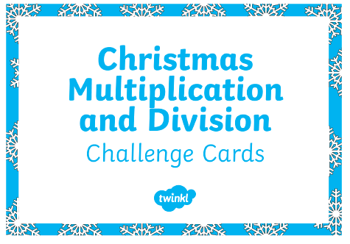
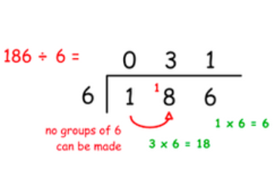
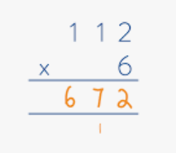
Maths:
Objective: To use your knowledge of the formal methods
of multiplying and dividing to solve word problems.
Use the RUCSAC method to help you solve your word problems
This week you have used the column
method of multiplication and the bus stop method for division to help you solve multiplication and division sums.
Use this knowledge you have learnt to help you solve your Christmas word problems today.
1* - See next slide for the Christmas division and multiplication word problems.
2*/3* - The children will be need to think carefully about using the column method to multiply or bus stop method to divide in order to help them solve their
word problems.

Slide 5
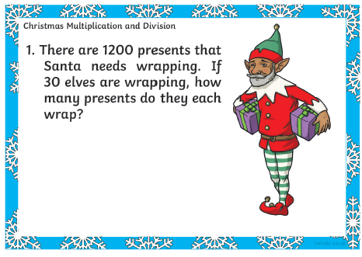
1* STAR TASK!
Using the RUCSAC method of:
Read, Understand, Choose, Solve, Answer and check,
Have a go at solving these word problems.
Remember to show your working out and use
The methods of multiplication and
Division that you have learnt to help you solve the problems.
2. There are 80 robot toys to be packed in 8 boxes. How many robots will there be in each box?
1. There are 120 presents that need wrapping. If 3 elves are wrapping,
How many presents do they each wrap?
3. Reindeer dust weighs 15 grams per sack. How much does 15 sacks weigh?

Slide 6
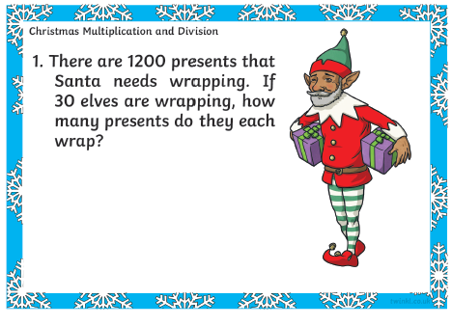
2*/3* STAR TASK!
Using the RUCSAC method of:
Read, Understand, Choose, Solve, Answer and check,
Have a go at solving these word problems.
Remember to use the formal methods of
multiplication and division to help you solve
the problems. Have a go at doing as many as you like.

Slide 7
2/3 STAR TASK!

Slide 8
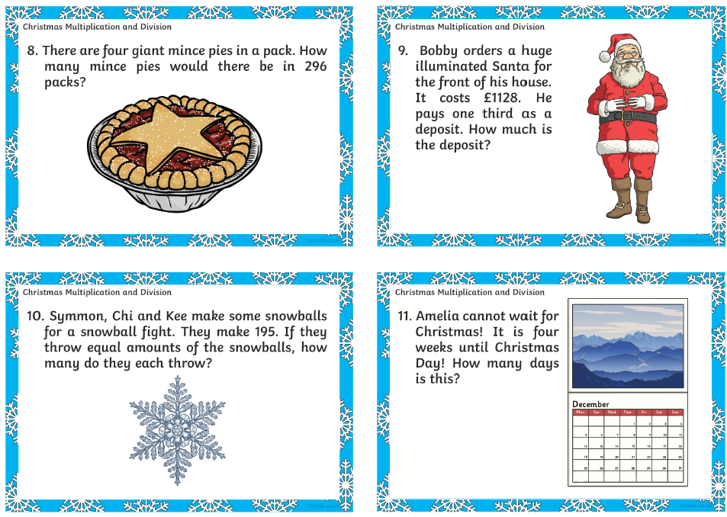

Slide 10
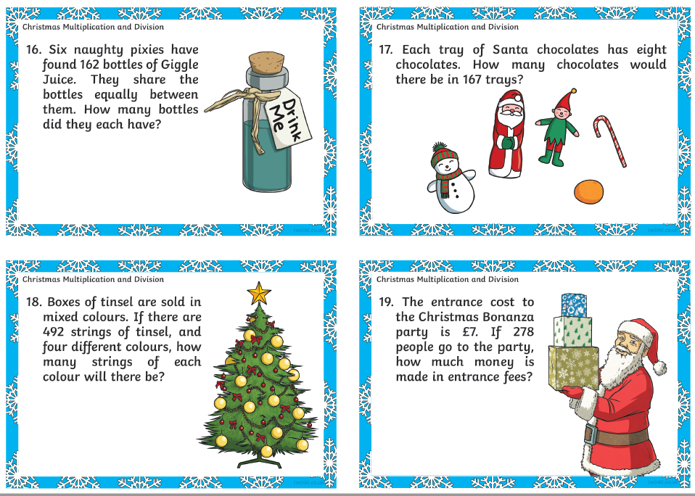

Slide 11
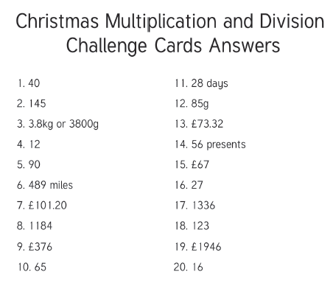
Here is the answer sheet for the 2*/3* so you can check your children’s answers. Please award
yourselves 10 House Points for every word problem they have got right as these questions were
really tricky.
☺ Well done 4NJ!

Slide 12
Reading Task:
1* Task: Read the information focusing on Christmas traditions and answer the following questions.
Please answer the following questions on the next slide.

Slide 13
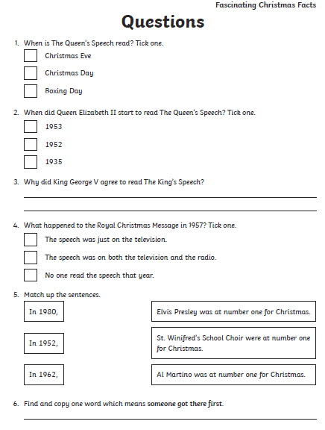
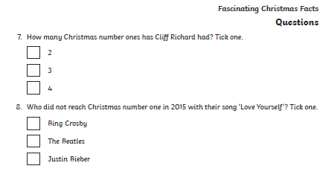

Slide 14
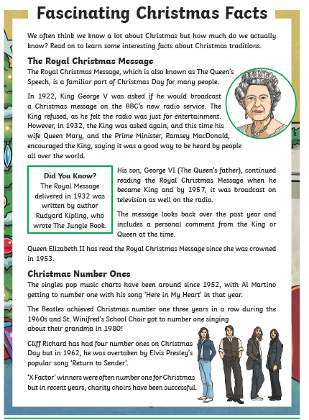
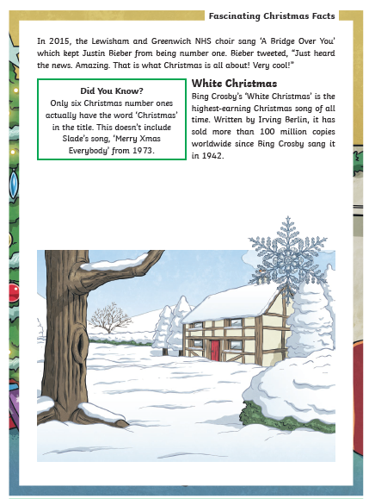
Reading Task:
2*/3* Task: Read the information focusing on Christmas traditions and answer the following questions

Slide 15
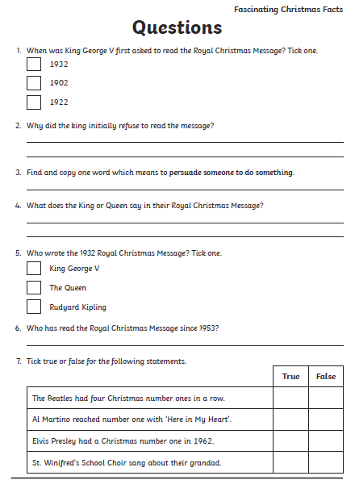
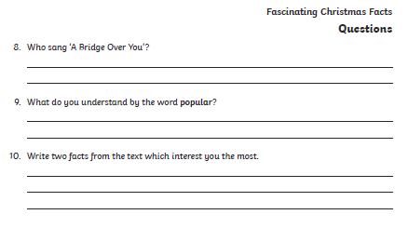

Slide 16
4NJ as a massive thank you from me for
being absolute superstars all week,
I would like to set you a craft challenge to
do at home whenever you have chance as I
know we are also doing a craft lesson online
this afternoon.
I would like you to have a go at making a spiral paper snowman. The template for
making this is on the following slide.
To make your snowman stronger, stick the template to card and then have a go at cutting it out and attaching some string once you have assembled it.
You will need: glue, card, scissors and string.
Enjoy. ☺

Slide 17
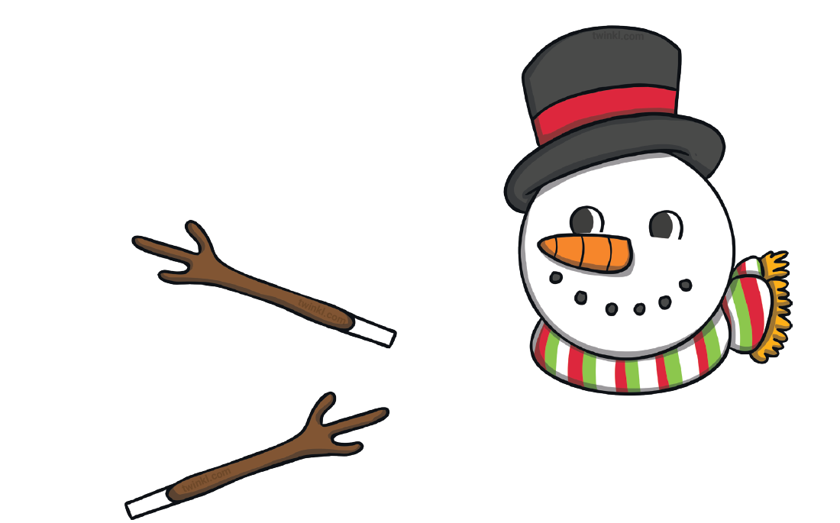

Slide 18
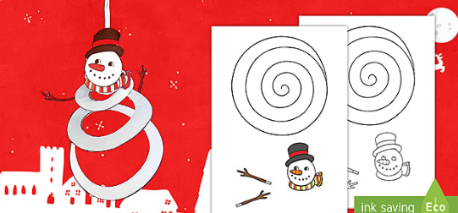
Your finished decoration should look like this.

