Slide 1
Remote Learning Plan!
Hello 4NJ!
Over the next couple of weeks, I will be providing the children with remote learning on a daily basis. The work will be available on the website the day before e.g. Monday’s work will be online Sunday.
Everyday the remote learning will consist of:
English Lesson
Maths Lesson
Reading Lesson
One other curriculum lesson (PSHE, Art etc)
I will be available during the hours of 9am and 4pm so please feel free to contact myself!
Some of the work provided will be split into the star levels that the children use everyday in class (1,2 3).
Stay safe everyone and look after yourselves!
All my best wishes Mrs Jukes.

Slide 2
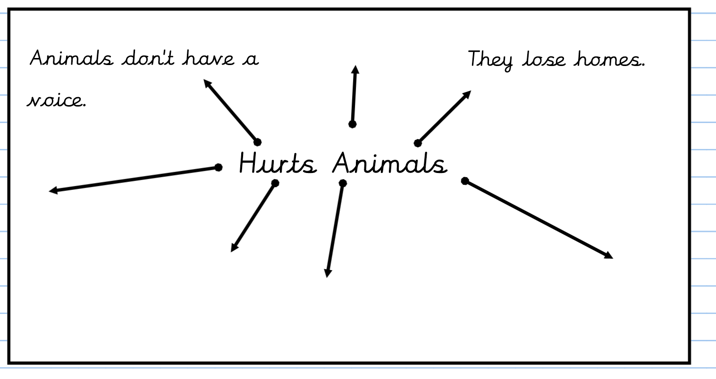
English: Last week in English we were learning about the use of Palm oil in products such as shampoo that we buy from the supermarket. The English lessons will be based on persuasive features and the language we use to persuade other.
Objective: To support points of persuasion.
Palm Oil Video
1 Star – After watching the above video, write two sentences about why supermarkets should not sell products with palm oil in them. Please complete
the mind map to the right and think of at least 3
more ideas about the effects palm oil has on
animals and their habitats.
Once you have completed the mind map, pick one
point from it and try and persuade your family.
2 Star/ 3 Star:
Please watch the video focusing on palm oil. Write a paragraph about why we should not purchase products that contain palm oil from the supermarket. Please complete the mind
map to the right of the page focusing on how palm oil effects and destroys animals and their homes.
Once you have completed the mind map, pick one point from it and try and persuade your family.

Slide 3
Maths:
Objective: To multiply numbers by a single digit using
Short multiplication.
Using short multiplication to multiply numbers using a single digit!
Once you have multiplied the units, tens and hundreds remember to add together the three separate answers..
E.G. 12 + 160 + 2000
Write down each number clearly (one digit per square.)
Write down underneath the number you are multiplying by. Multiply the units first, then the tens and then the hundreds after.
1* - See next slide for multiplying a 3-digit number by a single digit.
2*/3* - The children will be multiplying a 4-digit number by a single digit and as an extension they will complete the grid method multiplication sums.

Slide 4
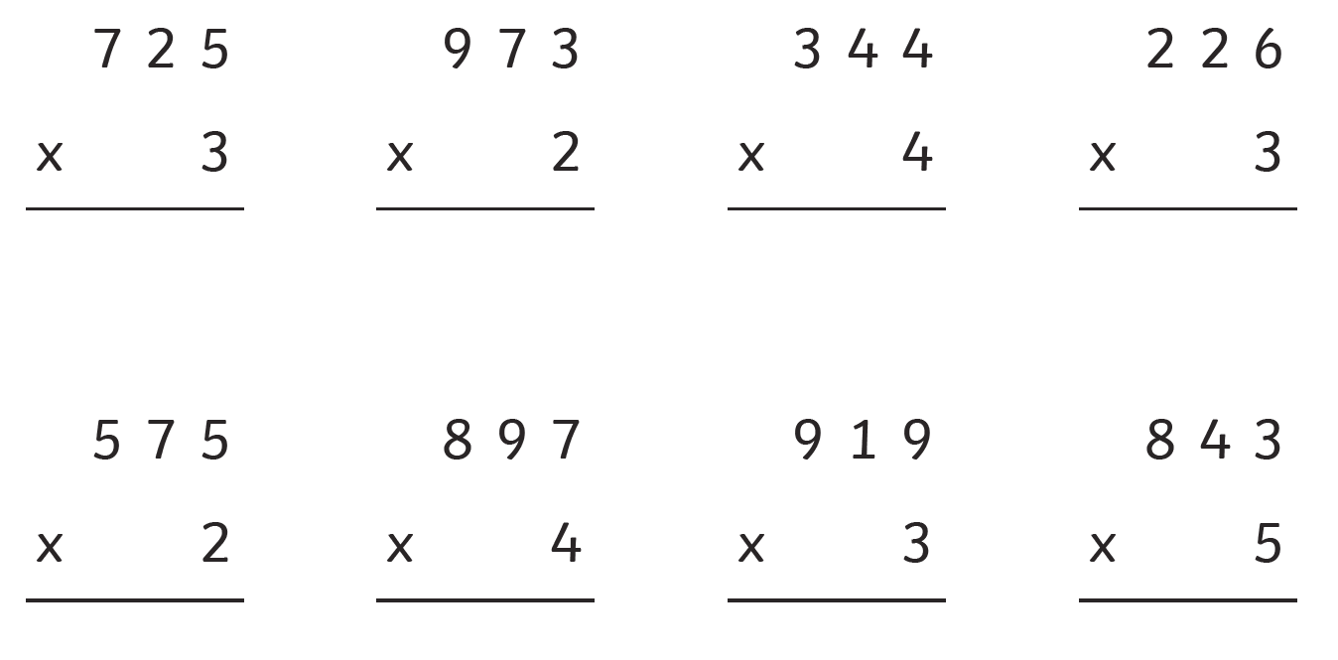
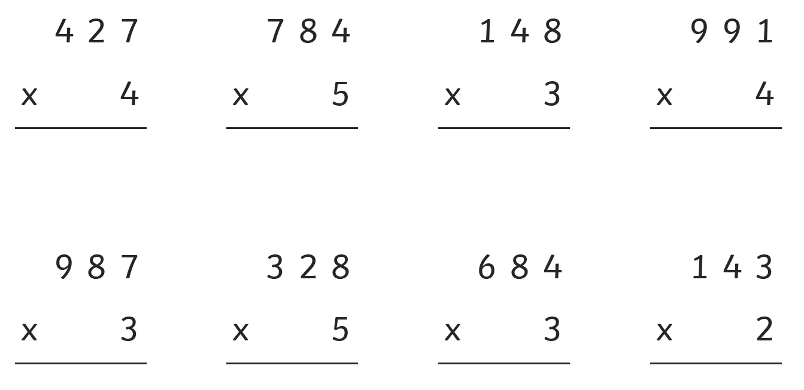
1 STAR TASK!

Slide 5
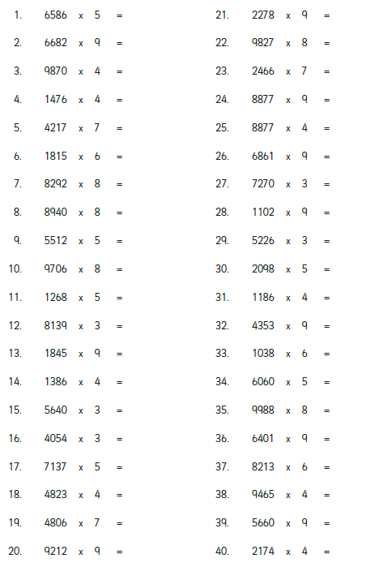
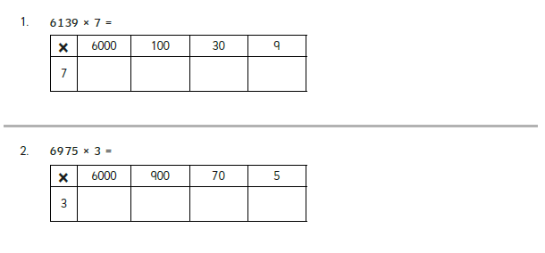
2/3 STAR TASK!
Please remember to set these multiplication
sums out using the short multiplication method.
Extension: Please complete the following grid
method multiplication sums.

Slide 6
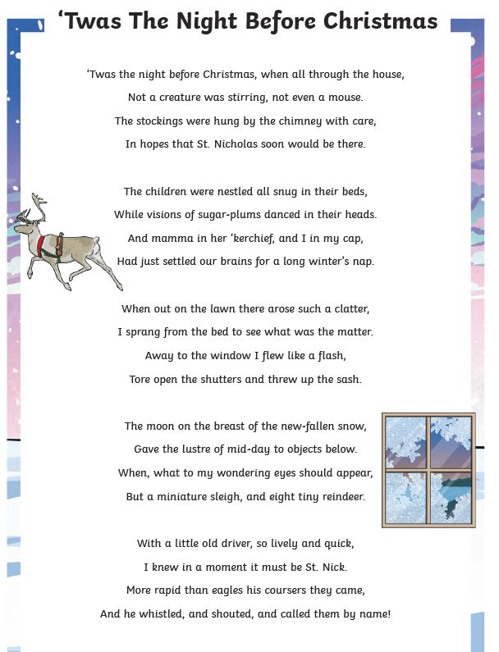
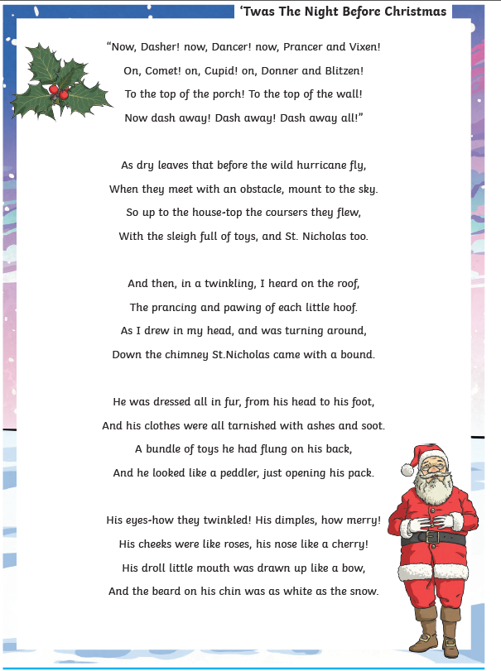
Reading: Every day the children will receive a piece of text to read and some reading comprehension questions. Please complete the following questions after reading the story.
Objective: To revise the story of ‘Twas The Night Before Christmas.’

Slide 7
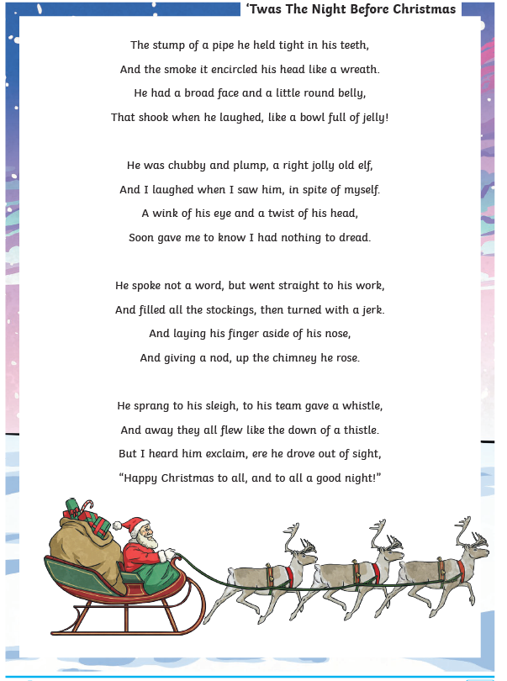
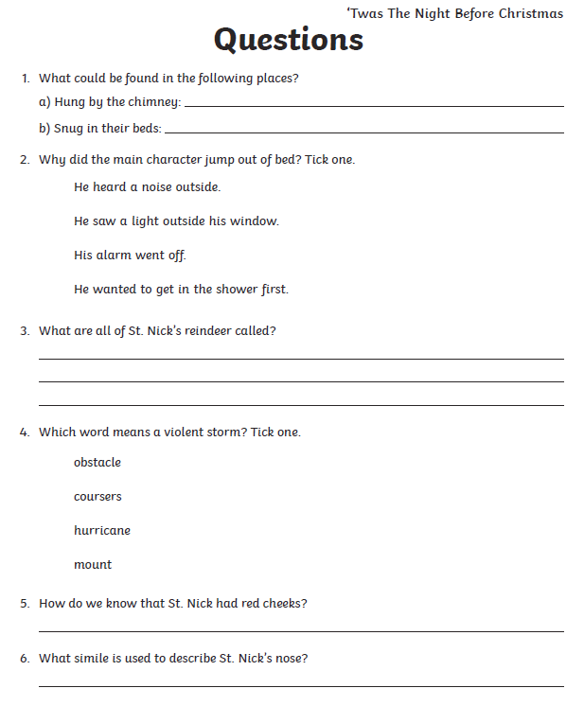
1 Star Questions

Slide 8
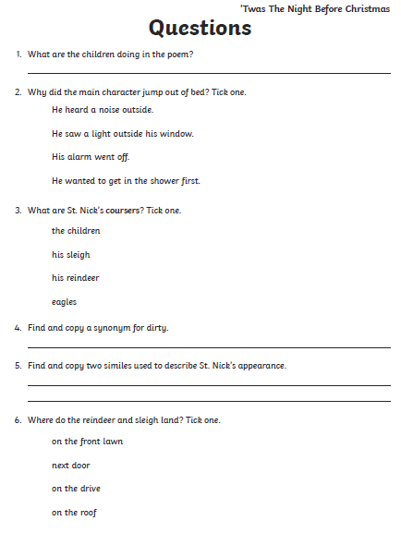
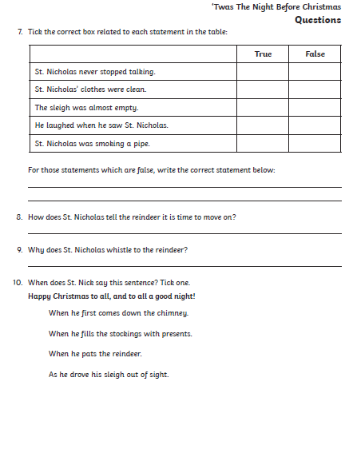
2*/3* Questions.

Slide 9
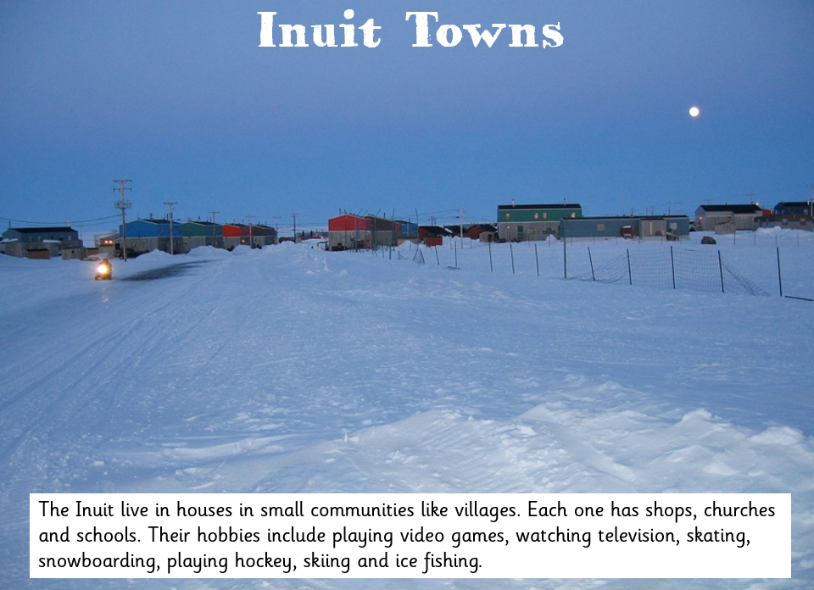
Other Subject: Geography
Objective: To write facts about Inuit settlers
This term we have been focusing on the Arctic and Antarctic climate and as part their geography topic, I would like the children to research facts about the Inuit settlers.
1* - Create a poster about the Inuit people and include at least four facts about them!
2* and 3* - Create a fact-file all about the Inuit settlers. Include at least a paragraph of facts and information about them.

Slide 11
