Slide 1
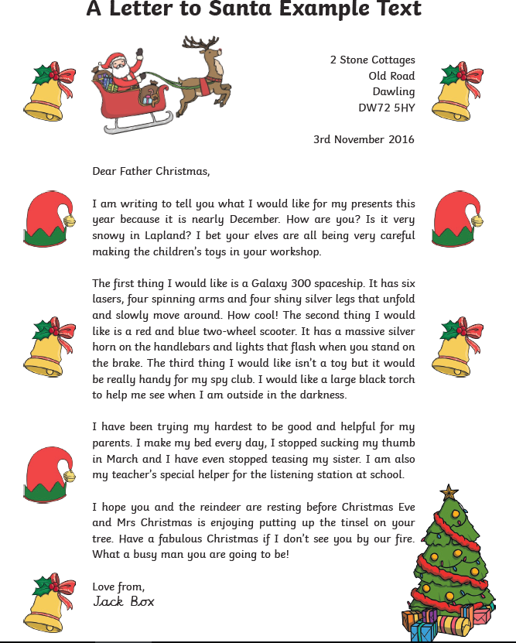
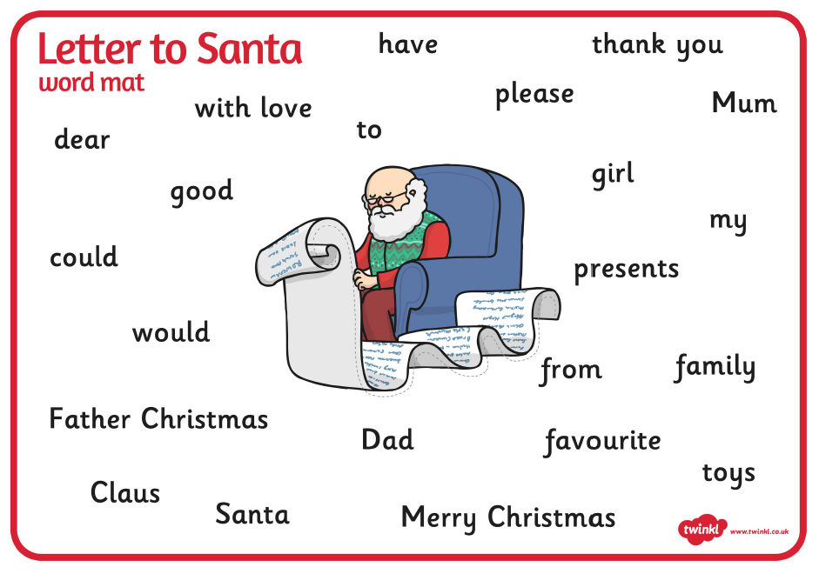
English: Following on from the letters the children have written focusing on the use of palm oil and its dangers, I would like the children to think about other types of persuasive letters they could write.
Objective: To write a persuasive letter to Santa.
Here is an example of a persuasive letter to Santa:
Think carefully about identifying and explaining why
you would like the gifts you have listed and how
could you persuade Santa to deliver them to you
on Christmas Eve.
.

Slide 2
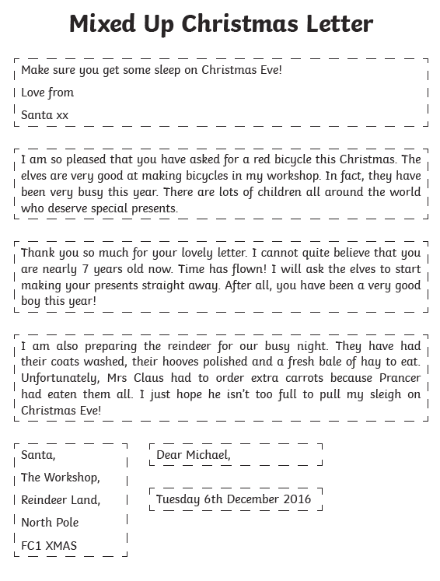
1 Star Task:
Read the Mixed Up Christmas letter and either print it out and cut it up and re-arrange it in the correct order or have a go at re-writing it in the correct order.
Extension Task:
Use this letter as a model to write your own Christmas letter.

Slide 3
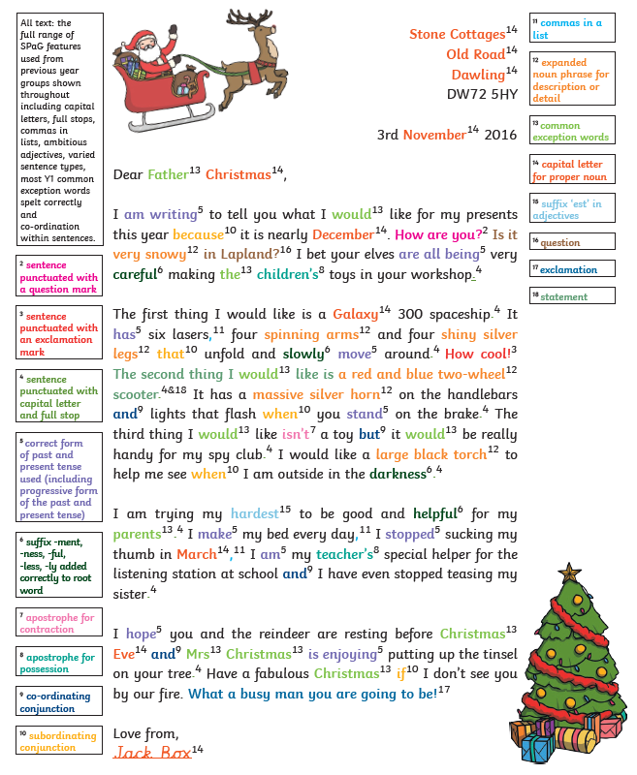
2*/3* Task:
Read Santa’s letter carefully and look at all of the colour coded sections which give you a good example of all of the accurate spelling, grammar and punctuation needed to write a letter to Santa.
Think about your use of persuasive language too.
Use the template on the following slide to help you write your letter and set it out.

Slide 4
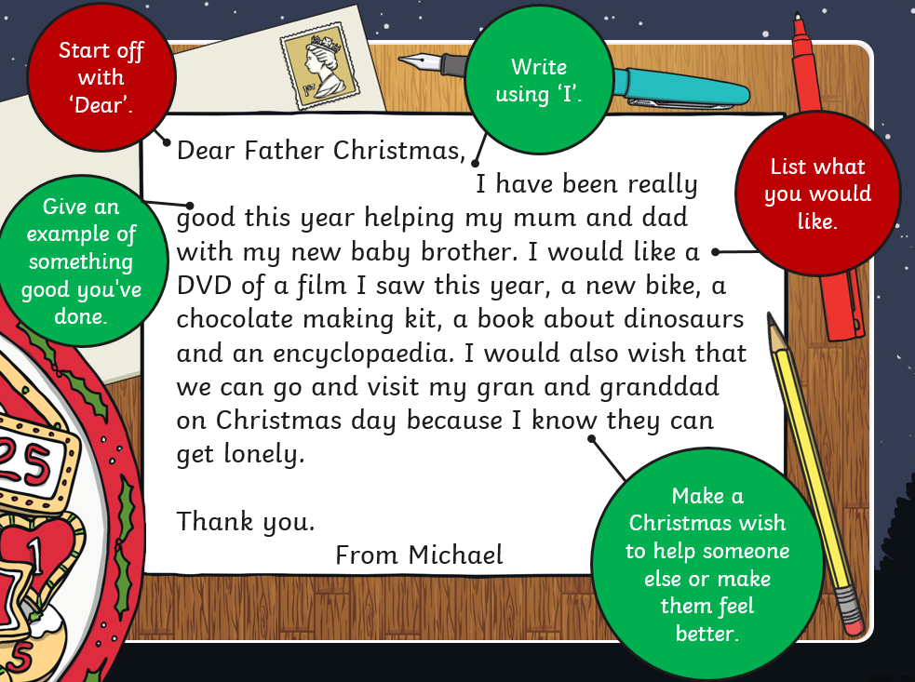
Enjoy using this paper to help you set out your letter to Santa and enjoy decorating it once you have completed it.

Slide 5
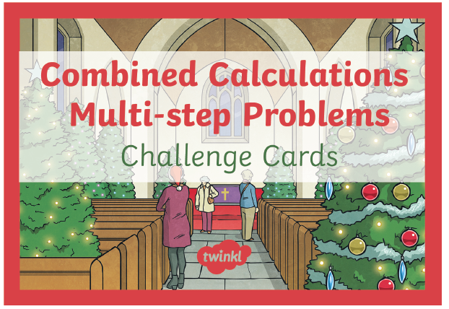
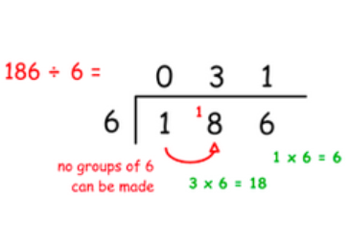
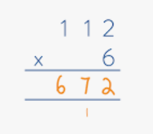
Maths:
Objective: To use your knowledge of the formal methods
of multiplying and dividing to solve word problems.
Use the RUCSAC method to help you solve your word problems
This week you have used the column
method of multiplication and the bus stop method for division to help you solve multiplication and division sums.
Use this knowledge you have learnt to help you solve your Christmas word problems today.
1* - See next slide for the Christmas division and multiplication word problems.
2*/3* - The children will be need to think carefully about using the column method to multiply or bus stop method to divide in order to help them solve their
word problems.

Slide 6
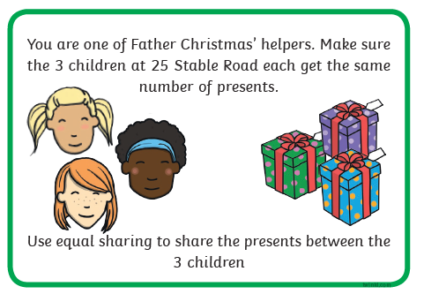
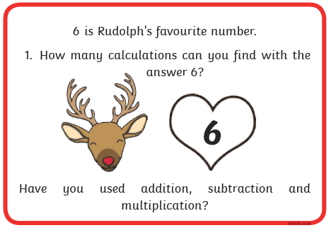
1* STAR TASK!
Using the RUCSAC method of:
Read, Understand, Choose, Solve, Answer and check,
Have a go at solving these word problems.
Remember to show your working out and use
The methods of multiplication and
Division that you have learnt to help you solve the problems.

Slide 7
2*/3* STAR TASK!
Using the RUCSAC method of:
Read, Understand, Choose, Solve, Answer and check,
Have a go at solving these word problems.
Remember to use the formal methods of
multiplication and division to help you solve
the problems.

Slide 8
2/3 STAR TASK!

Slide 9
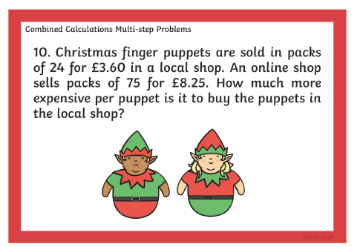
I hope you have enjoyed using the formal methods
and the RUCSAC method to help you solve the problems.

Slide 10
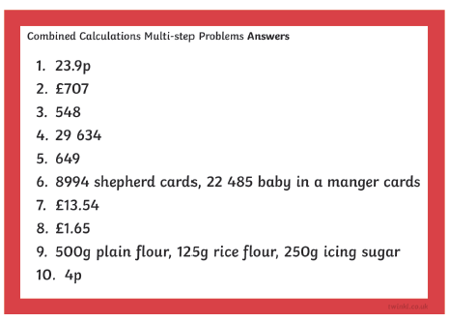
Here is the answer sheet for the 2*/3* so you can check your children’s answers. Please award
yourselves 10 House Points for every word problem they have got right as these questions were
really tricky.
☺ Well done 4NJ!

Slide 11
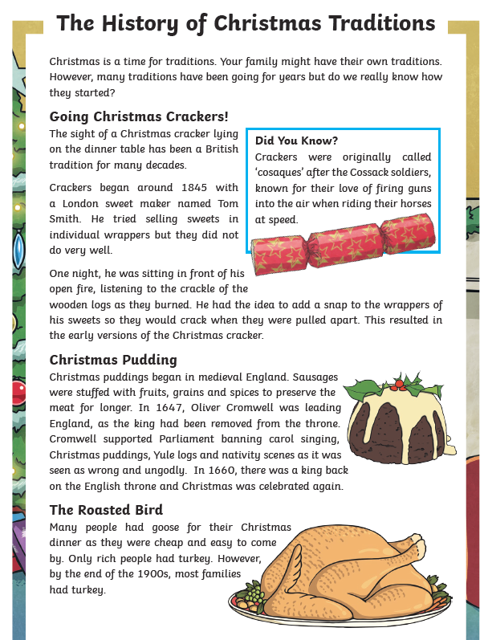
Reading Task:
1* Task: Read the information focusing on Christmas traditions and answer the following questions.
Please answer the following questions on the next slide.

Slide 12
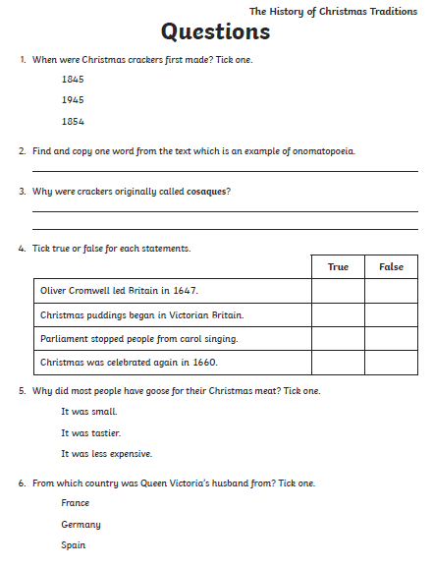

Slide 13
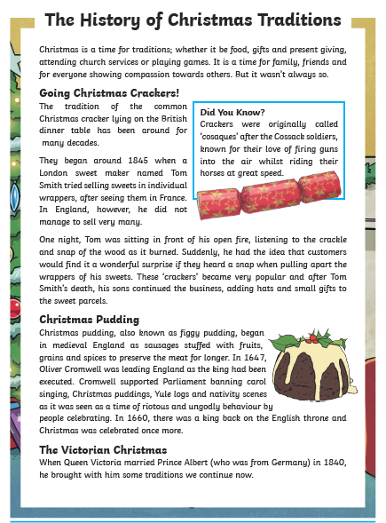
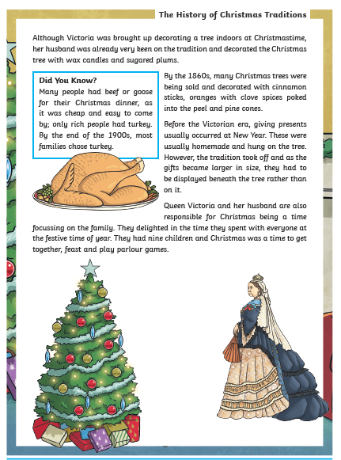
Reading Task:
2*/3* Task: Read the information focusing on Christmas traditions and answer the following questions

Slide 14
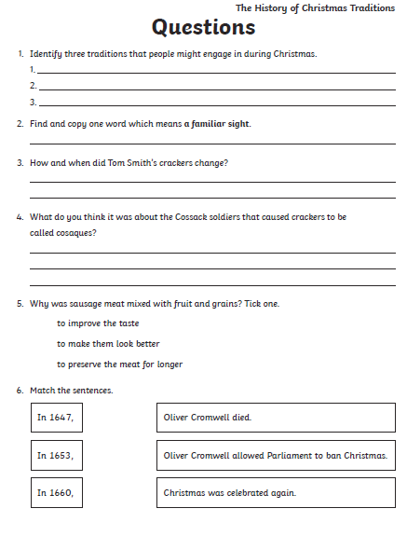
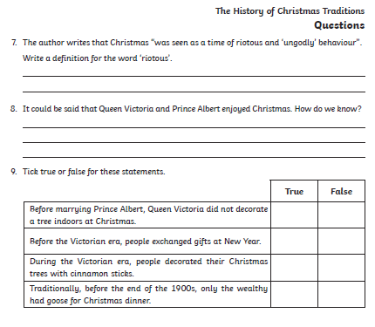

Slide 15
Your Topic task this afternoon will focus on the varying types of weather that occur within the
Tropics and the UK.

Slide 16
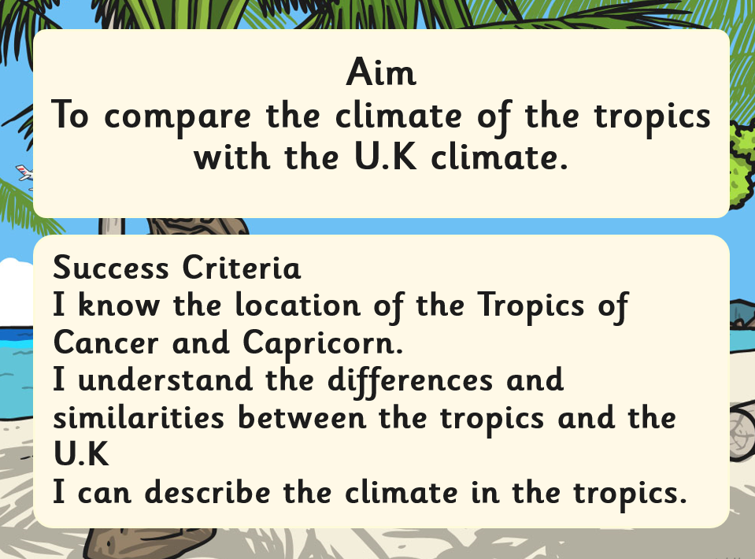

Slide 18
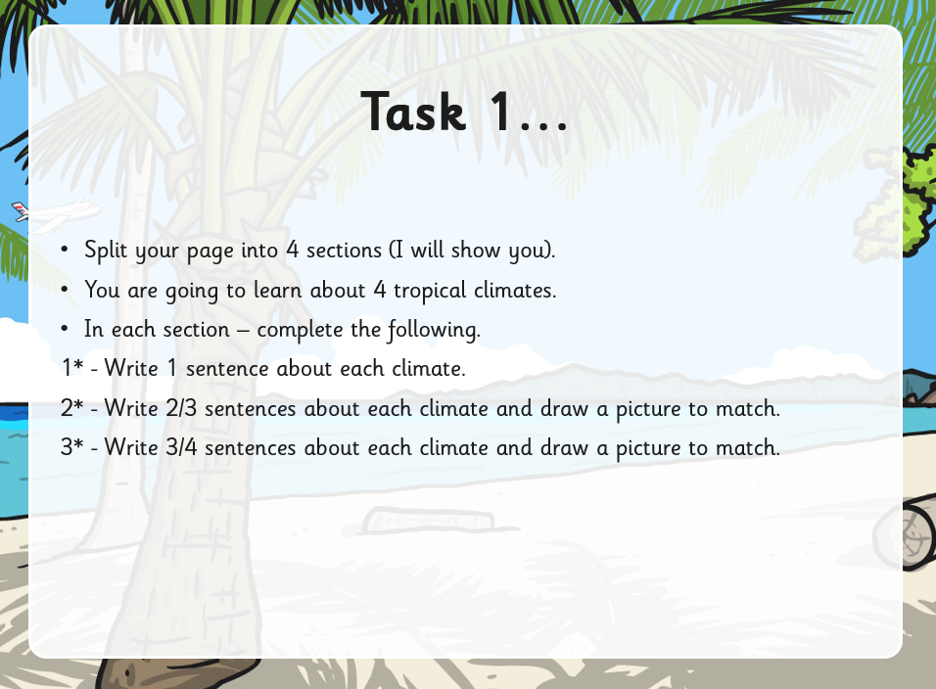

Slide 24
