Slide 1
English: Following on from the work the children carried out yesterday focusing on the use of palm oil in everyday products we purchase, I would like the children to form a persuasive letter plan.
Objective: To plan a persuasive letter.
Palm Oil Video
The children will plan a persuasive letter to the owner of Waitrose.
Each point the children make will be the start of a new paragraph, so remember to add supporting ideas.
Use the Internet to research the disadvantages to the use of palm oil in products.

Slide 2
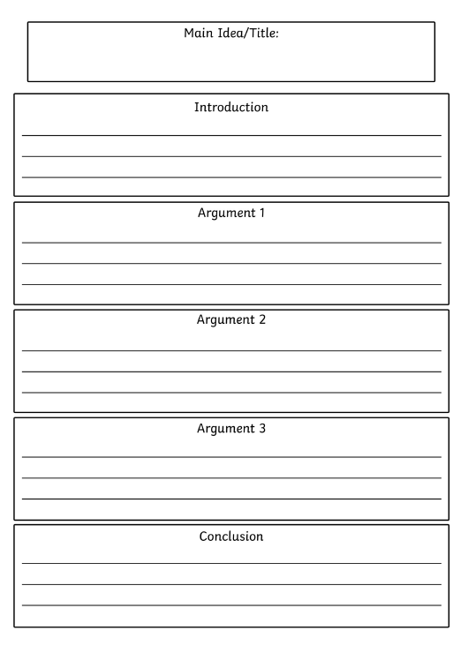
1 Star Task:
Use this template to plan your persuasive letter focusing on
the dangers of using palm oil.
Remember to use the Internet to research some of the dangers of excessive use of palm oil and think about how forests are destroyed which endanger animals such as Orang-utan's.

Slide 3
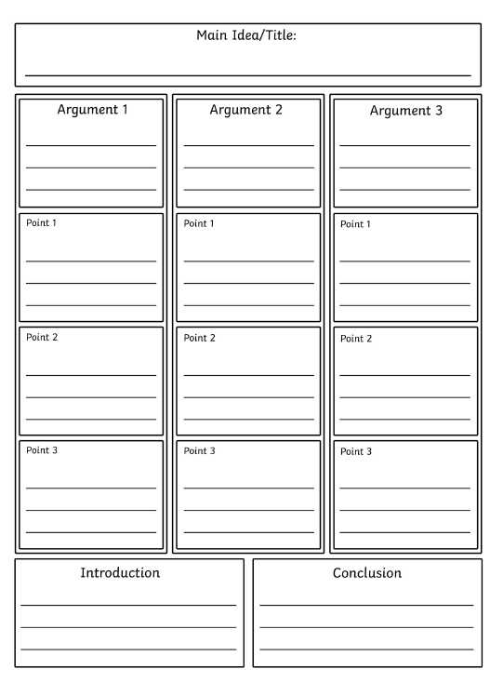
2*/3* Task:
Use the Internet to research
the dangers of using palm
oil and remember that each
argument box you complete
will be a new paragraph that
you will form when
writing your letter up
in our next lesson.

Slide 5
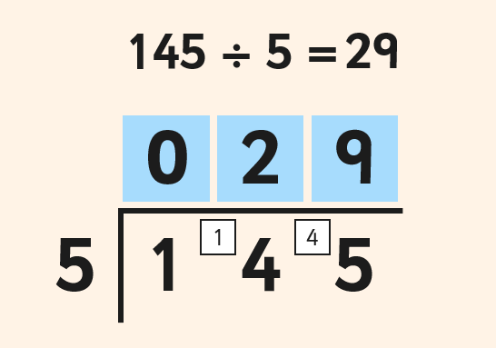
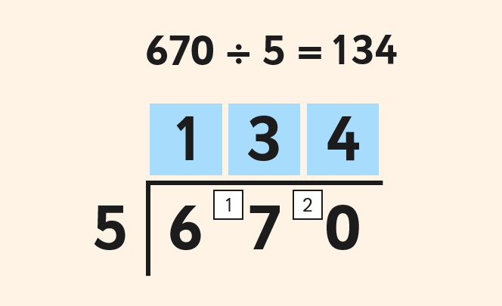
Maths:
Objective: To divide numbers by a single digit using
the short division method.
Using short division to divide numbers using a single digit!
Write down each number clearly (one digit per square.)
Using a ruler, draw a line on the left hand side and across the top of your number. Make sure you separate the number from the number you are dividing by.
1* - See next slide for the division sums. You will be dividing a 2-digit number by a 1-digit number.
2*/3* - The children will be using the Bus Stop method to divide 2 and 3-digit numbers.
Extension Task: Solve the word problem on the last slide.

Slide 6
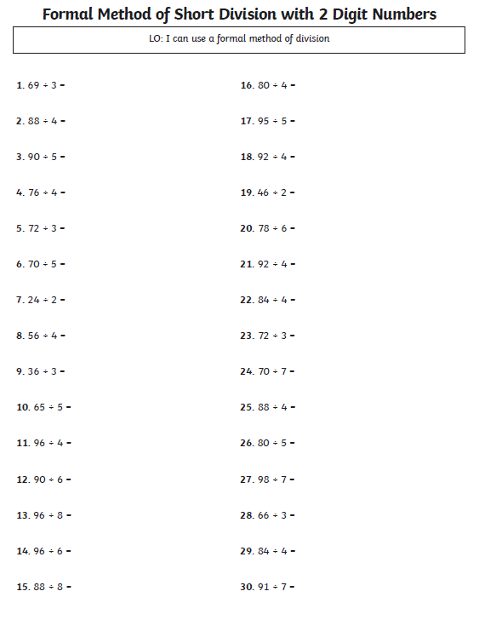
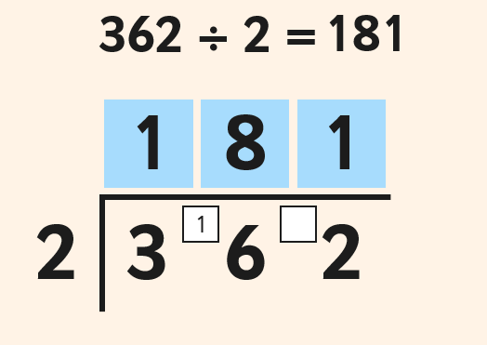
1 STAR TASK!
Using the above example, set out
each of the division sums using
the bus stop method.

Slide 7
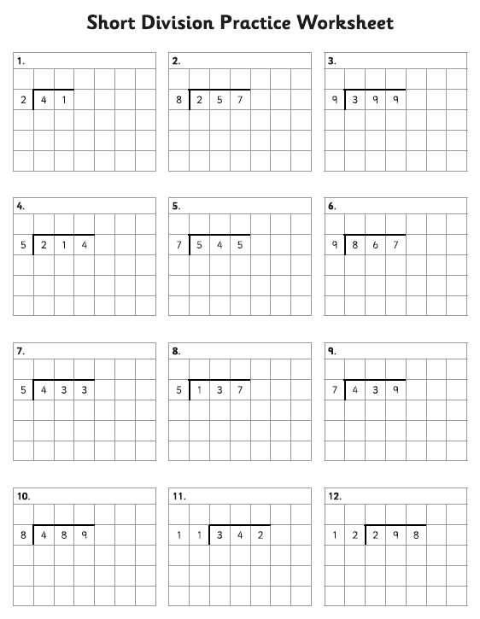
2/3 STAR TASK!
Please remember to set these division sums
out just like you see in the examples on the
sheet using the bus stop method.
Extension Task: Complete this division word
Problem.

Slide 8
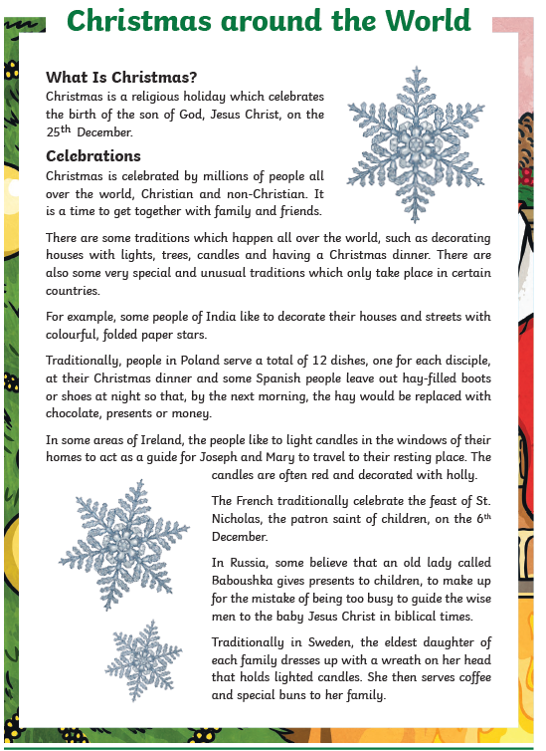
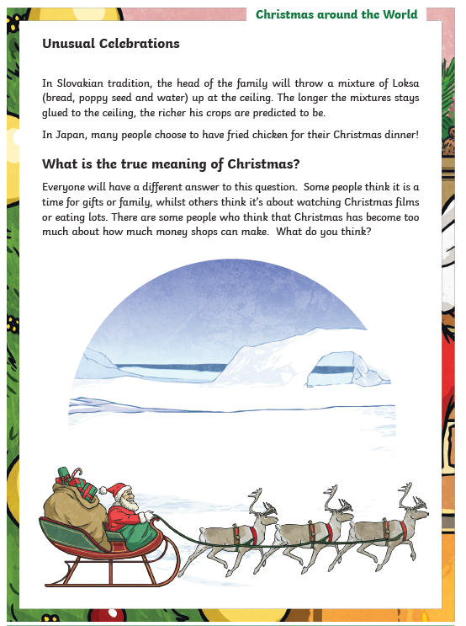
Reading: Every day the children will receive a piece of text to read and some reading comprehension questions. Please complete the following questions after reading the text.
Objective: To learn how Christmas is celebrated all over the world. This is the 1 Star Text:

Slide 9
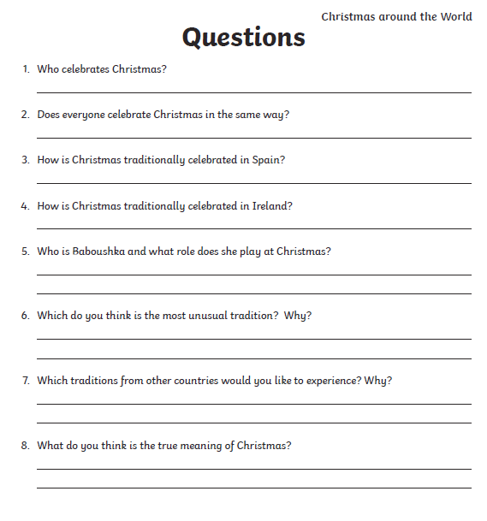
1 Star Questions

Slide 10
2*/3* Text and Questions.

Slide 11
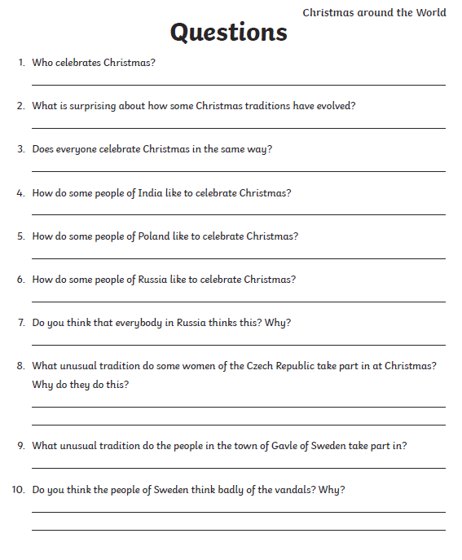
2*/3* Questions:

Slide 12
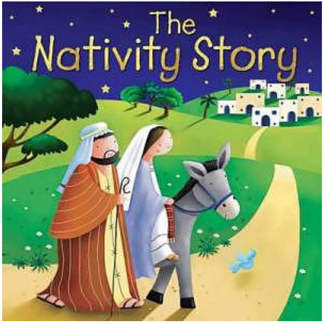
Other Subject: Beliefs and Values
Objective: To learn the Christmas Story of the birth of Jesus and sequence events.
This half term, we have been learning about what Christmas means to Christians.
Use the Internet to research the story of Christmas.
1*: Use the pictures and cut and stick them in the correct
order on the sheet with the boxes.
Colour in the pictures and write a short sentence to
describe what is happening in each picture.
2*/3*: Cut and stick the pictures into the correct
boxes and write your own version of the Christmas story.

