Slide 1
English: Following on from the work the children carried out yesterday focusing on the use of palm oil in everyday products we purchase, I would like the children to write a persuasive letter today.
Objective: To write a persuasive letter.
Palm Oil Video
The children will write a persuasive letter to the owner of Waitrose. Please try and include some of these features.
.

Slide 2
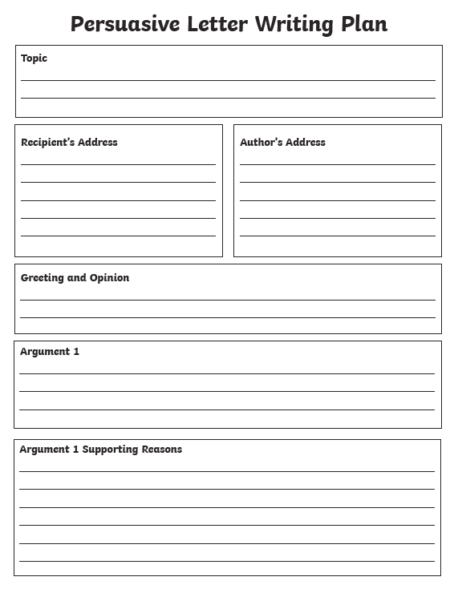
1/2/3 Star Task:
Use this template if you wish to do so to write your persuasive letter focusing on
the dangers of using palm oil.
Remember to use the Internet to research some of the dangers of excessive use of palm oil and think about how forests are destroyed which endanger animals such as Orang-utan's.
Think about important facts to place into your letter to persuade the owner of Waitrose not to buy or sell any products that contain palm oil in his stores.

Slide 3
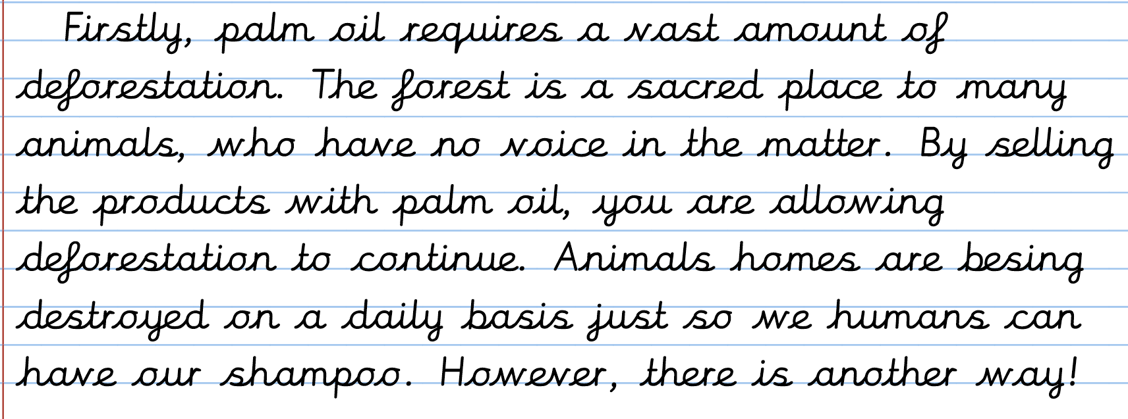
Children please
Use this WAGOLL
‘What a good
one looks like.’ To
help you write your
own persuasive
letter to the owner
of Waitrose.
Think about how
Many facts you can
Include. What are
your personal
opinions and how
could you close
your letter?

Slide 4
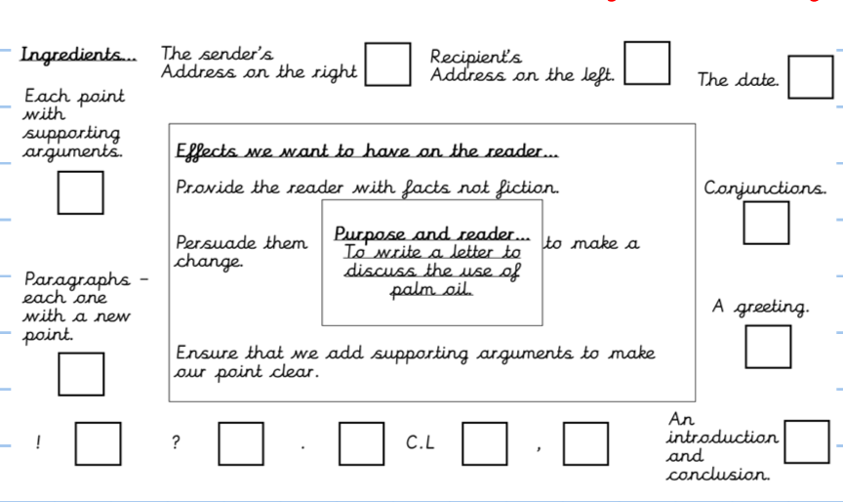
Plenary:
List all of the features of the success criteria you were able to include in your letter:

Slide 5
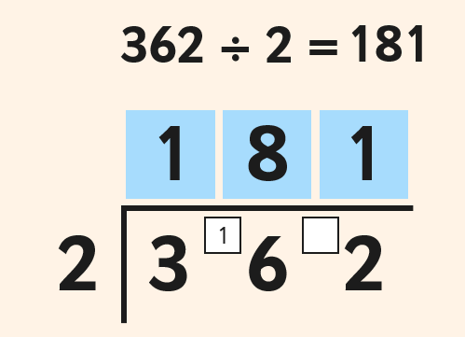
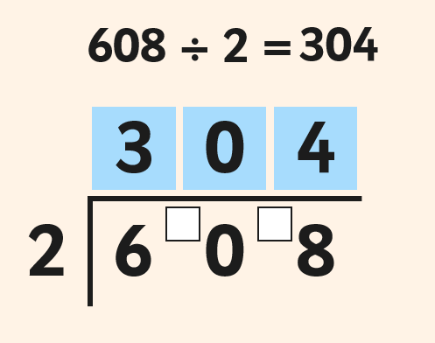
Maths:
Objective: To divide numbers by a single digit using
the short division method.
Using short division to divide numbers using a single digit!
Write down each number clearly (one digit per square.)
Using a ruler, draw a line on the left hand side and across the top of your number. Make sure you separate the number from the number you are dividing by.
1* - See next slide for the division sums. You will be dividing a 3-digit number by a 1-digit number.
2*/3* - The children will be using the Bus Stop method to divide 4-digit numbers.
Extension Task: Solve the word problem on the last slide.

Slide 6
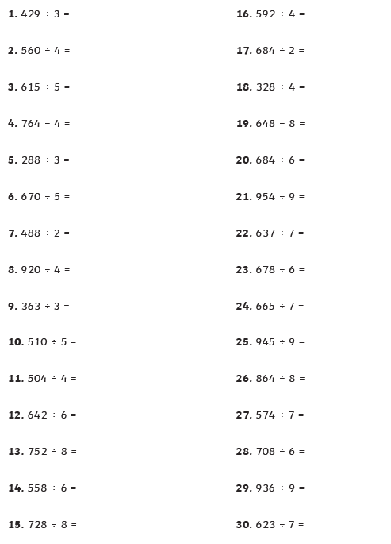
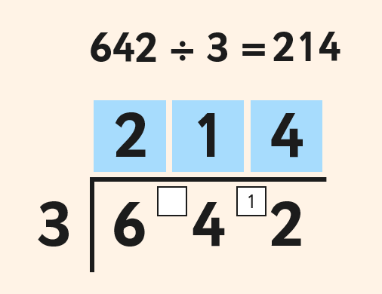
1 STAR TASK!
Using the above example, set out
each of the division sums using
the bus stop method.

Slide 7
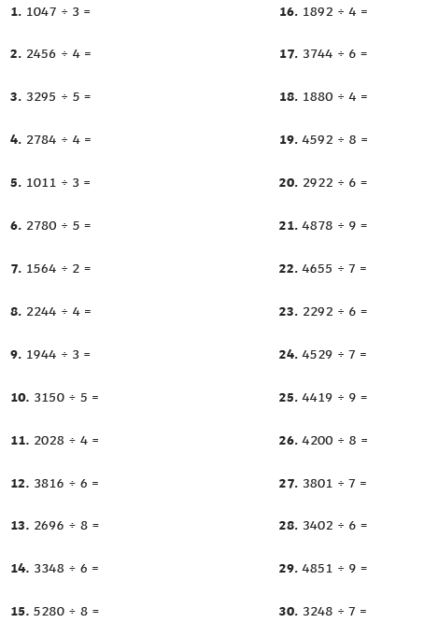
2/3 STAR TASK!
Please remember to set these division sums
out just like you see in the previous slides using the bus stop method.
Extension Task: Complete this division word
Problem.

Slide 8
Children as a treat today, no reading tasks or
topic activities have been set for you as you will
be able to watch NJS’s Christmas Pantomime
Production. Mrs Moody has sent a parent mail to
all of your parents with the logging on details
for our pantomime. I hope you enjoy watching
It this afternoon. There is also an activity pack
So feel free to select and choose an activity
To do while you are watching. The bingo one
looks brilliant. Enjoy ☺

