Slide 1
Happy Thursday 4J!

Slide 2
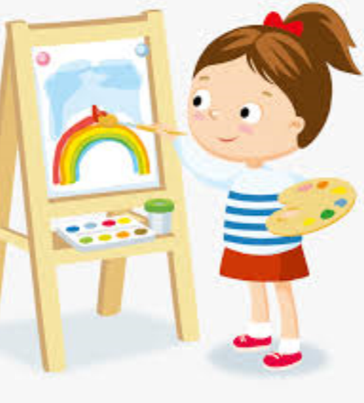
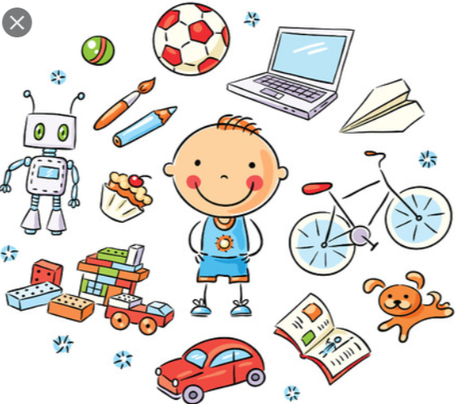
We have had a great week so far! What has been your favourite activity to have done this week?

Slide 3
Today…
English – To compare Viking Gods Loki and Thor.
Maths – To draw and measure lines of angles accurately and compare angle sizes.
Reading – To use noun phrases to describe an image.
Other – Science: To recognise differences with solids, liquids and gases.

Slide 4
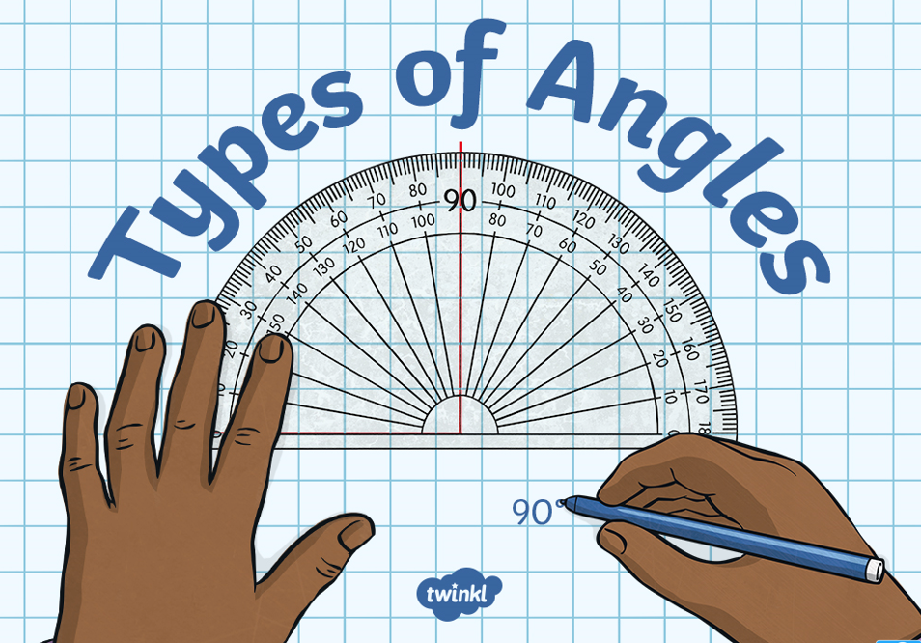
All week we have been learning about the different types of angles.
What are the names of the angles we have learnt so far?

Slide 5
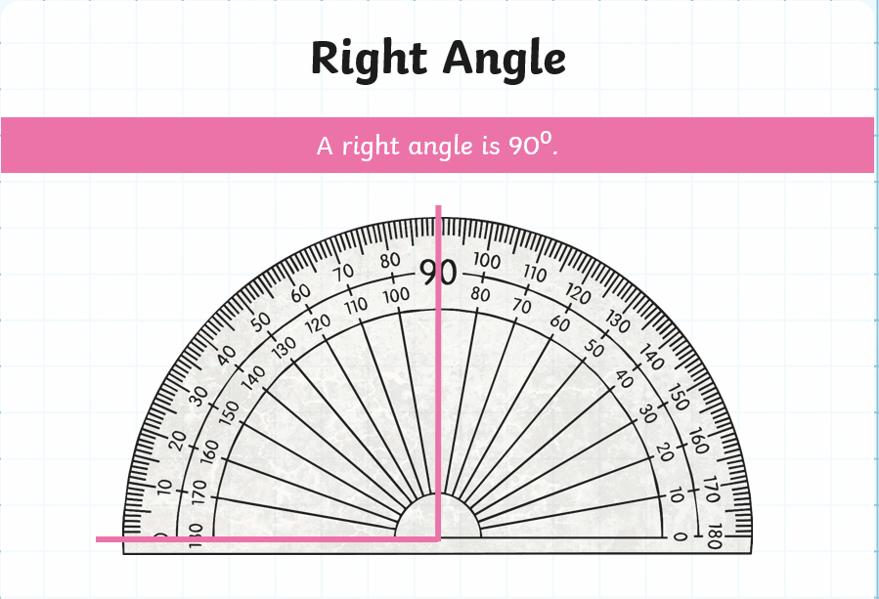

Slide 6
How is
an acute
angle different
from a
right angle?

Slide 7
Do you think an
obtuse angle is the
biggest angle
that exists?

Slide 9
Now we have re-capped
On what all of the main
Angles are, which oneis the
Smallest angle?
Which is the biggest
Angle?

Slide 10
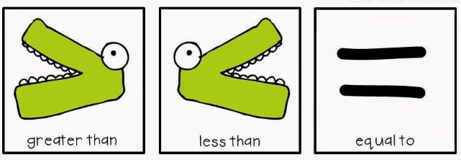
Today you will be learning how to compare angle sizes using the more than and less than symbols:

Slide 11
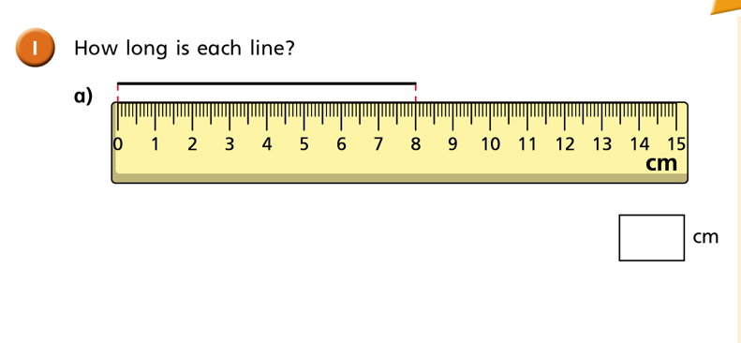
You will also be learning how to use a ruler accurately to measure lines in centimetres and millimetres.

Slide 12
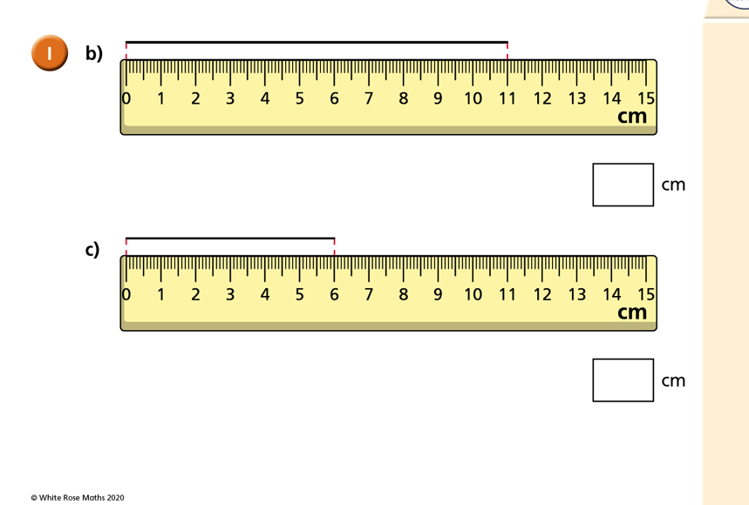

Slide 13
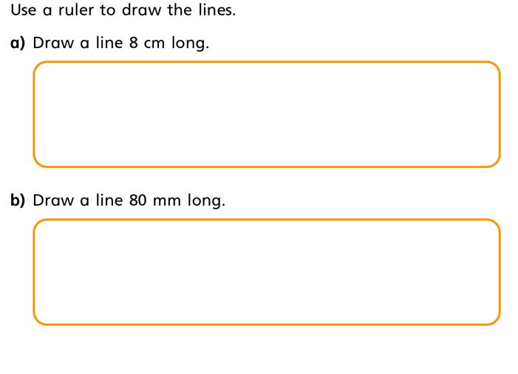
Take your ruler, pencil and paper now and have a go at this task:
Once you have
drawn the two
lines, what
do you notice
about them?

Slide 14
Your tasks in Numeracy today are:

Slide 15
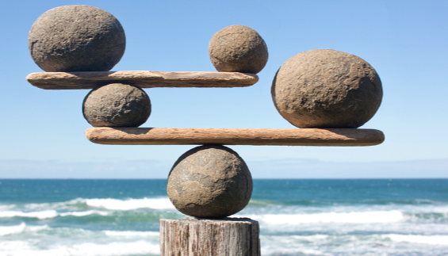
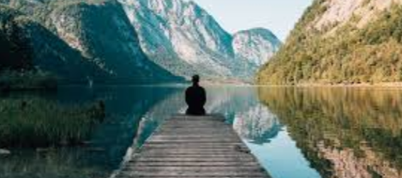
Well done 4NJ!
Before we finish we will end with some Mindfulness.

Slide 16
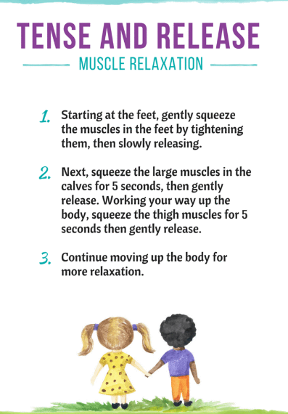
Thortful Thursday …
Sometimes when we are busy working hard
With our school work it can be tricky to concentrate for long periods of time.
Today, if you have found it hard to sit in a position for a long time whilst studying try this tense and release muscle relaxation activity.
Take time for yourself and remember to be kind to yourself and think about what makes you happy and calm.
Have a fabulous Thursday everyone. ☺

