Slide 1
Remote Learning Plan!
Hello Year 4!
During the next few weeks, we will be providing the children with remote learning on a daily basis. The work will be available on the website the day before e.g. Monday’s work will be online Sunday.
Everyday the remote learning will consist of:
English Lesson
Maths Lesson
Reading Lesson
One other curriculum lesson (PSHE, Art etc)
We will be available during the hours of 9am-4pm so please feel free to contact us on our new e-mail njs.year4@taw.org.uk
Some of the work provided will be split into the star levels that the children use everyday in class (1,2 3).
Stay safe everyone!
Miss Jones, Mrs Jukes, Mrs Kuczynska and Mrs Sisson.

Slide 2
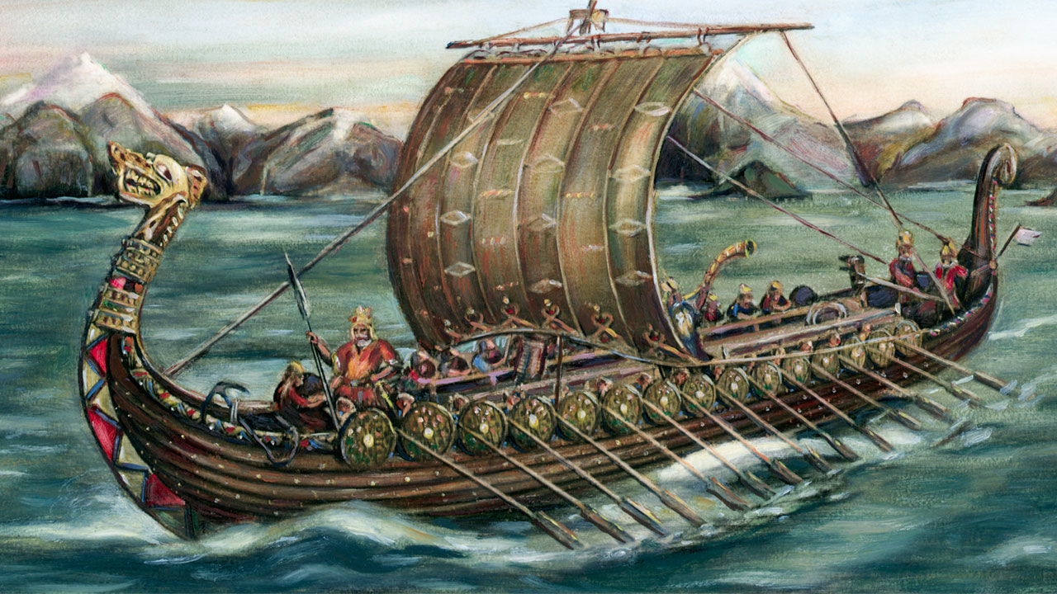
English:
Objective: To write creatively using an idea or stimulus.
FREE WRITE FRIDAY!
Use the image to create your own piece of writing.
This picture shows a group of Vikings on a quest or journey. You could:
Write a diary entry about your days at sea. What do you see? How do you feel? Where are you going?
Draw a comic strip and explain what is happening in the story.
Write a poem about being a Viking or being a sea.
Imagine you are a stowaway on the boat and someone finds you.
Write about your arrival at your destination. What happens once you arrive?
Be as creative as you can!

Slide 3
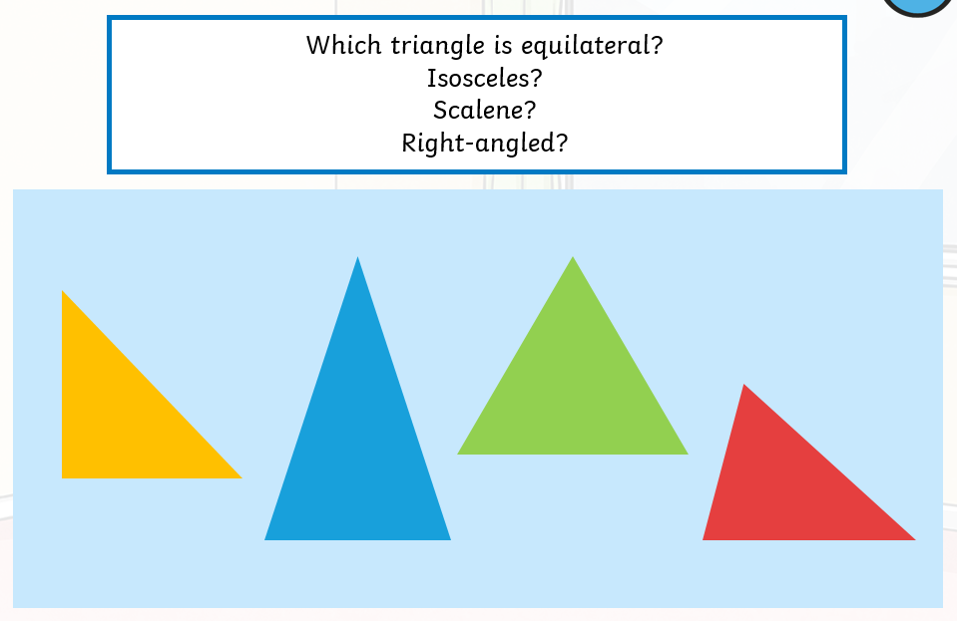
Maths:
Objective: To identify the names of various triangles.
Types of Triangles
Today you will be learning all about various triangles and their different names:
Equilateral,
Isosceles,
Scalene and Right-angled triangles.
Click on the link above to learn about what different
triangles exist.
1* - Have a look at each type of triangle. Write the name of the various types of triangles and then shade them in using different colours; one colour for equilateral, a colour for isosceles, scalene and right-angled.
2*/3* - Today you will be focusing on triangles and polygons. Try and name the triangles and solve the problems focusing on triangles.
Extension: Complete the True or False statement exploring equilateral triangles.

Slide 4
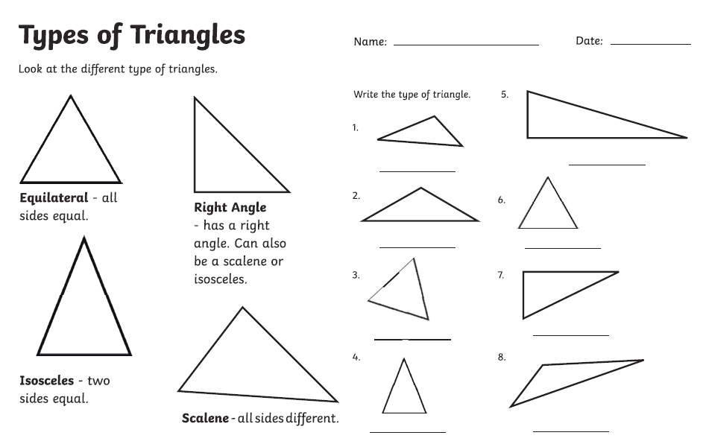
1 STAR TASK!

Slide 5
2/3 STAR TASK!

Slide 7
Extension Task!
Please explore this statement by drawing this
accurately on squared paper. Make sure
each of your triangles have equal sides and then
measure the whole triangle to check it is an equilateral triangle. .

Slide 8
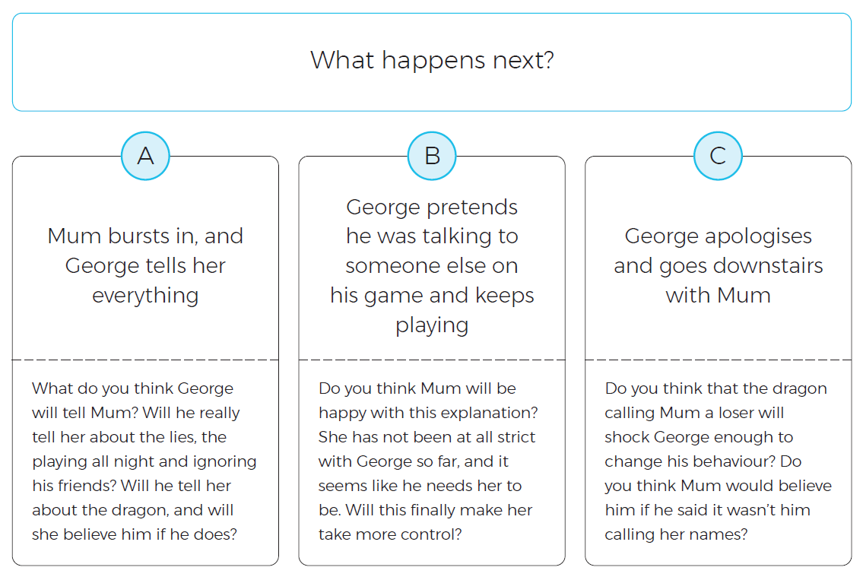
Reading:
Objective: To write a prediction based on what we have read so far.
At the end of the chapter, Pepperoni the dragon starts to cause trouble for George.
1* Task…
Which option do you think will happen next?
Use the questions under each option to support your ideas.
2/3* Task…
Which option do you think will happen next? Use the questions under each option to form your response. Try to use the text to justify your ideas.
Write a paragraph explaining what you think George SHOULD have done.

Slide 9
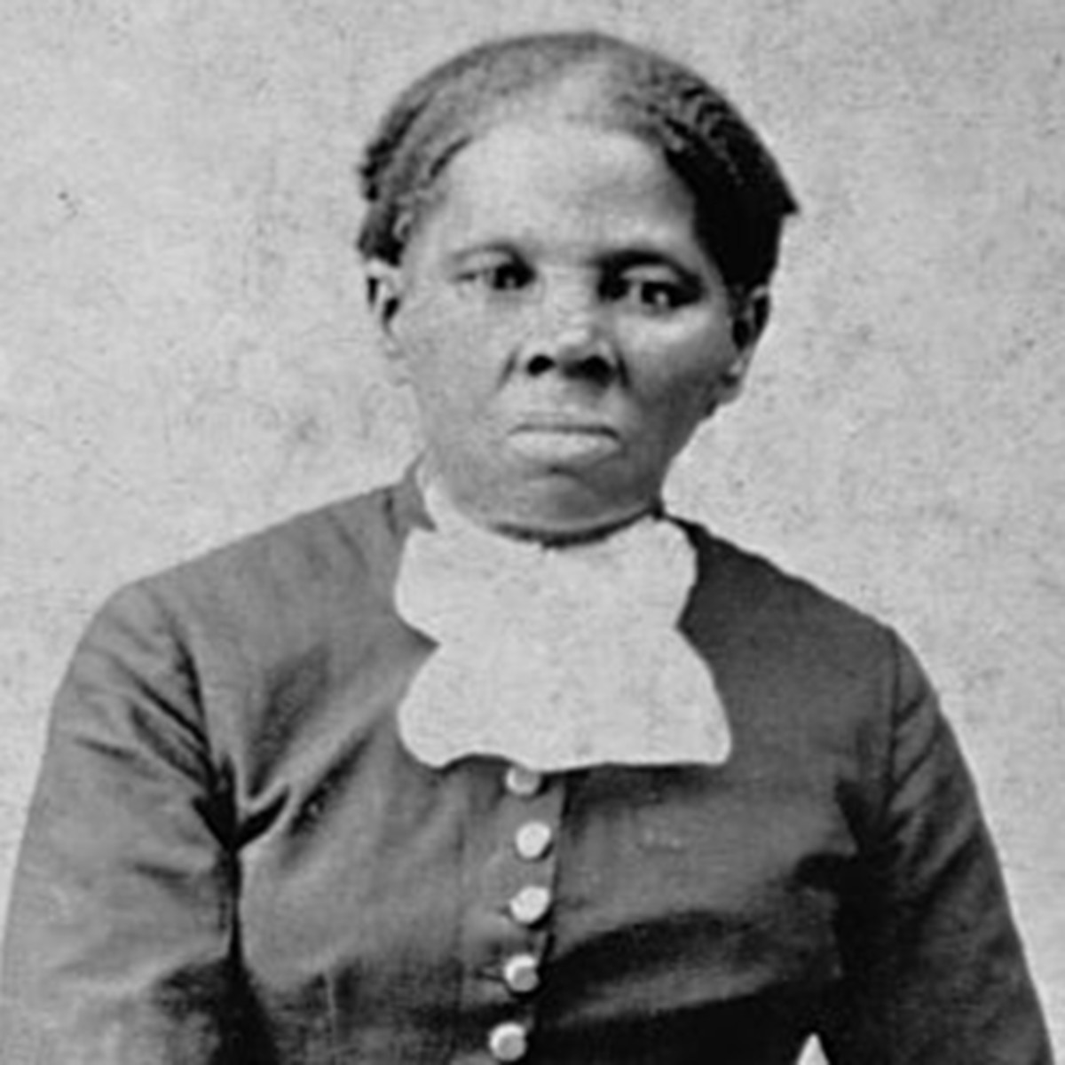
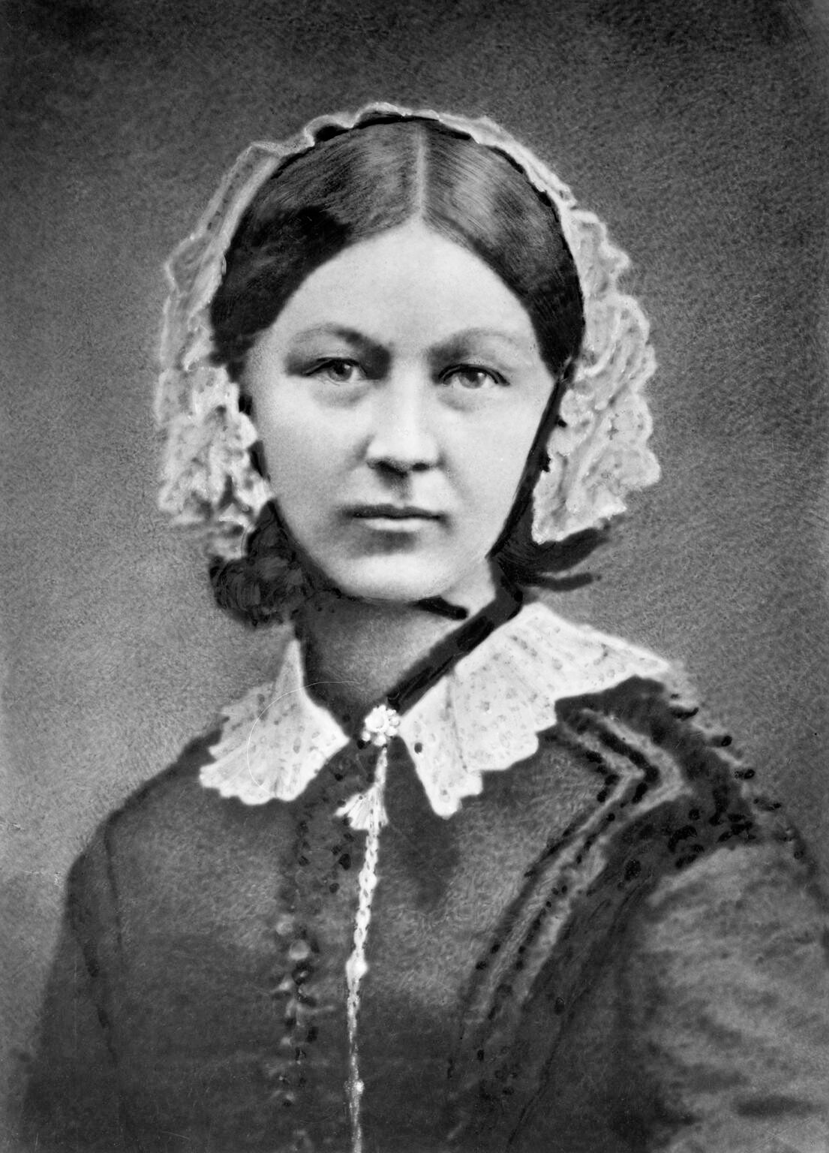
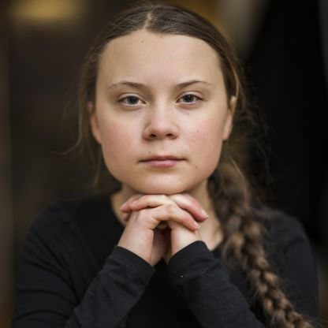
Other: PSHE and Mindfulness
Objective: To design a poster all about a courageous advocate.
Today we would like you to create a poster about your courageous advocate.
Using the facts you collected yesterday think about what facts you would like to use and how you want to present your information.
You could do a power point, make a poster using word,
draw a poster or present it in a different way!
Make your poster colourful and eye catching and make it so it encourages people to want to read it.
Please could you forward your poster onto us when you have completed it so that we can display some on the website.
We hope you have enjoyed your learning about hopes, dreams, goals and inspirational people and it has made you feel more positive.
4J – Harriet Tubman 4NJ – Florence Nightingale 4S – Greta Thunberg

