Slide 1
Remote Learning Plan!
Hello Year 4!
During the next few weeks, we will be providing the children with remote learning on a daily basis. The work will be available on the website the day before e.g. Monday’s work will be online Sunday.
Everyday the remote learning will consist of:
English Lesson
Maths Lesson
Reading Lesson
One other curriculum lesson (PSHE, Art etc)
We will be available during the hours of 9am-4pm so please feel free to contact us on our new e-mail njs.year4@taw.org.uk
Some of the work provided will be split into the star levels that the children use everyday in class (1,2 3).
Stay safe everyone!
Miss Jones, Mrs Jukes, Mrs Kuczynska and Mrs Sisson.

Slide 2
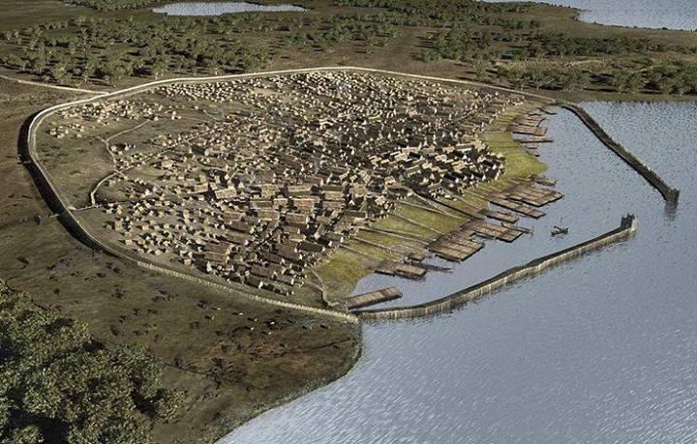
English:
Objective: To write creatively using an idea or stimulus.
FREE WRITE FRIDAY!
Use the image to create your own piece of writing.
This picture shows a group of Vikings Village surrounded by a wall. You could:
Find out about Viking Homes – Create a report about what you would find.
Write a story about growing up in a Viking Village.
Write a story about where the wall came from and why it is there.
Write a story to show the Village in danger! Who is coming? How will they defeat them?
Be as creative as you can!

Slide 3
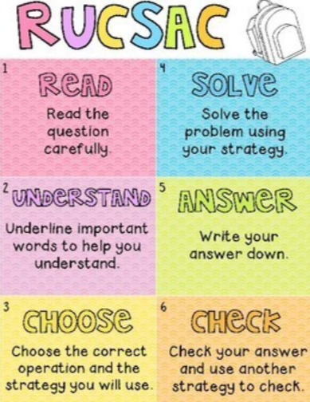
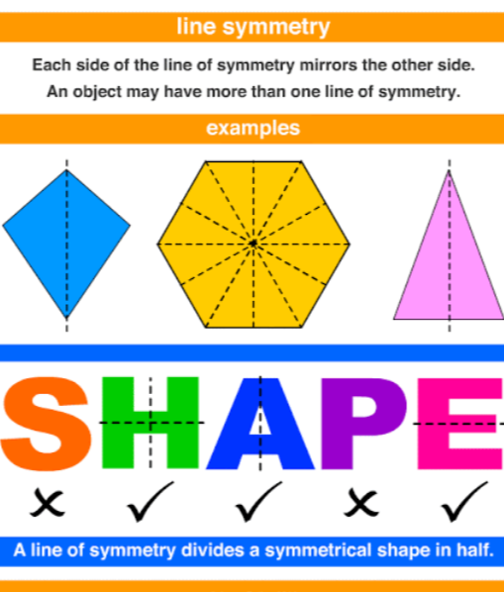
Maths:
Objective: To solve problems involving symmetry.
Lines of symmetry in shapes
Following on from the work we did yesterday, we will be continuing to solve problems using symmetrical patterns.
Click on the link above to learn about lines of symmetry in shapes. This will help you with your problem solving today.
1* - Today you will be solving problems focusing on symmetry within shapes. Use the RUCSAC method to read through and solve the problems.
2*/3* - Today you will be solving problems focusing on symmetry within shapes. Use the RUCSAC method to read through and solve the problems.
Extension: Focus on the lines of symmetry. Which lines of symmetry match which particular shape?
Please have a go at solving the problem.

Slide 4
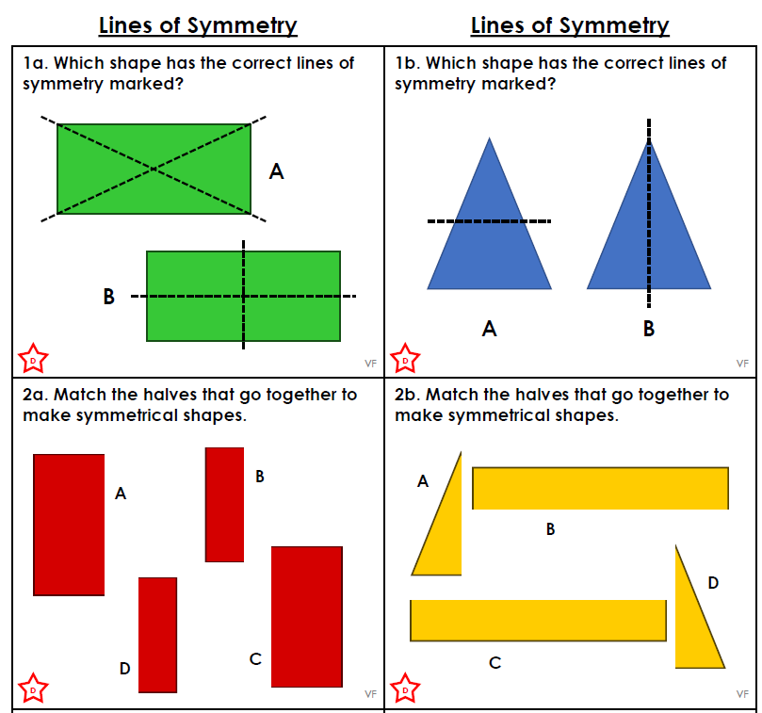
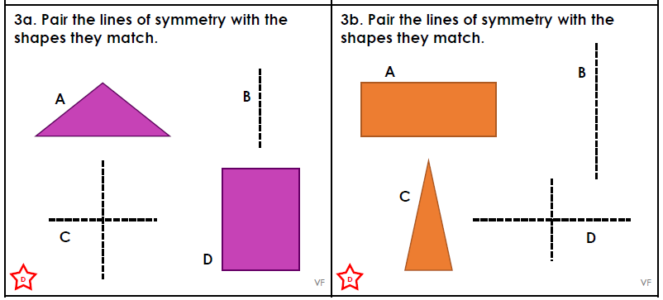
1 STAR TASK!

Slide 5
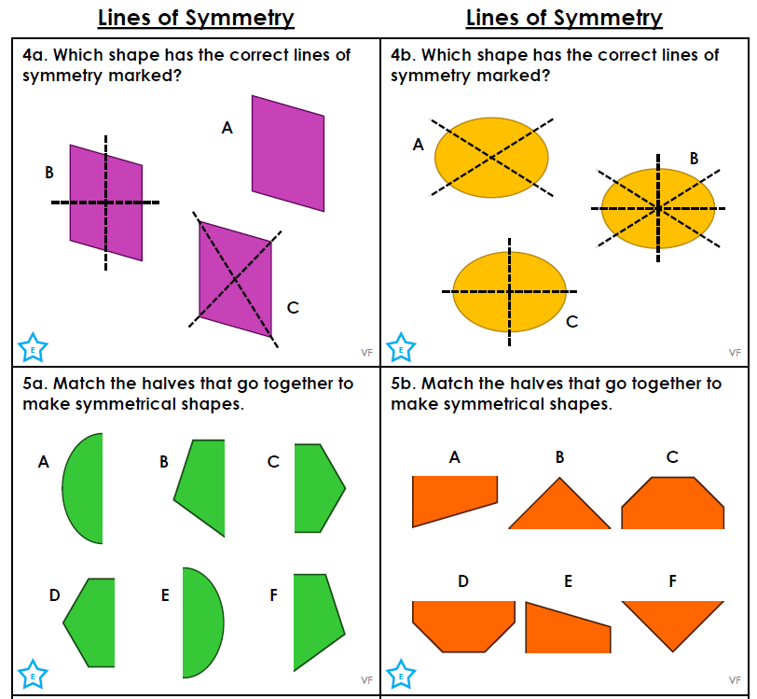
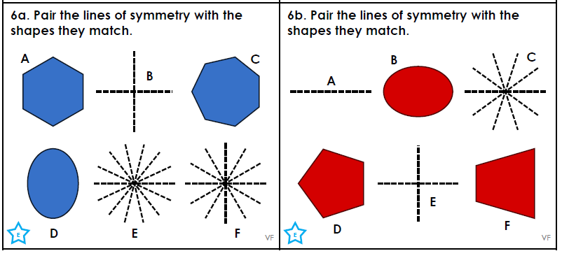
2 STAR TASK!

Slide 6
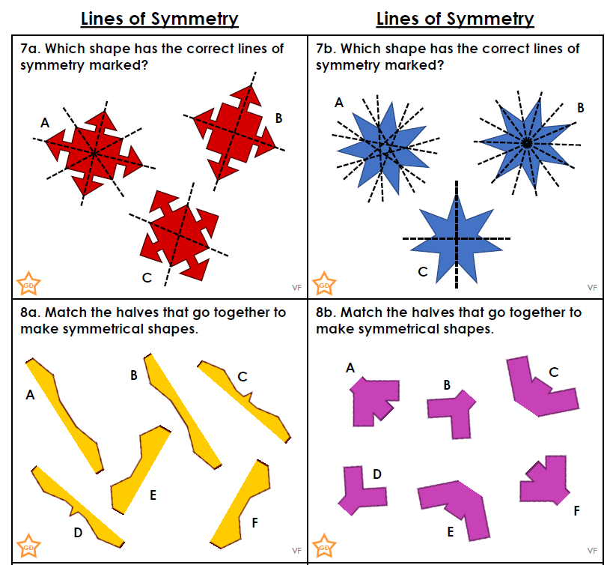
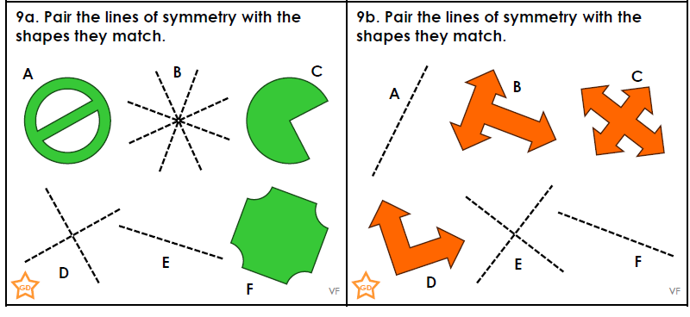
3 STAR TASK!

Slide 7
Extension Task!
Please explore this statement by focusing on which lines of symmetry match which shape?
Pair the letters together.

Slide 8
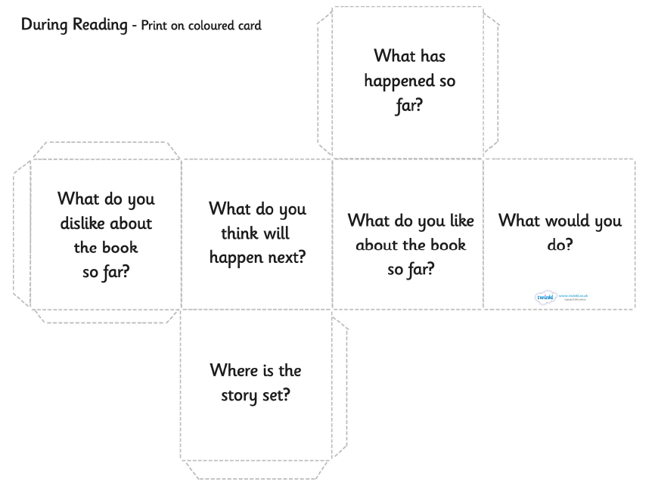
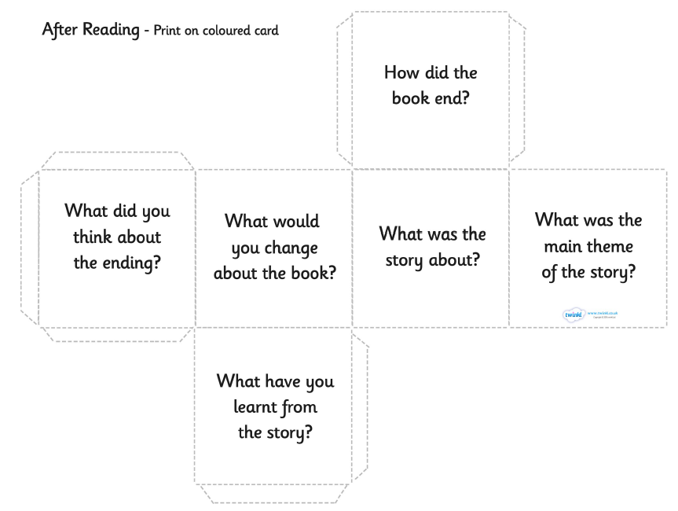
Reading:
Objective: To create a reading question dice.
When we have our guided reading sessions at school, we often ask you questions about what you are reading.
Have a look at these reading dice examples – they have questions you could ask someone about their book.
On the next slide is a blank cube for you to create your own set of questions.
You can use some of the examples and magpie the ideas.
When you next read your own book, roll the dice and answer the question you land on.
You might even want to use this on your parents/carers or siblings to see what they know about the book they are reading!

Slide 9
Use this blank net to make your reading cube!

Slide 10
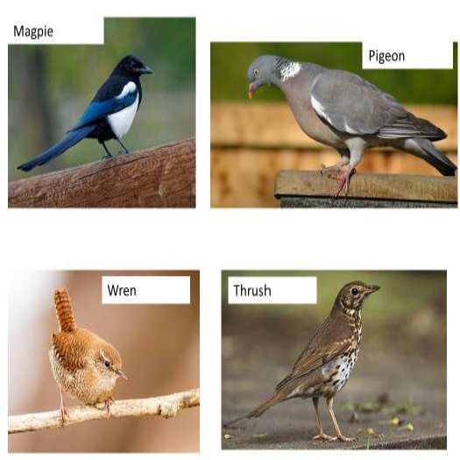
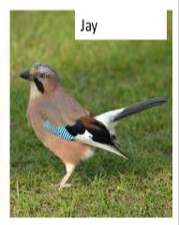
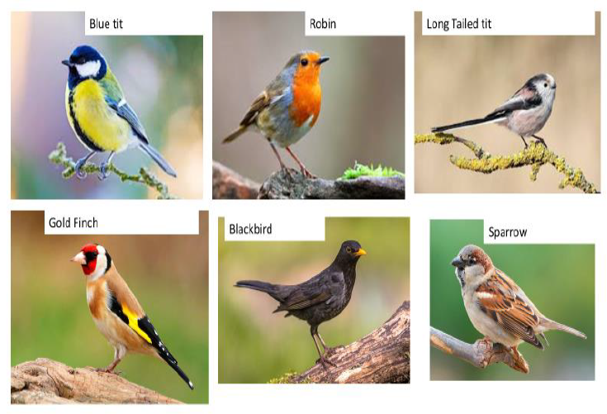
Other: The Big Bird Watch
Objective: To look for birds in the garden and understand the importance of ‘The Big Bird Watch’.
Either by looking out of your window or by going into your garden count the number of birds you see. Follow the link to see more from the RSPB
https://www.rspb.org.uk/get-involved/activities/birdwatch/
You must remember that you can only record the largest number of one type of bird that you see.
For example – If you see one robin and then ten minutes later you see two robins this would only count as two robins (not three!!)

Slide 12
Task… Choose between one of the tasks!
Task one… A poster about the dangers humans pose to birds.
OR
Task two… Create your own Simple Bird Feeder!

