Slide 1
Remote Learning Plan!
Hello Year 4!
During the next few weeks, we will be providing the children with remote learning on a daily basis. The work will be available on the website the day before e.g. Monday’s work will be online Sunday.
Everyday the remote learning will consist of:
English Lesson
Maths Lesson
Reading Lesson
One other curriculum lesson (PSHE, Art etc)
We will be available during the hours of 9am-4pm so please feel free to contact us on our new e-mail njs.year4@taw.org.uk
Some of the work provided will be split into the star levels that the children use everyday in class (1,2 3).
Stay safe everyone!
Miss Jones, Mrs Jukes, Mrs Kuczynska and Mrs Sisson.

Slide 2
English:
Objective: To write creatively using an idea or stimulus.
FREE WRITE FRIDAY!
Use the image to create your own piece of writing. You could:
Write a character description for the giants. Who are they?
Write a story about what happens between the giants and the man.
Pretend to be a passenger on the airships – where are they going? Where have you come from?
Tell the story from the giant’s point of view.
Describe a land where the giants and airships came from. Design it and then complete a setting description.
Write a diary as any character about what happened.
Be as creative as you can!

Slide 3
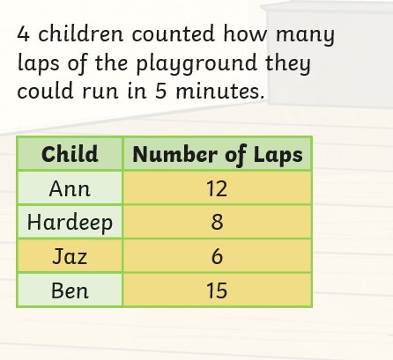
Maths: We will be focusing on Statistics.
Objective: To interpret Tables.
Please watch the video link below and focus on the teaching strategies used to help you interpret Tables and retrieve data from them.
Tables and Statistics
How many laps did Ann run?
Who ran the most number of laps?
How many laps were run altogether?
https://newportjuniorschool.org.uk/wp-content/uploads/2019/10/Calculation-Policy.pdf
As we are beginning a new topic, please read the calculation policy which will offer guidance on how to set calculations out.
1* - Today you will be focusing on reading tables and you will need to focus on the table and answer the questions using the data provided in the table.
2*/3* - Today you will be looking at tables and you will need to look at the data carefully and answer the questions.
Extension: Today you will be focusing on the table.
Answer the true or false statement focusing on the ticket prices. Have they all gone up by 4p?

Slide 4
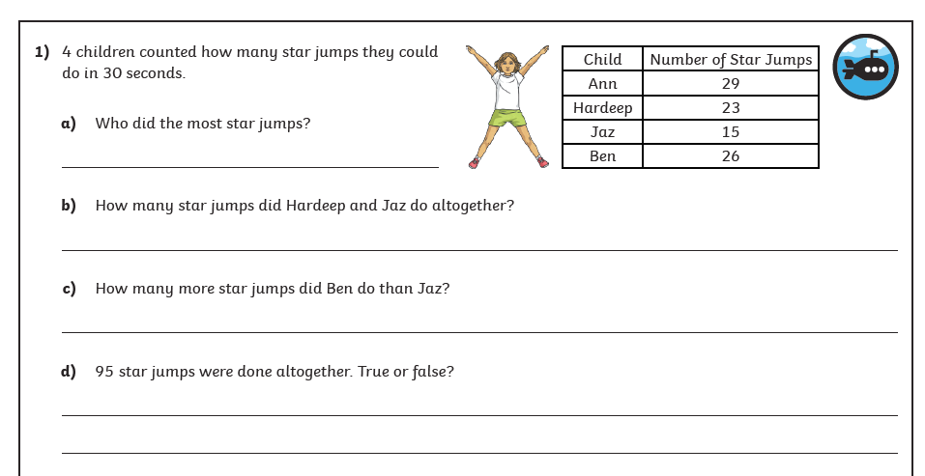
1 STAR TASK!

Slide 5
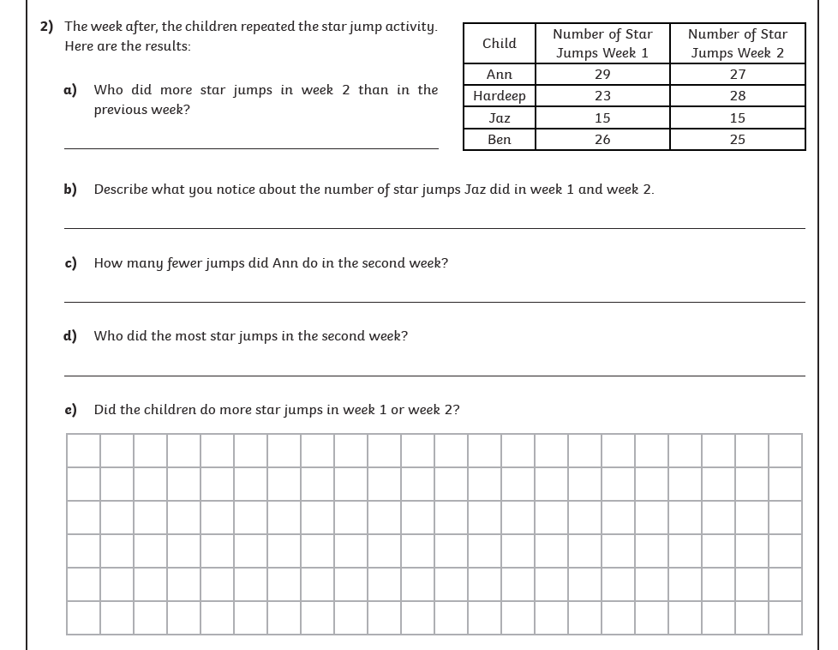

Slide 6
2/3 STAR TASK!

Slide 7
2/3 STAR TASK!

Slide 8
Extension Task!
Please explore this statement by focusing on the table.
Has each price increased by 4p?
Is the statement correct?

Slide 9
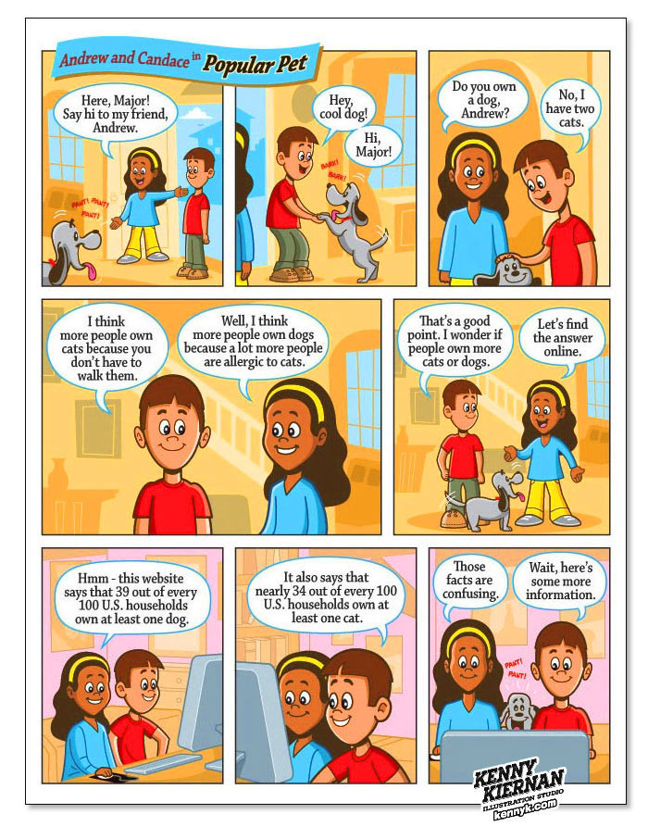
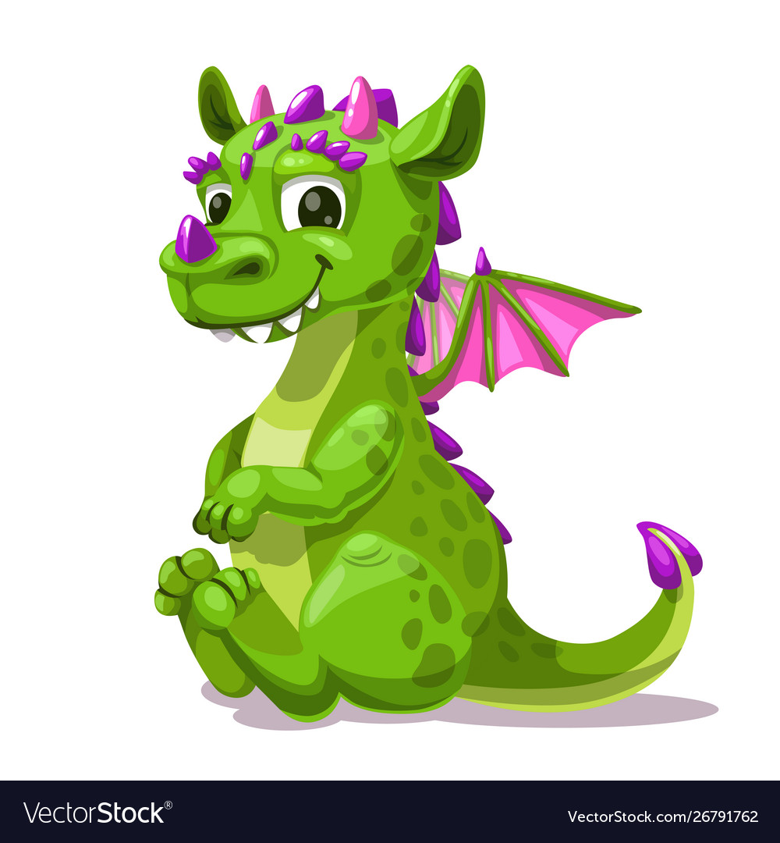
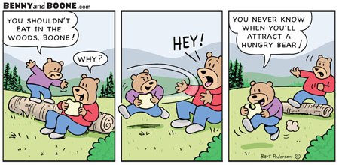
Reading:
Objective: To create a comic strip.
Look at the example of a comic style story on this page.
We would like you to create your own comic story. On your strip, show a story of you meeting a dragon (like when George meets Pepperoni). On the next couple of slides you will find 2 templates. Remember comics need to be clear with the drawings and speech bubbles provide some writing.
You might want to map your story out first before drawing it!

Slide 10
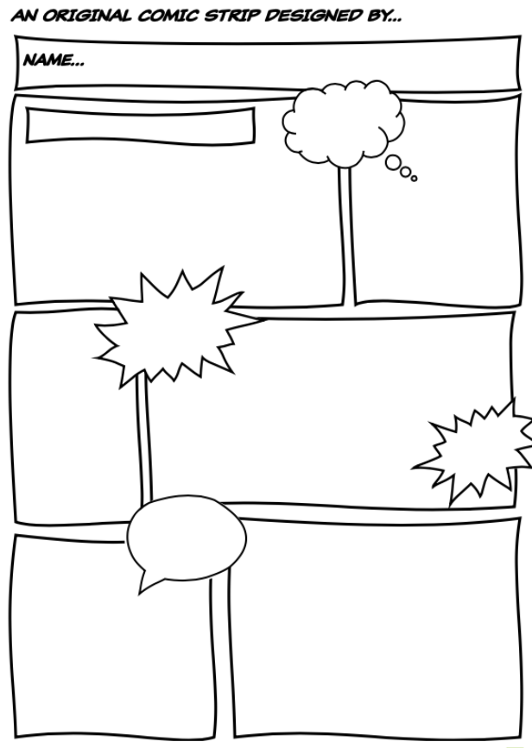

Slide 12
Other: E-safety
Objective: To understand the importance of staying safe online.
Watch, Play, Like, Share
Watch: Film 1 – Block Him Right Good Alfie.
https://www.thinkuknow.co.uk/8_10/watch/
Task 1… Answer these questions:
What did you think? What did you like about Play, Like, Share?
What different things do Sam, Ellie and Alfie do online?
What problem did Alfie face at the beginning of the film?
How did the gamer make Alfie feel?
What did Alfie do when he realised something wasn’t right?
What happened when Selfie’s video was made public? How did it make them feel?
Task 2:
Design a poster for Selfie.
Can you create a poster which highlights all the good things/ qualities/ skills about the members of the band.

