Slide 1
Remote Learning Plan!
Hello Year 4!
During the next few weeks, we will be providing the children with remote learning on a daily basis. The work will be available on the website the day before e.g. Monday’s work will be online Sunday.
Everyday the remote learning will consist of:
English Lesson
Maths Lesson
Reading Lesson
One other curriculum lesson (PSHE, Art etc)
We will be available during the hours of 9am-4pm so please feel free to contact us on our new e-mail njs.year4@taw.org.uk
Some of the work provided will be split into the star levels that the children use everyday in class (1,2 3).
Stay safe everyone!
Miss Jones, Mrs Jukes, Mrs Kuczynska and Mrs Sisson.

Slide 2
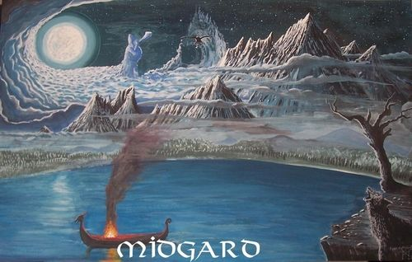
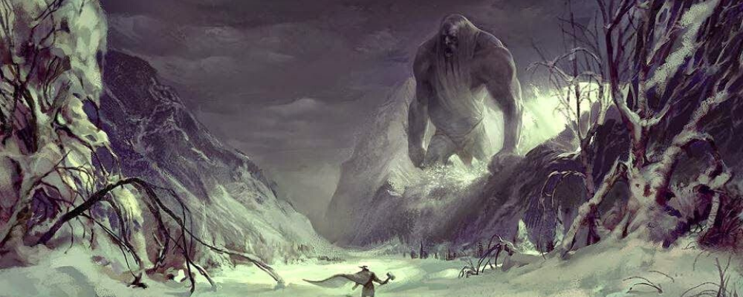
English:
Objective: To write creatively using an idea or stimulus.
Main task…
Free Writing Friday!
Use the images of Odin’s creation to create a piece of writing.
You might write a letter, diary, story or poem.
It is up to you!

Slide 3
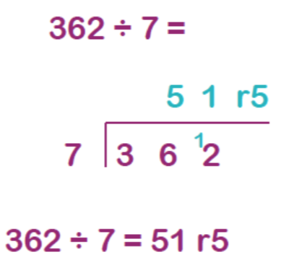
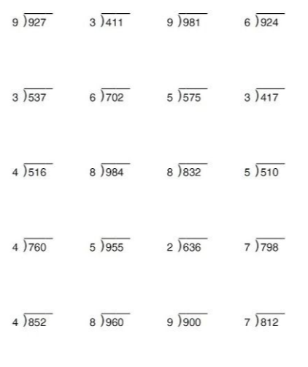
Maths:
Objective: To divide a 3-digit number by a 1-digit
number.
Using short division to divide a 3-digit number by a 1 digit number!
(47) Short Division - 3 digits by 1 digit - YouTube
Here is an example
of how we set out a division sum using the
bus stop method.
Write down each number clearly (one digit per square.)
Write the number you are dividing by next to the box and place the numbers you would like to divide in her box.
1* - See next slide for dividing a 3-digit number by a 1 digit number. Remember to use the bus stop method to show your working out.
2*/3* - The children will be dividing a 3-digit number by a 1-digit number and solving the problems using the bus stop method.
Extension task: Match the calculations on the last page to the answers.

Slide 4
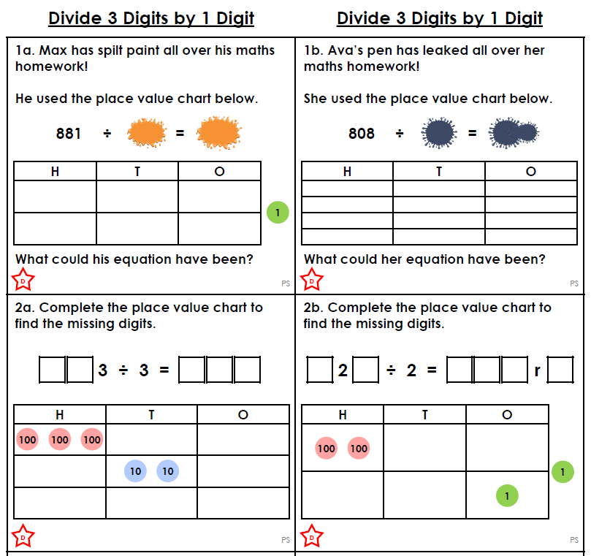
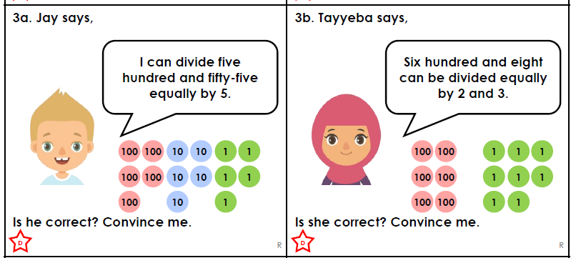
1 STAR TASK!

Slide 5
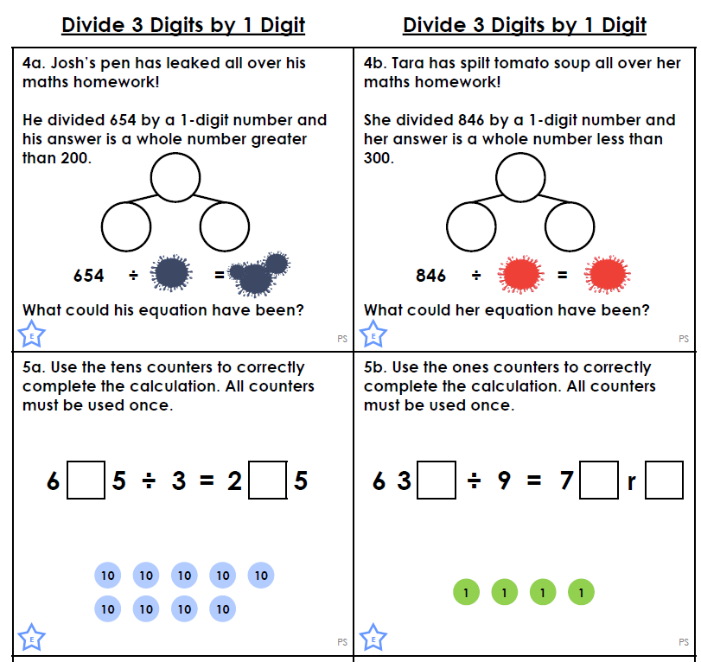
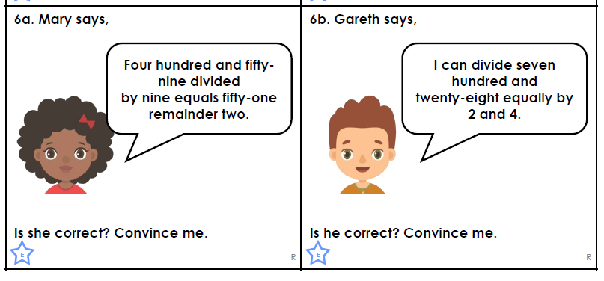
2 STAR TASK!

Slide 6
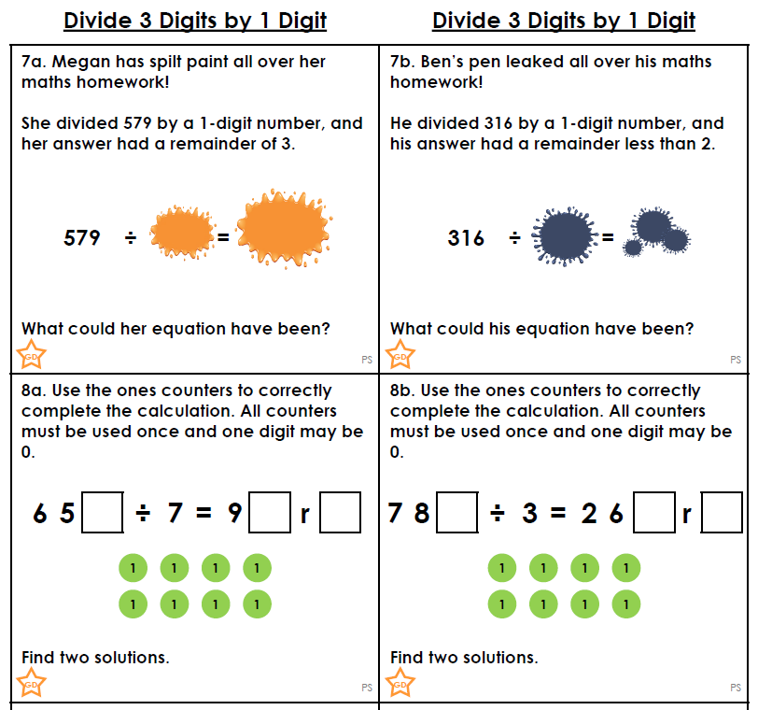
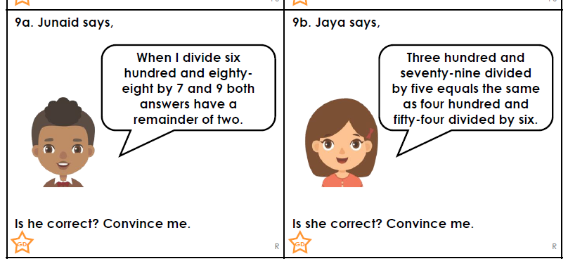
3 STAR TASK!

Slide 7
Extension Task!

Slide 8
Reading:
Objective: To answer questions from a different point of view.
Task…
Imagine you are the man who finds the lost thing.
1* - Think of 3 questions you would like to ask the object.
Try and write a response as the lost thing to each of your questions.
2/3* - Write down 5 questions you would like to ask the object.
Write down five responses you think the lost thing would say to your questions.

Slide 9
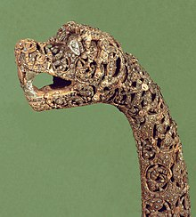
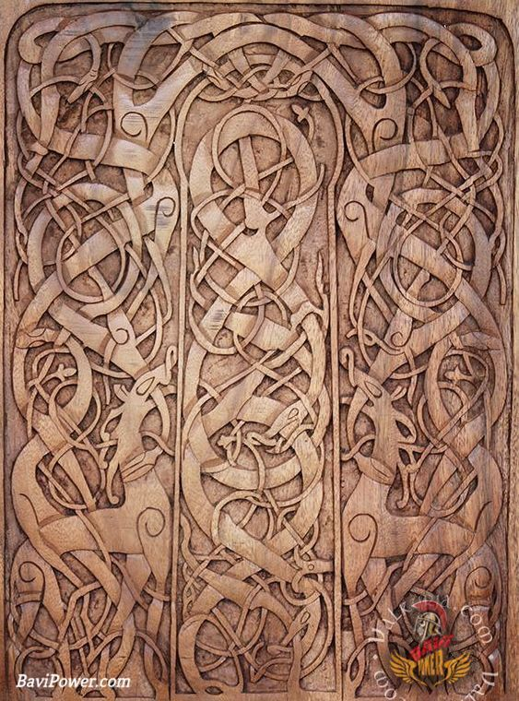
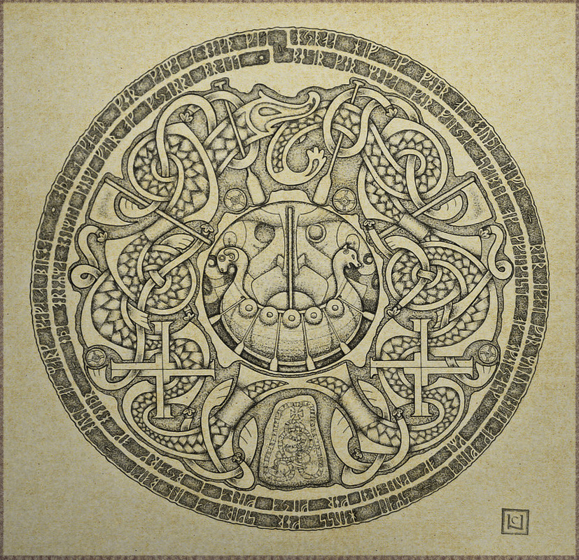
Other:
Objective: To explore Viking Art and Identify its key characteristics and features.
Task…
Have a look at the slides based on Viking Art. Look through the examples and the different styles of art that the Vikings used.
Which style do you like the most and why? Write down your thoughts.
Choose a design from the styles or example pictures – Copy this design.

