Slide 2
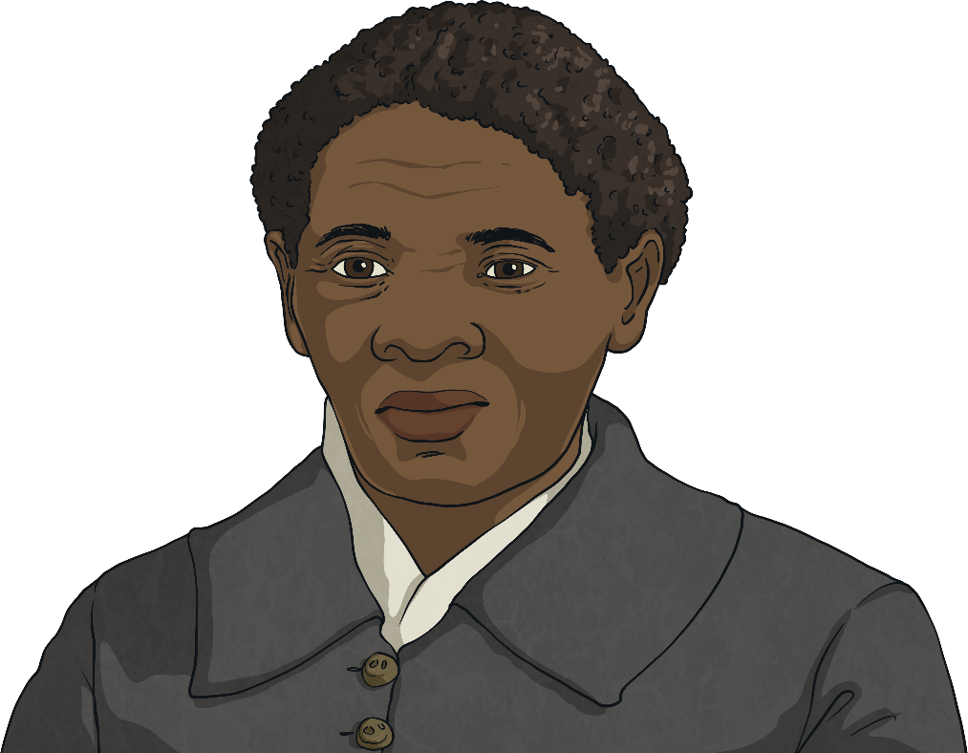
Who Was Harriet Tubman?
Harriet Tubman was a person who was enslaved but managed to escape. She was responsible for leading hundreds of enslaved people to freedom before the American Civil War in 1861. She used a system that was called the Underground Railroad.
She was also a nurse, a civil rights activist, a Union spy and a supporter of women’s suffrage.
In 2015, a group called ‘Women on Twenties’ held an online poll in the US asking which female figure should be on the $20 note. The list of 15 women included Eleanor Roosevelt and Rosa Parks. Harriet Tubman won by more than 600 000 votes!

Slide 3
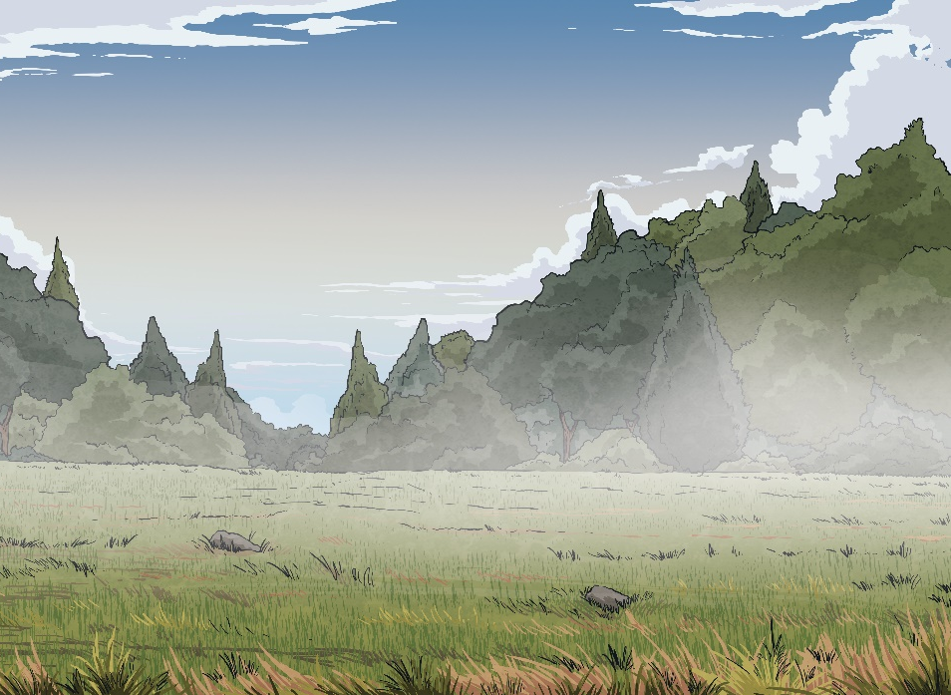
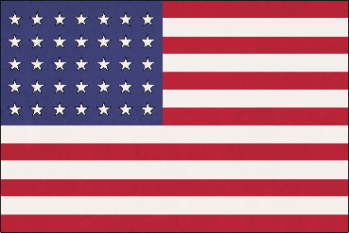
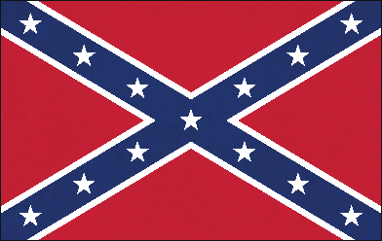
Slavery
Being enslaved means being forced to work without getting paid and having freedom and basic human rights (such as proper food, water and a safe place to live) taken away.
In the past, many people who were enslaved were legally owned, which meant that they could be bought and sold. Their children were also enslaved and treated very badly.
Under the Universal Declaration of Human Rights, slavery is now prohibited. However, illegal slavery still takes place in some countries.
In the US, during the 19th century, states in the north had abolished slavery. However, southern states wanted enslaved people for their plantations and this fundamental difference was one of the main causes of the American Civil War.

Slide 4
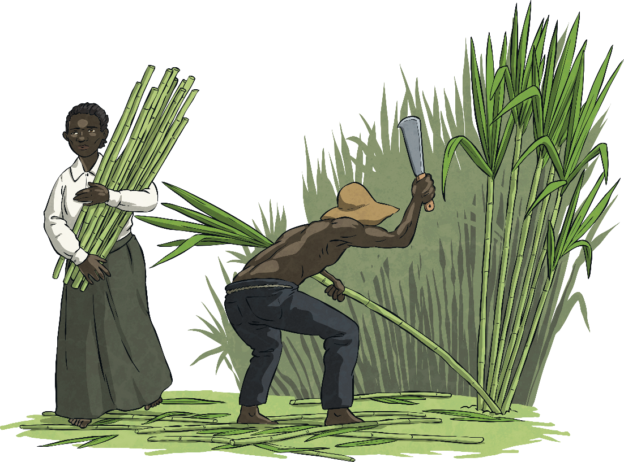
Araminta ‘Minty’ Ross
Harriet Tubman was born around 1820. She was born on a plantation in Maryland. Owners of enslaved people did not keep birth records, meaning they didn’t record when they were born. For this reason it is unclear whether she was born in 1820, 1821 or even 1822.
Her parents named her Araminta Ross and they used the nickname ‘Minty’ for her. She was one of nine children.
When she was 13, she decided to take her mother's name - Harriet.

Slide 5
The Life of Enslaved People
The life of enslaved people was extremely hard and Harriet’s life was no different. Her family was split when she was young, with three of her sisters being sold to distant plantations.
Physical violence was common and, like many other enslaved people, Harriet received lashes as punishment. As an adolescent, she was struck with a weight in the head by an overseer for refusing to help catch a runaway enslaved person. The injury caused headaches and dizziness for the rest of her life.

Slide 6
The Underground Railroad
The Underground Railroad was not a railway. It was a network of secret routes and houses that were safe for runaway enslaved people to use in order to escape from plantations and flee to the northern states of the US, where slavery had been abolished.
Harriet Tubman’s role in helping enslaved people to escape was vital. Special language was used to keep the escaped enslaved people safe. Harriet was a ‘conductor’ and the houses were called ‘stations’.
Harriet Tubman led so many people into freedom that her nickname was ‘Moses’, referring to Moses leading Jewish people out of slavery in Egypt.
back to original slide

Slide 7
Harriet’s Work as a Nurse
Harriet and her brothers Ben and Henry escaped from slavery in 1849.
In 1862, she travelled to Beaufort, South Carolina, to be a nurse for Black people who did not have a hospital to go to. She used home remedies she had learnt from her mother to treat smallpox and other infectious diseases.
She also worked at Freedmen’s Hospital in Washington. This was the first hospital that treated Black people who had been enslaved.
But she wanted to do more. Her vision of creating a nursing home for the poor and old people in her community was realised in 1908 when the Harriet Tubman Home for the Elderly was opened.
back to original slide

Slide 8
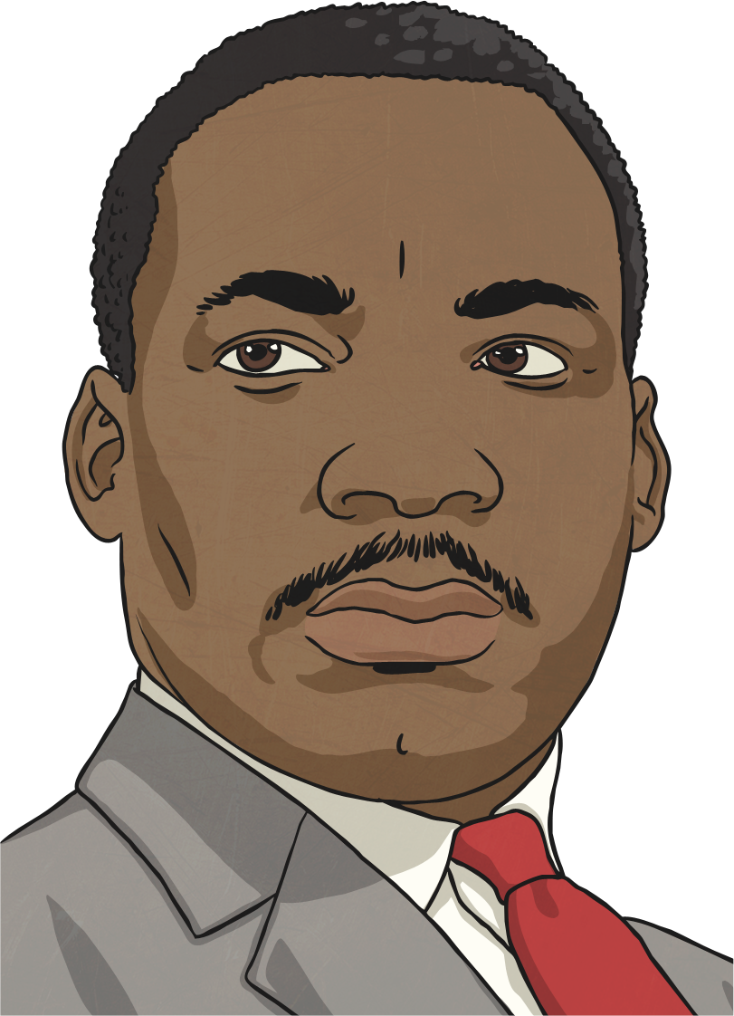
What Is a Civil Rights Activist?
The Civil Rights Movement is the name given to the struggle of Black Americans between the 1940s and the 1960s to end racial discrimination in the United States. People, such as Martin Luther King Jr, Rosa Parks and Malcolm X were key in this movement.
Harriet Tubman’s actions paved the way for the work of these figures and so she is often referred to as a civil rights activist. She was an abolitionist and took part in anti-slavery meetings. Her actions freed hundreds of enslaved people by means of the Underground Railroad.
back to original slide

Slide 9
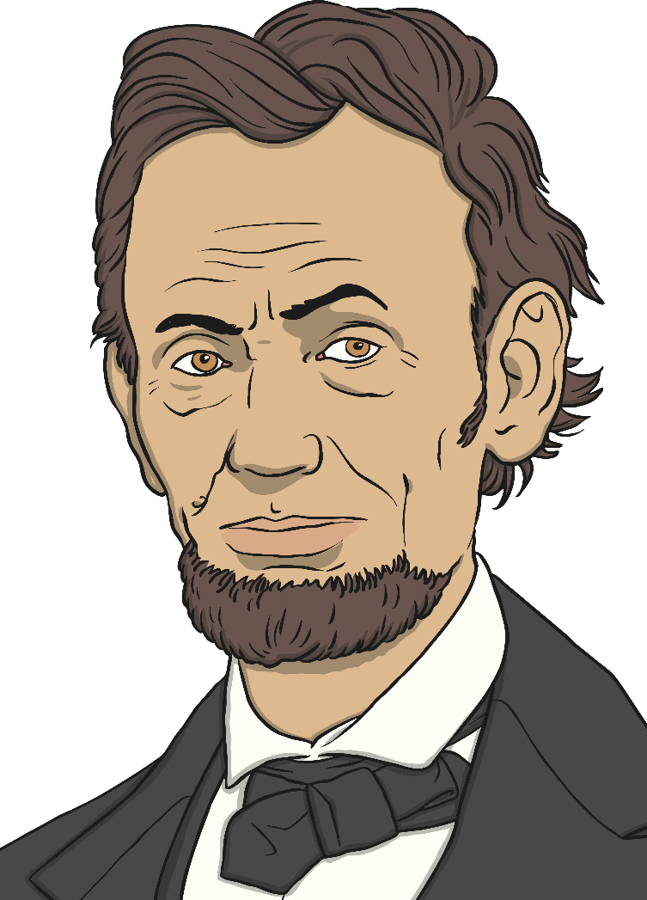
Being a Union Spy
The American Civil War took place between 1861 and 1865. It was fought between the Union states and the states of the Confederacy. Harriet Tubman was a spy for the Union states.
The use of former enslaved people as spies was an operation that Abraham Lincoln kept secret. Abraham Lincoln was president of the United States during the war. Tubman and the rest of the secret spy ring were effective because the Confederates didn’t consider them intelligent enough to serve as spies.
back to original slide

Slide 10
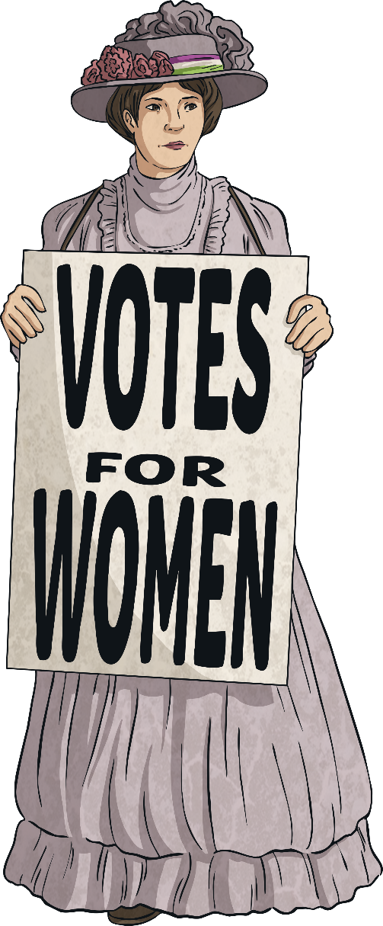
Women’s Suffrage
Harriet Tubman toured New York, Boston and Washington speaking in favour of the women’s right to vote.
As a woman who had fought for her own freedom and the freedom of others, her speeches were very popular and always left people wanting more.
The right for women to vote was finally passed in the United States in 1920.

Slide 11
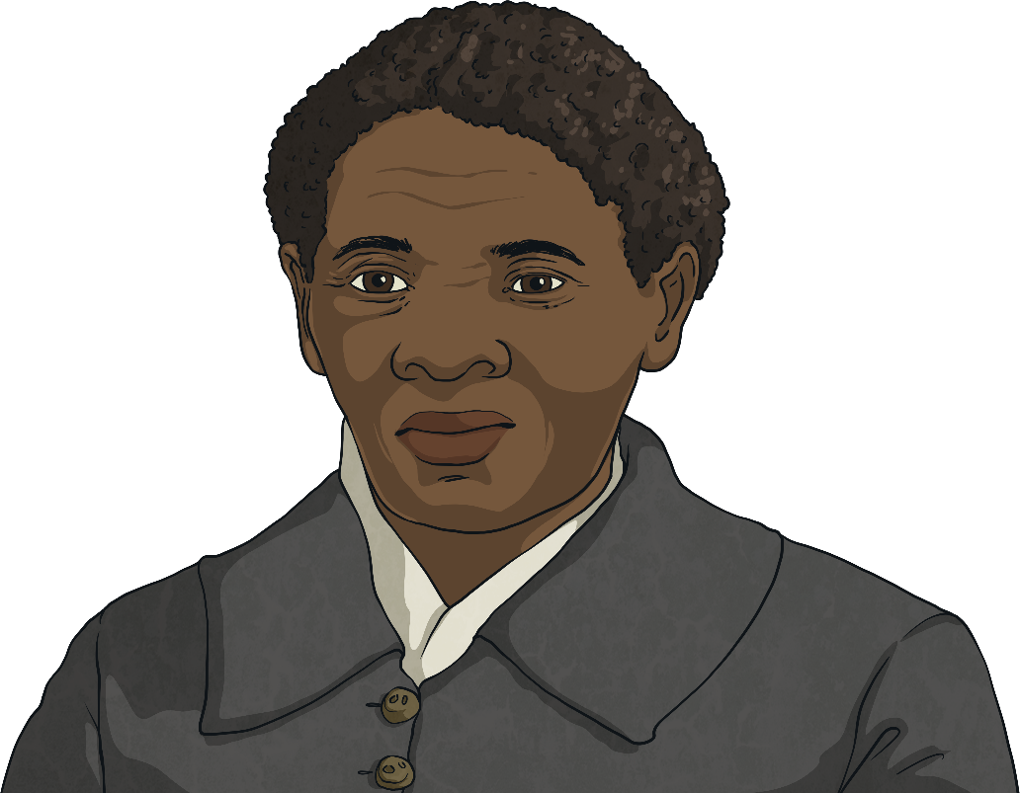
The Twenty-Dollar Note
2020 was going to be the year when the image of Harriet Tubman replaced that of Andrew Jackson on the US $20 note.
This was announced in 2015 by the Treasury Department (in charge of deciding issues related to money in the US) under President Obama.
However, in May 2019, the Treasury Department under President Trump announced that this change of image would have to wait until 2026.

Slide 12
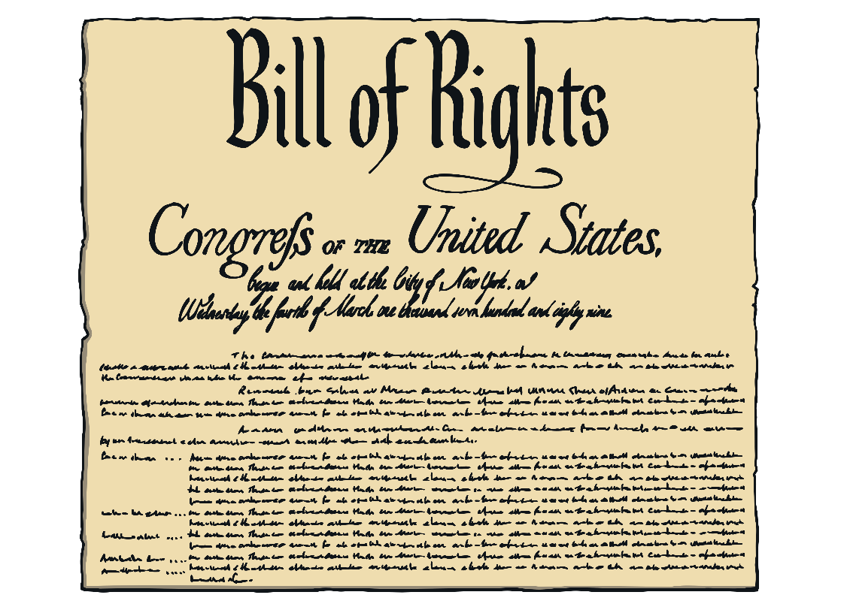
Harriet Tubman’s Legacy
Harriet Tubman is remembered as a symbol of freedom in the United States. During her life, she led many enslaved people to freedom and she also inspired many others. By planting the dream of freedom in the hearts and minds of countless enslaved people, she made them see that Black people not only deserved a better life but that it was possible for them to have one too.

Slide 13
Glossary
abolish – To put an end to something.
abolitionist – A person who wanted slavery to end.
enslaved – A better word to use than slave because it reflects that the person who becomes enslaved is a victim, as slavery is not a choice. Enslaved people are forced to work without pay, denied their freedom and restricted access to basic human needs, such as food and water.
freedom – This is one of the basic human rights – the right to act or move as one wishes.
overseer – A supervisor who makes sure people are working.
plantation – An estate on which crops, such as sugar and tobacco, are grown.
Union state – In the American Civil War, the Union were the states of the America that fought against the Confederates and were led by Abraham Lincoln.
women’s suffrage – This means the right of women to vote in elections.

