Slide 1
To write a description using specific grammatical skills.
Thursday 7th January 2021

Slide 2
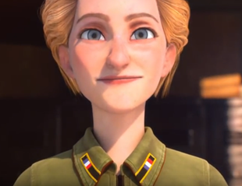
Aviatrice Video Clip
Please watch the clip and pay attention to the detail!!
You are using the video as a stimulus to write a 1st person diary
You may want to watch this back a few times to familiarise yourself with the content.

Slide 3
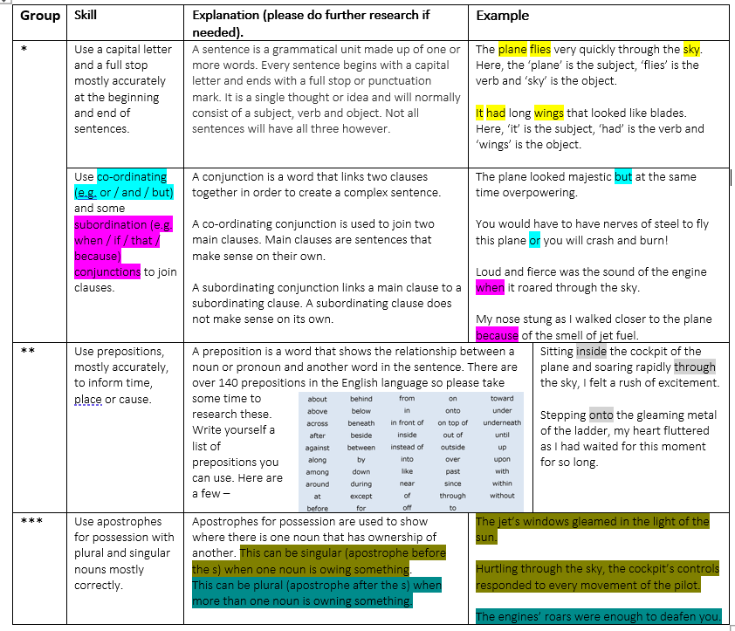
Skills we are working on…
Read each one and show me 3 clear examples of each – write neatly in your book.
*** You need to fulfil all examples of grammatical features.

Slide 4
Task
Write a description based on the plane and the pilot.
Use the grammatical targets for */**/**
*** you need to use all grammatical features.
If you need information, re-play the video!
Write neatly in your book.

