Slide 1
Remote Learning Plan!
Hello Year 4!
During the next few weeks, we will be providing the children with remote learning on a daily basis. The work will be available on the website the day before e.g. Monday’s work will be online Sunday.
Everyday the remote learning will consist of:
English Lesson
Maths Lesson
Reading Lesson
One other curriculum lesson (PSHE, Art etc)
We will be available during the hours of 9am-4pm so please feel free to contact us on our new e-mail njs.year4@taw.org.uk
Some of the work provided will be split into the star levels that the children use everyday in class (1,2 3).
Stay safe everyone!
Miss Jones, Mrs Jukes, Mrs Kuczynska and Mrs Sisson.

Slide 2
English:
Objective: To recognise features of a myth and find examples within a story.
Main task…
On the next slide, you will find a table with features of a myth.
You will need to read ‘The Building of Asgard’s Wall’ – This is on the slides for you.
2/3* - Look at each of the features… can you find an example in the text?
Look at the example to support your ideas.
1* - If you feel confident, try the features task set for 2/3*. If not, write 5 sentences to summarise the story.

Slide 3
Feature 1: Where is the story set? Can you find any descriptions to support? | Evidence of Feature 1: The story is set in Asgard. Asgard is the city of Gods and sparkles in the sunshine because it is made from gold. | Feature 2: Does the story feature a hero or heroine? This is the person who saves the day. | Evidence of Feature 2:
Feature 3: Does the story contain a quest? What quest do they need to go on? A quest is similar to a journey. | Evidence of Feature 3: | Feature 4: Does the story contain mythical creatures or monsters? | Evidence of Feature 4:
Feature 5: Does the story contain any powers? A person might have the powers or it could be an object. It could be a place or location. | Evidence of Feature 5: | Feature 6: Does the story contain a dilemma? A dilemma is a problem that needs solving. | Evidence of Feature 6:

Slide 4
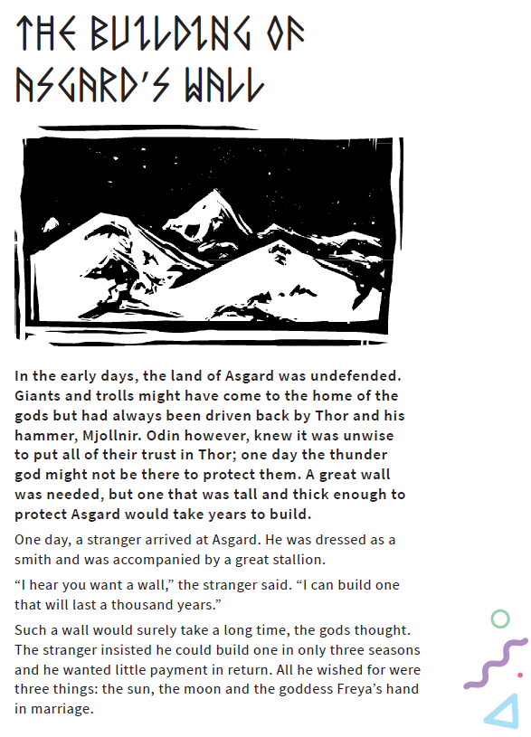
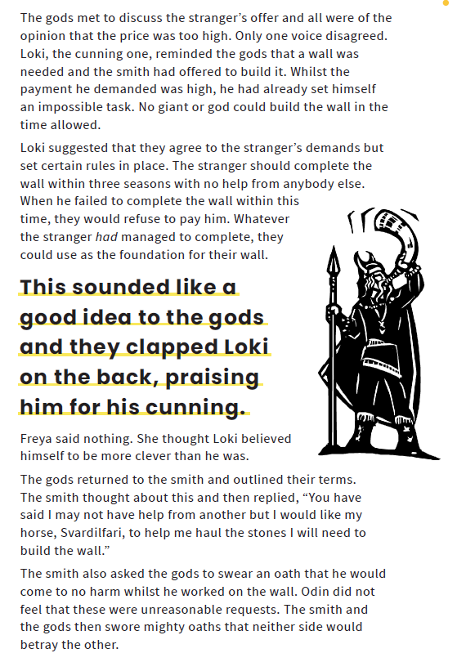

Slide 5
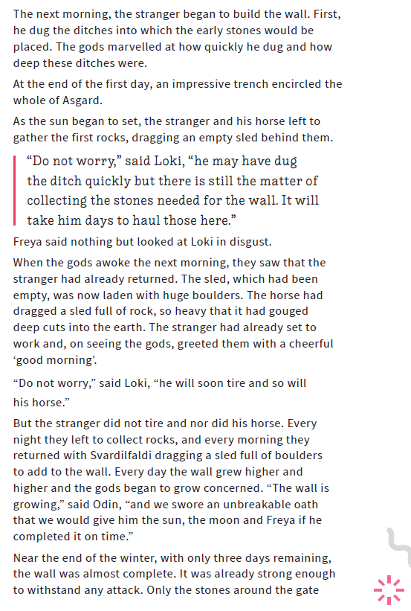
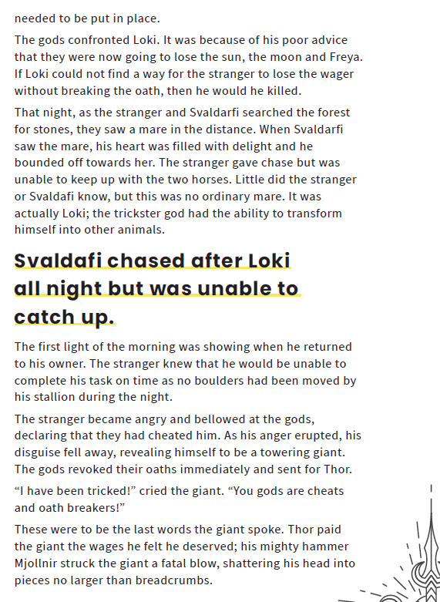

Slide 6
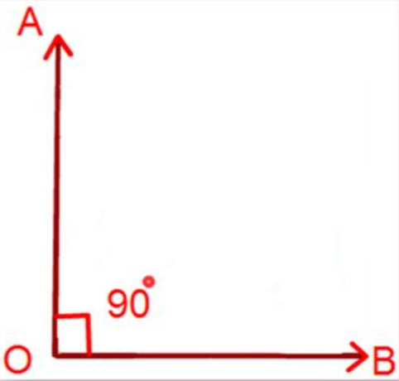
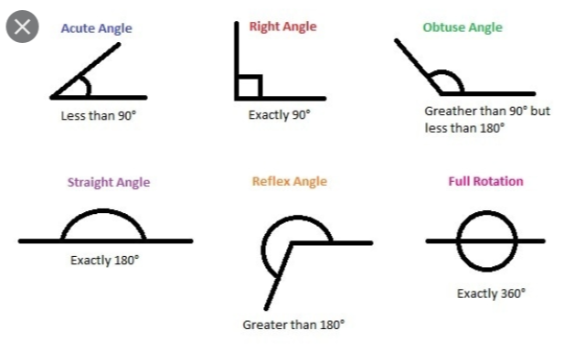
Maths:
Objective: To identify various angles in properties
Of shapes.
https://www.bbc.co.uk/bitesize/topics/zb6tyrd/articles/zg68k7h
What are the names of the different types of angles that exist within shapes?
This is a right angle, it has 90 degrees and also
shows a quarter turn clockwise.
How many different right angles can you
find in and around your homes?
Click on the link above for BBC Bitesize. Revise your knowledge of all of the different types of angles that exist within shapes.
1* - See next slide for identifying acute, obtuse and right angles .
2*/3* - Look at the questions and read them carefully.
You will be identifying various angles and learning about clockwise and anti-clockwise turns.
Extension task: Solve the problems and go on an angle hunt around your homes. Can you identify where angles can be found in window frames for example? Feel free to draw and take pictures of the angles you find.

Slide 7
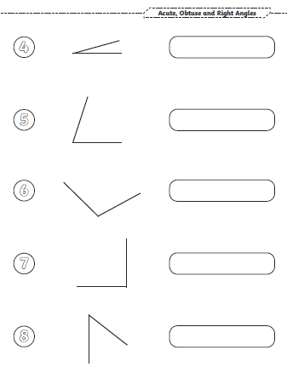
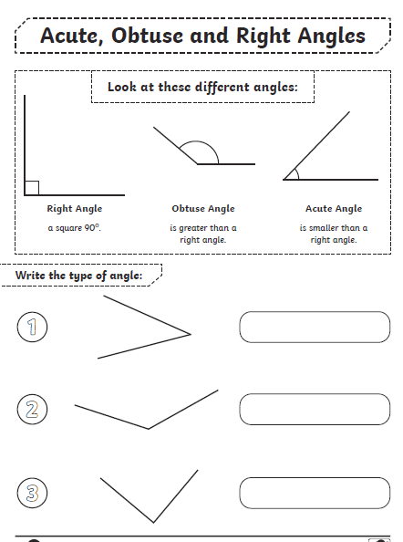
1 STAR TASK!

Slide 8
2/3 STAR TASK!

Slide 9
2/3 STAR TASK!

Slide 10
Extension Task!

Slide 11
Reading:
Objective: To make inferences from a front cover.
We will be looking at ‘The Dragon Inside Me’ by Adam Bushnell for the next few weeks. On the front cover you can see lots of images… pizza, on/off button, games console and many more.
1* - Choose 3 of the images.
Write a sentence to explain how you think they will fit into the story.
2* - Choose 5 of the images.
Write an explanation of why you think the author has used them on the front cover. Add a reason for how you think they will fit into the story.
3* - Choose 7 of the images.
Write an explanation of why you think the author has used them on the front cover. Add a reason for how you think they will fit into the story.
Example:
The pizza. I think that the front cover contains this image because it is the main character’s favourite food.

Slide 12
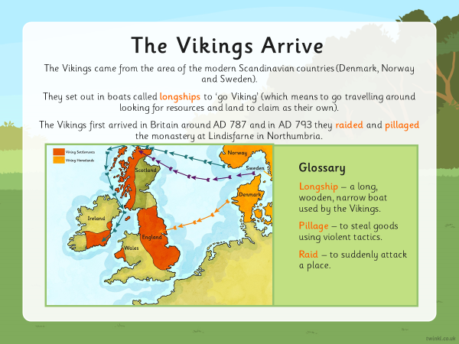
Other:
Objective: To create a timeline for the Vikings.
Watch the clip below to understand what a timeline is:
https://www.youtube.com/watch?v=xc64qurhFng

Slide 13
Task… All Children
Watch the video on the previous slides about timelines.
On the next slide, you will find an example of a timeline, which shares important parts of history.
Use the final slide (black and white images) to create your own Viking timeline.
You might want to cut them out or write them. It is up to you!
Make sure they are in the correct order.

Slide 14
