Slide 1
Remote Learning Plan!
Hello Year 4!
During the next few weeks, we will be providing the children with remote learning on a daily basis. The work will be available on the website the day before e.g. Monday’s work will be online Sunday.
Everyday the remote learning will consist of:
English Lesson
Maths Lesson
Reading Lesson
One other curriculum lesson (PSHE, Art etc)
We will be available during the hours of 9am-4pm so please feel free to contact us on our new e-mail njs.year4@taw.org.uk
Some of the work provided will be split into the star levels that the children use everyday in class (1,2 3).
Stay safe everyone!
Miss Jones, Mrs Jukes, Mrs Kuczynska and Mrs Sisson.

Slide 2
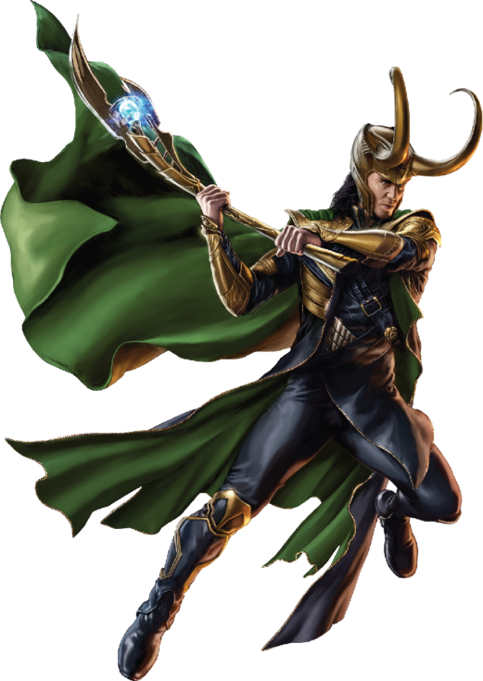
English:
Objective: To map a journey from Asgard to Jotenheim.
Main task…
This week you are going to end up with your own myth that includes Thor and Loki.
God of Thunder. God of mischief.
Imagine you are Thor or Loki and Odin is sending you on a mission from Asgard to Jotunheim.
Draw your journey to the land of the giants. HOWEVER… Heimdall is missing and so the rainbow bridge cannot be used.
Once you have designed your map (the journey from Asgard to Jotenheim). Draw how you will get there with an added explanation.
It could be by Viking Long Boat, A spear that opens a portal, a magic helmet or flying.
See the next slide for some map ideas and another slide transport ideas!

Slide 3
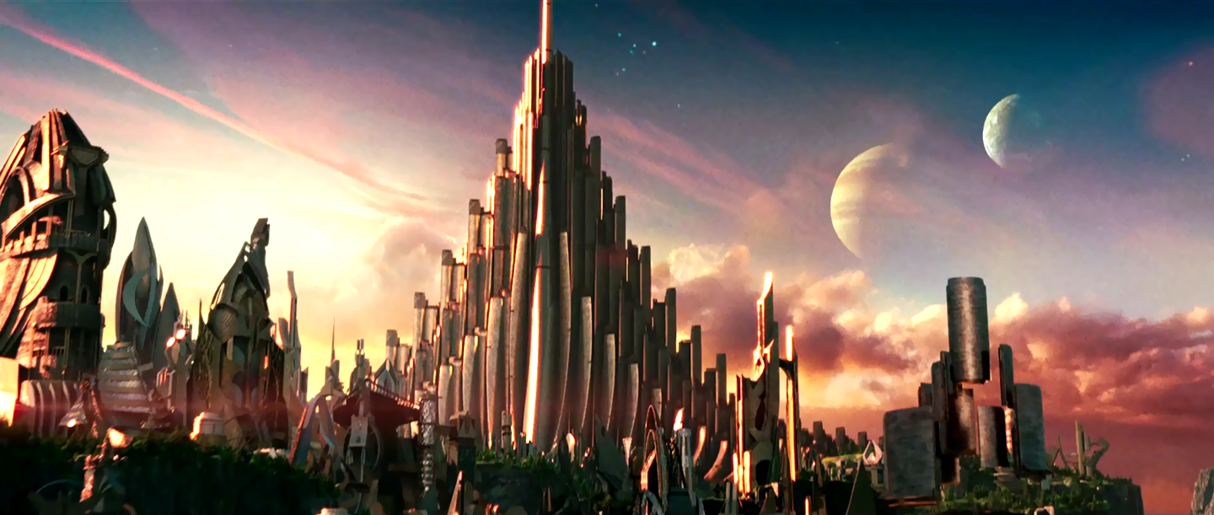
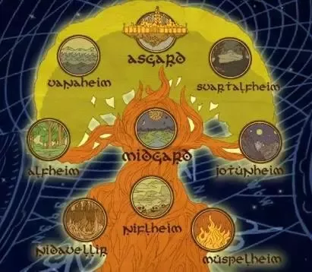
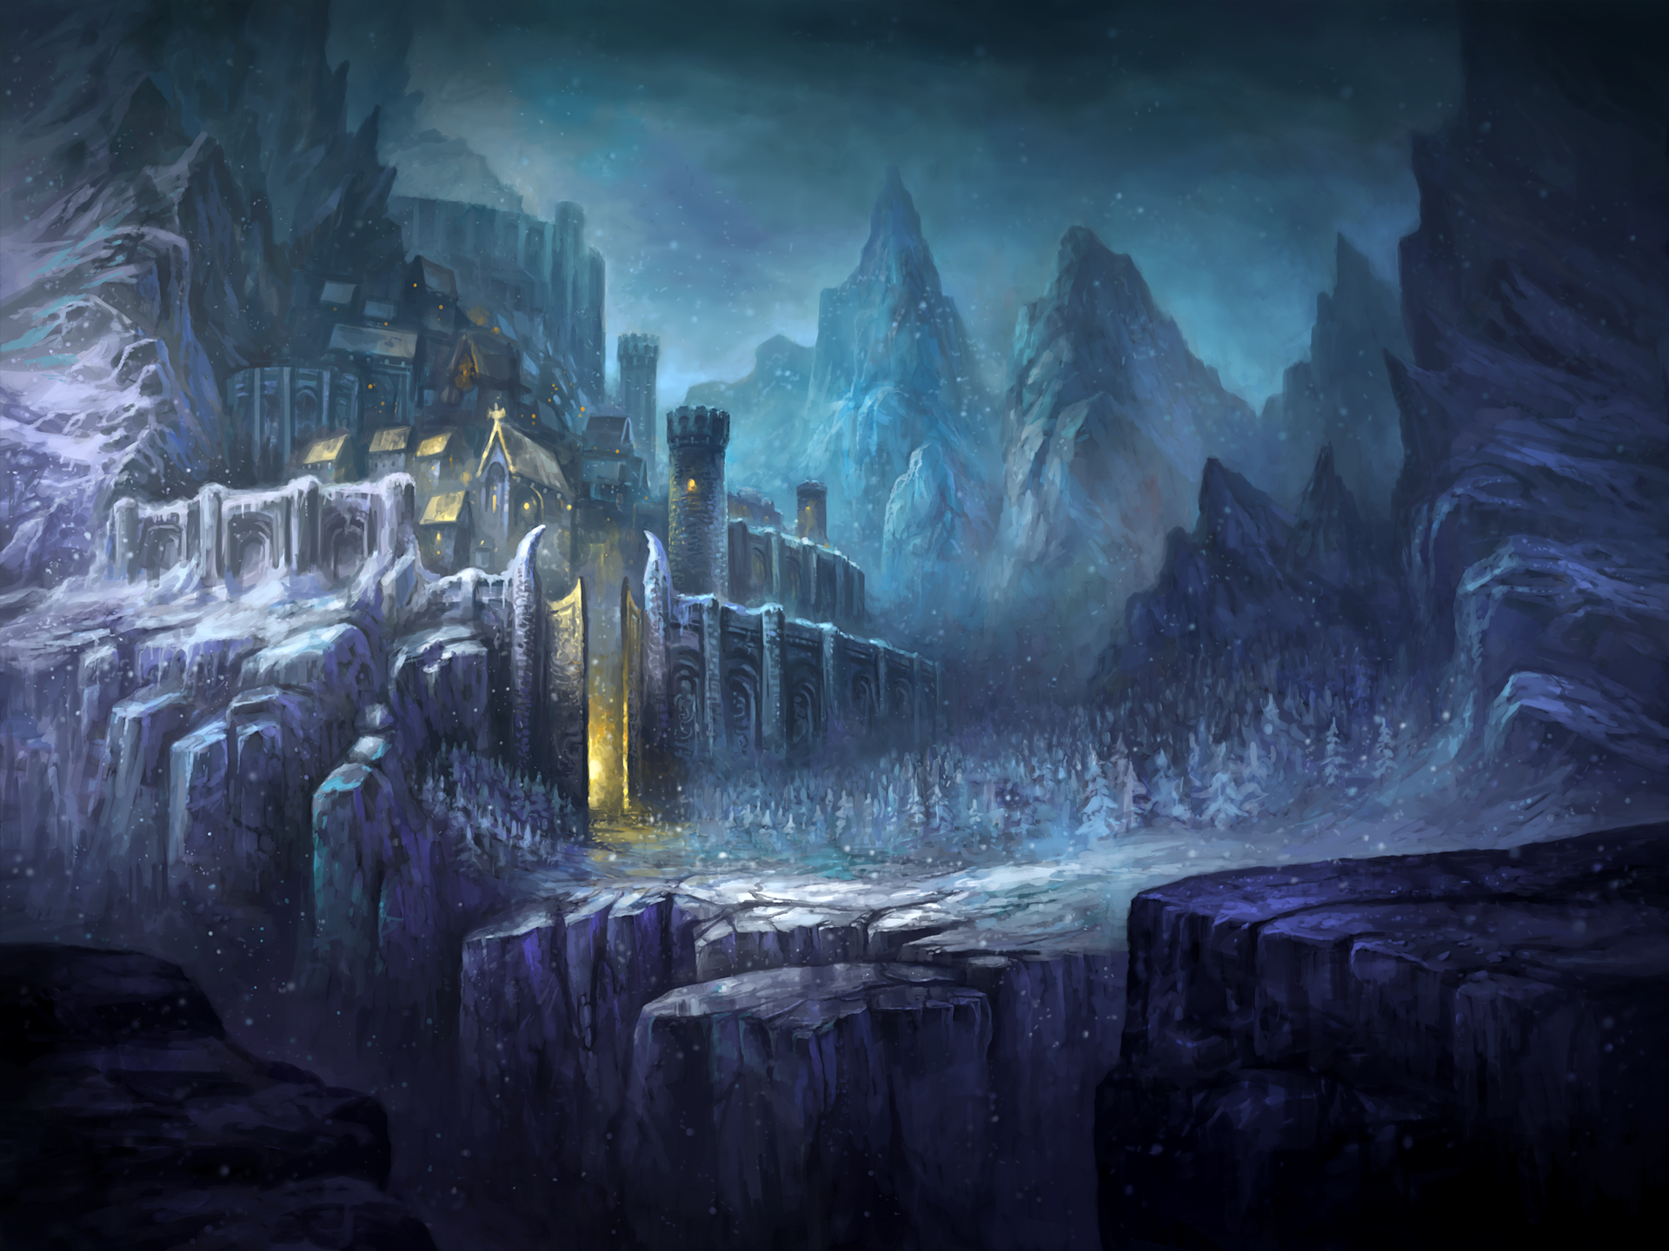
Asgard
Jotunheim

Slide 4
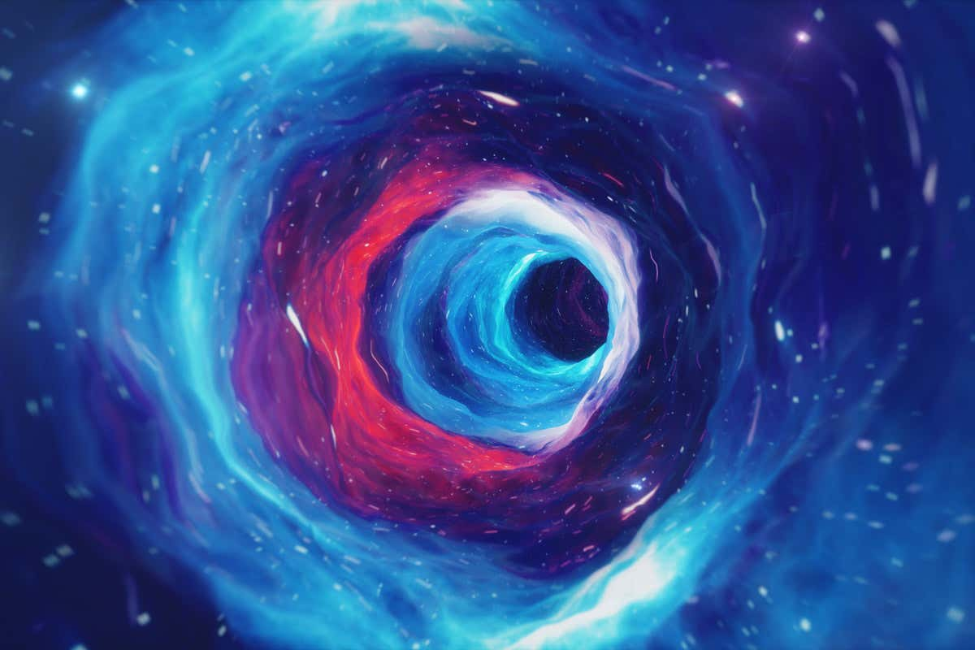
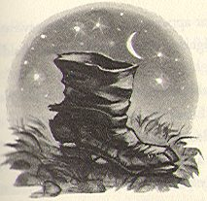
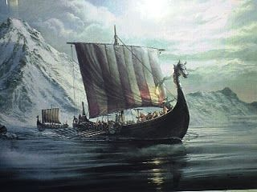
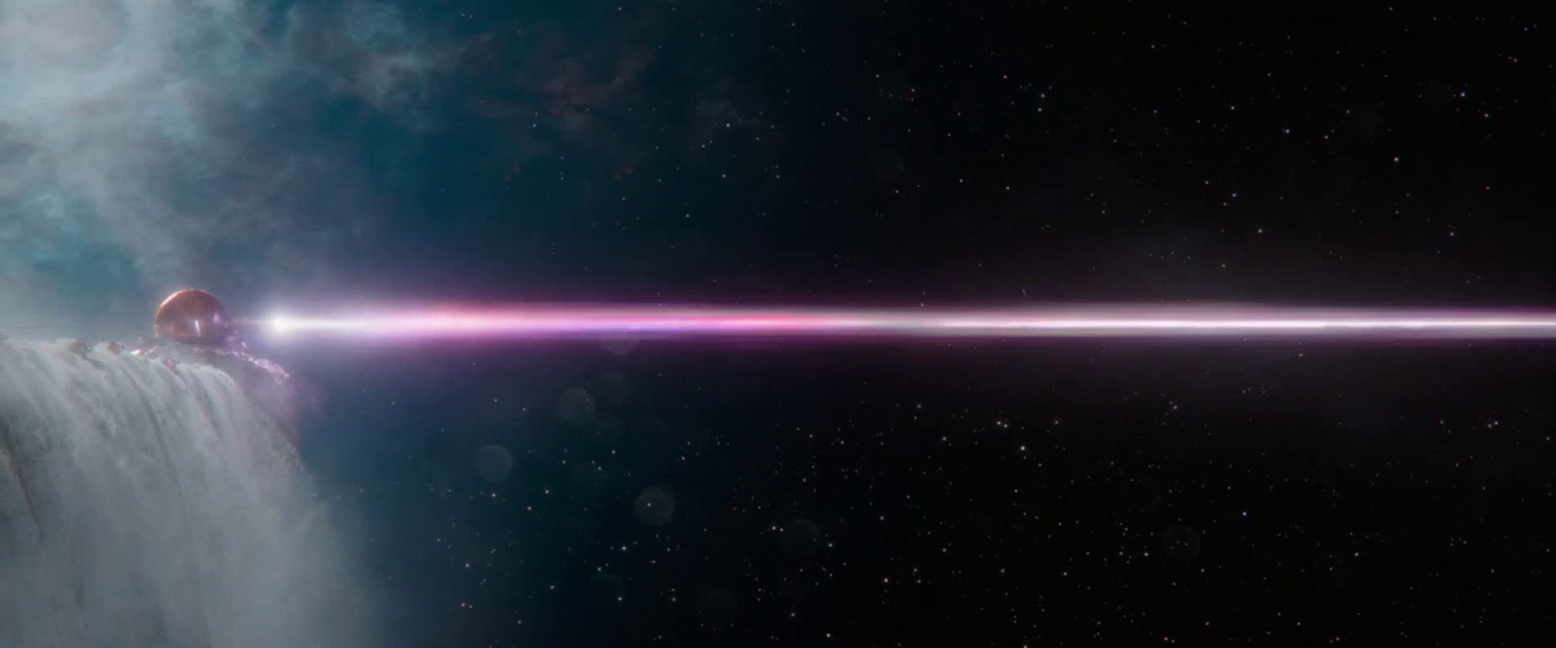
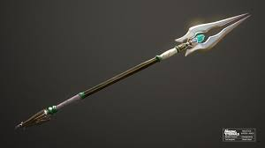
A wormhole
A port key
A Magical Viking Longship
A laser
A magical spear or weapon

Slide 5
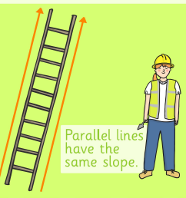
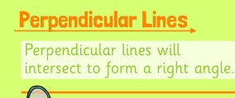
Maths:
Objective: To identify parallel and perpendicular lines.
Parallel and Perpendicular
Today you will be learning the difference between parallel and perpendicular lines.
Remember to use your rulers accurately
to draw straight lines.
Click on the link above for a quick reminder what parallel and perpendicular lines are.
1* - Have a go at circling which pairs of lines are parallel and perpendicular. Please draw lines which are parallel and perpendicular to the lines on the sheet.
2*/3* - Today you will be identifying parallel and perpendicular lines. Have a go at drawing the lines accurately and solving the problems.
Extension: Complete the True or False statement focusing on perpendicular lines.
Parallel lines never intersect.
Perpendicular lines will intersect to form a right angle.

Slide 6
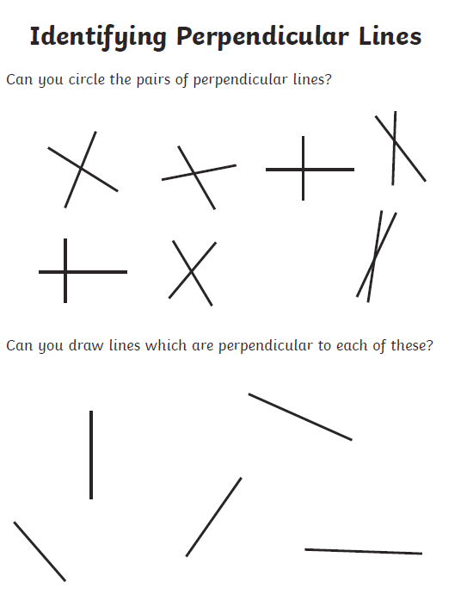
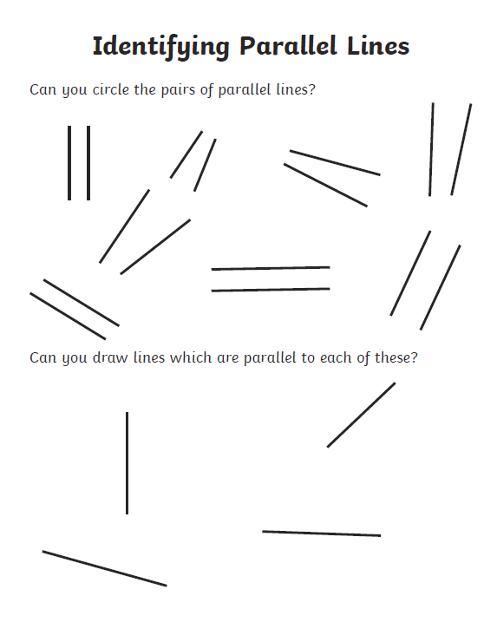
1 STAR TASK!

Slide 7
2/3 STAR TASK!

Slide 9
Extension Task!
We would like you to draw this shape.
Write down the meaning of what a perpendicular
line is. Does this shape have any perpendicular
lines ?

Slide 10
Reading:
Objective: To describe the personality of George and his mum.
Think about what happened in chapter 1 ‘School’s Out!’ from last week. Read chapter 2 ‘Pizza, Pizza, Pizza’ before attempting the task for today!
George’s mum does a lot for him including bringing him lunch, breakfast and drinks. In this chapter, we see a different side of George and how he treats his mum.
1* - Use the roll on the wall template (See slide after chapter). In the speech bubbles write how you think George’s mum would feel when he is rude to her.
2/3* - Use the text to answer the following questions about the characters George and his mum.
1. Find and copy all the words that describe how George’s mother talk. For example… cheerfully.
2. How do you think she is feeling about George?
3. How does George talk to his mother? Find and copy some examples.
4. How do you think George should talk to his mother?
5. How else is George rude to his mother?
6. What do you think might stop George from behaving badly?
7. If you could give George a piece of advice, what would you tell him?

Slide 17
1* - Use the roll on the wall template. In the speech bubbles write how you think George’s mum would feel when he is rude to her.

Slide 18
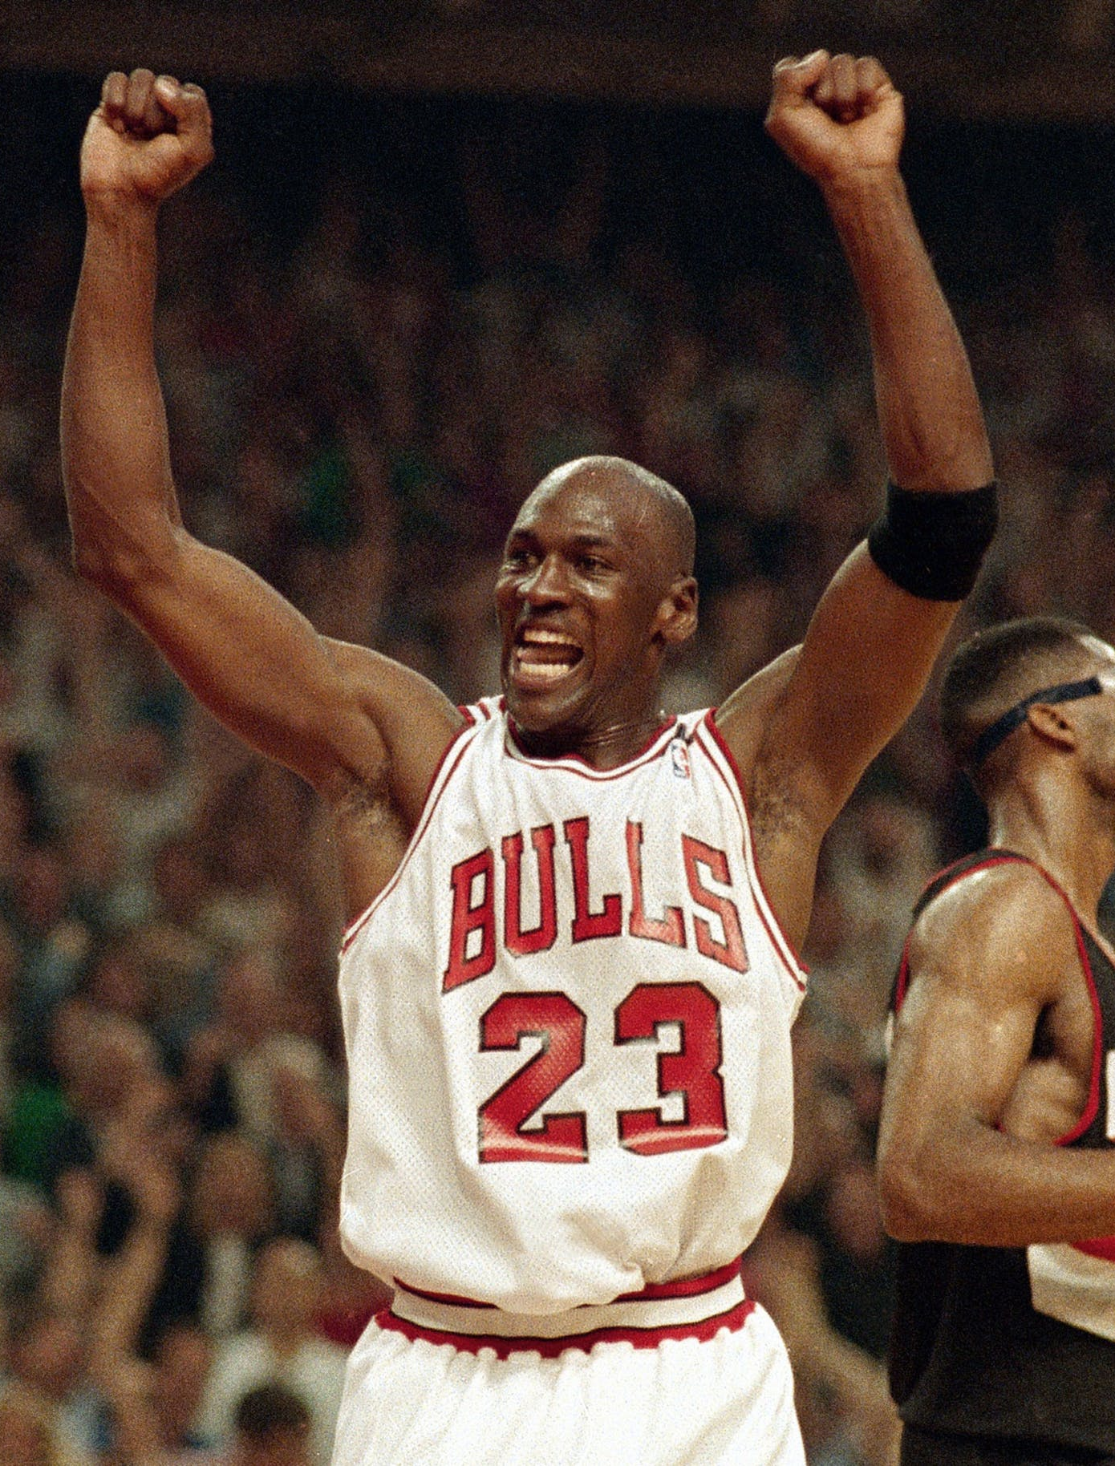
Other:
Objective: To recognise dreams and goals.
Watch the story of Michael Jordan:
https://www.youtube.com/watch?v=1StyBOsMSLE
The story is about a famous basketball player called Michael Jordan. Often, dreams come true from hard work and perseverance rather than ‘quick fixes’.
We have to be resilient and have a positive attitude if we want to achieve anything in our lives.
Think about how inspirational Michael Jordan is and how he achieved his dreams and goals.
Use this to help with the task on the next slide!

Slide 19
Task 2…
Opposite you will find six scenarios where someone’s hopes and dreams have gone wrong.
1* - Pick 2 of the scenarios then answer all the questions below for each scenario.
2* - Pick 3 of the scenarios then answer all the questions below for each scenario.
3* - Pick 4 of the scenarios then answer all the questions below for each scenario.
How might this person feel?
What might the person do in that situation?
How could they overcome the hurt that this situation might cause?
How could the person become more resilient in the future?

