Slide 1
Remote Learning Plan!
Hello Year 4!
During the next few weeks, we will be providing the children with remote learning on a daily basis. The work will be available on the website the day before e.g. Monday’s work will be online Sunday.
Everyday the remote learning will consist of:
English Lesson
Maths Lesson
Reading Lesson
One other curriculum lesson (PSHE, Art etc)
We will be available during the hours of 9am-4pm so please feel free to contact us on our new e-mail njs.year4@taw.org.uk
Some of the work provided will be split into the star levels that the children use everyday in class (1,2 3).
Stay safe everyone!
Miss Jones, Mrs Jukes, Mrs Kuczynska and Mrs Sisson.

Slide 2
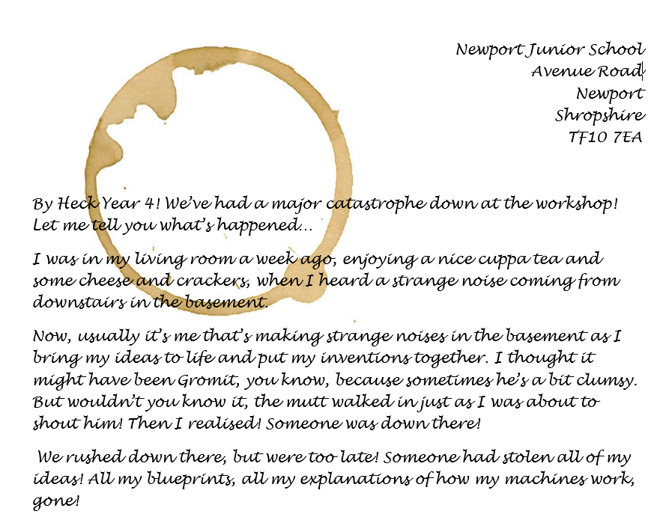
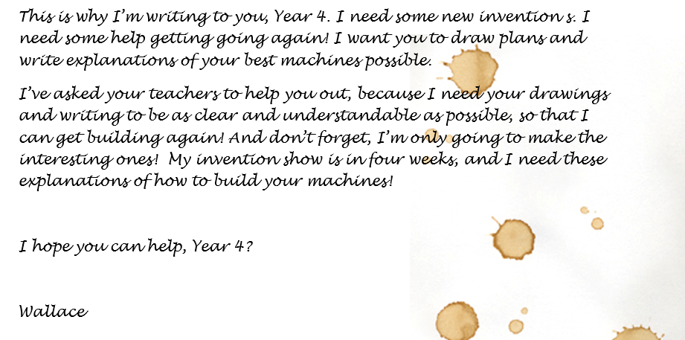
English:
Objective: To write a letter in reply to Wallace.
https://www.youtube.com/watch?v=_6g8WGpMstI
What does the word invention or inventor mean? Watch the clip above to see Wallace and Gromit in action! They have been making inventions for a long time… some successful and others not quite.
Wallace has sent the following letter to you year 4!
Main task…
Write a reply to Wallace following his letter.
1* - Use the postcard template to send a response to Wallace.
2*/3* - Write two or three paragraphs in response to Wallace.
Use the next slide for a reminder on letter writing!

Slide 4
1*

Slide 5
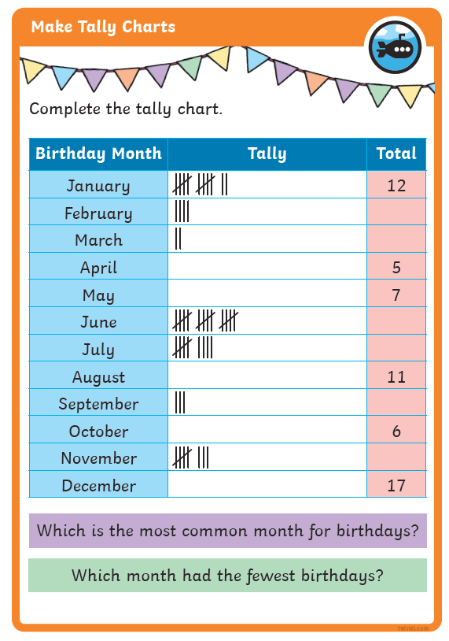
Maths: We will be focusing on Statistics.
Objective: To make Tally Charts.
Making Tally Charts and Grouping Numbers
Please watch the video link below and focus on the teaching strategies used to help you count and learn how to tally numbers
https://newportjuniorschool.org.uk/wp-content/uploads/2019/10/Calculation-Policy.pdf
As we are beginning a new topic, please read the calculation policy which will offer guidance on how to set calculations out.
1* - Today you will be gathering data based on different activities and complete the tally chart.
2*/3* - Today you will be looking at data, completing tally charts and having a go at making your own tally chart.
Extension: Today you will be reading the data within the tally chart and deciding if the statement is true or false.

Slide 6
1 STAR TASK!

Slide 7
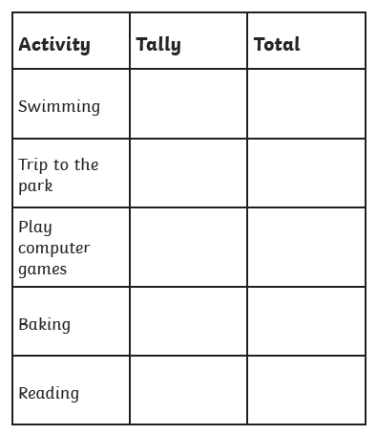
1 STAR TASK!

Slide 8
2/3 STAR TASK!

Slide 9
2/3 STAR TASK!

Slide 10
Extension Task!
Please explore this statement by focusing each pet. What is the
Total number of tallies for each pet?
How many dogs are there?
How many pets are there altogether?

Slide 11
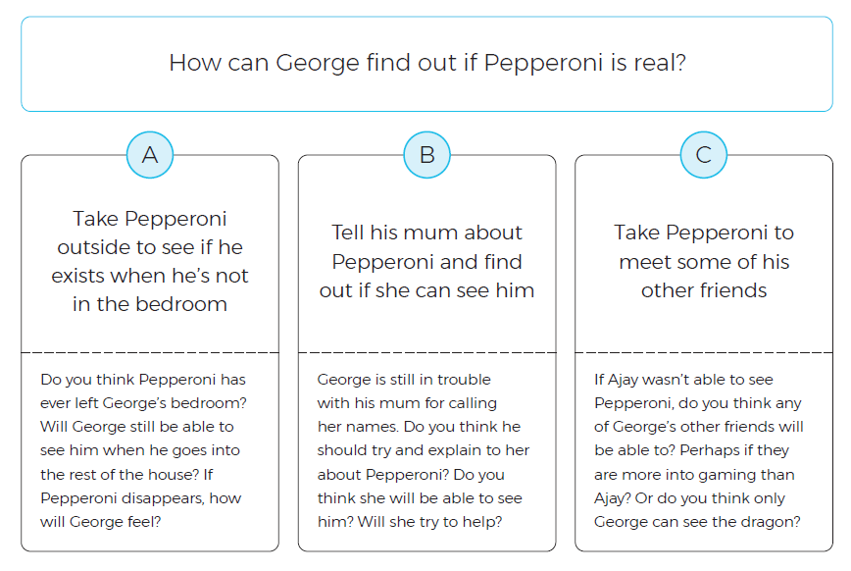
Reading:
Objective: To make a prediction and use the text to justify my ideas.
Read the chapter ‘Mirror, Mirror’.
1* Task…
Answer the question ‘How can George find out if Pepperoni is real?’ from Option A, B or C.
Use the questions under each option to support your ideas.
2/3* Task…
Which option do you think answers the questions ‘How can George find out if Pepperoni is real?’. Use the questions under each option to form your response. Try to use the text to justify your ideas.
Write a paragraph explaining if you think Pepperoni is real or not. Provide reasons for your ideas.

Slide 15
Other: PSHE
Objective: To set goals and understand how to be resilient.
We all face disappointment sometimes.
We need to remember to stay positive, be determined and resilient.
Sometimes our own self-belief can really help us manage being disappointed.
Negative feelings are a natural part of being disappointed but can be unhelpful to us if we hold onto them for too long.
Why is this?
https://www.youtube.com/watch?v=-fCimjFW4kA
https://www.youtube.com/watch?v=vC2lDIGHpvU
How do you think the runner-up feels here?
What about the winners?
How would you over come it?

Slide 16
Complete the 3 step approach to a dream…
Step three… How might you stay positive and resilient?
Step two… How might you reach your
goals? Who might help you?
Step one… What is your dream?

