Slide 1
Remote Learning Plan!
Hello Year 4!
During the next few weeks, we will be providing the children with remote learning on a daily basis. The work will be available on the website the day before e.g. Monday’s work will be online Sunday.
Everyday the remote learning will consist of:
English Lesson
Maths Lesson
Reading Lesson
One other curriculum lesson (PSHE, Art etc)
We will be available during the hours of 9am-4pm so please feel free to contact us on our new e-mail njs.year4@taw.org.uk
Some of the work provided will be split into the star levels that the children use everyday in class (1,2 3).
Stay safe everyone!
Miss Jones, Mrs Jukes, Mrs Kuczynska and Mrs Sisson.

Slide 2
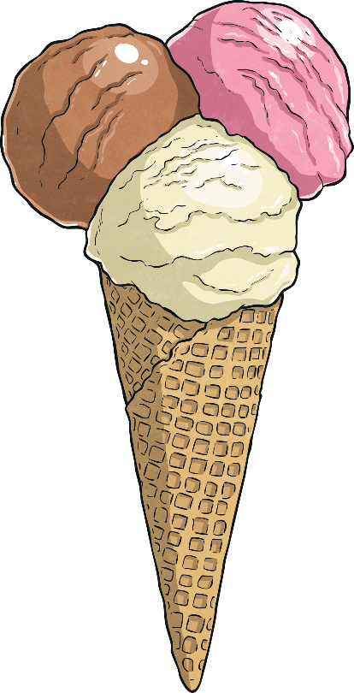
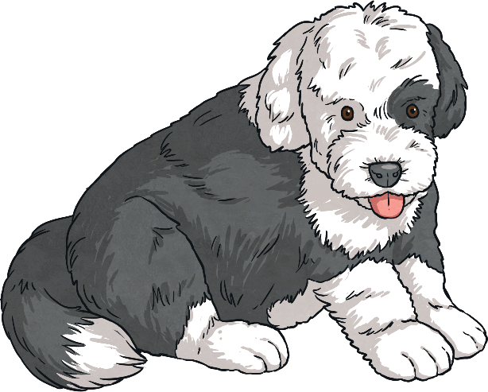
English:
Objective: To understand what a ‘Kennings’ poem is and how to write one.
Each line of the poem is made of a two-word phrase.
Kennings are like riddles.
They describe something without ever saying what it is.
The words are joined by a hyphen.
A tail-wager
A face-licker
A ball-catcher
A house-guardian
A furry-friend
A cat-chaser
lip-licking
chin-dripping
sauce-swirling
cone-filling
flake-holding
tongue-freezing
The phrases are usually made up of a noun + a verb (the verb usually ends in –ing or -er).
Main task…
See the next slide for an example on how to write your own Kennings Poem. Then complete the task…
1* - Create a kennings or acrostic poem about an animal of your choice.
2/3* - Create 2 kennings poems. Poem 1 – Animal of your choice.
Poem 2 – Object of your choice.
Some Kennings start every line with A.

Slide 3
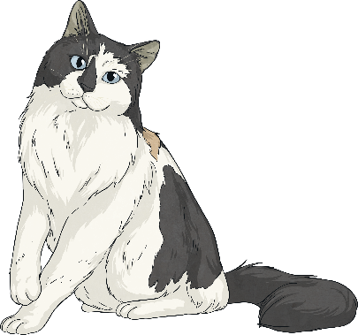
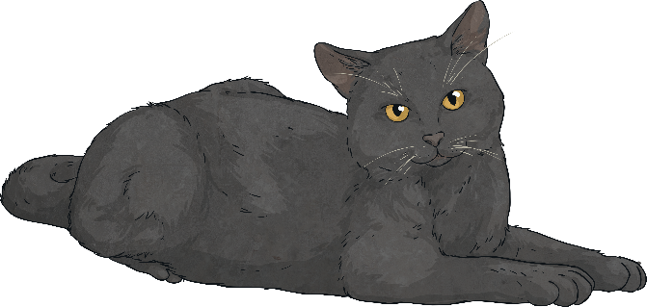
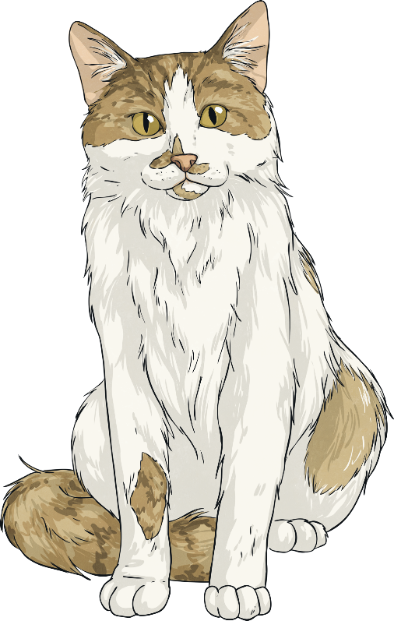
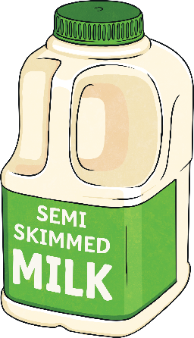
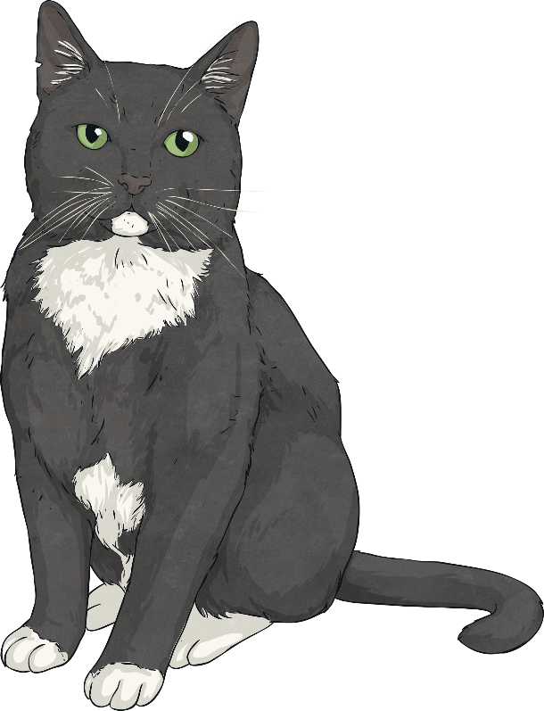
How can we write a kenning?
First, we need to choose a theme. It could be animals, an object or even a location (e.g the beach).
To start creating your kenning, try and make a noun + noun phrase or a noun + verb phrase using your words.
Finally, put them together in your two-word phrases.
Don’t forget the hyphens!
cat
mouse-hunter
milk-drinker
night-stalker
fur-licker
ankle-rubber
dog-hater
nose-nuzzler
ear-scratcher
loud-purrer
Then, we brainstorm lots of words or phrases associated with that theme…
mice
stalk
sleeps a lot
rubs ankles
hunter
hates dogs
fur
purr
scratch
nuzzle
night

Slide 4
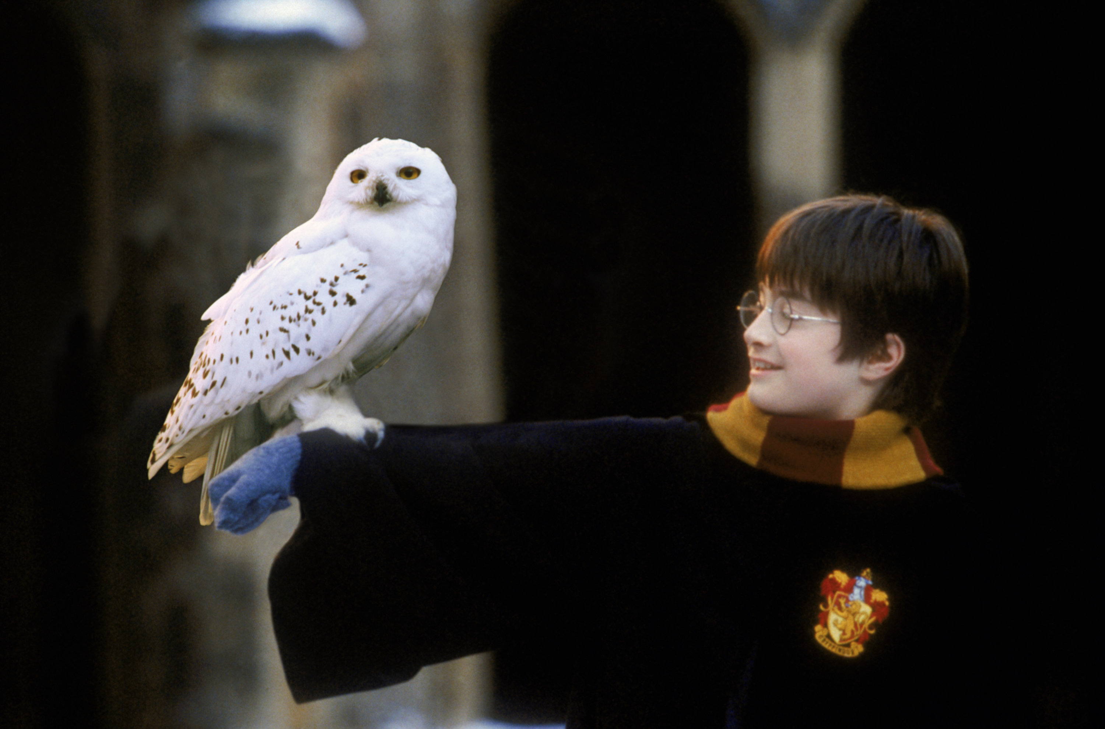
Night flyer, Mouse eater, Silent swooper, Head twister, Taloned taker
Night = NOUN
Flyer = VERB

Slide 5
Maths:
Objective: To identify what quadrilaterals are.
Quadrilaterals
Today you will be learning all about what quadrilaterals are.
Think about:
How many sides does it have?
Is it a 2-D or 3-D shape?
How many angles does it have?
Click on the link above to learn about what different quadrilaterals exist.
1* - Explore what quadrilaterals are and try and draw as many different quadrilaterals as you can.
2*/3* - Today you will be focusing on quadrilaterals. Label as many different quadrilaterals as you can and have a go at answering the questions and solving the problems focusing on quadrilaterals. What properties do they have?
Extension: Draw the Venn diagram and sort the
Quadrilaterals accurately into the venn diagram.
Is the statement true or false?

Slide 6
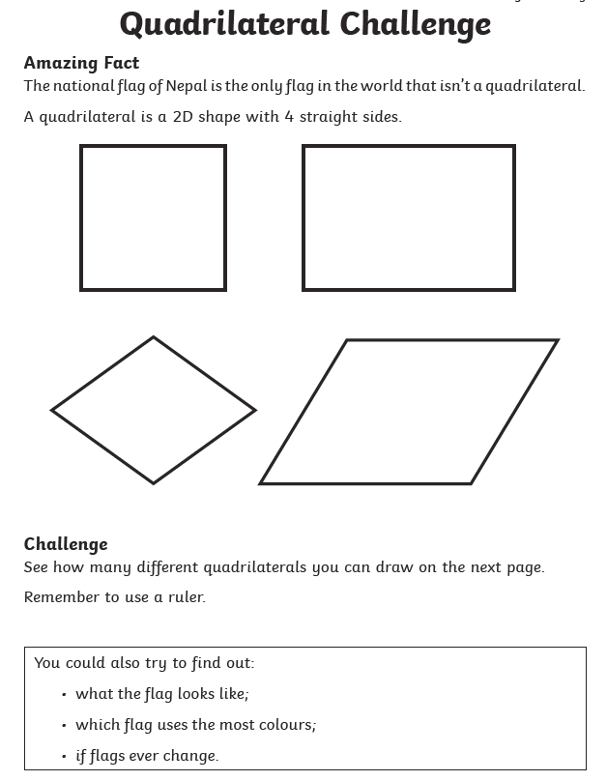
1 STAR TASK!

Slide 7
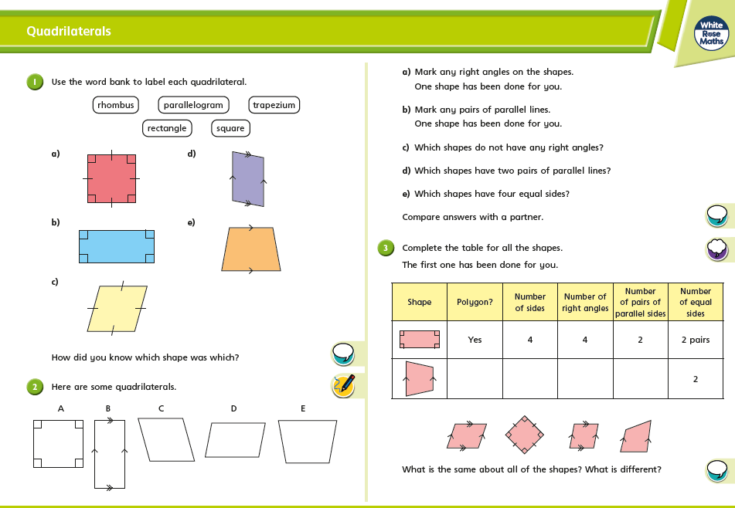
2/3 STAR TASK!

Slide 9
Extension Task!
Please explore this statement by drawing the Venn diagram. Explore the statement by drawing as many quadrilaterals as
You can and sorting them accurately into the Venn diagram.
Is it true or false?

Slide 10
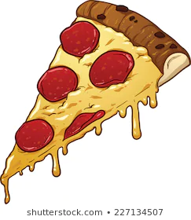
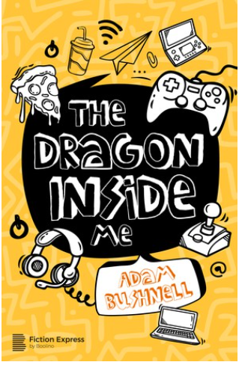
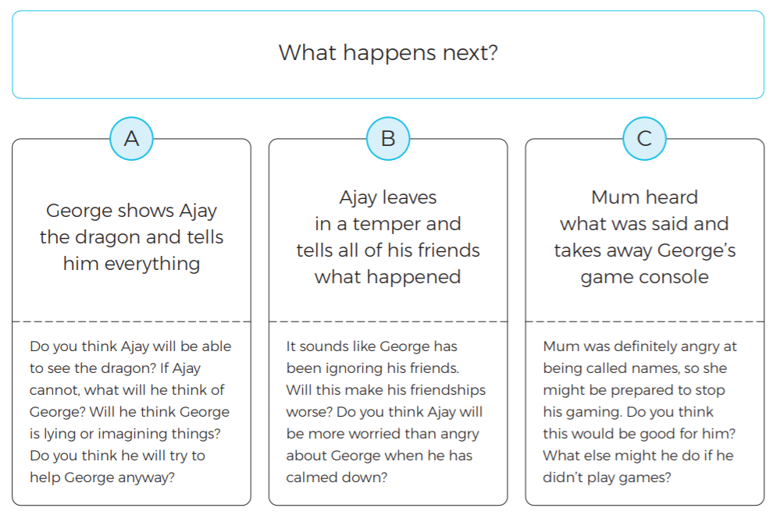
Reading:
Objective: To make a prediction and use the text to justify my ideas.
Read the chapter ‘A Monster Under My Bed’.
1* Task…
Which option do you think will happen next?
Use the questions under each option to support your ideas.
2/3* Task…
Which option do you think will happen next? Use the questions under each option to form your response. Try to use the text to justify your ideas.
Write a paragraph explaining what you think George SHOULD have done when Ajay arrived.

Slide 14
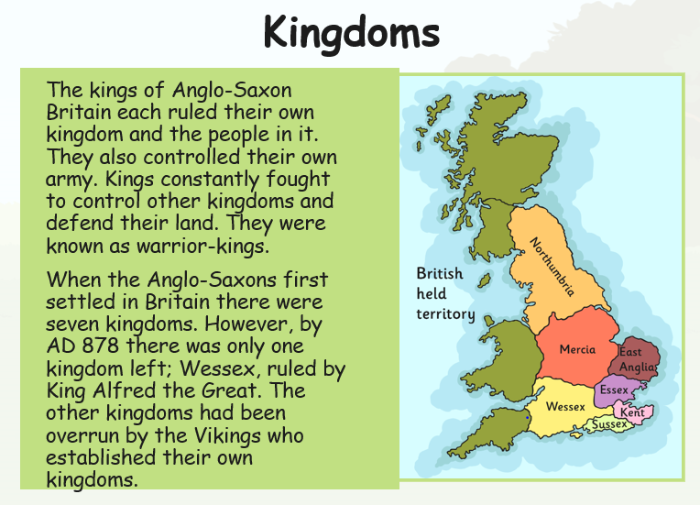
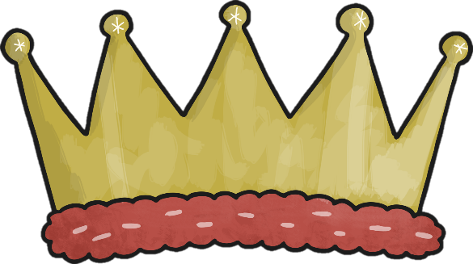
Other: Topic
Objective: To find similarities and difference between King Alfred the Great and King Athelstan.
Some of the Anglo-Saxon Kings are well known for the resistance they put up against the Vikings. They fought hard to keep control of their land and tried to push the Vikings out.
One of the best known Anglo-Saxon kings is King Alfred the Great. He is the only British monarch to have the title ‘great’ in his name.
Main Task…
1* - Create a fact file for each king.
2/3* - Divide your page into 2.
Write down similarities and differences between the two kings.

Slide 15
