Slide 1
Remote Learning Plan!
Hello Year 4!
During the next few weeks, we will be providing the children with remote learning on a daily basis. The work will be available on the website the day before e.g. Monday’s work will be online Sunday.
Everyday the remote learning will consist of:
English Lesson
Maths Lesson
Reading Lesson
One other curriculum lesson (PSHE, Art etc)
We will be available during the hours of 9am-4pm so please feel free to contact us on our new e-mail njs.year4@taw.org.uk
Some of the work provided will be split into the star levels that the children use everyday in class (1,2 3).
Stay safe everyone!
Miss Jones, Mrs Jukes, Mrs Kuczynska and Mrs Sisson.

Slide 2
English:
Objective: To compare the Viking Gods Loki and Thor.
Read the information on this slide before attempting the main task.
We have looked at Viking myths involving both Thor (Odin’s son) and Loki. Think about what both characters were like in the myths. You can use these website links as well!
https://www.gods-and-goddesses.com/norse/thor/
https://www.gods-and-goddesses.com/norse/loki/

Slide 3
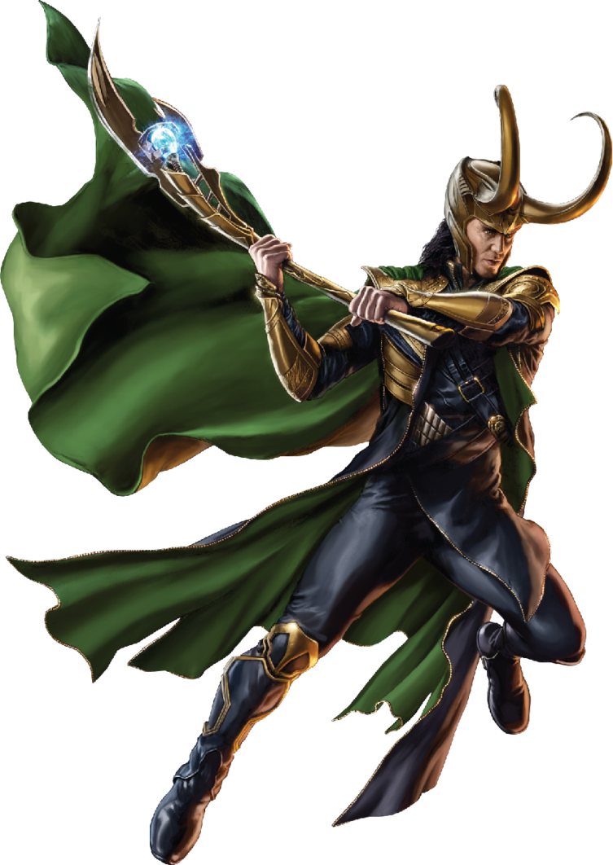
1* - Imagine Loki has escaped! He has been up to no good and is wanted by Odin.
Create a WANTED poster for Loki. Try to add as much detail as you can so they can find him.

Slide 4
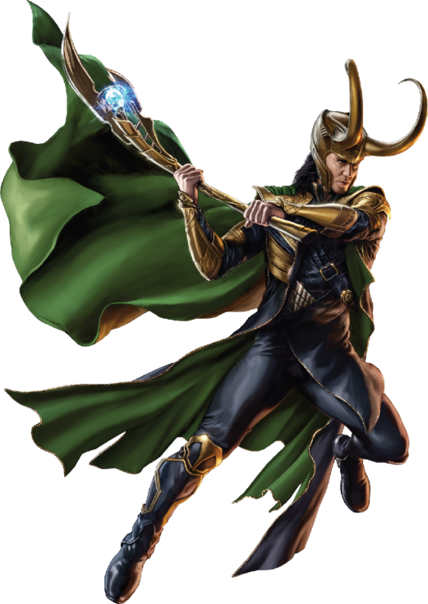
2/3* - Compare and contrast the characters of Loki and Thor. What makes them similar? What makes them different? Use the information from the stories and the research to help your ideas.
____________________________________________________________________________________________________________________________________________________________________________________________________________________________________________________________________________________________________________________
____________________________________________________________________________________________________________________________________________________________________________________________________________________________________________________________________________________________________________________

Slide 5
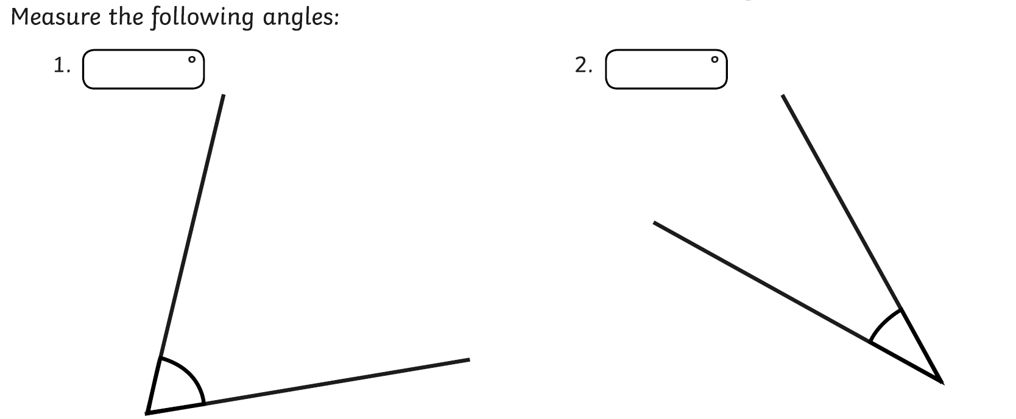
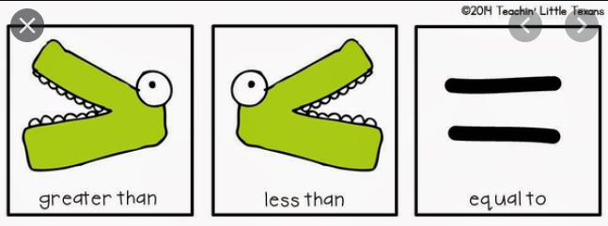
Maths:
Objective: To draw and measure lines of angles
accurately and compare the sizes.
(1) Angles: measuring angles and their names! | Educational Videos for Kids - YouTube
How can we use our rulers accurately to draw lines carefully in centimetres and
millimetres?
Today you will be learning how compare
angles using the more than. Less than
and equals symbols.
You will also have a go at drawing accurate
lines using your rulers.
Click on the link above for a quick re-cap on all the various angles which exist. Revise your knowledge of all of the different types of angles and think about how the sizes of angles can vary.
1* - Have a look at the angles and compare the two angles you can see using the more than, less than and equals symbols. Have a go at drawing these angles too.
2*/3* - Today you will be drawing lines accurately using your rulers and comparing the lengths of various lines. You will need to think about accuracy and identifying differences between centimetres and millimetres.
Extension: Complete the True or False statement focusing on length.
Have a go at drawing an acute angle
and measuring the length of the lines.
As a challenge, use a protractor to
measure how many degrees it has.

Slide 6
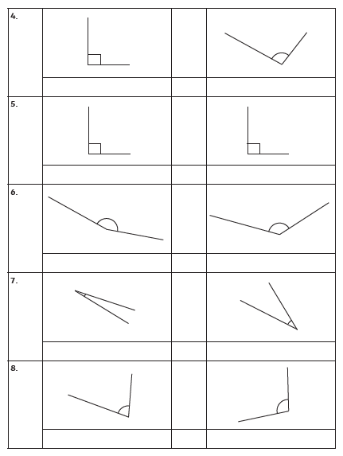
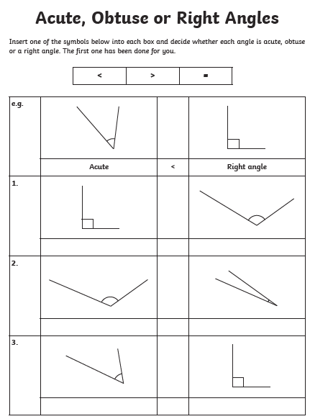
1 STAR TASK!

Slide 7
2/3 STAR TASK!

Slide 8
Extension Task!
We would like you to explore this statement by
drawing the line you see above. How many
Centimetres and how many millimetres is it?

Slide 9
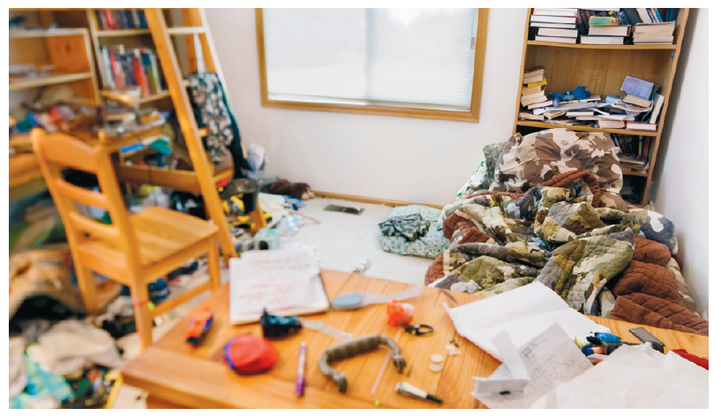
Reading:
Objective: To use noun phrases to describe an image.
George spends nearly all his time inside his bedroom. Do you think his room would be tidy or messy?
https://www.bbc.co.uk/bitesize/topics/zwwp8mn/articles/z3nfw6f
Have a look at the link above to remind
yourself how to write a noun phrase.
Task…
1* - Write a noun phrase for each of the following nouns: the chair, the floor, the shelves, the bed and the desk.
2/3* - Write 5 noun phrases from the picture of the messy bedroom.
Then put your phrases into full sentences.
See the next slide for an example to help.

Slide 10
2/3* - Example…
The camouflage covered bed.
The camouflage covered bed sat in front of the book case.
Extra detail such as a preposition (This explains where something is).
The original noun phrase.

Slide 11
Other:
Objective: To recognise the difference between solids, liquids and gases.
Last week, we looked at sorting different objects into solids, liquids and gases. Read through the information on the properties of each material before completing the task on the final slide.

Slide 12
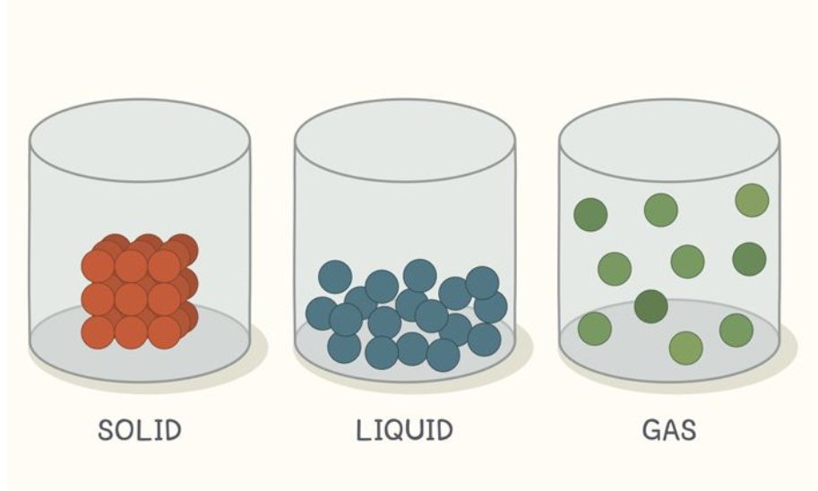
If we were to look at what the tiny particles in the 3 different states they would look like this…. Can you spot the differences?

Slide 13
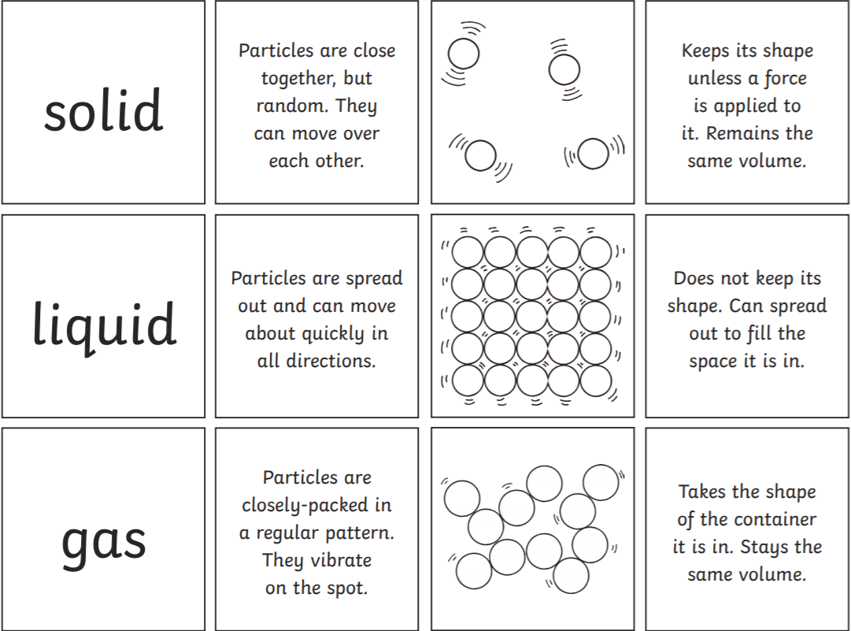
Task… Write down in your books or cut out and stick in your books which statement applies to which state?
Each key word should have 2 statements and a diagram.

