Slide 1
Remote Learning Plan!
Hello Year 4!
During the next few weeks, we will be providing the children with remote learning on a daily basis. The work will be available on the website the day before e.g. Monday’s work will be online Sunday.
Everyday the remote learning will consist of:
English Lesson
Maths Lesson
Reading Lesson
One other curriculum lesson (PSHE, Art etc)
We will be available during the hours of 9am-4pm so please feel free to contact us on our new e-mail njs.year4@taw.org.uk
Some of the work provided will be split into the star levels that the children use everyday in class (1,2 3).
Stay safe everyone!
Miss Jones, Mrs Jukes, Mrs Kuczynska and Mrs Sisson.

Slide 2
English:
Objective: To finish writing my own myth and edit for spelling and punctuation errors.
Main Task… ALL!
Today, you have the opportunity to write the second half of the myth you planned Wednesday. This means, you will complete the sections: next, mythical monster, then, conflict and resolution.
1* - Focus on writing clear sentences and adding adjectives where you can. Remember an adjective is a describing word such as: strong, brave.
2*/3* - Use the word mats on the next few slides to help improve your writing. Remember paragraphs and aim to write as much as you can.
When you finish, check through your work for simple spelling mistakes, missing punctuation or words and any areas you could improve the vocabulary. Use the word mats to see if you can use ambitious vocabulary!
We cannot wait to read your myths so please send them to your teacher or njs.year4@taw.org.uk

Slide 3
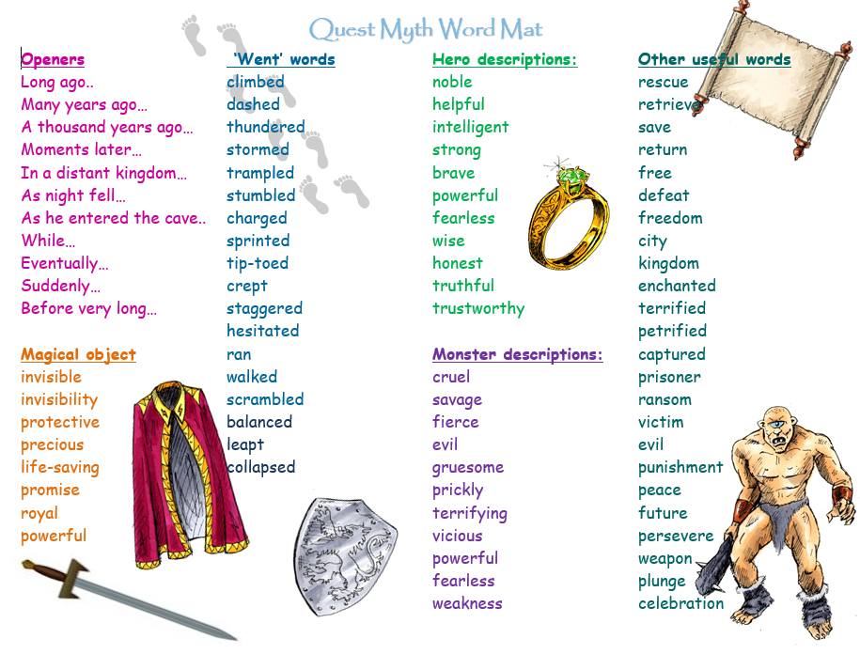

Slide 5
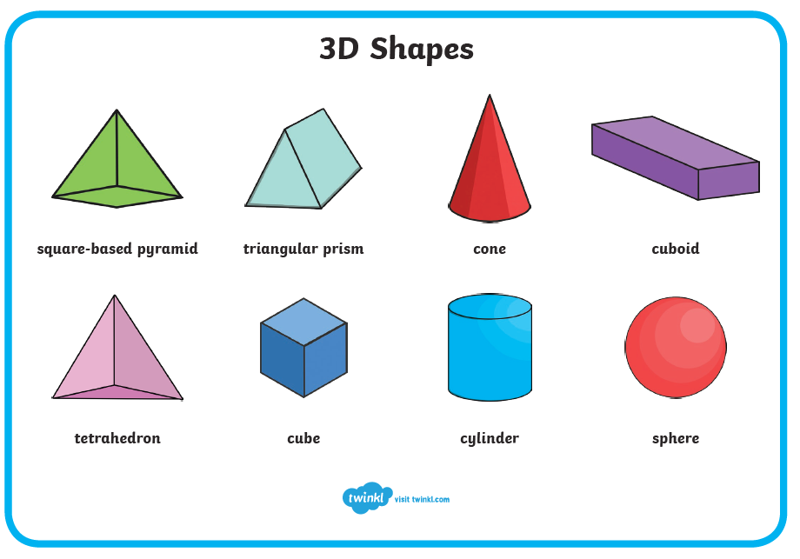
Maths:
Objective: To make 3-D shapes.
3-D Shapes and their properties
Today you will be learning all about 3-D shapes and how they are made. Think about how to remember the names of all of the 3-D shapes.
What are their properties? What do their nets look
Like?
Click on the link above for a quick reminder of what 3-D shapes and how they are created using nets.
1* - Have a look at each 3-D net. Choose as many 3-D nets as you like and try and create your own 3-D shapes by cutting out the nets and sticking the edges
together. If you would like to make your shapes secure, stick the nets onto card first.
2*/3* - Today you will be focusing on 3-D shapes. Try and solve the problems and answer the questions. Remember you can use lego cubes to make the structures in the examples.
Extension: Complete the True or False statement explore making a 3-D net shape using straws and see if you can solve the problem and write down what you have discovered.

Slide 7
1 STAR TASK!

Slide 8
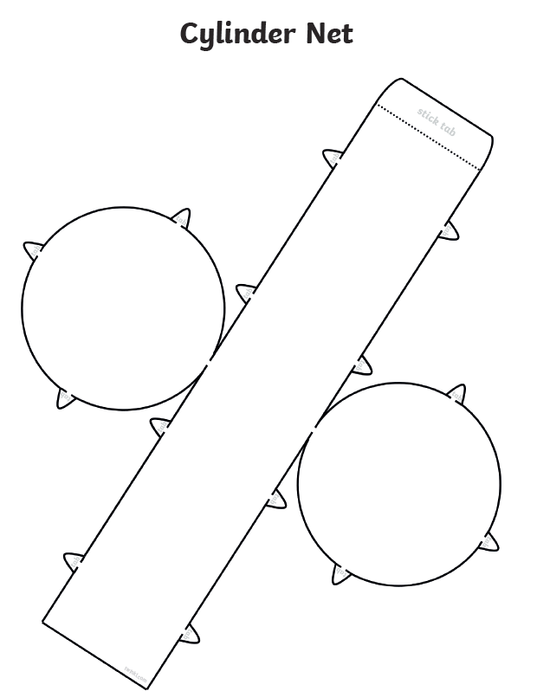
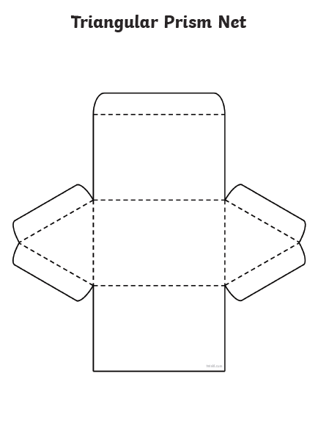

Slide 9
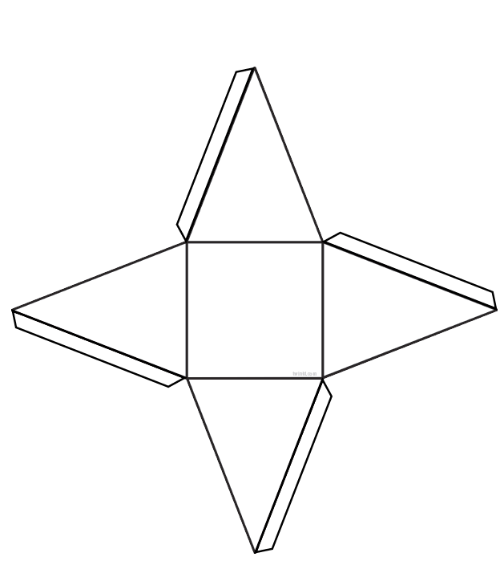
The net of a square based
pyramid.

Slide 10
2/3 STAR TASK!

Slide 12
Extension Task!
Please explore this statement using spaghetti, mechano,
or lego pieces if you do not have any straws.

Slide 13
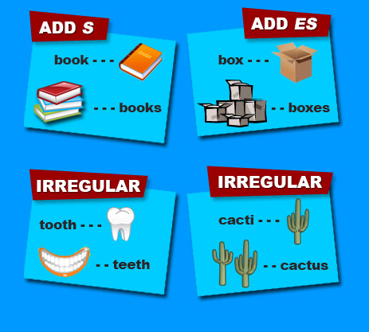
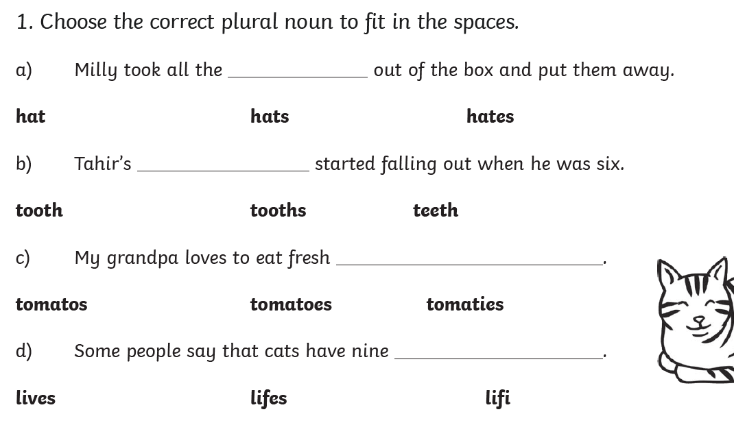
Reading:
Objective: To make singular nouns plural.
Look at the link below to revise how to turn a singular noun into a plural. 1* Task
can be found on this slide. 2/3* task your task is on the next slide.
https://www.bbc.co.uk/bitesize/topics/zbmv2sg/articles/zfqh92p
1*

Slide 14
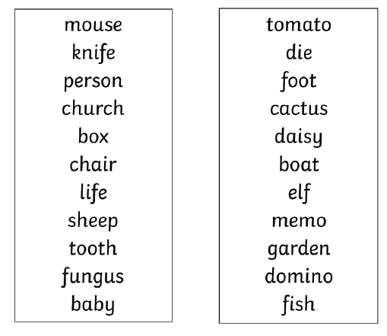
2/3* Task…
Make this set of singular nouns plural and put them into the right group on the next slide.
E.G
Box → boxes
Foot → feet

Slide 15
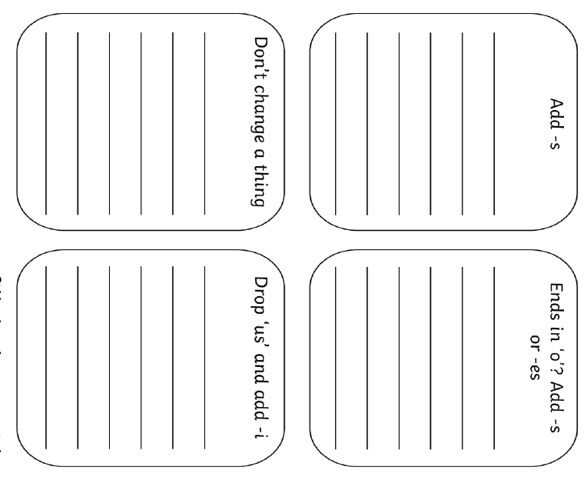
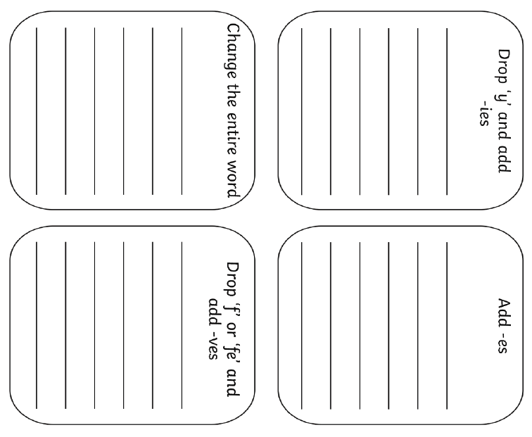
boxes
feet

Slide 16
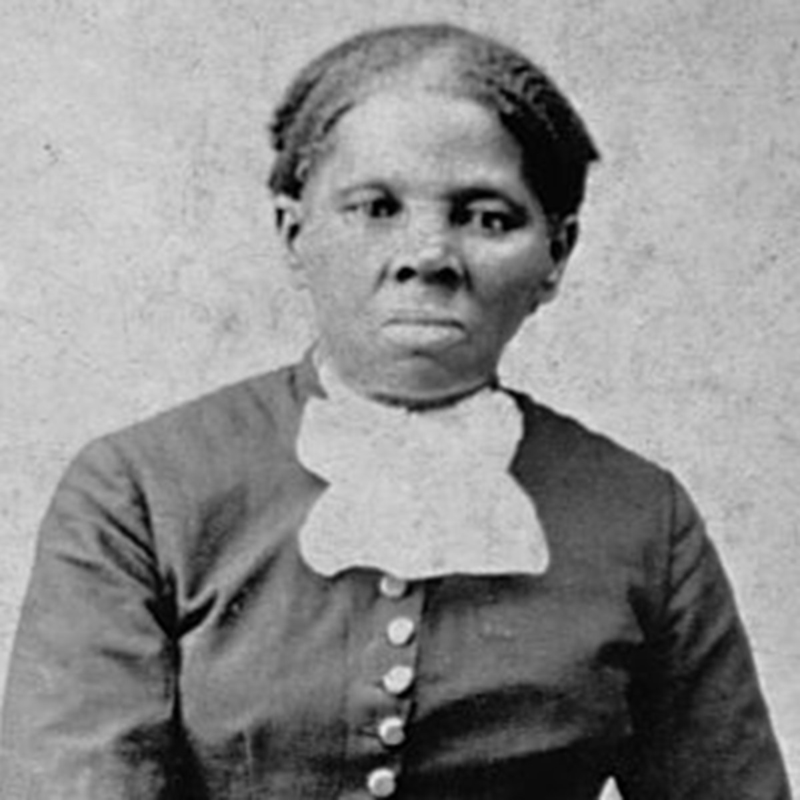
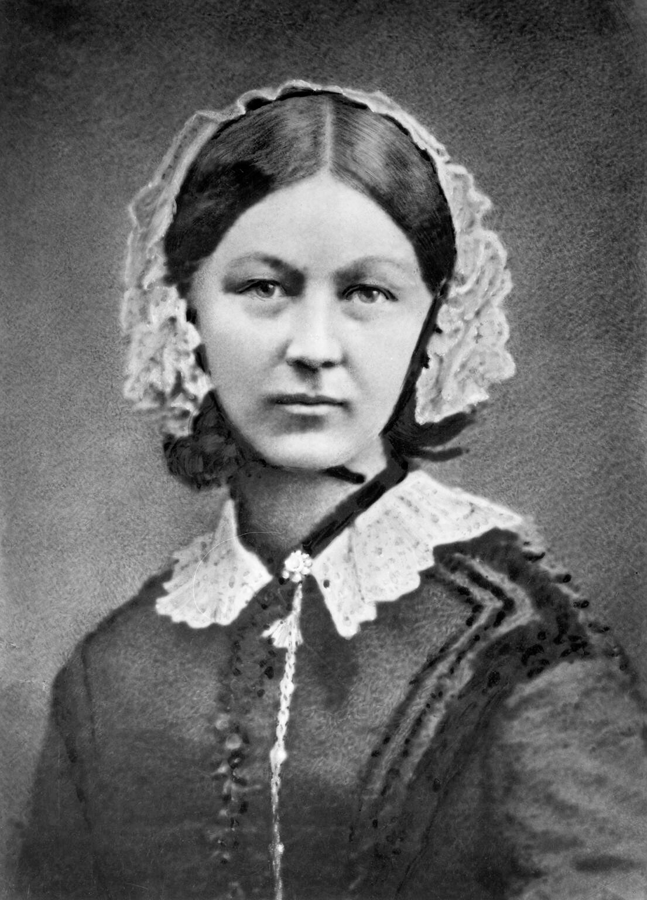
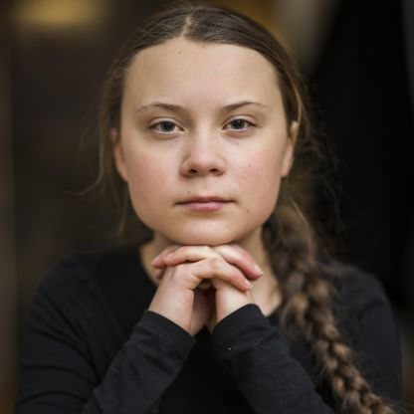
Other: PSHE and Mindfulness
Objective: To research a courageous advocate.
Our courageous advocates – people who inspire us – are:
4J – Harriet Tubman 4NJ – Florence Nightingale 4S – Greta Thunberg
Today we would like you to research and find some information out about your courageous advocate. You will need this for a poster tomorrow.
4S – You will find some information about Greta attached to the website to help start your research. You only need to use the first 2 pages!
4J and 4NJ – You will find a powerpoint on the website to start you off.
Use google to find out some more facts and record these to use tomorrow in your work books.

Slide 17
Other websites that might help are –
4J - https://www.ducksters.com/biography/women_leaders/harriet_tubman.php
https://kids.kiddle.co/Harriet_Tubman
4NJ –
https://www.natgeokids.com/uk/discover/history/general-history/florence-nightingale/
https://kids.kiddle.co/Florence_Nightingale
4S –
https://www.natgeokids.com/uk/kids-club/cool-kids/general-kids-club/greta-thunberg-facts/
https://kids.kiddle.co/Greta_Thunberg

