Slide 1
Remote Learning Plan!
Hello Year 4!
During the next few weeks, we will be providing the children with remote learning on a daily basis. The work will be available on the website the day before e.g. Monday’s work will be online Sunday.
Everyday the remote learning will consist of:
English Lesson
Maths Lesson
Reading Lesson
One other curriculum lesson (PSHE, Art etc)
We will be available during the hours of 9am-4pm so please feel free to contact us on our new e-mail njs.year4@taw.org.uk
Some of the work provided will be split into the star levels that the children use everyday in class (1,2 3).
Stay safe everyone!
Miss Jones, Mrs Jukes, Mrs Kuczynska and Mrs Sisson.

Slide 2
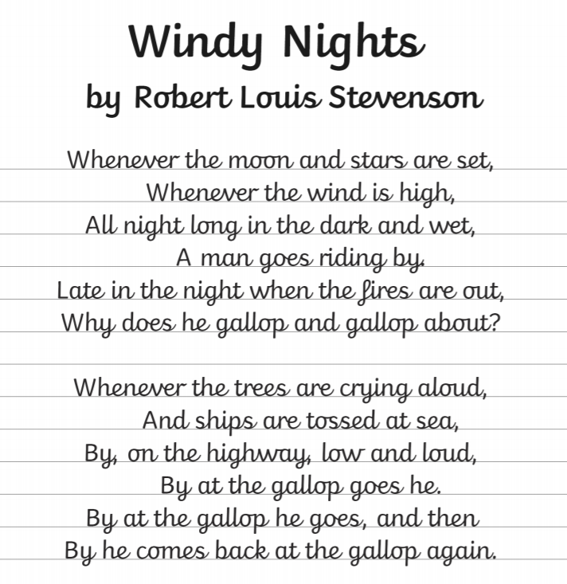
English:
Objective: To practise using cursive handwriting.
We focus a lot on our handwriting in school. Therefore, today we just want you to focus on your cursive handwriting.
Copy the poem ‘Windy Nights’ in your neatest handwriting.
Once you have finished you can decorate your poem with a background or boarder of your choice.
Look at the next slide for some letter formation reminders!
TIP: Take your time and focus on one word at a time!

Slide 4
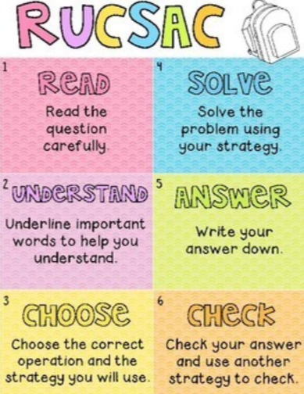
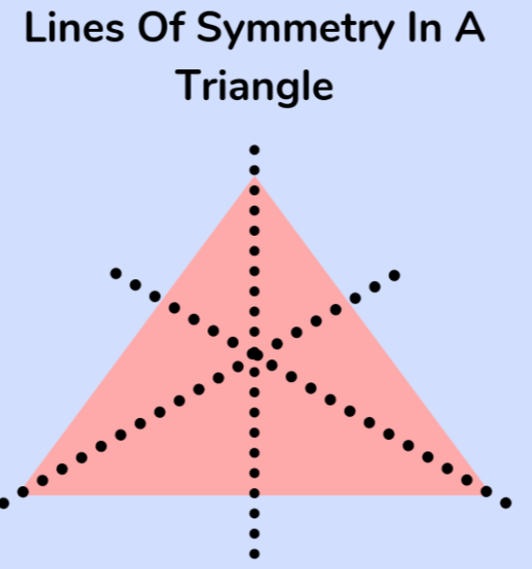
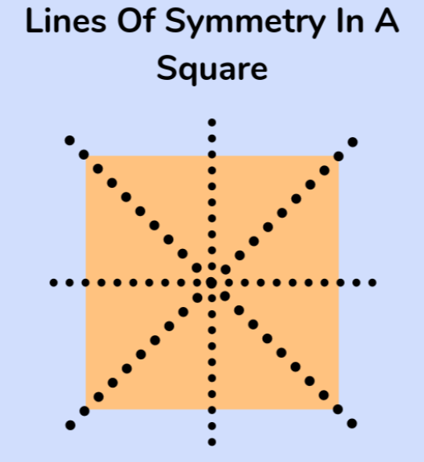
Today you will be focusing on lines of symmetry and solve problems and sort/classify shapes depending upon how many lines of symmetry your shapes have.
Maths:
Objective: To solve problems involving symmetry.
Lines of symmetry in shapes
Click on the link above to learn about lines of symmetry in shapes.
1* - Today you will be solving problems focusing on symmetry within shapes. Use the RUCSAC method to read through and solve the problems.
2*/3* - Today you will be solving problems focusing on symmetry within shapes. Use the RUCSAC method to read through and solve the problems.
Extension: Focus on the symmetrical pattern.
Which shape has the correct lines of symmetry?
Please have a go at solving the problem.

Slide 5
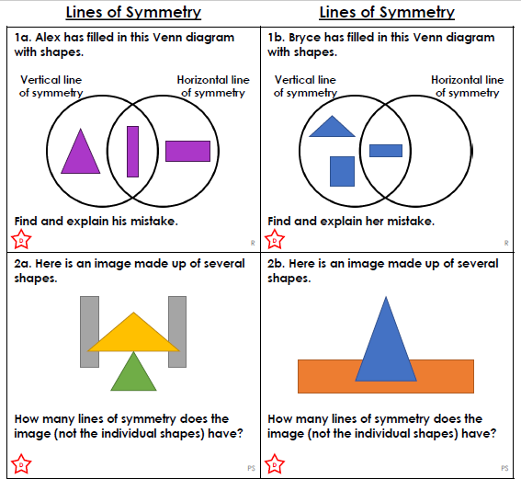
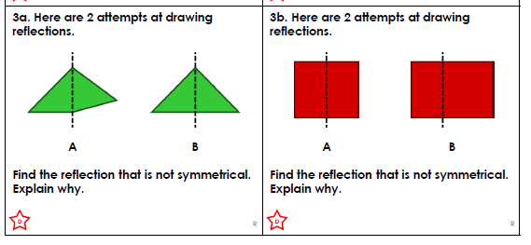
1 STAR TASK!

Slide 6
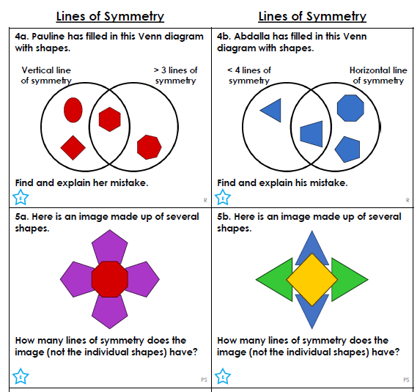
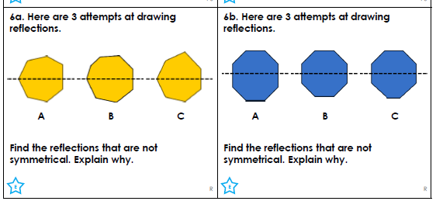
2 STAR TASK!

Slide 7
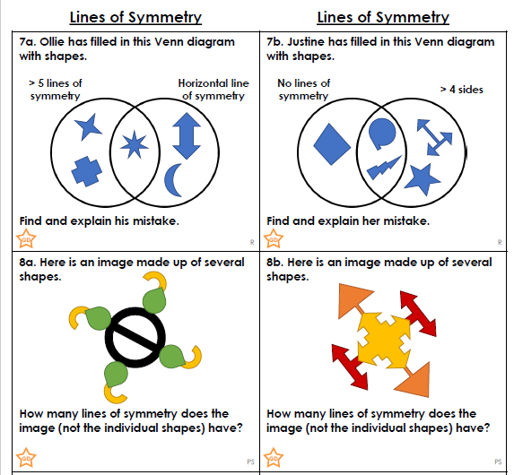
3 STAR TASK!

Slide 8
Extension Task!
Please explore this statement by drawing the shapes. Have a go at discovering how many lines of symmetry each shape has. Try and discover which shape has the correct lines of symmetry marked?

Slide 9
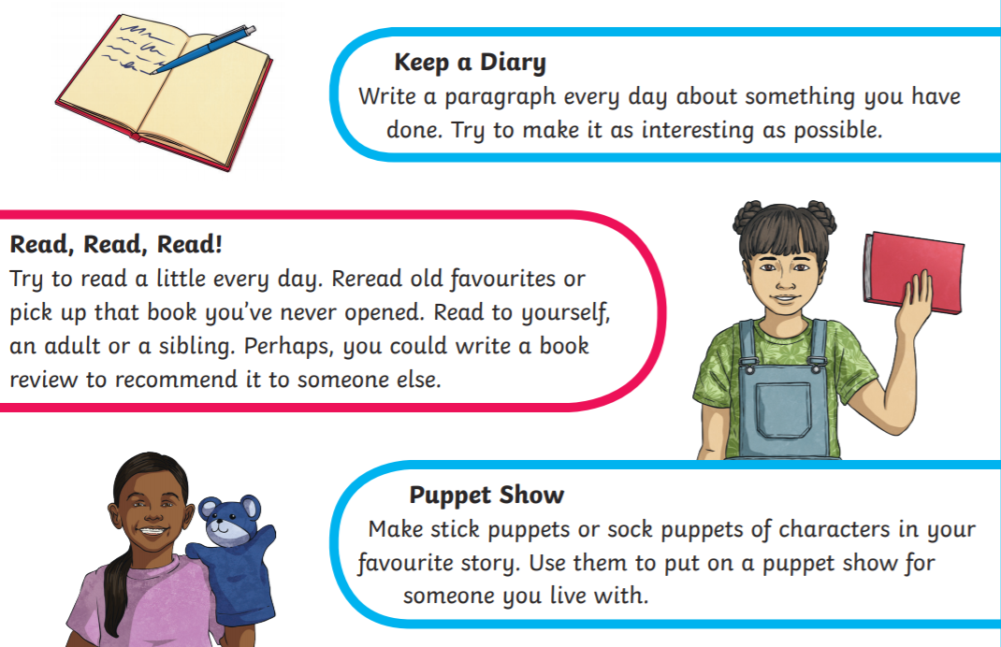
Reading:
Objective: To design a poster with alternative
activities to being online.
Read through the Daily News Article about children spending time online.
We know that George rarely leaves his room as he is always gaming.
Think – Is this healthy for him?
Task…
1* - Design a poster that tells children alternatives to playing online.
2/3* - Write a paragraph summarising how children can stay safe online.
Then design a poster showing children other activities they can do that are not online.
Some screen free ideas can be found on this slide!

Slide 10
Daily News
Technology x UK News x
31st January 2020
Children Spending More Time Online, Says Child wise
How much time are young people spending online? A group called Child wise have been trying to find out. The group says they are a “leading specialist in research with children and young people”. They say that, on average, children spend three hours a day online.
This had increased from their last survey. They also say that 57% of the children they asked slept with their mobiles next to their beds.
The Internet can be an amazing tool! You can use it to talk to friends who live far away, play games and even catch up on what is happening from across the world!
However, Simon Leggett, a researcher for Child wise, said phones “dominate” our lives. So should we take a break from our screens?
The NHS says children should get around an hour of activity per day. Some ideas they suggest include going for a walk or playing with friends at the park. Other people recommend sitting down at mealtimes talking to others and to make them a screen-free time.
Do you know much time do you spend online every day?
Do we spend too much time online?
Should schools ban smartphones?
How can I stay safe online?
Photo: A smartphone.
Notes:
Teacher Note - Please do not let the next video automatically play at the end of the clip. Please check the content in this link, including any comments, is suitable for your educational environment before showing. Twinkl accepts no responsibility for the content of third party websites.

Slide 11
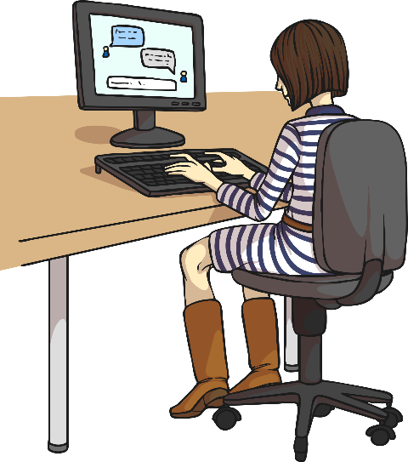
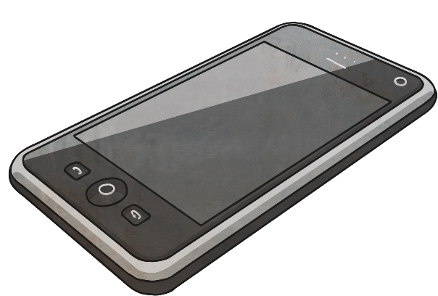
How Can I Stay Safe Online?
communicate
identity
immediately
Technology can be fantastic and allow us to communicate with friends and family across the world.
Tell an adult immediately if you come across anything which scares you, upsets you or makes you feel uncomfortable.
Remember, not everyone online is who they say they are!
Never send a picture of yourself to someone you’ve never met and never meet up with anyone you’ve only talked to on the Internet.
However, it’s important to stay safe when we’re online.
Don’t give out your identity by telling a stranger your name, address or other personal details.
How else can you stay safe online?

Slide 12
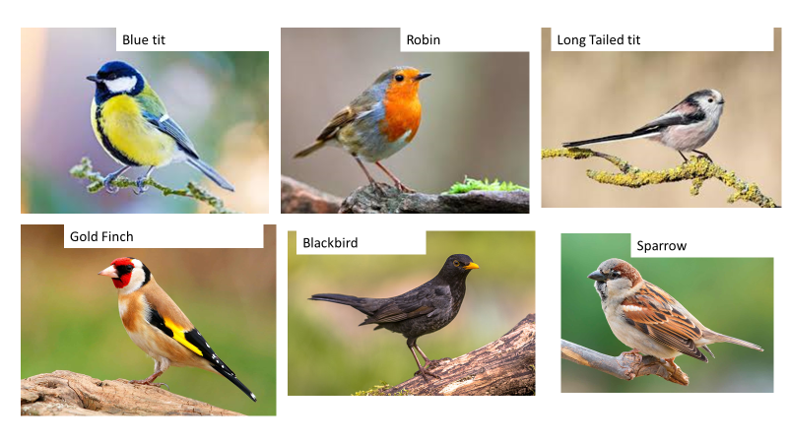
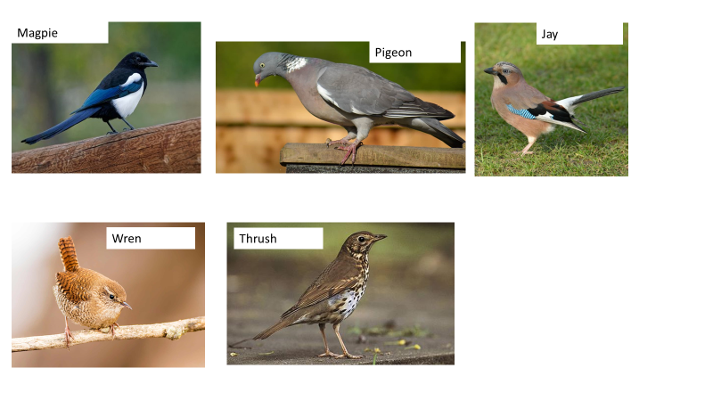
Other: The Big Bird Watch
Objective: To recognise different birds by their sounds and colours.
Look at the birds on the slides –
Can you draw some looking carefully at the colours.
If you would prefer you could use the outline of the birds on the next slides to colour.

Slide 13
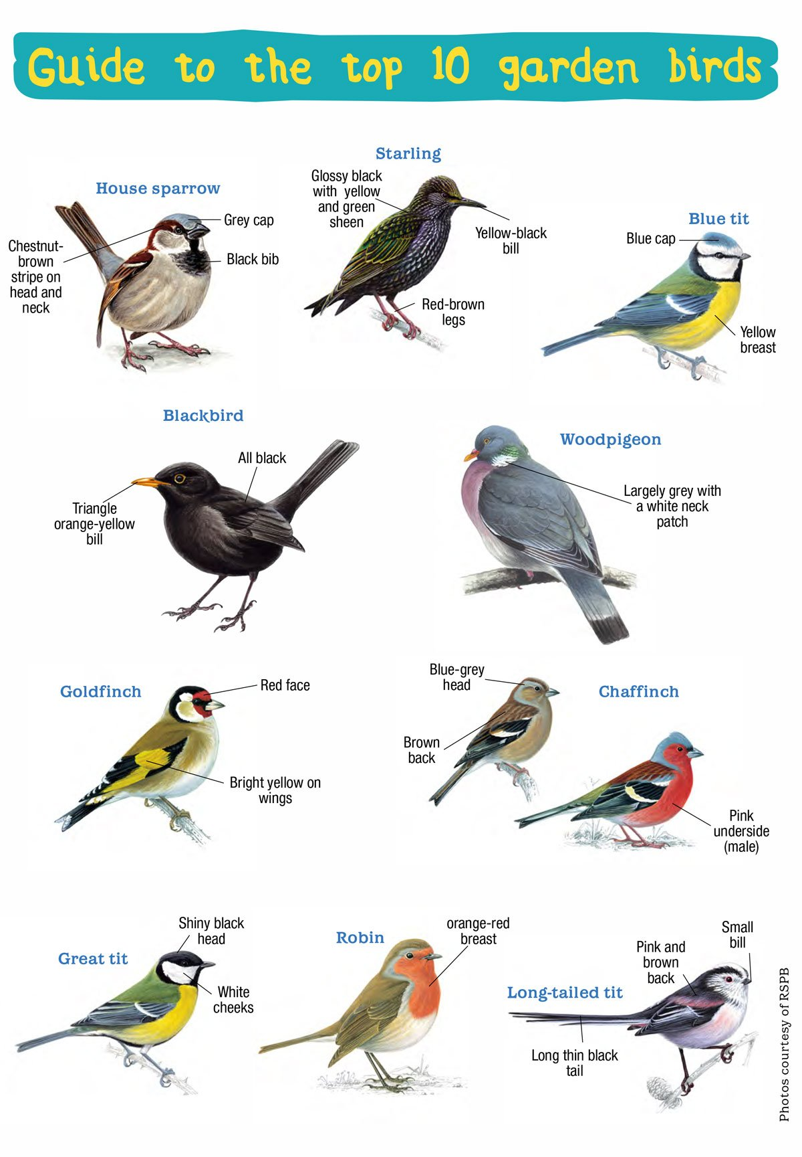
Listen to these sounds and match them back to the birds on the first slide…
Robin - https://www.youtube.com/watch/s9dbAfjlrks
Pigeon - https://www.youtube.com/watch?v=AWet9qFT15M
Magpie - https://www.youtube.com/watch?v=nxtORth2BIY
Jay - https://www.british-birdsongs.uk/jay/
Sparrow - https://www.youtube.com/watch?app=desktop&v=dV1PMs0C5Eo
Black bird - https://www.youtube.com/watch?v=997RTKzc39c
Gold Finch – https://www.youtube.com/watch?v=xtJIl7PNwQM
Wren - https://www.youtube.com/watch?v=ouPPVBBOODI
Thrush - https://www.youtube.com/watch?v=G53oH-MI9qU

Slide 14
