Slide 1
Remote Learning Plan!
Hello Year 4!
During the next few weeks, we will be providing the children with remote learning on a daily basis. The work will be available on the website the day before e.g. Monday’s work will be online Sunday.
Everyday the remote learning will consist of:
English Lesson
Maths Lesson
Reading Lesson
One other curriculum lesson (PSHE, Art etc)
We will be available during the hours of 9am-4pm so please feel free to contact us on our new e-mail njs.year4@taw.org.uk
Some of the work provided will be split into the star levels that the children use everyday in class (1,2 3).
Stay safe everyone!
Miss Jones, Mrs Jukes, Mrs Kuczynska and Mrs Sisson.

Slide 2
An oven that cooks everything for you! You simply add the ingredients and press which meal you would like!
English:
Objective: To create a mind-map of ideas.
Yesterday, you looked at an invention of your choice. Next week, we are going to design something for Wallace and Gromit.
Inventors take the time to mind-map ideas and that is what we are going to do! In the middle of a mind-map place the words ‘My Ideas’.
Come up with as many inventions as you can. Think of ideas that will change your life or help you everyday. For example: a homework machine or a robot that cleans the house.
Mind-map as many ideas as possible before completing the final task below…
Out of your ideas, pick your favourite two! Write a short explanation on why you think they would be good inventions and how they will help people.
BE AS CREATIVE AS YOU CAN BE!
My ideas…
A lawn mower that recognises where the grass is on the garden and cuts it for you.

Slide 3
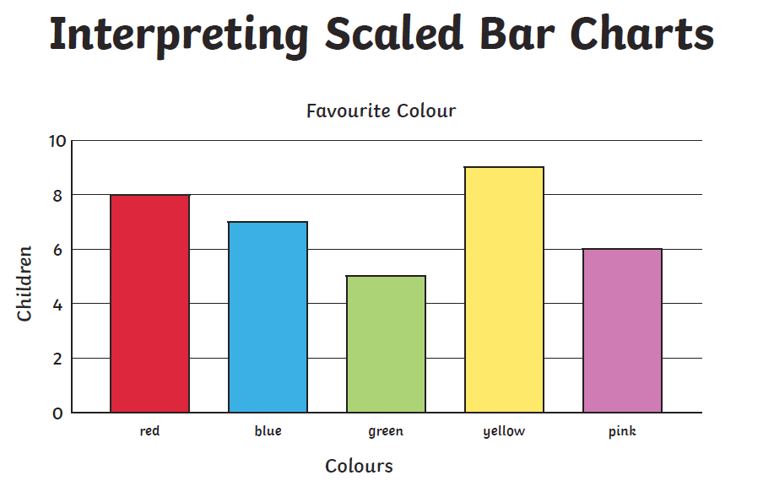
Maths: We will be focusing on Statistics.
Objective: To interpret Bar Charts.
How many children like the colour red?
How many children like the colour green?
What is the most popular colour?
Please watch the video link below and focus on the teaching strategies used to help you interpret Bar charts and retrieve data from them.
Bar Charts
https://newportjuniorschool.org.uk/wp-content/uploads/2019/10/Calculation-Policy.pdf
As we are beginning a new topic, please read the calculation policy which will offer guidance on how to set calculations out.
1* - Today you will be focusing on bar charts and you will need to focus on the bar chart and answer the questions focusing on the data from the bar chart.
2*/3* - Today you will be looking at bar charts and you will need to look at the data carefully and answer the questions.
Extension: Today you will be focusing on the bar chart.
Answer the true or false statement focusing on the bar chart.

Slide 4
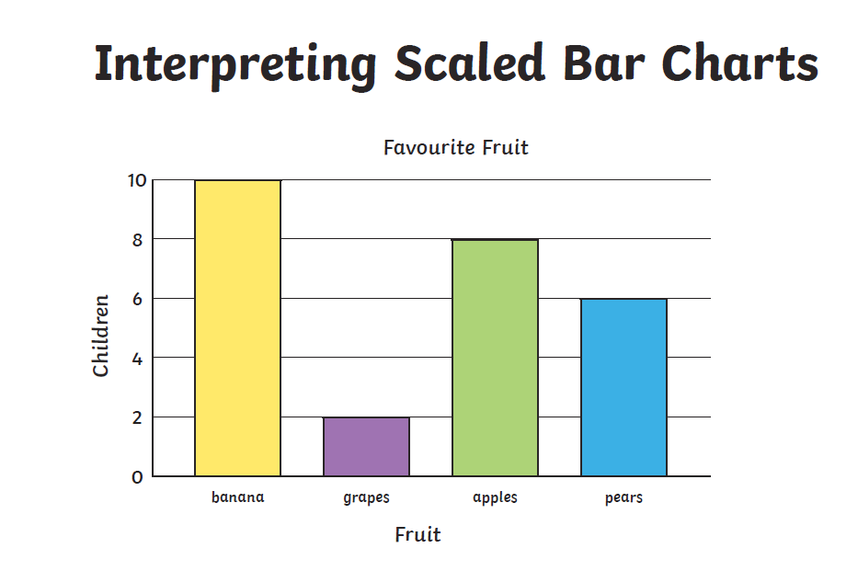
1 STAR TASK!

Slide 5
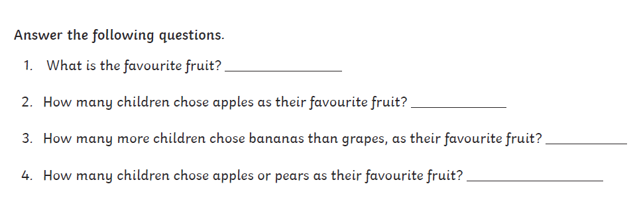
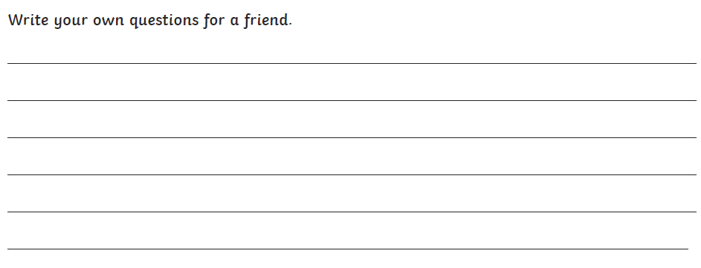

Slide 6
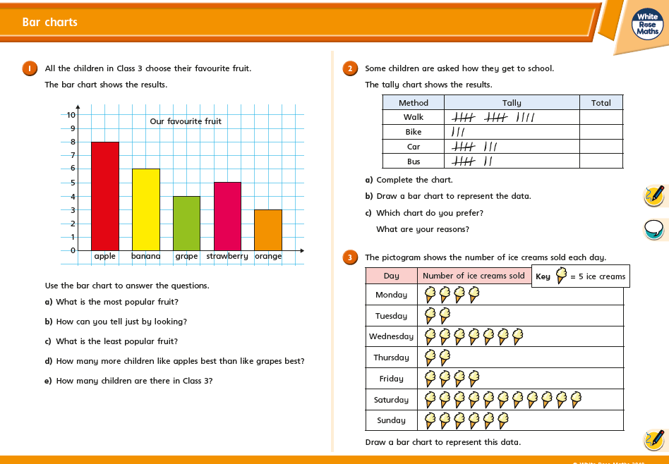
2/3 STAR TASK!

Slide 7
2/3 STAR TASK!

Slide 8
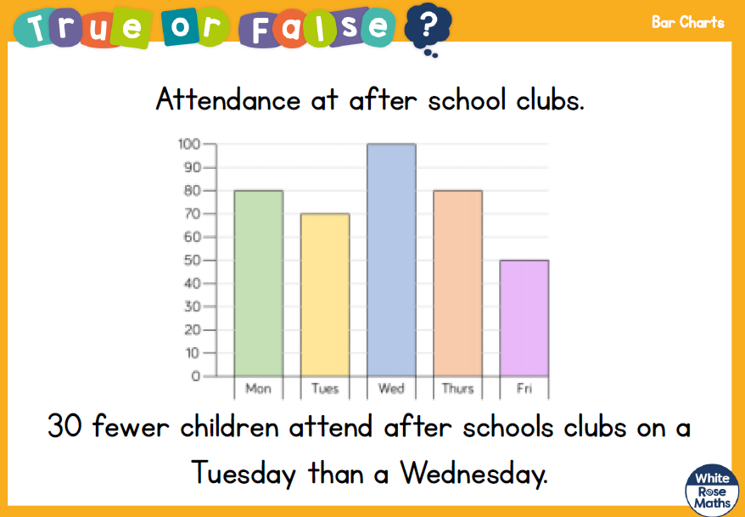
Extension Task!
Please explore this statement by focusing on the Bar Chart.
Look at the Y axis and focus on the number of children attending the after school clubs.
Is the statement correct?

Slide 9
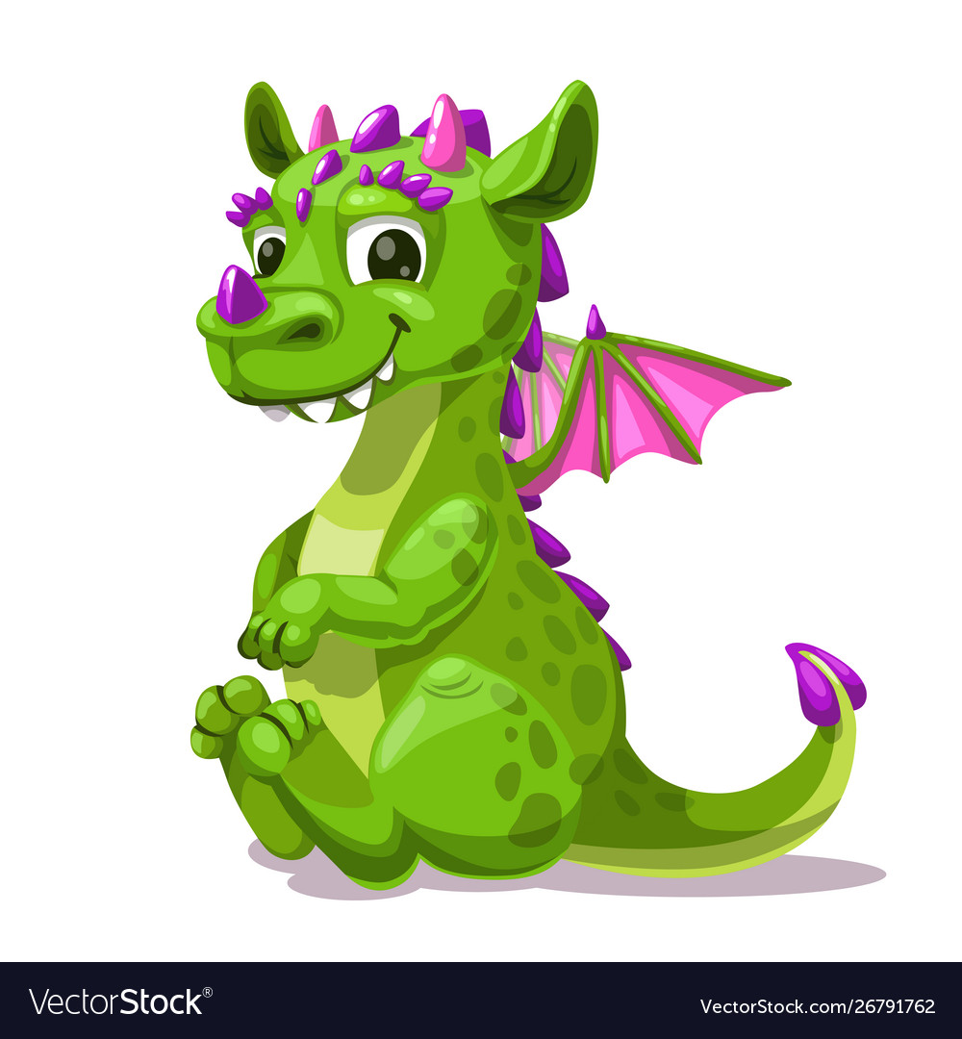
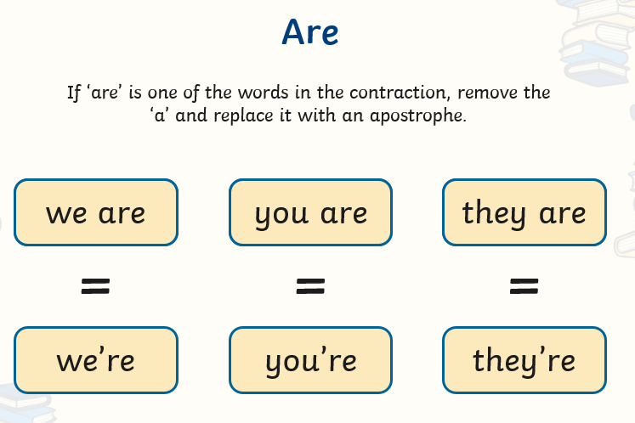
Reading:
Objective: To understand and use contractions accurately.
Sometimes, we join two words together to make
them shorter.
We call these contractions.
Please complete the tasks on the next slides…
The video below provides a recap on using apostrophes for contraction…
https://www.youtube.com/watch?v=OyI8xH2CXsw

Slide 10
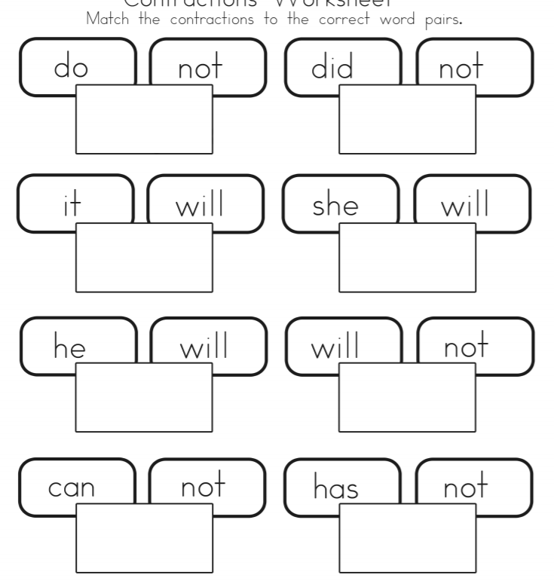
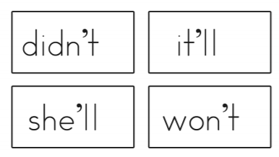
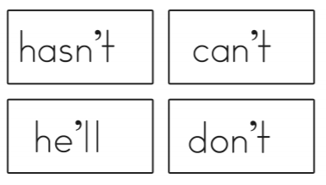
1* -
Task 1… Match the correct contractions to the word pairs.
Task 2… Choose 3 contractions from your sheet and put them into a sentence each.

Slide 11
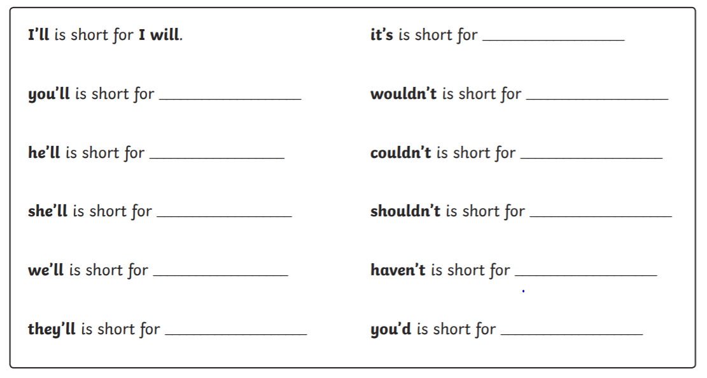
2/3* -
Task 1… Finish the statements in the box. The first one has been done for you.
Task 2… Re-write the sentences, putting the underlined word in the contracted form.

Slide 12
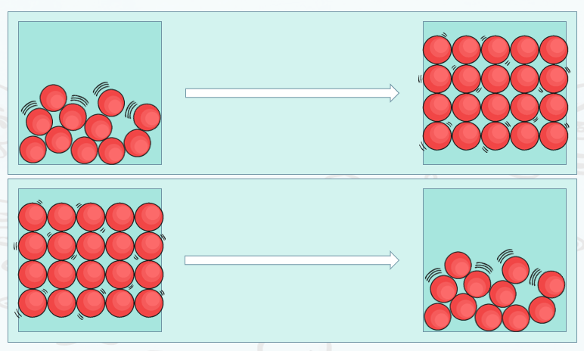
Other: Science
Objective: To understand how materials can change state through heating and cooling.
The following links will support the learning for today…
https://www.youtube.com/watch?v=lLKJuvjIFgQ
https://www.bbc.co.uk/bitesize/topics/zkgg87h/articles/z9ck9qt

Slide 13
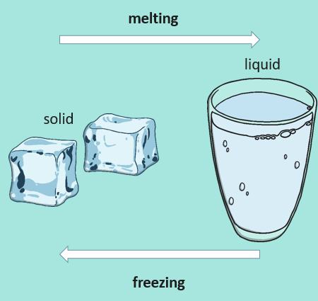
Task –
Task 1… Use the table to answer the questions.
Task 2… What has caused the materials to change.
Remember a reversible change is something that can go back to their original state - ice can be changed back to water and back then into ice again.
Irreversible changes are ones the you cannot change back – bread can be turned into toast but can’t be changed back to bread again.

Slide 14
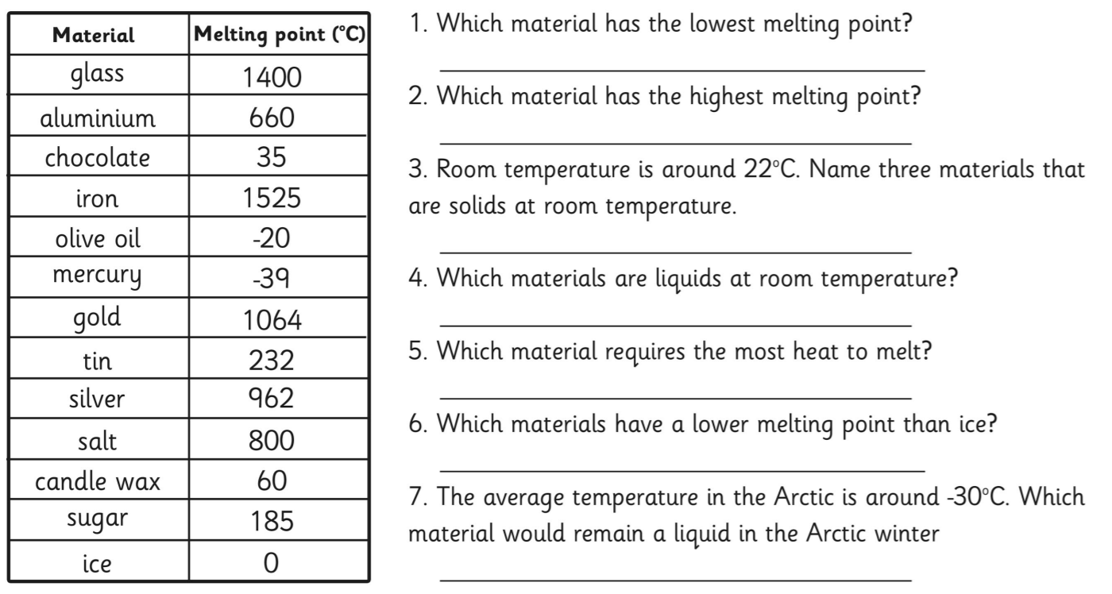
Use the information in the table to answer the questions…

Slide 15
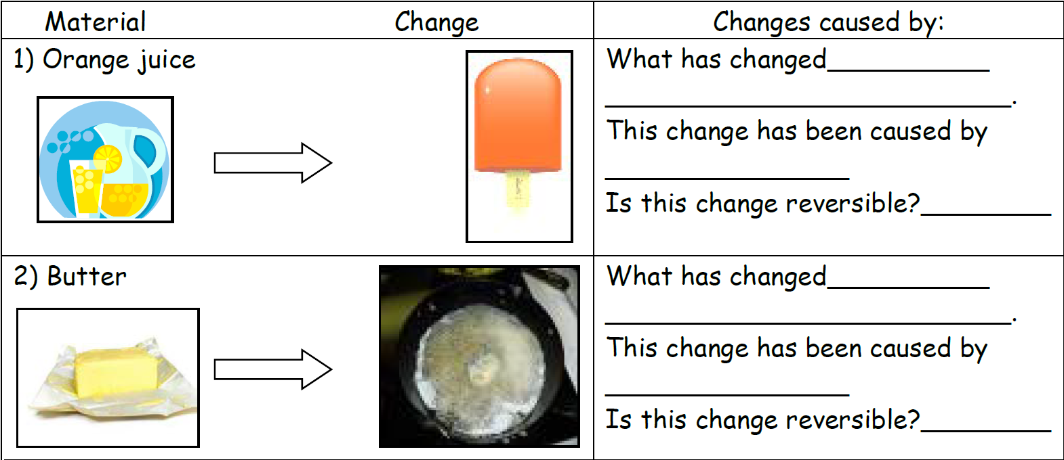
Melting and freezing can cause materials to change; some of these changes may be reversible and some may not. Some materials can exist as both a solid and a liquid. Orange juice is a liquid but when frozen turns to ice and becomes a solid. Chocolate is a solid but when heated begins to melt and becomes a liquid.
Look at the materials below and say what has caused them to change (melting or freezing) and whether this change is reversible. If the change is caused by heating, colour the arrow RED and if it caused by cooling, colour the arrow BLUE.

Slide 16
