Slide 1
Times Table Rock Stars – NJS’ Top Rockers

Slide 2
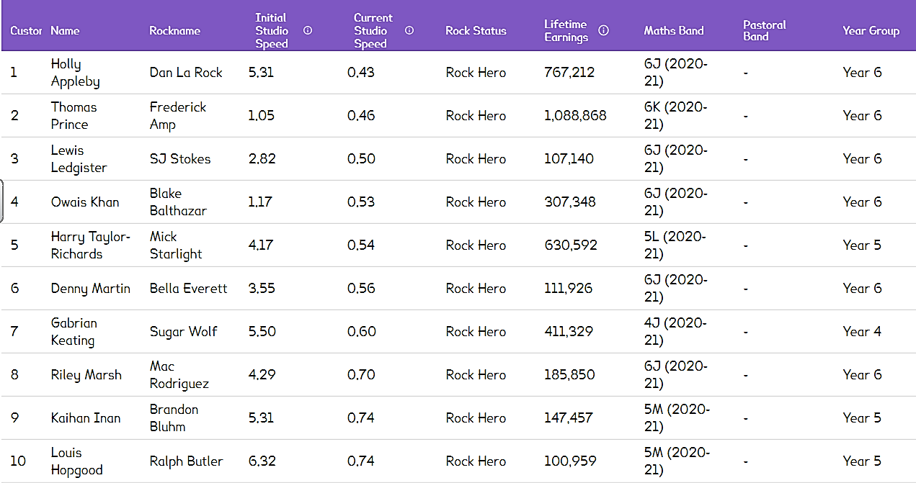
Whole School

Slide 3
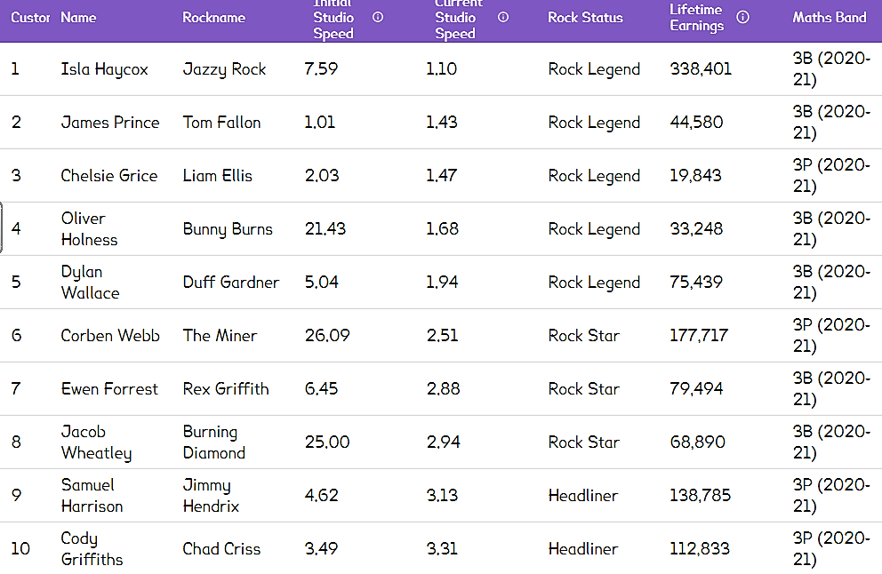
YEAR 3

Slide 4
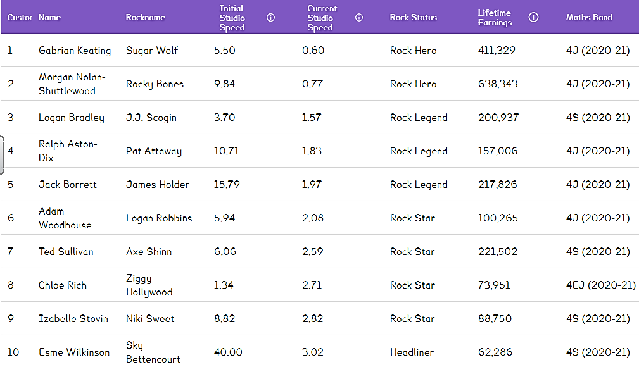
YEAR 4

Slide 5
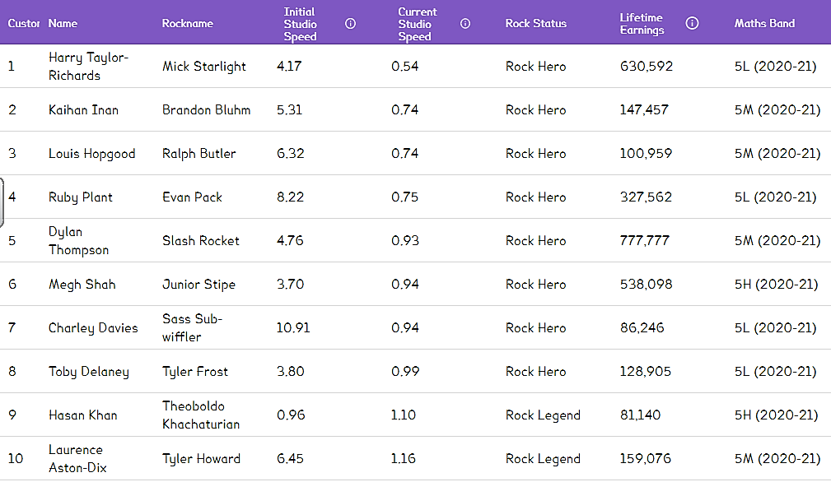
YEAR 5

Slide 6
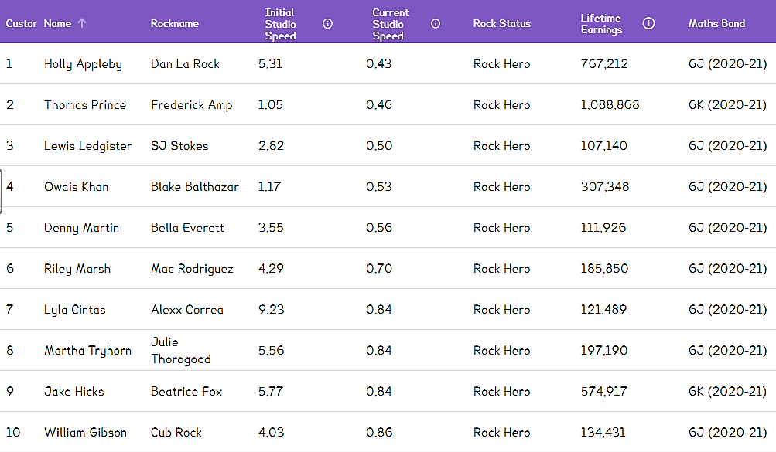
YEAR 6

