Slide 1
Remote Learning Plan!
Hello Year 4!
During the next few weeks, we will be providing the children with remote learning on a daily basis. The work will be available on the website the day before e.g. Monday’s work will be online Sunday.
Everyday the remote learning will consist of:
English Lesson
Maths Lesson
Reading Lesson
One other curriculum lesson (PSHE, Art etc)
We will be available during the hours of 9am-4pm so please feel free to contact us on our new e-mail njs.year4@taw.org.uk
Some of the work provided will be split into the star levels that the children use everyday in class (1,2 3).
Stay safe everyone!
Miss Jones, Mrs Jukes, Mrs Kuczynska and Mrs Sisson.

Slide 2
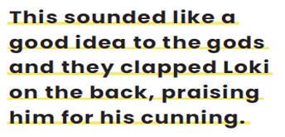
English:
Objective: To recognise features of a myth and find examples within a story.
Main task…
1* - Look at the 3 sentences. Answer the following questions…
Which is your favourite sentence?
Explain why you like it.
What does your favourite sentence tell you about the story?
2/3* - Super Hero Sentences!
See the next slide for your task!
Finish each sentence using the question prompts to support your thoughts.
Sentence 1
Sentence 2
Sentence 3

Slide 3
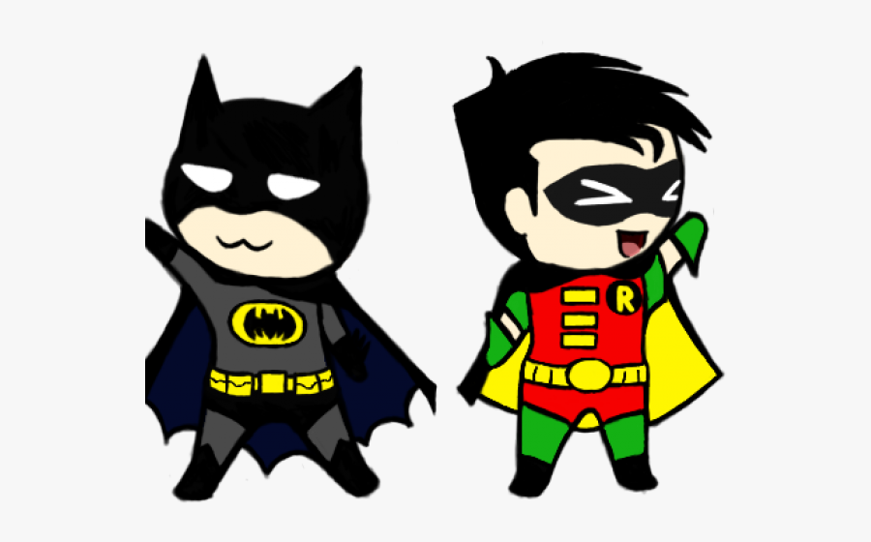
Superhero Sentences… EXAMPLE ON THE NEXT SLIDE!
2/3* - For each sentence on the previous slide complete the task below. These sentences should be completed 3 times for each of the sentences provided.
Each statement has some questions to help prompt your ideas!
This sentence is very revealing because…
(What does it show you? Tell you? What is it not telling you?)
This sentence has an impact upon me because…
(How does it make you feel? Why? Does it remind you of something you have experienced yourself?)
Evidence that supports my view can also be found…
(Can you think of another part of the story that supports your thoughts?)

Slide 4
EXAMPLE 2/3*
You need to complete each statement for all 3 sentences.
This sentence is very revealing because it is showing us the Gods do not always agree with each other. As they discussed the offer, it tells the reader that they were considering saying yes. It is not telling us how long they discussed the matter for.
This sentence has an impact upon me because it makes you question who is the God that disagrees. It also makes you question is you as the reader would accept the offer as well.
Evidence that supports my view can also be found throughout the story because Loki is the one to convince the Gods to take the offer. We know that Loki is the God of mischief so it makes the reader question what his motive is.

Slide 5
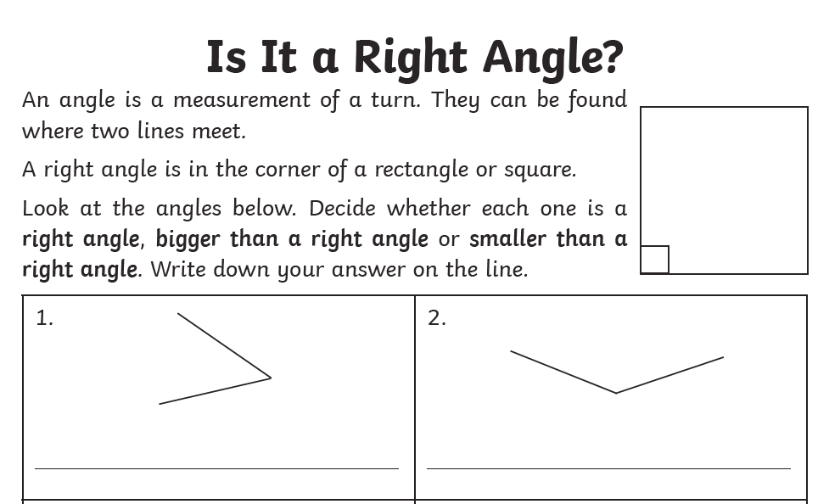
Maths:
Objective: To identify right angles in shapes and solve
Problems involving the use of right angles.
https://www.bbc.co.uk/bitesize/topics/zb6tyrd/articles/zg68k7h
How many degrees are there in a right angle?
This is a right angle, it has 90 degrees and also
shows a quarter turn clockwise.
Click on the link above for BBC Bitesize. Revise your knowledge of all of the different types of angles that exist within shapes.
1* - See next slide for sorting right angles in shapes.
Cut out the shapes on the next slide or draw each shape and place it in the correct column.
2*/3* - Look at the questions and read them carefully.
You will be identifying what right angles are and how we can identify them in various shapes. Read the questions carefully and solve the problems.
Extension: Complete the True or False statement about which shapes contain right angles.

Slide 6
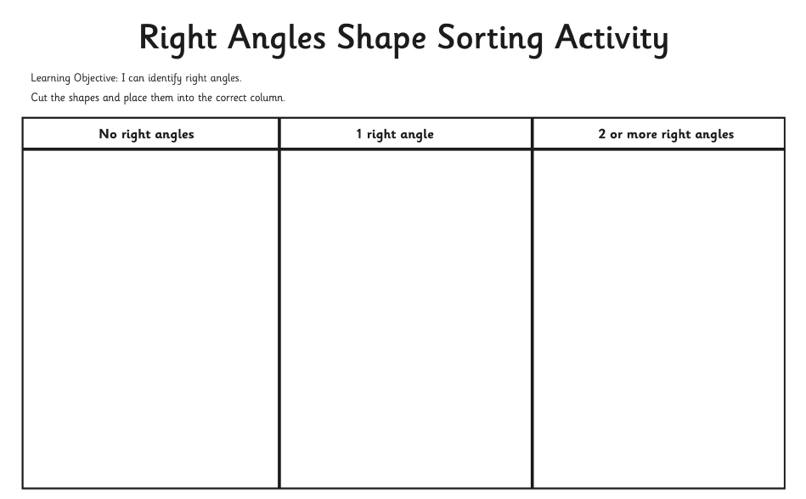
1 STAR TASK!

Slide 8
2/3 STAR TASK!

Slide 9
2/3 STAR TASK!

Slide 10
Extension Task!

Slide 11
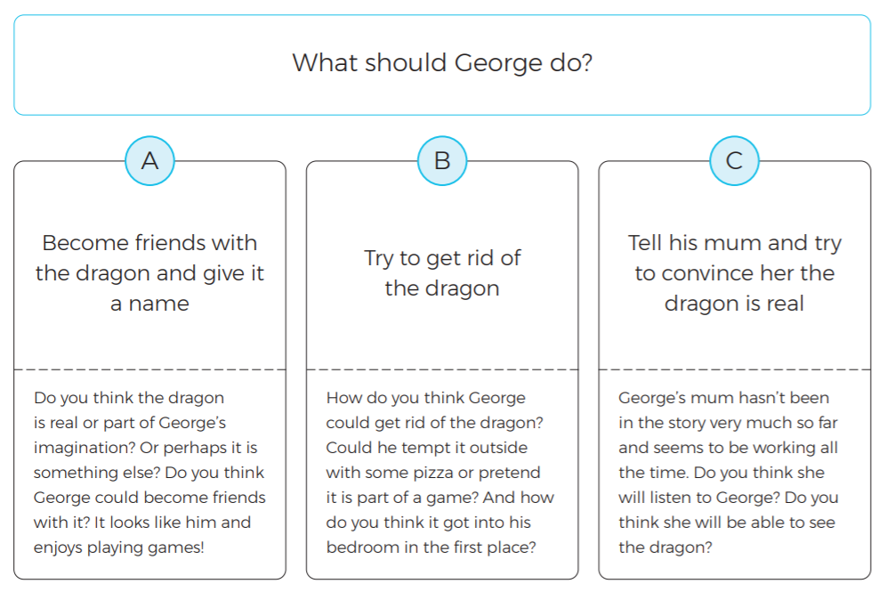
Reading:
Objective: To justify my ideas using the text.
Read Chapter 1… School’s Out!
Think about what George should do next. Choose A, B or C.
1* - Explain why you think George should do your chosen option.
2/3* - Explain why you think George should do your chosen option. Answer the questions in the box to develop your thoughts. Aim for at least a paragraph.
3* Extra Challenge. Find quotes in the chapter to support your ideas.

Slide 18
Other:
Objective: To recall the months of the year in French.
Task…
See in you can identify the months of the year in this word search:
Watch the following video to remind you of the months of the year in French!
https://www.youtube.com/watch?v=qHFapUrSuVM

Slide 19
