Slide 1
Remote Learning Plan!
Hello Year 4!
During the next few weeks, we will be providing the children with remote learning on a daily basis. The work will be available on the website the day before e.g. Monday’s work will be online Sunday.
Everyday the remote learning will consist of:
English Lesson
Maths Lesson
Reading Lesson
One other curriculum lesson (PSHE, Art etc)
We will be available during the hours of 9am-4pm so please feel free to contact us on our new e-mail njs.year4@taw.org.uk
Some of the work provided will be split into the star levels that the children use everyday in class (1,2 3).
Stay safe everyone!
Miss Jones, Mrs Jukes, Mrs Kuczynska and Mrs Sisson.

Slide 2
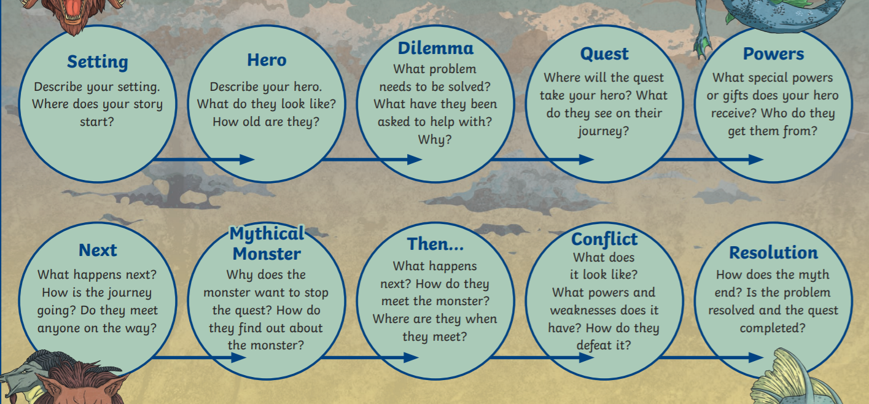
English:
Objective: To plan a myth involving Loki and Thor.
Main task ALL… Yesterday you mapped a quest for Thor and Loki from Asgard to Jotunheim. Below is a planning format for your own myth! Imagine that Odin has sent you (Thor or Loki) on a quest to defeat the giants. Think of a dilemma you may face as you try to save Asgard. When you plan (See next slide), use the questions below to help build your story!

Slide 3
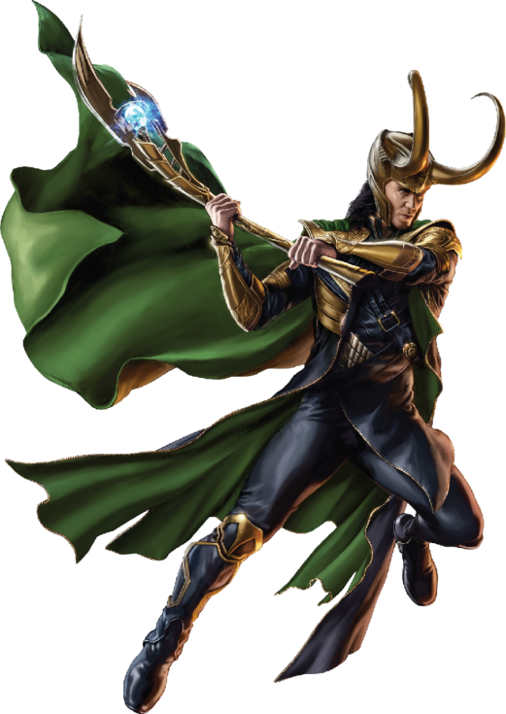
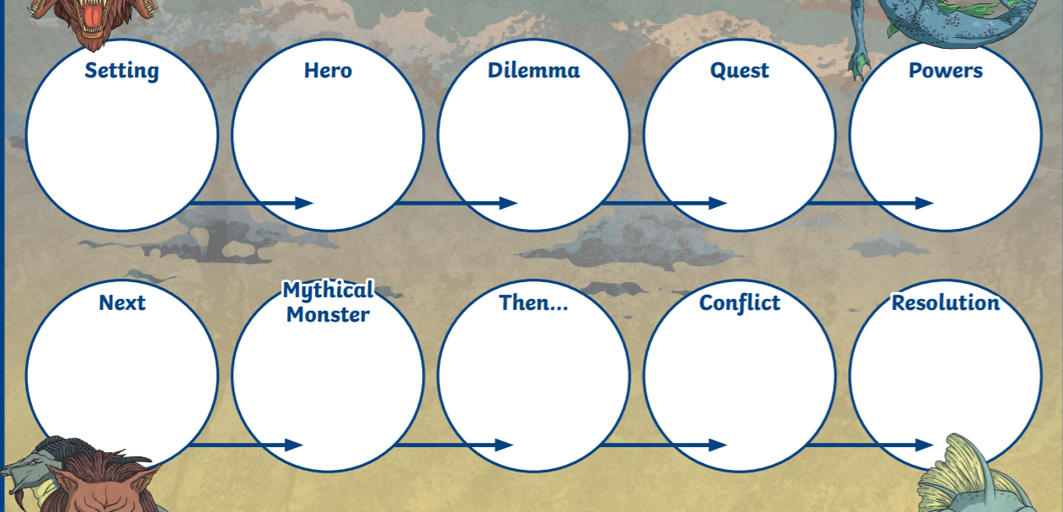

Slide 4
Maths:
Objective: To recognise and describe 2-D shapes.
Identifying 2-D shapes and polygons
Today you will be learning all about 2-D shapes and recognising their properties. Think about how to remember the names of all of the 2-D shapes.
How many sides do they have?
Click on the link above for a quick reminder of what 2-D shapes and polygons are.
1* - Have a look at each shape carefully. How many sides does it have? What is it called? Complete the worksheet and feel free to colour your shapes and make a shape key.
2*/3* - Today you will be focusing on 2-D shapes. Learn the names of the shapes and solve the problems and answer the questions.
Extension: Complete the True or False statement focusing on perpendicular and parallel lines.

Slide 5
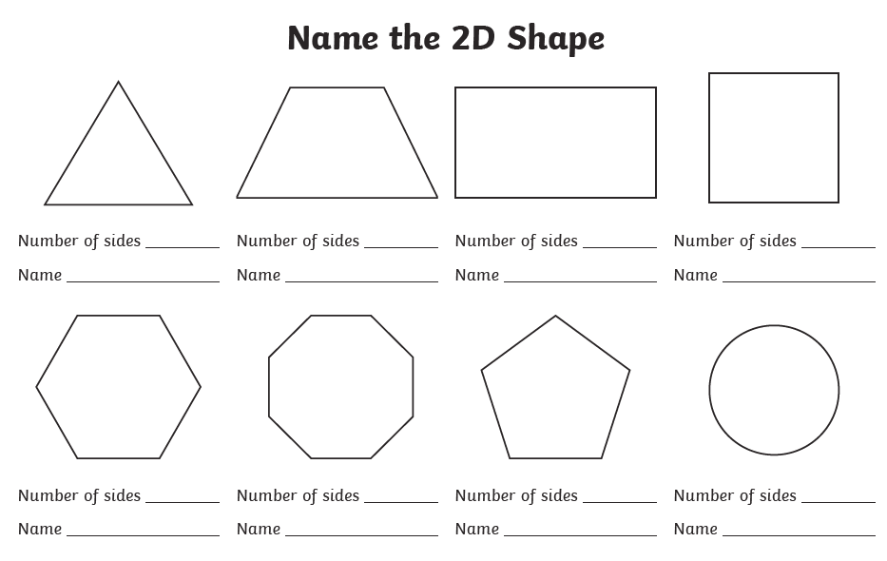
1 STAR TASK!

Slide 6
2/3 STAR TASK!

Slide 8
Extension Task!
We would like you to draw lots of different types
of triangles and explore this statement. Do they
All have 3 sides? Do all triangles have acute angles?
Do any triangles have parallel and perpendicular lines?

Slide 9
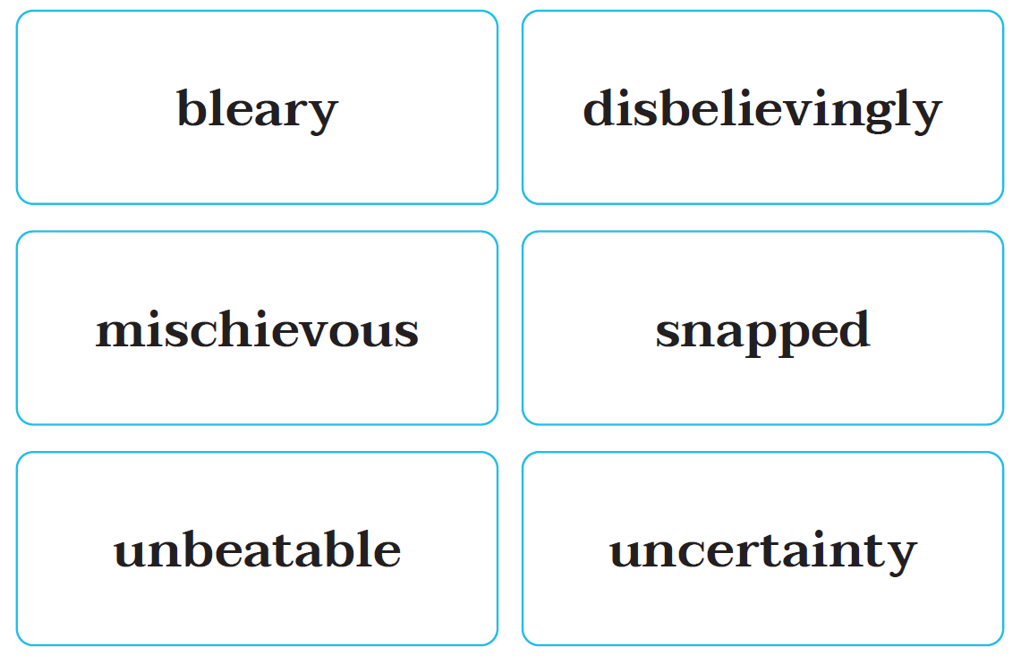
Reading:
Objective: To use a dictionary to find the meaning of new words.
On this slide, you can see 6 ambitious words that the author uses in the text. Re-read chapter 2 – Pizza, pizza, pizza!
Can you find the words in the chapter?
Read how they have been used to see if you can tell the meaning.
Task 1 ALL…
Write down the meaning of each of the words.
You could use the text to help you or an online dictionary… https://kids.britannica.com/kids/browse/dictionary
Task 2 2/3*…
Put each word into a sentence of your own. Your sentence can be as creative as you like.
Please try to add as much detail to your sentences… avoid writing a simple sentence for example: I snapped at my cat.

Slide 13
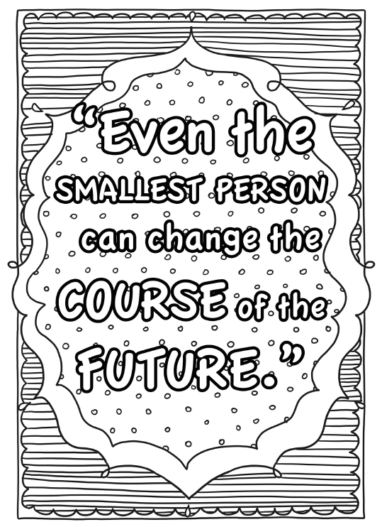
Other: PSHE and Mindfulness
Objective: To recognise the importance of inspiration and what inspires me.
Yesterday you looked at Michael Jordan and how he achieved his dreams and goals. He is an inspiration to us – he gives us hope that we too can achieve our dreams and goals.
Over the next few days we are going to look at inspiration and inspirational people finishing with looking at our courageous advocates for this half term-
4J – Harriet Tubman
4NJ – Florence Nightingale
4S – Greta Thunberg
Today we would like you to choose a colouring sheet that you think would inspire you. Please see the separate document on the website!
When you have completed it if you are proud of your work send it to us so we can display them in the class room. If you cannot print a sheet why not create your own using some of the thoughts on the sheets?

