Slide 1
Remote Learning Plan!
Hello Year 4!
During the next few weeks, we will be providing the children with remote learning on a daily basis. The work will be available on the website the day before e.g. Monday’s work will be online Sunday.
Everyday the remote learning will consist of:
English Lesson
Maths Lesson
Reading Lesson
One other curriculum lesson (PSHE, Art etc)
We will be available during the hours of 9am-4pm so please feel free to contact us on our new e-mail njs.year4@taw.org.uk
Some of the work provided will be split into the star levels that the children use everyday in class (1,2 3).
Stay safe everyone!
Miss Jones, Mrs Jukes, Mrs Kuczynska and Mrs Sisson.

Slide 2
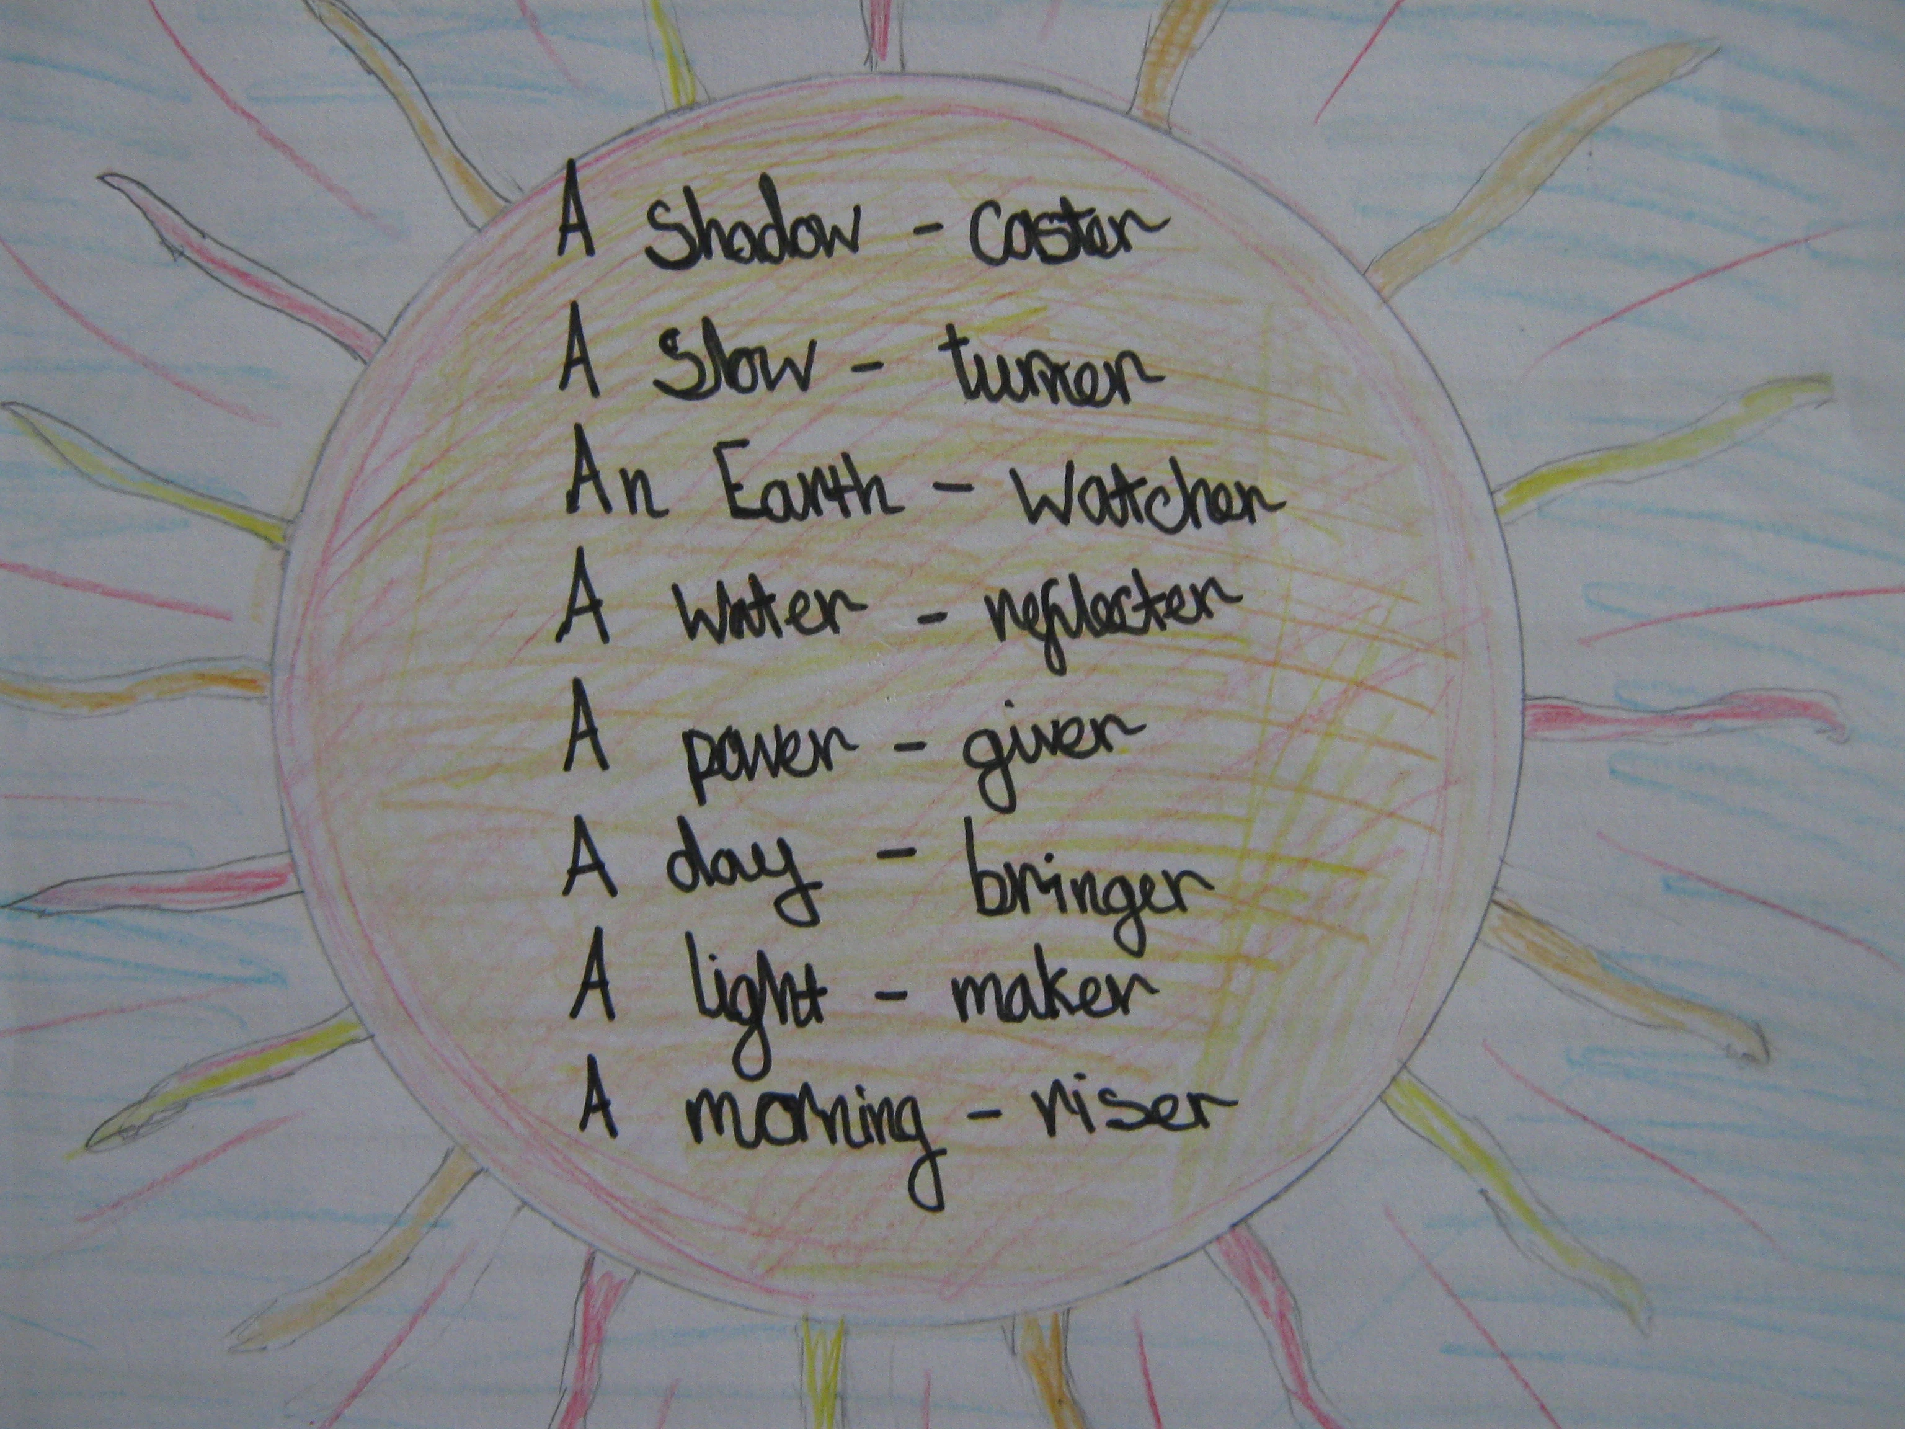
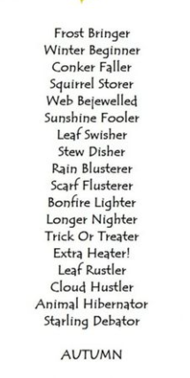
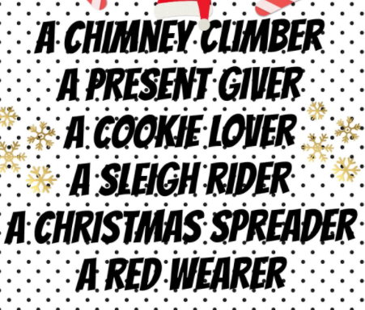
English:
Objective: To write a kennings poem about the seasons.
Main task…
Write a new Kennings poem for either: Winter, Spring, Summer or Autumn.
1* - Pick 1 season and write a kennings or acrostic poem.
2/3* - Pick 2 seasons and write a kennings poem for each.
Make a mind-map of what you associate with the season and then write your poem.
Remember you want people to know you are describing a season without telling them which one.
Use the examples to help you and the reminder on Kennings Rules!

Slide 3
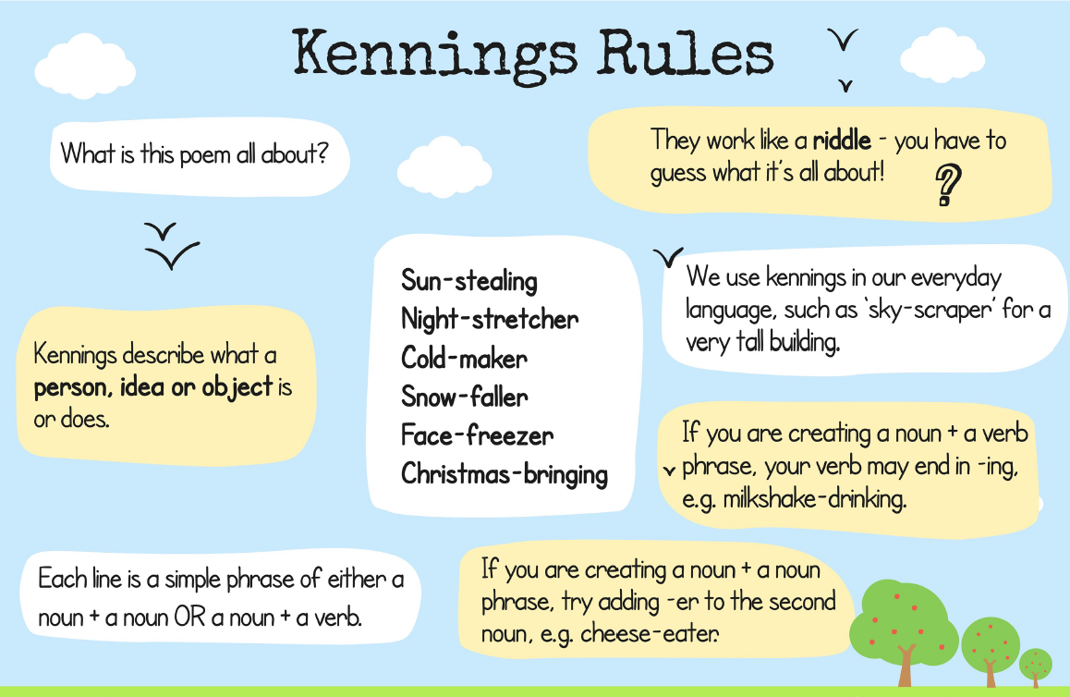

Slide 4
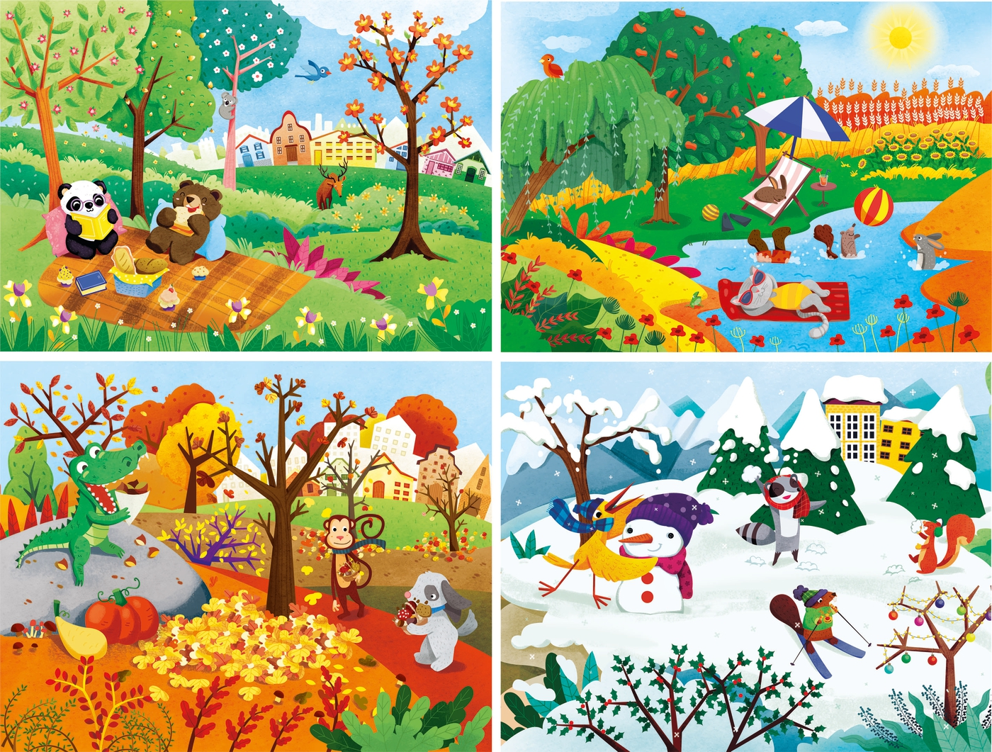
https://www.youtube.com/watch?v=WVM9vaYfe58 - This link may help with finding nouns to build your kennings. Please note FALL = AUTUMN

Slide 5
All- You can brainstorm your ideas using a simple mind-map.
My _________
mind map

Slide 6
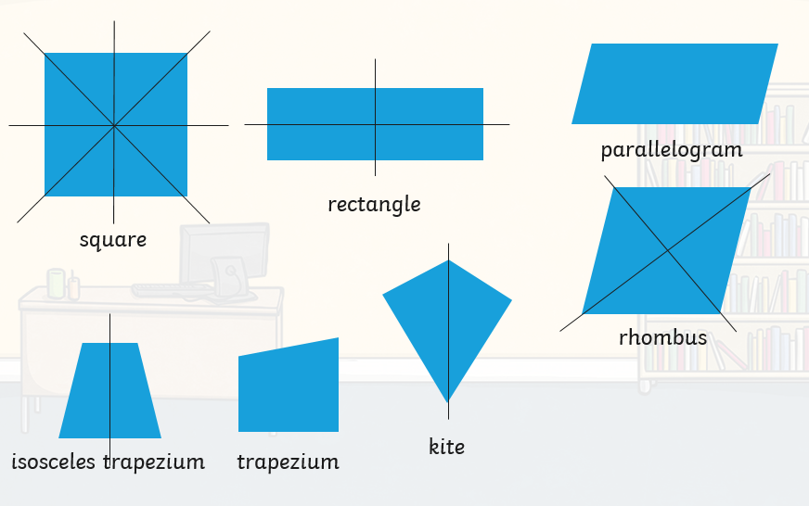
Maths:
Objective: To identify lines of symmetry.
Lines of Symmetry in Shape
Today you will be learning all about lines of symmetry in shape.
Think about:
How many lines of symmetry there are?
Why are there no lines of symmetry in the irregular trapezium below?
Click on the link above to learn about what symmetry is.
1* - Name each shape accurately and write how many lines of symmetry each shape has.
2*/3* - Today you will be focusing on lines of symmetry in a variety of shapes. Think about which shapes have at least one line of symmetry?
Extension: Look at the shapes you can see. Think carefully about how many sides of symmetry each one has. Does it match the number of sides the shape has?

Slide 7
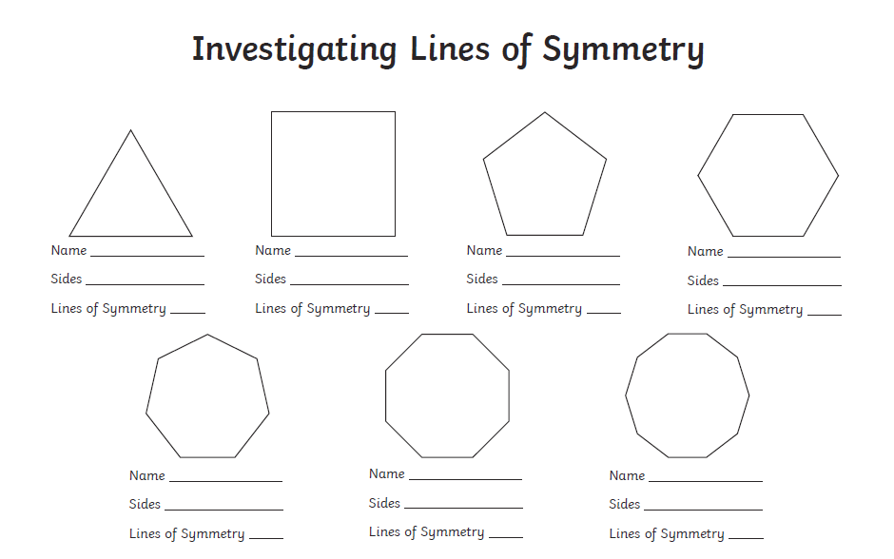
1 STAR TASK!

Slide 8
2/3 STAR TASK!

Slide 10
Extension Task!
Please explore this statement by drawing the shapes. Can you discover all of the lines of symmetry? Do the lines of symmetry
match the number of the sides the shapes have?
Is it true or false?

Slide 11
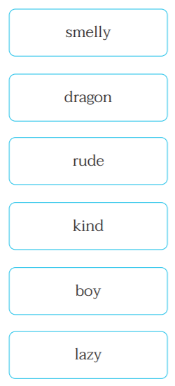
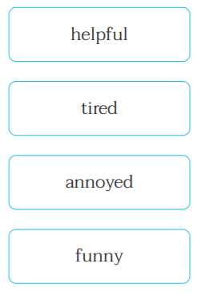
Reading:
Objective: To describe characters in the story.
Read the chapter ‘A Monster Under My Bed’.
The words on this slide all can be associated with the characters… George, Pepperoni, Mum or Ajay.
1* - Pick 1 word you would associate with each character. For example: George = Lazy.
Once you have your word, put it into a full sentence to describe the character in detail.
2/3* - Pick 2 words you would use to associate with each character. For example: George = lazy and smelly.
Then write two descriptive sentences for each character. However, your sentence must include your chosen words!
Please see an example for each star on the next slide!

Slide 12
1* Example…
2/3* Example…
George = Lazy.
George is a lazy person because he is making his mum do everything for him.
Ajay = Annoyed
George has not been a good friend to Ajay by ignoring him all summer so he is annoyed.
George = Lazy and smelly.
Since the start of the holidays, George has not left his room. His lazy attitude can be seen through allowing his mum to do everything for him rather than do it himself. As George has not left his room nor has he changed from his pyjamas, this shows the reader he is probably quite smelly.
Use the example to write your own descriptions of George, Pepperoni, Ajay and Mum.
You can only use the words provided on the previous slide!

Slide 13
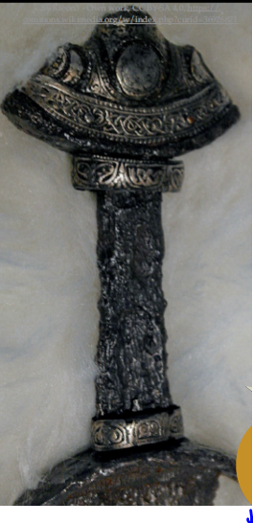
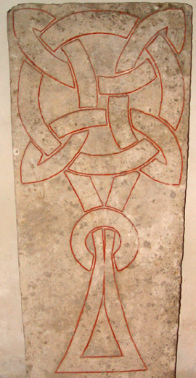
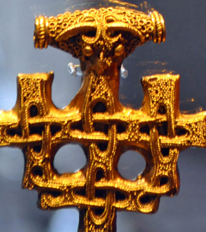
Other: Art
Objective: To be able to draw Viking patterns.
Main Task… Follow the steps on the next few slides to create your own Viking patterns.
You can explore the size of your pattern (make them big or small) and experiment with different colours!

Slide 16
