Slide 1
Remote Learning Plan!
Hello Year 4!
During the next few weeks, we will be providing the children with remote learning on a daily basis. The work will be available on the website the day before e.g. Monday’s work will be online Sunday.
Everyday the remote learning will consist of:
English Lesson
Maths Lesson
Reading Lesson
One other curriculum lesson (PSHE, Art etc)
We will be available during the hours of 9am-4pm so please feel free to contact us on our new e-mail njs.year4@taw.org.uk
Some of the work provided will be split into the star levels that the children use everyday in class (1,2 3).
Stay safe everyone!
Miss Jones, Mrs Jukes, Mrs Kuczynska and Mrs Sisson.

Slide 2
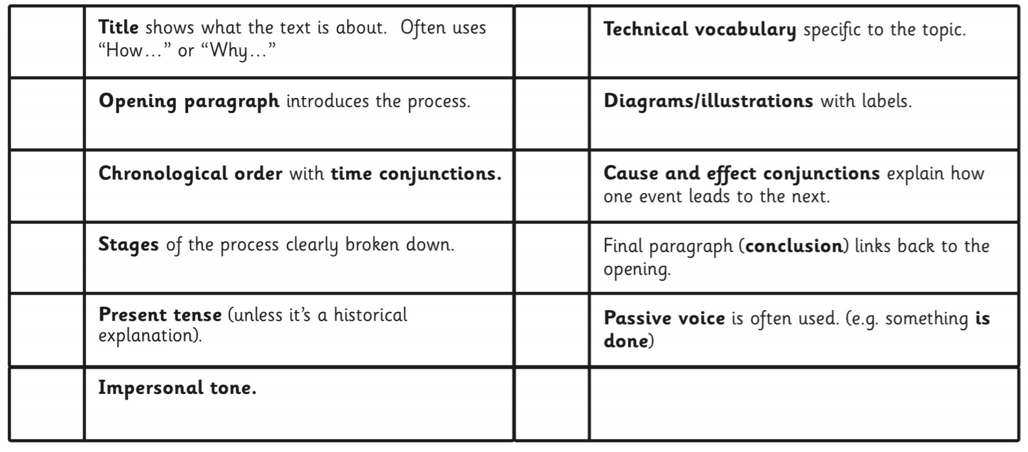
English:
Objective: To label the features of an explanation text.
Main task…
Read through the example explanation text on the next slide.
Can you find the following features?
You could present your task the following ways:
A mind-map. Draw lines off the text and show what the feature is.
A list. Write down the feature followed by an example from the text.
A key. Colour-code each feature in the list and then find in the text.
Try and find as many as you can… don’t worry if you are struggling to find a couple. Move on and come back to them if you can!

Slide 3
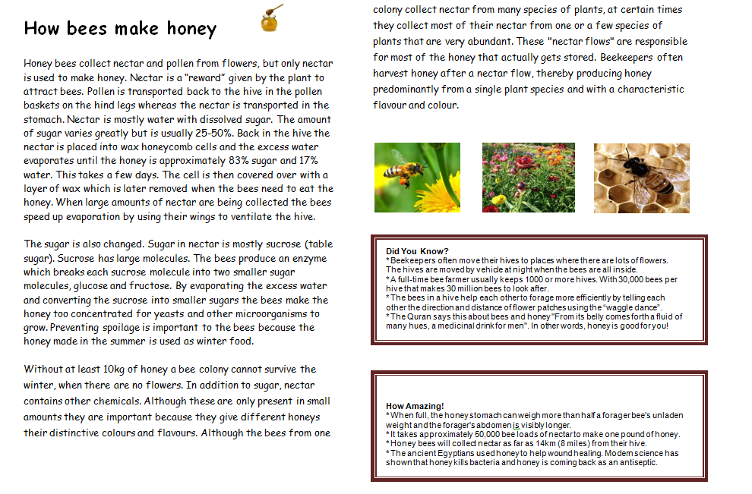

Slide 4
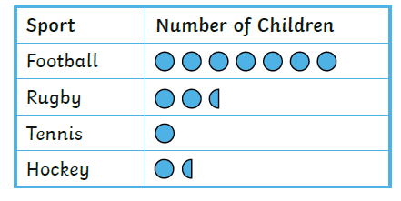
Maths: We will be focusing on Statistics.
Objective: To create Pictograms.
Please watch the video link below and focus on the teaching strategies used to help you create Pictograms using symbols to represent
Symbols.
Pictograms
https://newportjuniorschool.org.uk/wp-content/uploads/2019/10/Calculation-Policy.pdf
As we are beginning a new topic, please read the calculation policy which will offer guidance on how to set calculations out.
1* - Today you will be focusing on pictograms and you will need to answer the questions by looking carefully and interpreting the symbols on the graph.
2*/3* - Today you will be looking at comparing pictograms to tally charts and you will answer the following questions.
Extension: Today you will be comparing pictograms to tally charts and decide if the statement is true or false.

Slide 5
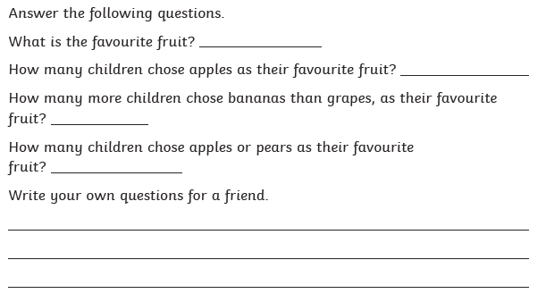
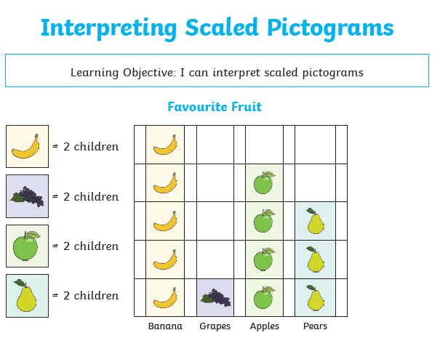
1 STAR TASK!

Slide 6
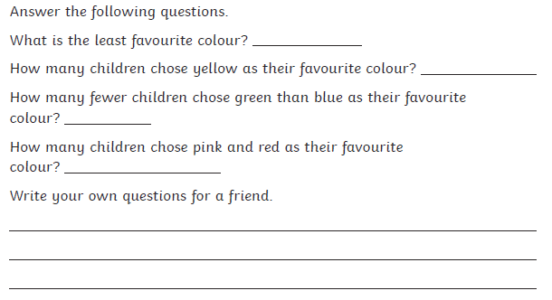
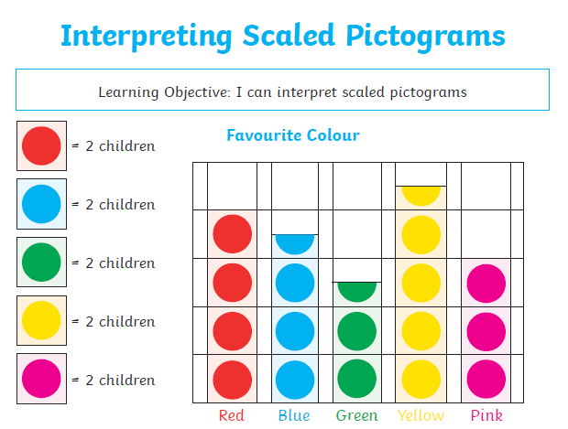
1 STAR TASK!

Slide 7
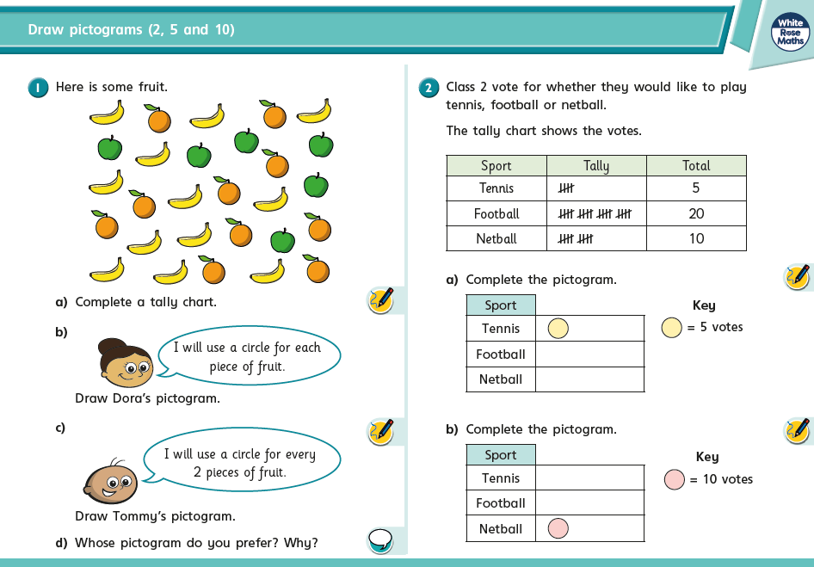
2/3 STAR TASK!

Slide 8
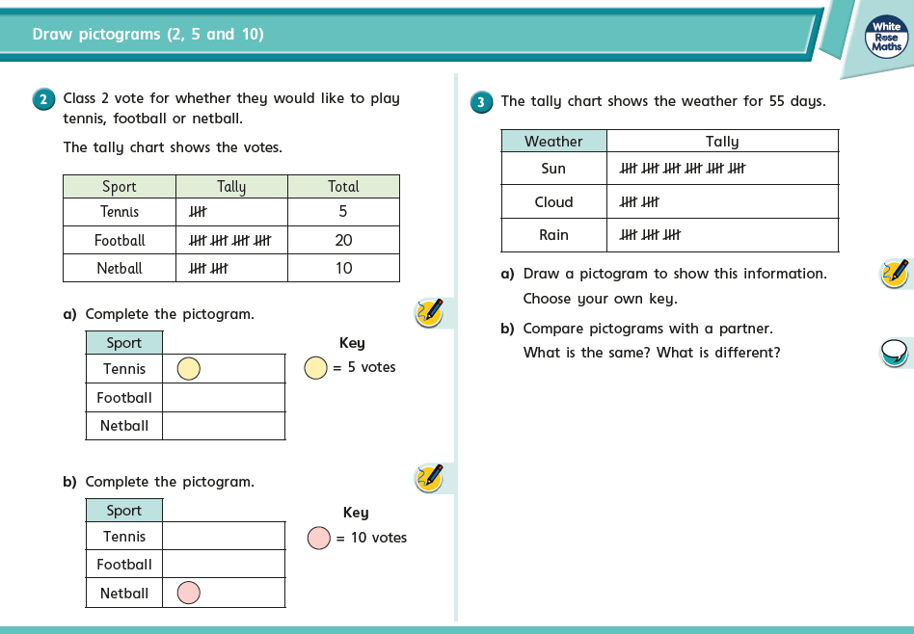
2/3 STAR TASK!

Slide 9
Extension Task!
Please explore this statement by focusing on comparing the tally chart with the Pictogram.
We know the square represents 10.
What does one cluster of tallies represent?

Slide 10
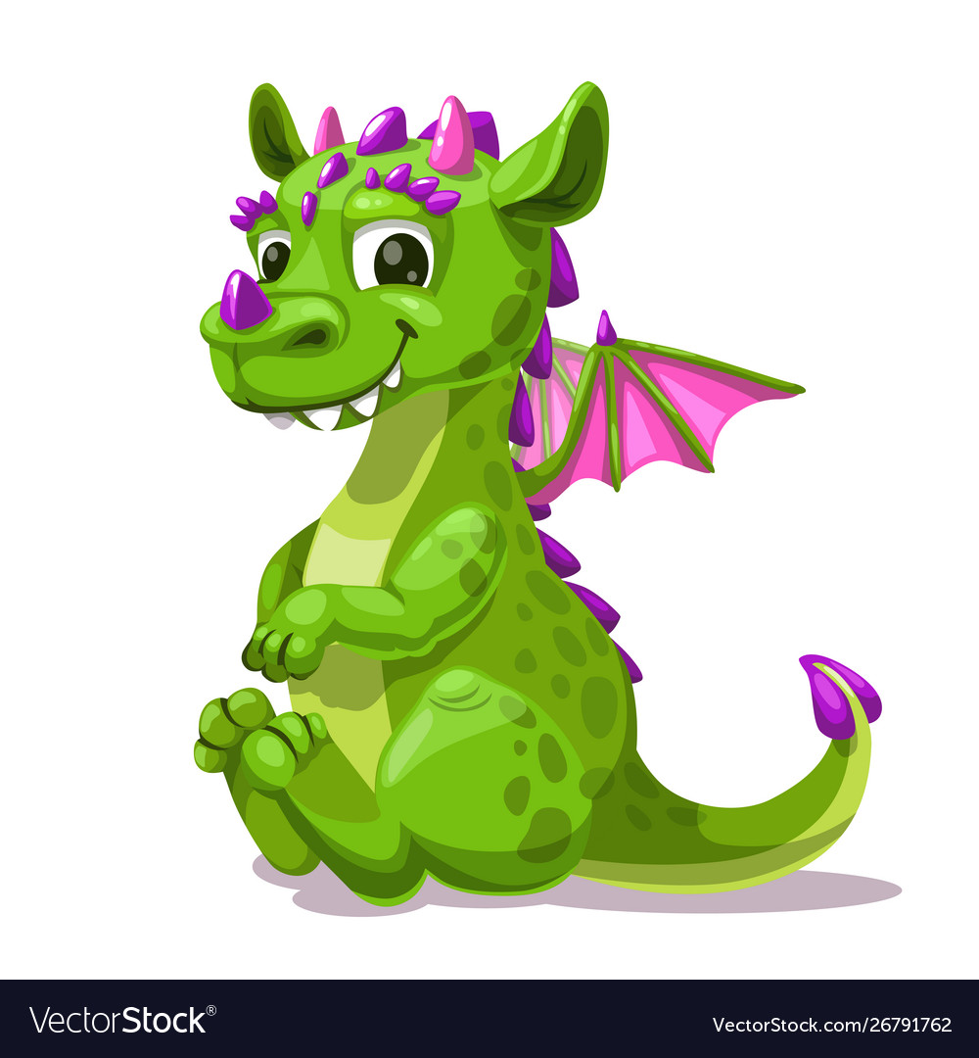
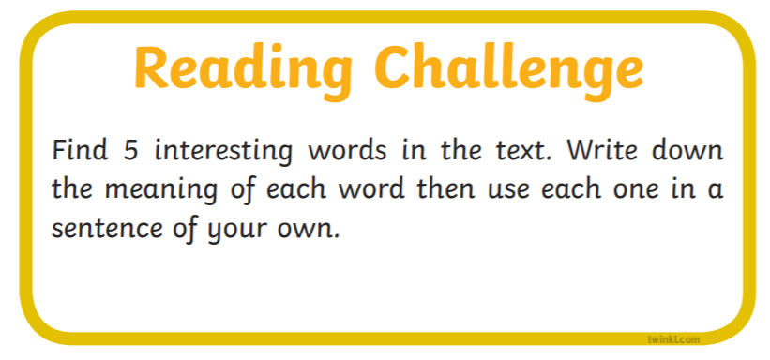
Reading:
Objective: To describe characters in the story.
Read the chapter ‘Mirror, Mirror’.
All Children… Using chapter 4, answer the following comprehension questions in full sentences.
2/3* - Try to find evidence in the text to support your ideas.
2/3* - Task 2! Complete the reading challenge card.
What does the word ‘blurted’ mean?
Why do you think Ajay can’t see the dragon?
Why is Ajay disappointed when he thinks George is pretending to see a dragon?
Find a copy a simile in the chapter. Remember a simile uses ‘like’ or ‘as’. For example free like a bird!
What would you like to happen in the final chapter?

Slide 14
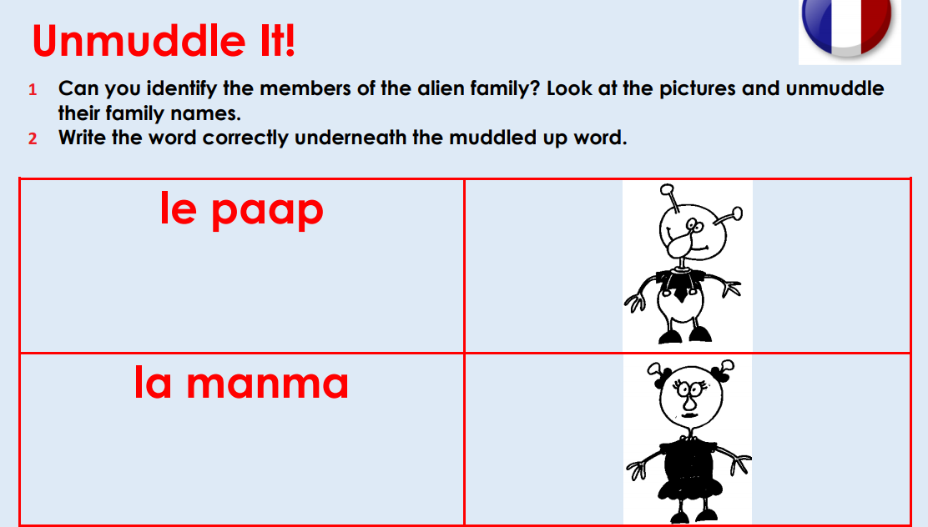
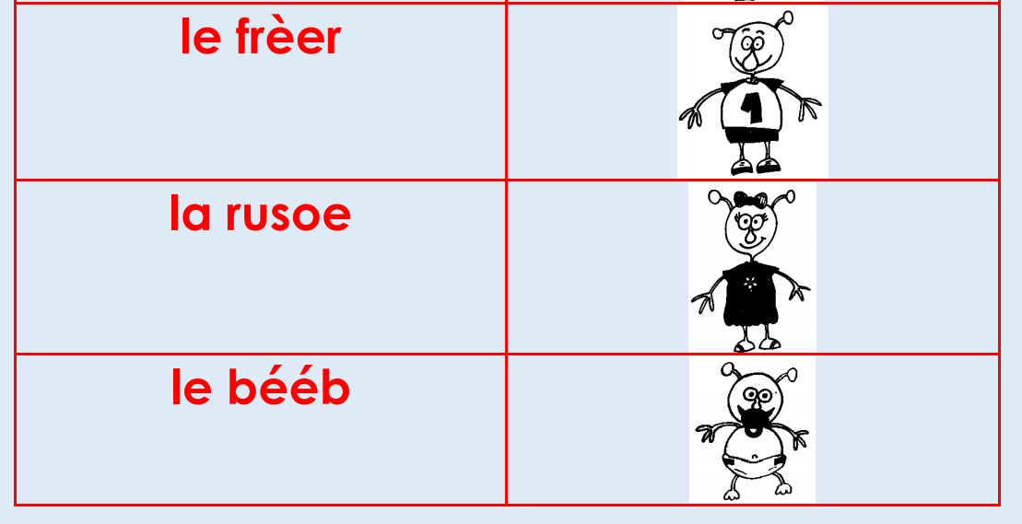
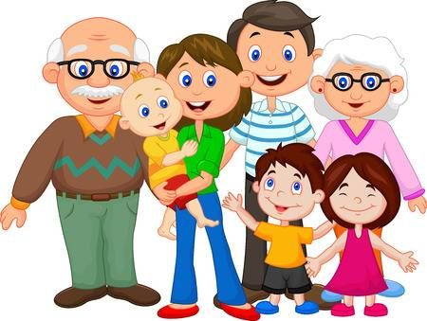
Other: French
Objective: To introduce family members in French.
Main Task… Read and listen to the alien family sentences.
They show the names of family members for an alien family.
1* - Complete the ‘Unmuddle it!’ challenge. Can you identify the members of the alien family. Write out the correct family name.
2/3* - Complete the ‘Unmuddle it!’ challenge. Then write some sentences about your own family. See the slides for some examples.

Slide 15
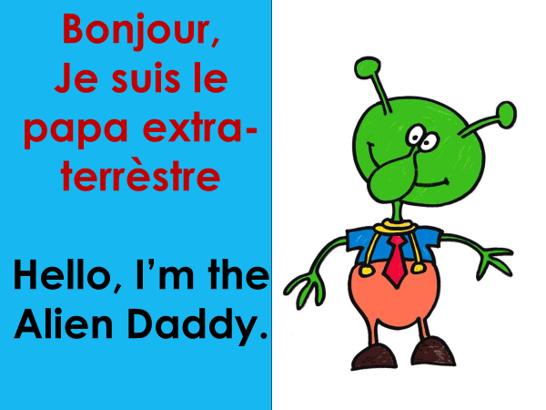
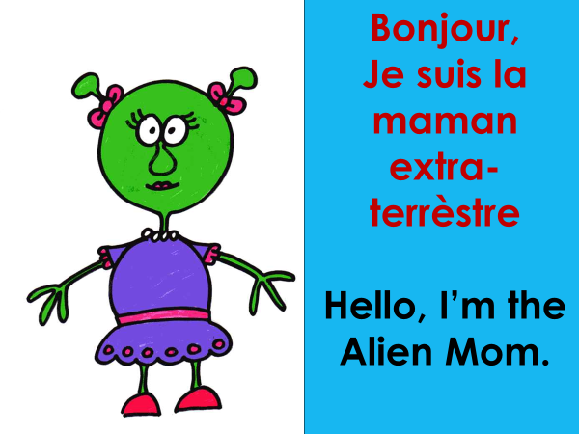
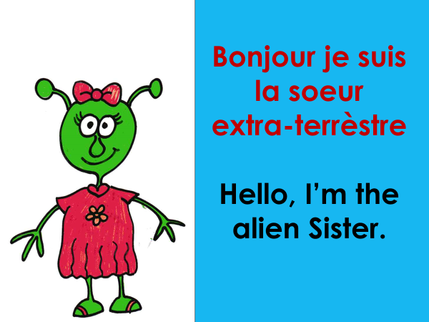

Slide 16
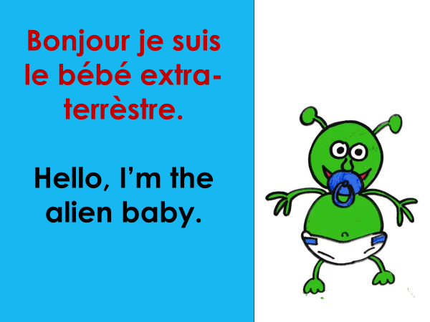
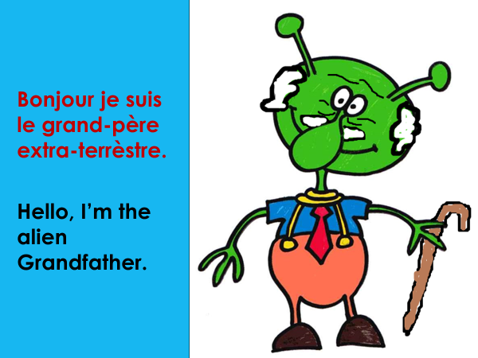
2/3* - Challenge
Draw each member of your own family and write a sentence to explain who they are.
See the next slide for an example!

Slide 17
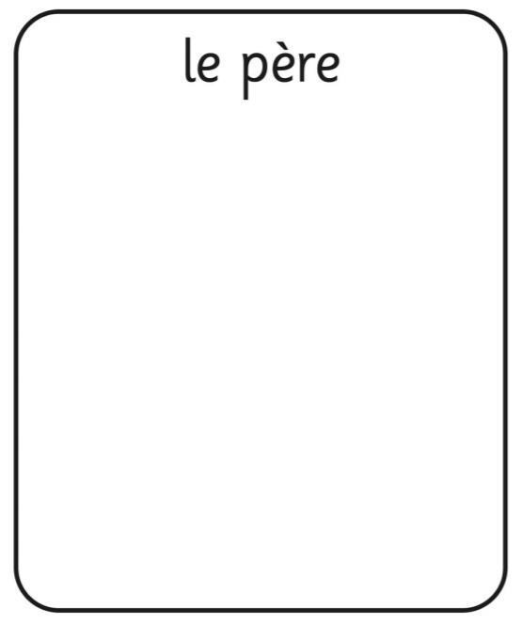
Ma maman est Mary = My mum is Mary.
Female members…
Ma ______ est _____
Ma soeur est Abi = My sister is Abi.
Male members…
Mon ______ est _____
Mon pere est Bob = My dad is Bob.

