Slide 1
Remote Learning Plan!
Hello Year 4!
During the next few weeks, we will be providing the children with remote learning on a daily basis. The work will be available on the website the day before e.g. Monday’s work will be online Sunday.
Everyday the remote learning will consist of:
English Lesson
Maths Lesson
Reading Lesson
One other curriculum lesson (PSHE, Art etc)
We will be available during the hours of 9am-4pm so please feel free to contact us on our new e-mail njs.year4@taw.org.uk
Some of the work provided will be split into the star levels that the children use everyday in class (1,2 3).
Stay safe everyone!
Miss Jones, Mrs Jukes, Mrs Kuczynska and Mrs Sisson.

Slide 2
English:
Objective: To design a powerful object for a Viking God.
Main task… See next slide!
On Monday we looked at features of a myth including a powerful or magical object.
The story below shows how Loki (God of Mischief) created some powerful objects, including Thor’s Hammer.
Read the story and think about the question at the bottom before attempting the task on the next slide.
Loki, being his mischievous self, cut of the hair of Thor’s wife Sif. When Thor found out, he was furious and threatened Loki, who begged for mercy and said he would get her new, better hair. Thor allowed this. Loki went down to Svartalfheim, home of the dwarves, to get Sif new hair. He first went to the sons of Ivaldi who made him Sif’s new hair, Skidbaldnir (a ship that always has favourable winds and can fold up and fit in one’s pocket), and Gungnir (the best spear). But Loki wasn’t satisfied, he hadn’t caused any trouble. So he went to the brothers Brokkr and Sindri and asked them to make gifts that were even better. He said if they did, they could have his head. They agreed. In order to win the bet, Loki took the shape of a fly and bit one of them each time they made an item. They made Gullinbursti (a live boar with golden hair “who gave off light in the dark and could run better than any horse”), Draupnir (a ring from which “every ninth night, fell nine new golden rings of equal weight), and finally Mjollnir (a hammer which never missed and returned to its owner). The only gift that was flawed was the hammer, which had a short handle. Loki took all the gifts and returned to Asgard where he distributed them among Thor, Sif, Odin and Freyr.
If you were a Viking God, which gift would you want from what Loki has? Why?

Slide 3
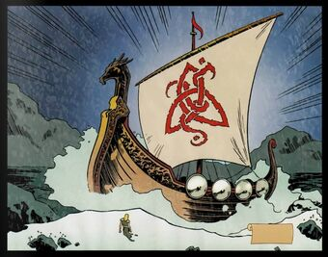
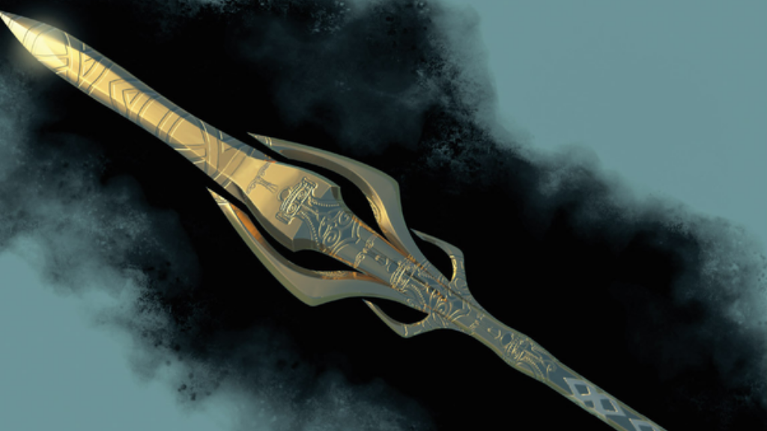
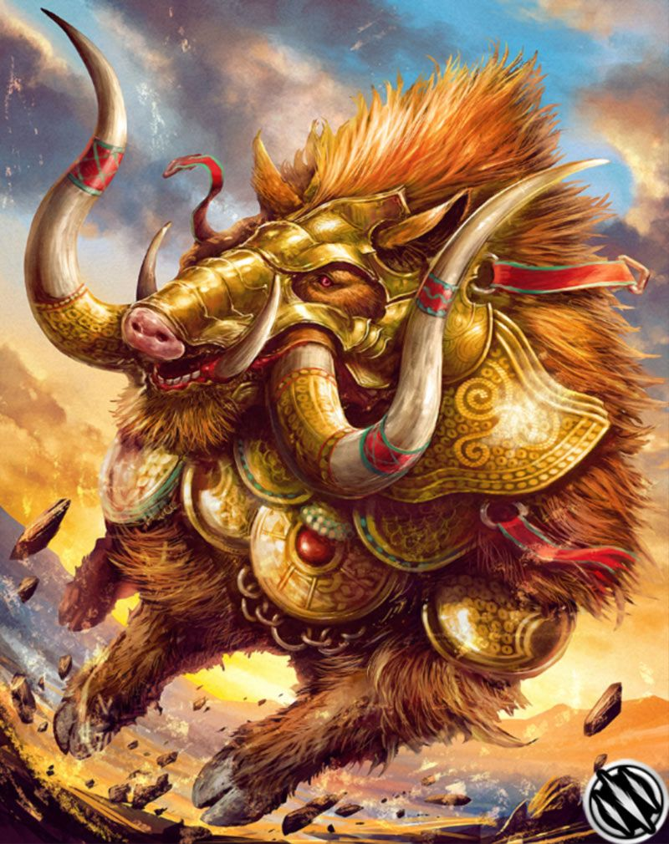
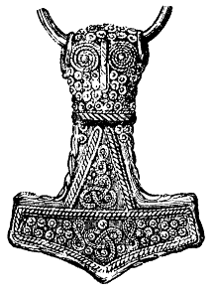
Main task…
ALL Children - Design your own powerful object that could be used by a Viking God. It could be a form of transport, a weapon or something you wear (glasses, jewellery)
1* - Draw your object in detail and create a mind-map to explain the features.
2* - Draw your object in detail and write a paragraph explaining why it is powerful and magical. Within this paragraph, explain how it works.
3* - Draw your object in detail then write a 3 paragraphs.
1 – What does it do?
2 – How does it work?
3 – Why is it useful?
Skidbaldnir
Gullinbursti
Gungnir
Draupnir
Mjollnir

Slide 4
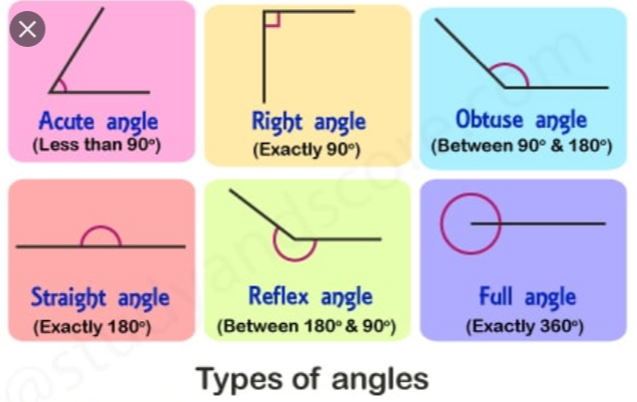
Maths:
Objective: To compare and order the size of angles.
https://www.bbc.co.uk/bitesize/topics/zb6tyrd/articles/zg68k7h
What are the different types of angles which exist?
Today you will be learning how to
order angles by focusing on the
size of each angle.
Which angle is acute, obtuse or a
right angle?
Click on the link above for BBC Bitesize. Revise your knowledge of all of the different types of angles that exist within shapes.
1* - See next slide for ordering angles from smallest
To largest. Use the squared boxes to write A B and C in the correct order .
2*/3* - Look at the questions and read them carefully.
Solve the problems focusing on how angles can be compared from smallest to largest.
Extension: Complete the True or False statement about acute angles.
Remember there is 360 degrees in a full
angle.
Look at how the degrees vary in each
angles.

Slide 5
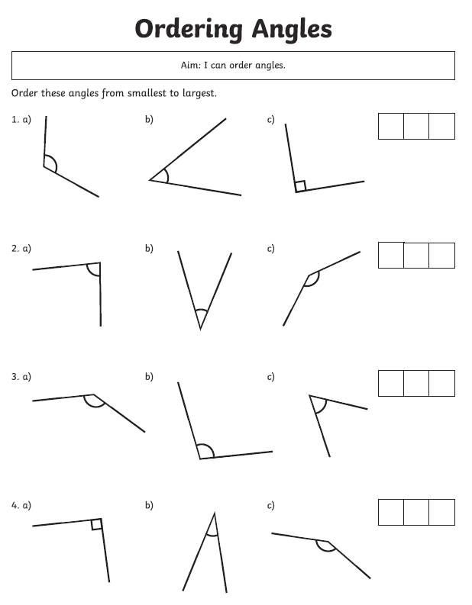
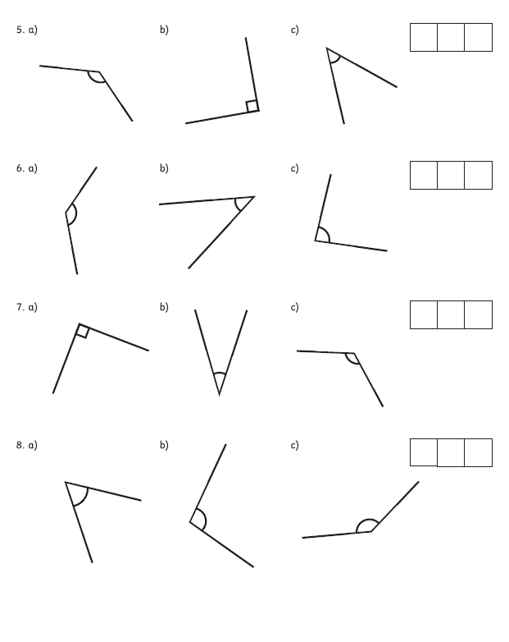
1 STAR TASK!

Slide 6
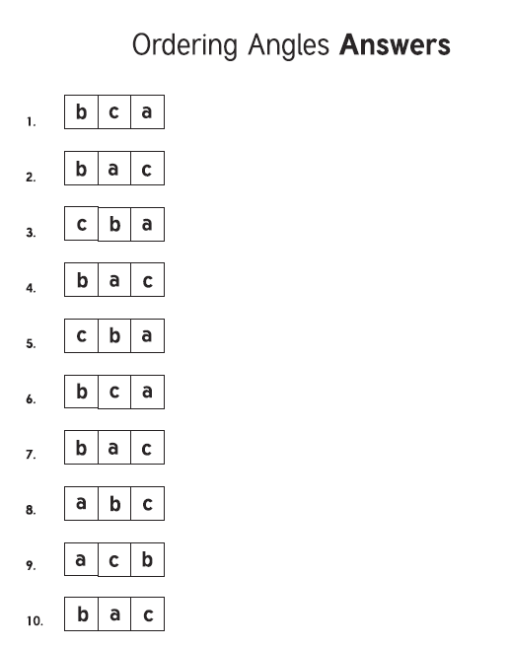
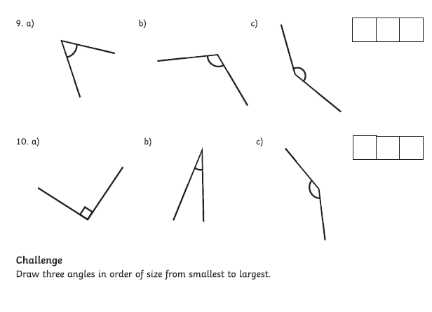

Slide 7
2/3 STAR TASK!

Slide 8
Extension Task!
We would like you to explore this statement
by drawing at least five different examples
of acute angles.

Slide 9
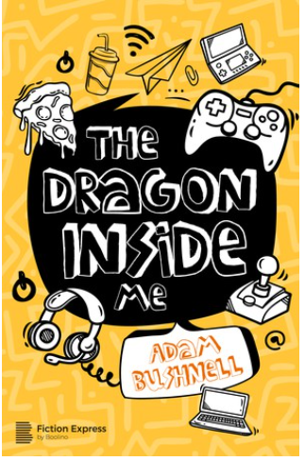
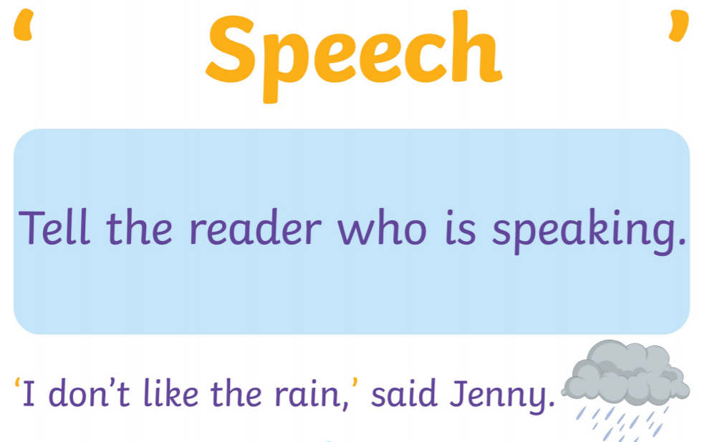
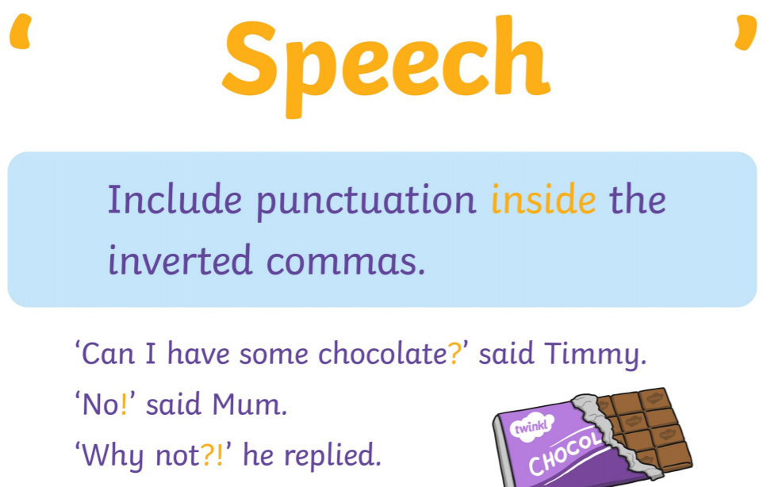
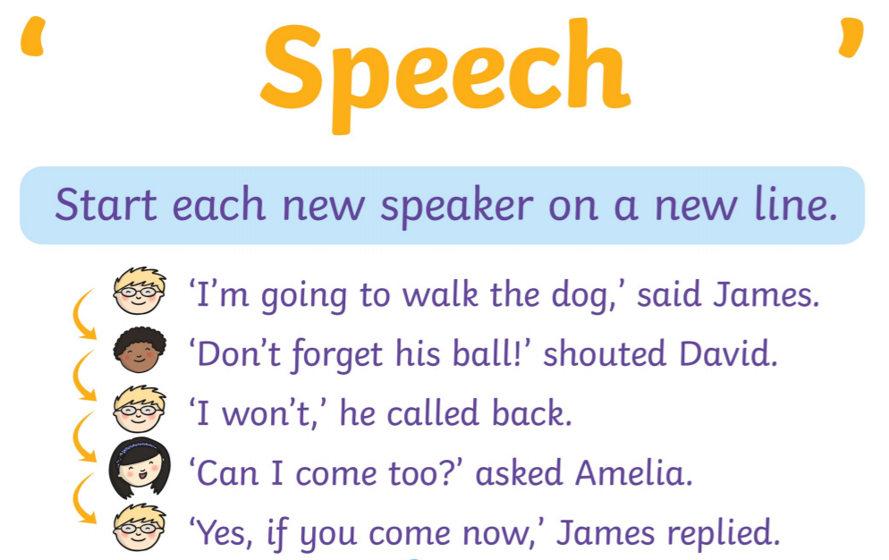
Reading:
Objective: To develop reading comprehension skills.
Re-read Chapter 1… School’s Out!
All children to complete task 1…
Answer the following comprehension questions in full sentences.
Why is George pleased that it is the school holidays?
Why isn’t George enthusiastic about meeting up with Ajay in the holidays?
How do you know that George hasn’t been out of the house?
Name three things that you think George could do to feel better.
Do you think the dragon will be friendly or not? Why?
George spends all of his time in his bedroom. Do you think it would be messy or tidy? Why do you think this?
2/3 * Task 2…
Write a conversation between you and the dragon.
What would you say to the dragon? How would they reply?

Slide 13
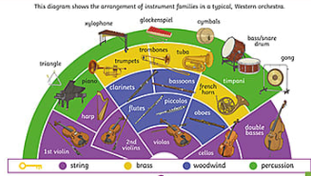
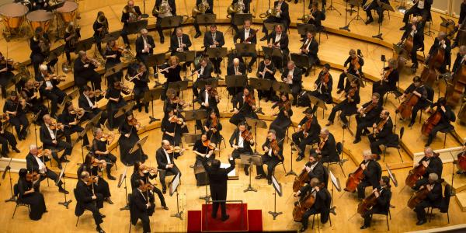
Other:
Objective: To recognise sections of an orchestra.
Watch the following videos about different sections of an orchestra.
Woodwind
String
Percussion
Brass
On the next slide you will find some of the instruments seen in the orchestra followed by your task.
https://www.youtube.com/watch?v=KEt1Mm8sSkA&list=PLLIE84w8WlZ-KKM-jtpEY13aQyY4tshMT&index=2
https://www.youtube.com/watch?v=MP2_6OLummA&list=PLLIE84w8WlZ-KKM-jtpEY13aQyY4tshMT&index=1
https://www.youtube.com/watch?v=xGKpngesISI&list=PLLIE84w8WlZ-KKM-jtpEY13aQyY4tshMT&index=4
https://www.youtube.com/watch?v=yE0aSxziNdY&list=PLLIE84w8WlZ-KKM-jtpEY13aQyY4tshMT&index=3

Slide 14
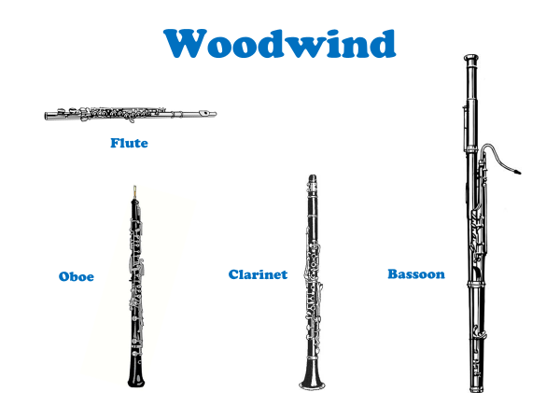
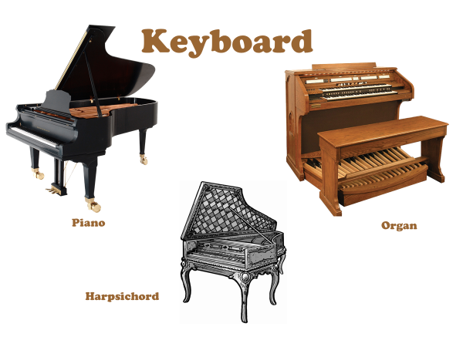
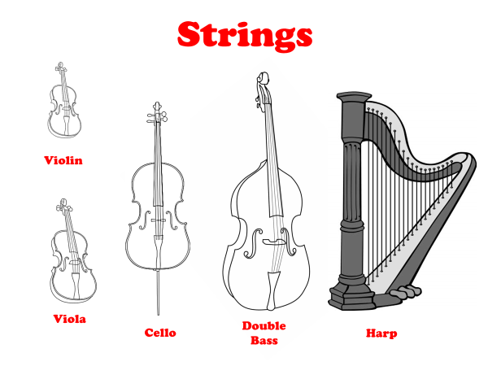
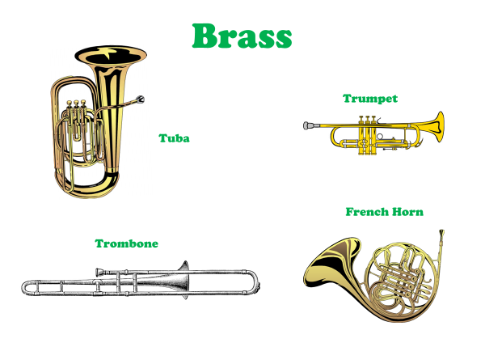

Slide 15
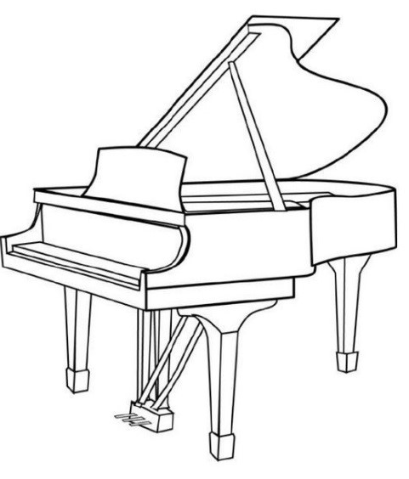
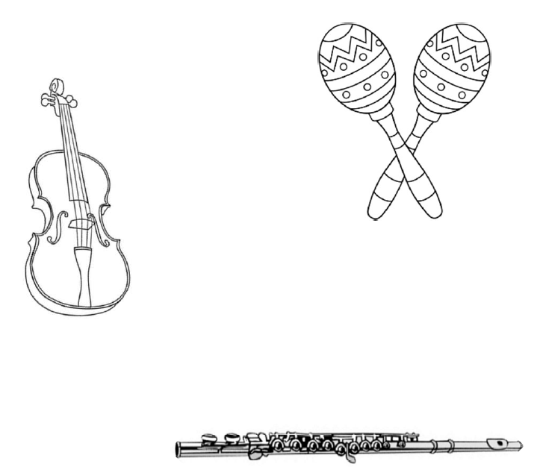
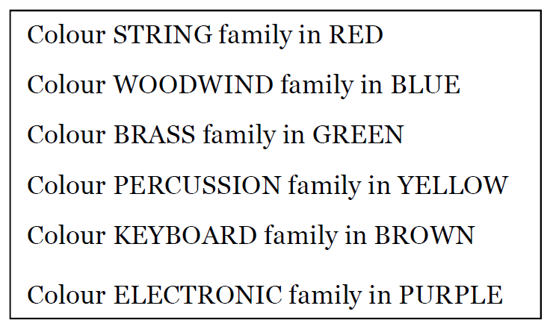
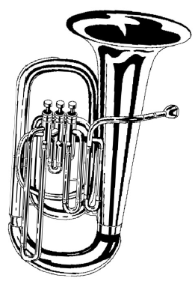
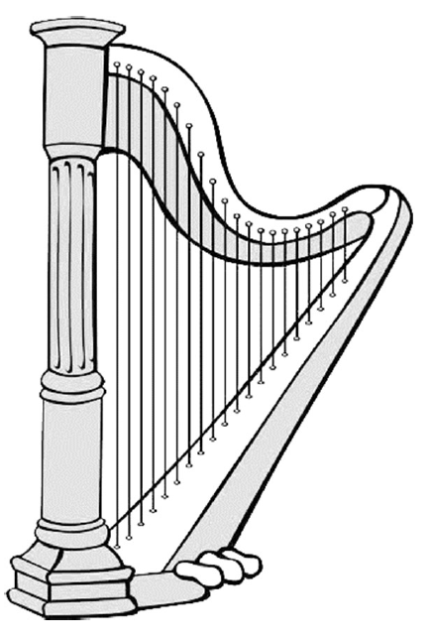
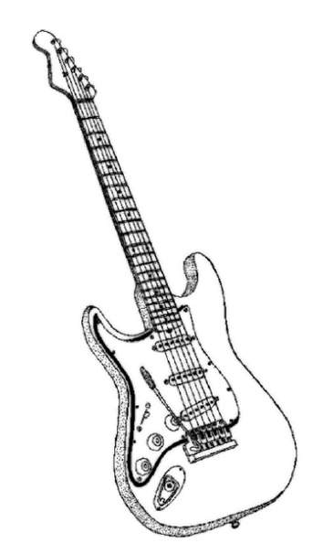
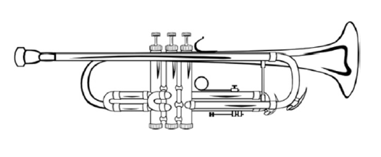
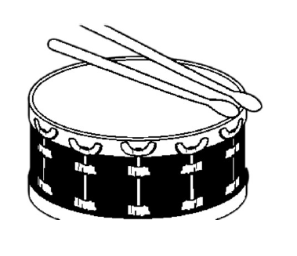
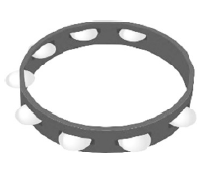
1* Task…

Slide 16
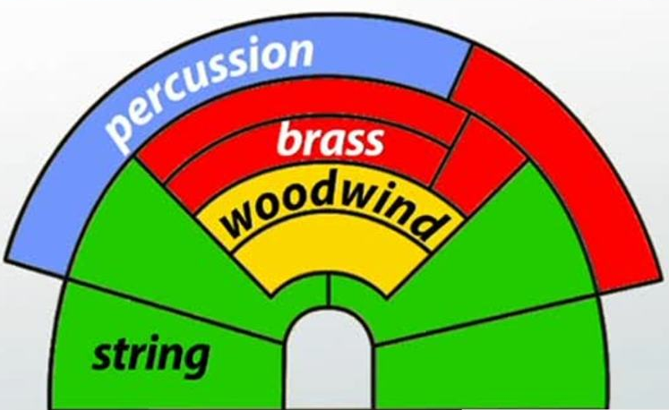
2/3* Task… Create a mind-map of an Orchestra. Explain what instruments you
might find in each section. You could draw the diagram below or cut it out.
Challenge:
Research 2 facts that you could add to your mind-map about each family.

