Slide 1
Remote Learning Plan!
Hello Year 4!
During the next few weeks, we will be providing the children with remote learning on a daily basis. The work will be available on the website the day before e.g. Monday’s work will be online Sunday.
Everyday the remote learning will consist of:
English Lesson
Maths Lesson
Reading Lesson
One other curriculum lesson (PSHE, Art etc)
We will be available during the hours of 9am-4pm so please feel free to contact us on our new e-mail njs.year4@taw.org.uk
Some of the work provided will be split into the star levels that the children use everyday in class (1,2 3).
Stay safe everyone!
Miss Jones, Mrs Jukes, Mrs Kuczynska and Mrs Sisson.

Slide 2
English:
Objective: To write the first half of my myth.
Main Task… ALL!
Today, you have the opportunity to write the first half of the myth you planned yesterday. This means, you will complete the sections: setting, hero, dilemma, quest and powers. In the powers section, you may wish to use the object you designed last week or an existing object such as Thor’s hammer.
1* - Focus on writing clear sentences and adding adjectives where you can. Remember an adjective is a describing word such as: strong, brave.
2*/3* - Use the word mats on the next few slides to help improve your writing. Remember paragraphs and aim to write as much as you can.
Remember to stop at the powers part of your plan and then edit what you have done so far. We will continue tomorrow with the second half of your myth.

Slide 3
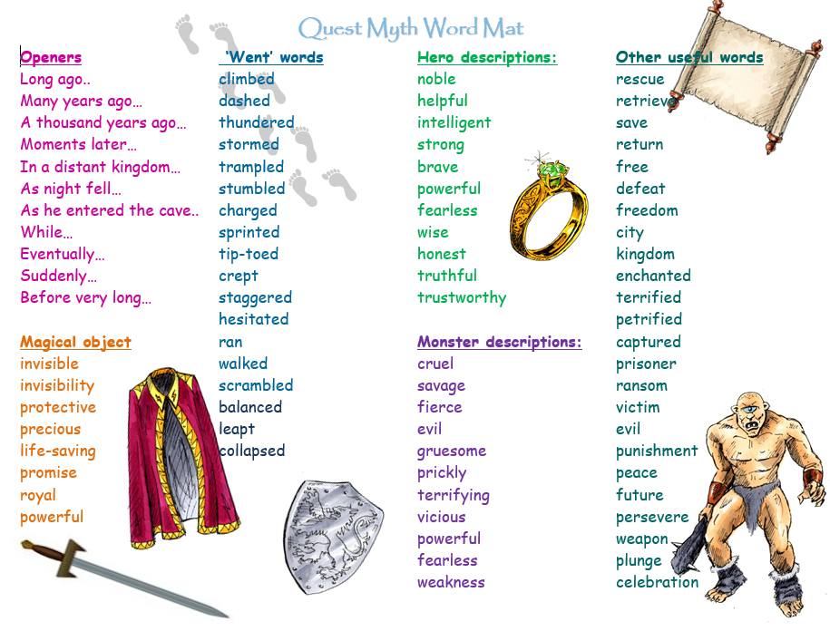

Slide 5
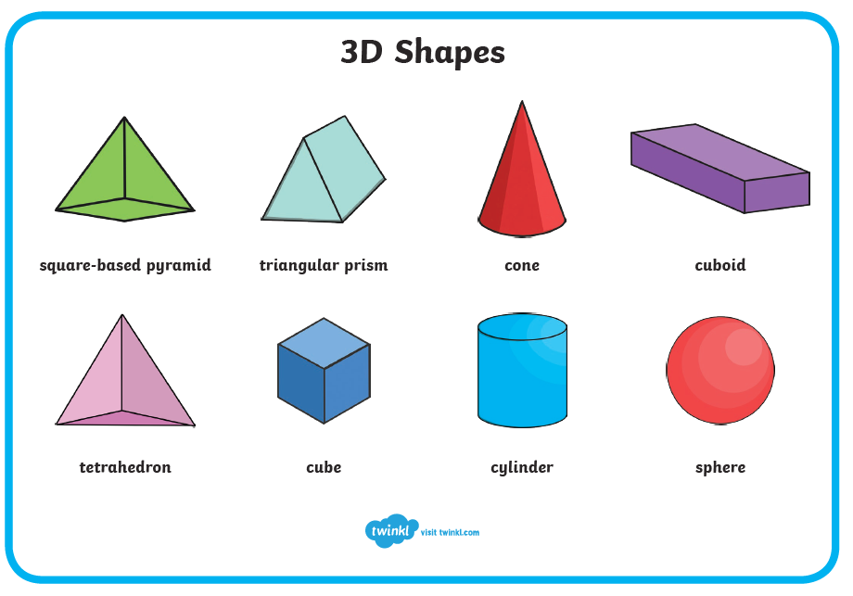
Maths:
Objective: To recognise and describe 3-D shapes.
3-D Shapes and their properties
Today you will be learning all about 3-D shapes and recognising their properties. Think about how to remember the names of all of the 3-D shapes.
What are their properties?
Click on the link above for a quick reminder of what 3-D shapes and how they are created using nets.
1* - Have a look at each shape carefully. How many faces does it have? How many vertices does it have? What is it called? Complete the worksheet and feel free to colour your shapes and make a shape key.
2*/3* - Today you will be focusing on 3-D shapes. Learn the names of the shapes and solve the problems and answer the questions.
Extension: Complete the True or False statement focusing on whether a circle can be classed as a 3-D shape?

Slide 7
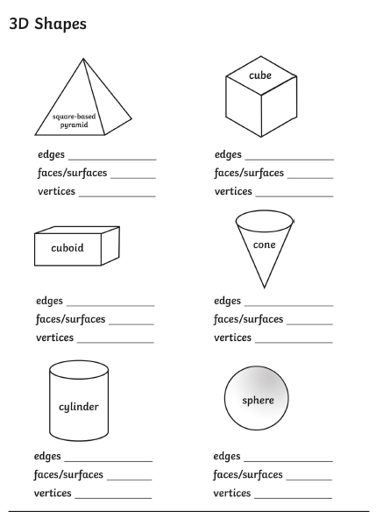
1 STAR TASK!

Slide 8
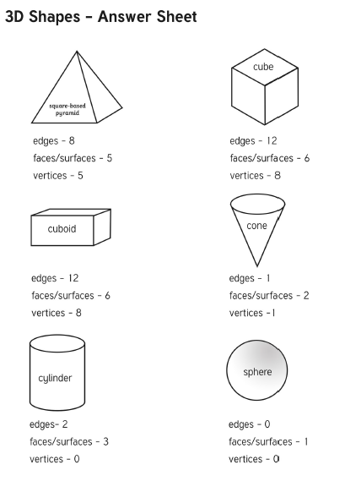
1 STAR ANSWERS!

Slide 9
2/3 STAR TASK!

Slide 11
Extension Task!
We would like you to think very carefully about this statement. Is a circle a 3-D shape?
Please write a detailed answer and please include some 3-D diagrams

Slide 12
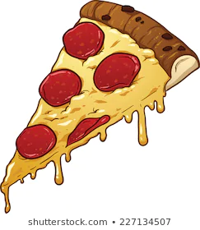
Reading:
Objective: To develop comprehension skills.
So far we have read chapter 1 and 2 from the story. Think about what we know about George, his mum and now Pepperoni the dragon.
Using chapter 2… answer the following comprehension questions in full sentences.
Find and copy a word that means ‘great’ in the first section.
What makes Pepperoni and George so good at their game?
How does the reader know that Pepperoni is very tired?
Why does Pepperoni roll his eyes?
How is George rude to his mother?
What do you think will happen in chapter 3?
2/3* - Task 2! Complete the reading challenge
card for the character of mum. What will she think at different parts of the story so far? For example… when George doesn’t leave his room.
I must get George out of his room.

Slide 16
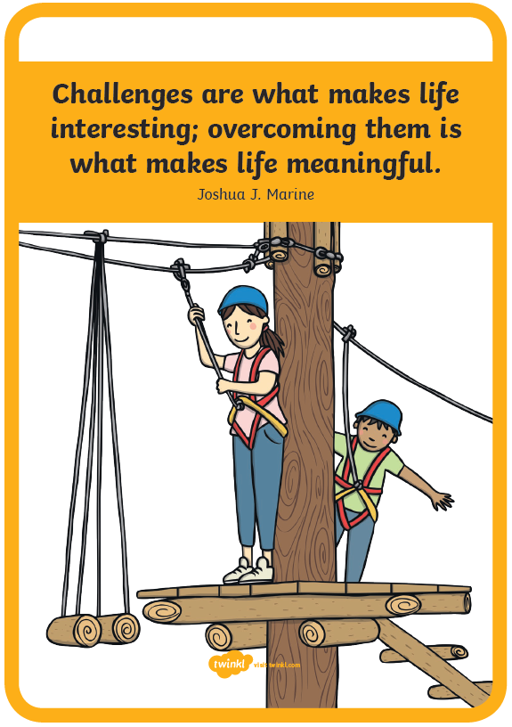
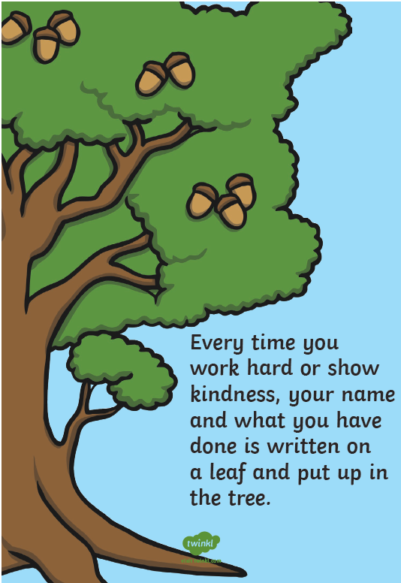
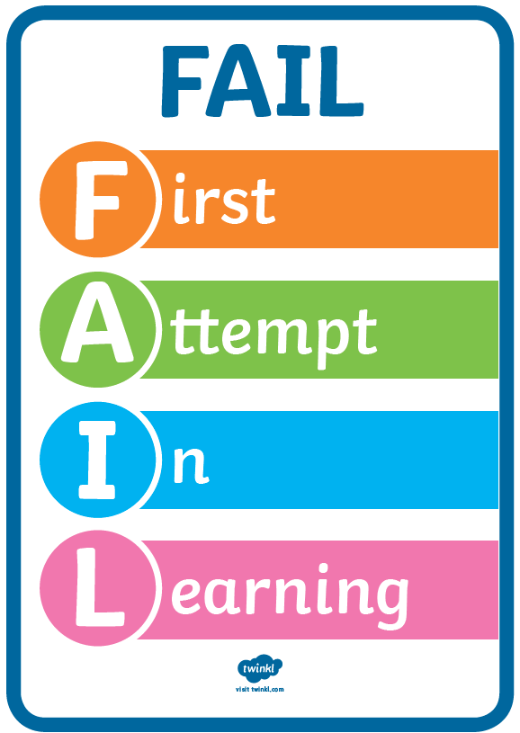
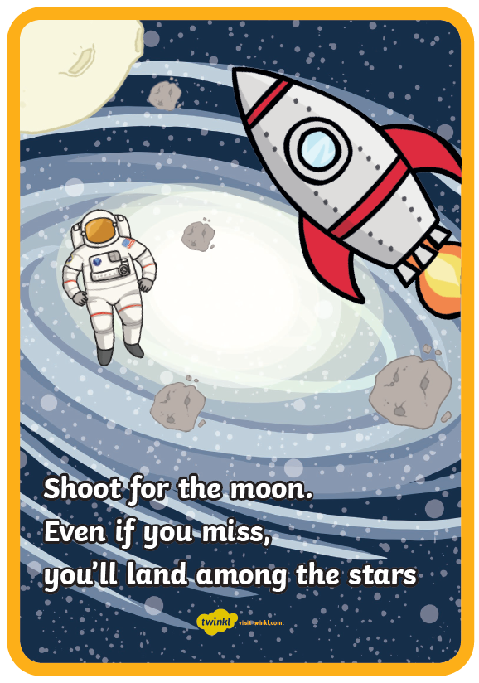
Other: PSHE and Mindfulness
Objective: To create a poster to celebrate inspiration.
Yesterday you did some colouring of inspirational quotes. Today we would like you to design your own poster based on your own thoughts.
Look at all of the ideas.
Can you think of some words that would inspire someone?
Make a poster celebrating your inspirational quote or if you are struggling to think of one use one of the quotes you have looked at that you think inspires you and create a poster to illustrate it.

