Slide 1
Remote Learning Plan!
Hello Year 4!
During the next few weeks, we will be providing the children with remote learning on a daily basis. The work will be available on the website the day before e.g. Monday’s work will be online Sunday.
Everyday the remote learning will consist of:
English Lesson
Maths Lesson
Reading Lesson
One other curriculum lesson (PSHE, Art etc)
We will be available during the hours of 9am-4pm so please feel free to contact us on our new e-mail njs.year4@taw.org.uk
Some of the work provided will be split into the star levels that the children use everyday in class (1,2 3).
Stay safe everyone!
Miss Jones, Mrs Jukes, Mrs Kuczynska and Mrs Sisson.

Slide 2
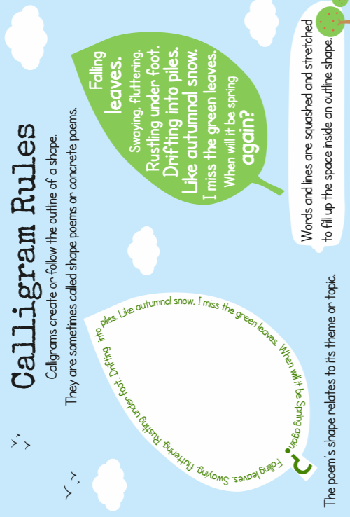
English:
Objective: To understand what a shape poem or calligram is and create my own.
A calligram is a poem that we sometimes call ‘shape poetry’. The poem takes the shape or outline of an image that relates to the poem itself.
For example… this poster shows a poem about a leaf. The poem is then written as a leaf outline or the shape of a leaf.
Think about:
the position of the words or phrases
any colours the poet has used
the shape the poem makes
Calligrams are often written as ‘free’ verse
– they don’t have to rhyme!
You will be producing your own calligrams today… your poem can be free verse (no rhyme) or it can rhyme. In order for your calligram to work, the shape must resemble the topic of theme of the poem. For example: A poem about the Vikings could be in the shape of a long boat or shield.

Slide 3
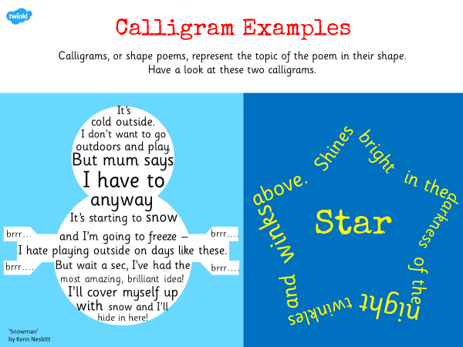
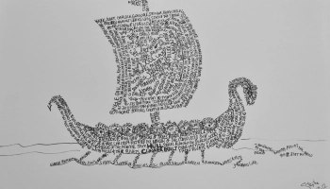
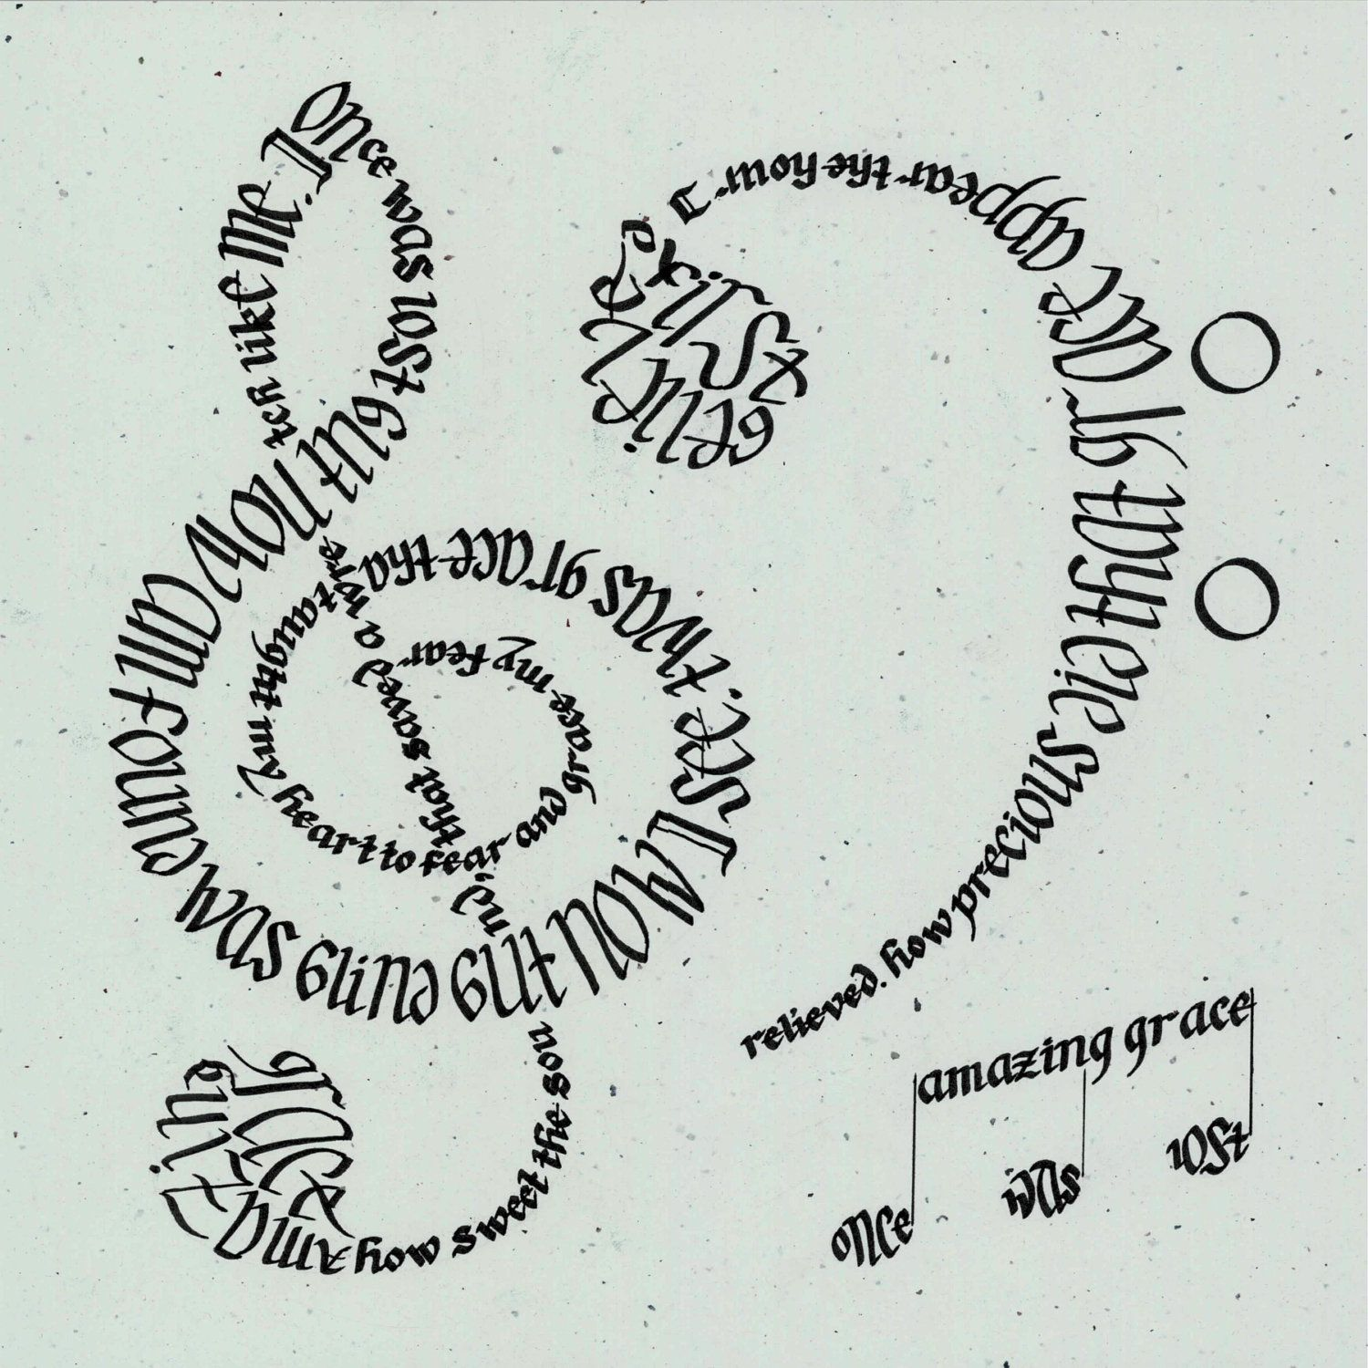
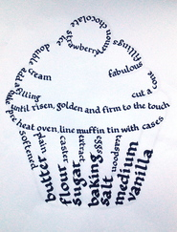
Calligram examples…

Slide 4
Standing under the bridge
The river ripples beside me
I shiver and look out
At the pouring rain.
My teddy is my best friend
His fat tummy is made
For hugging when I ’m happy or sad.
His big ears listen to my secrets
Soft paws, fluffy fur, bright eyes
I think he knows
Everything about me!
Falling leaves
Swaying, fluttering
Rustling under foot
Drifting into piles
Like autumnal snow
I miss the green leaves
When will it be spring again?
1* Task
Have a look at these poems. Pick your favourite poem and turn it into a calligram (shape poem).
Challenge… Write your own poem about a subject of your choosing and turn it into a calligram.

Slide 5
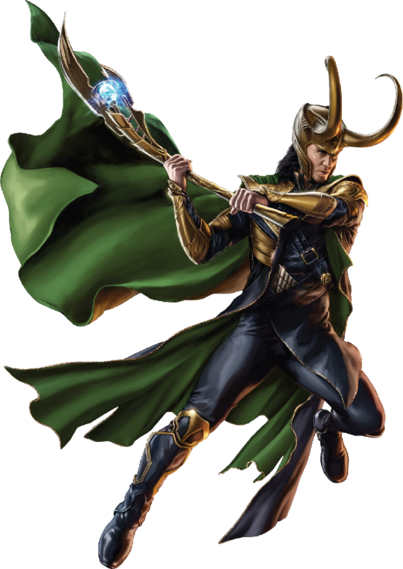
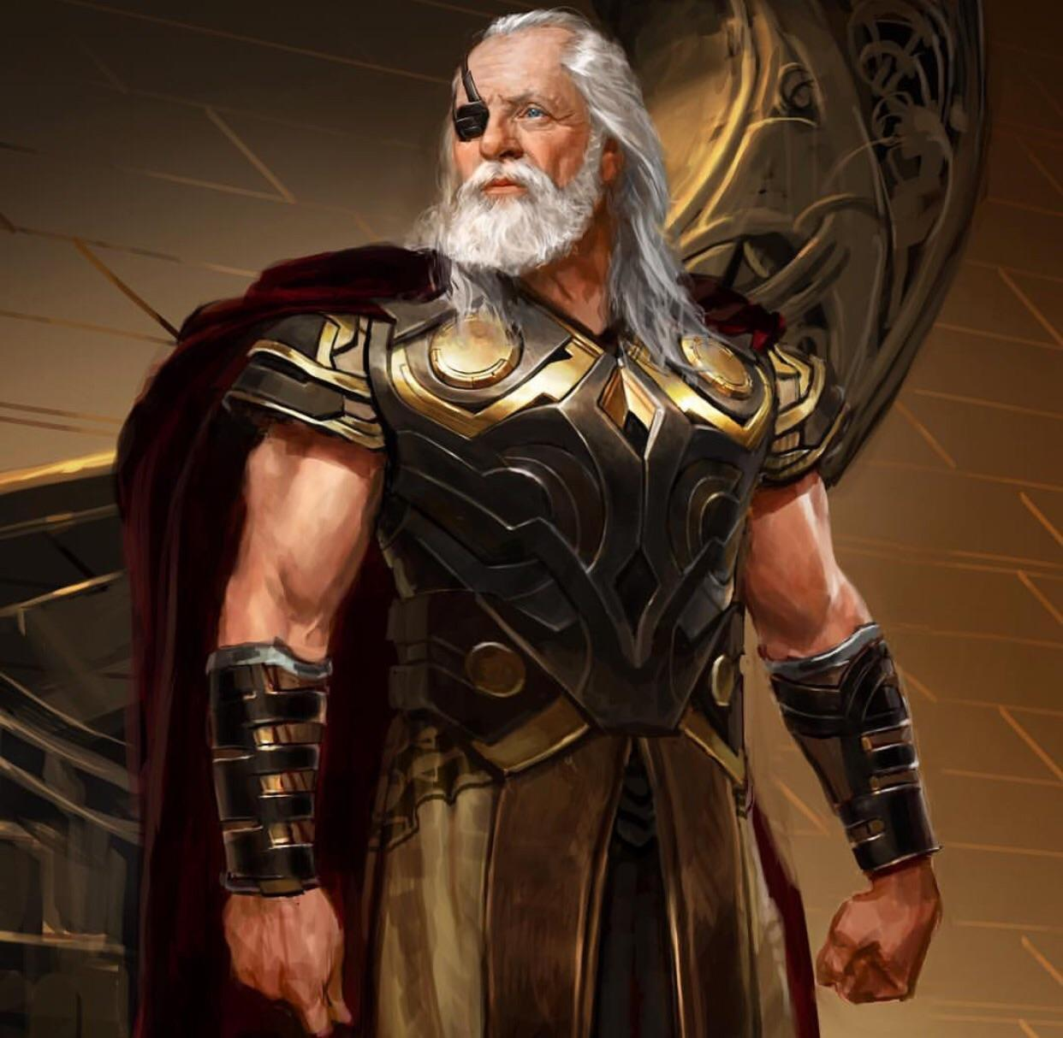
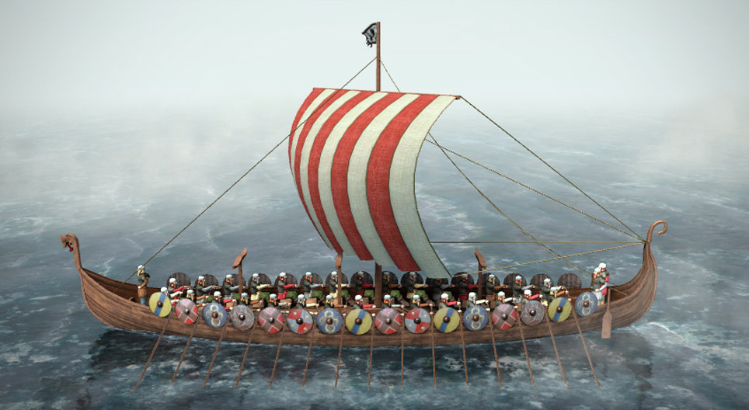
2/3* Task
Main task…
2/3* - Create your own Calligram poems about the Viking Gods Odin, Loki or Thor. Use all of the work we have been looking at to help form your poems.
Remember.. They can be free verse or rhyme but they MUST be in a shape of your choice.
You could write your poem in the shape of the character or a weapon (such as Thor’s Hammer).
TIP: Start by writing your poem normally and then turn it into a calligram.

Slide 6
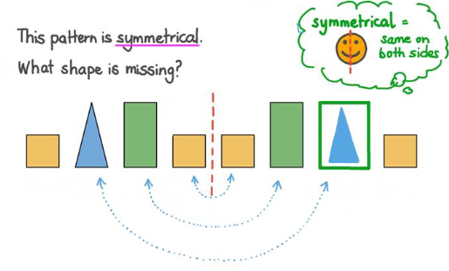
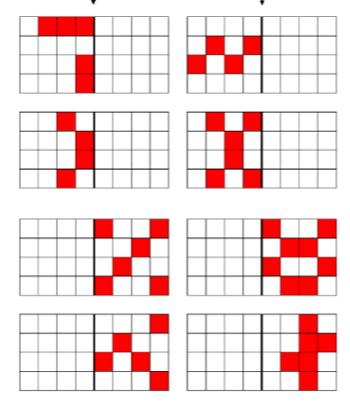
Maths:
Objective: To complete symmetrical figures and shapes.
Lines of symmetry in shapes
Today you will be learning all about completing symmetrical patterns.
Click on the link above to learn about lines of symmetry in shapes.
1* - Draw the lines in the new positions to complete the symmetrical patterns. Please remember to use a ruler to draw straight lines.
2*/3* - Today you will be focusing on completing symmetrical patterns in shapes. Have a go at reflecting patterns and rotating the shapes to make them symmetrical.
Extension: Focus on the symmetrical pattern. Would you need to add on only five more shaded squares to complete this symmetrical pattern?
Is the statement true or false?

Slide 7
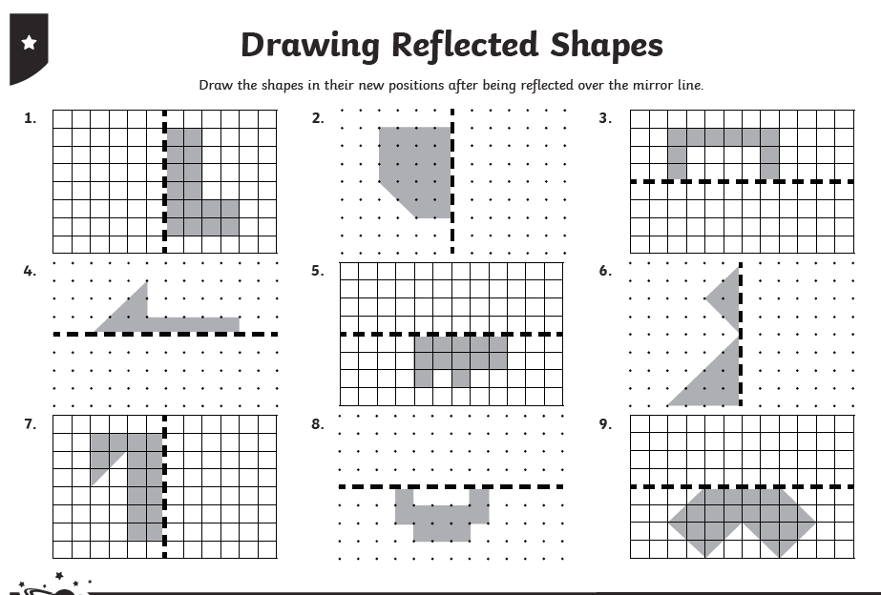
1 STAR TASK!

Slide 8
2/3 STAR TASK!

Slide 10
Extension Task!
Please explore this statement by drawing the symmetrical pattern exactly as you see it above on some squared paper. Would you need to add only five more shaded squares to place on the
right hand side to make it symmetrical? True or false?

Slide 11
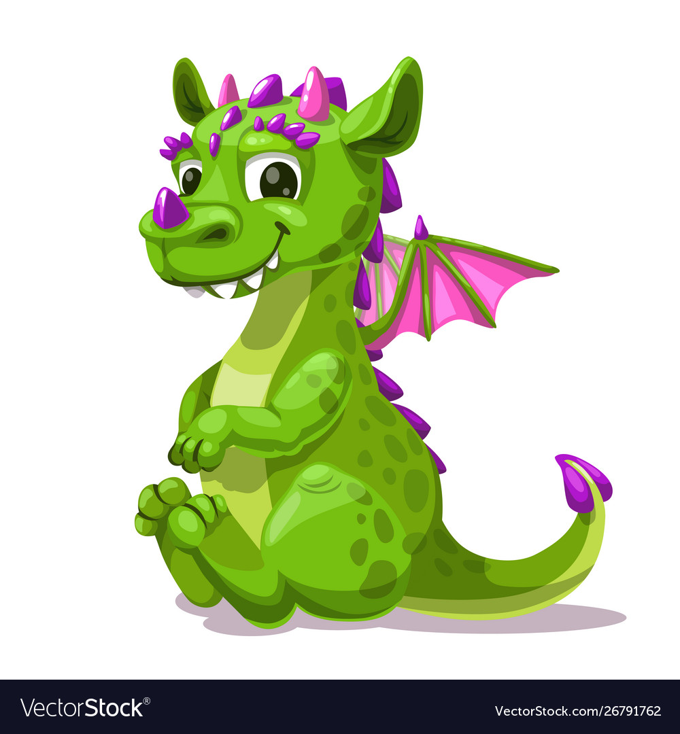
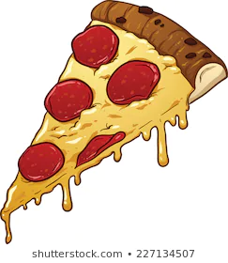
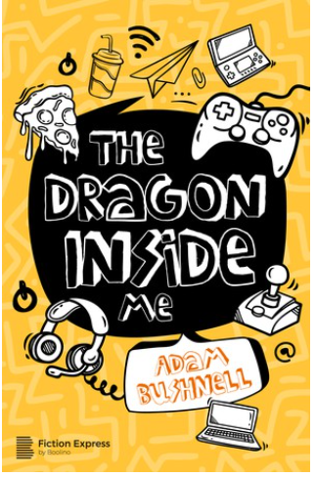
Reading:
Objective: To develop comprehension skills.
Read the chapter ‘A Monster Under My Bed’.
All Children… Using chapter 3, answer the following comprehension questions in full sentences.
2/3* - Try to find evidence in the text to support your ideas.
2/3* - Task 2! Complete the reading challenge card. Copy 3 of your favourite sentences from chapter 3. Write a short explanation for what you like about each sentence.
Why do you think George’s mother walks away wordlessly?
Why does Pepperoni laugh when George’s mother walks away?
How do you know that George’s mother is angry when she opens the door?
How is George like the dragon?
How is Ajay a good friend to George?

Slide 15
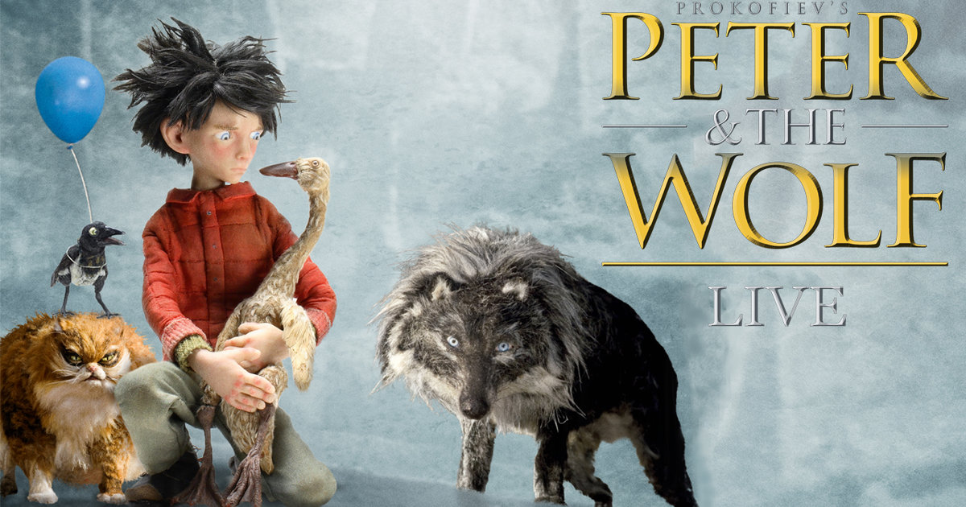
Other: Music
Objective: To identify instruments in Peter and the Wolf.
You are going to watch a short clip from Peter & The Wolf. This is a piece descriptive music and uses sounds to describe a story.
For each character, complete the table on the next slide. Pause the clip between each character.
Peter & The Wolf
Peter: Strings
Bird: Flute
Duck: Oboe
Cat: Clarinet
Grandfather: Oboe
Wolf: 3 French Horns
Rifle Shots: Bass Drum
Key words:
These may help with your task!
Dynamics: Volume of music.
Rhythm & Tempo: Beats and Speed.
Structure: Sections of music.
Instrumentation: Instruments used.
Texture: Layers of music.

Slide 16
Name | Instrument | Musical Features | What does it make you think about the character?
Peter | Strings | Loud (Forte). Moderate speed. Lots of instruments together. Quite high pitched. | Heroic, Happy, confident, Smiley and brave.
Bird | Flute
Duck | Oboe
Cat | Clarinet
Grandfather | Oboe
Wolf | 3 French Horns
Rifle Shots | Bass Drum

