Slide 1
Remote Learning Plan!
Hello Year 4!
During the next few weeks, we will be providing the children with remote learning on a daily basis. The work will be available on the website the day before e.g. Monday’s work will be online Sunday.
Everyday the remote learning will consist of:
English Lesson
Maths Lesson
Reading Lesson
One other curriculum lesson (PSHE, Art etc)
We will be available during the hours of 9am-4pm so please feel free to contact us on our new e-mail njs.year4@taw.org.uk
Some of the work provided will be split into the star levels that the children use everyday in class (1,2 3).
Stay safe everyone!
Miss Jones, Mrs Jukes, Mrs Kuczynska and Mrs Sisson.

Slide 2
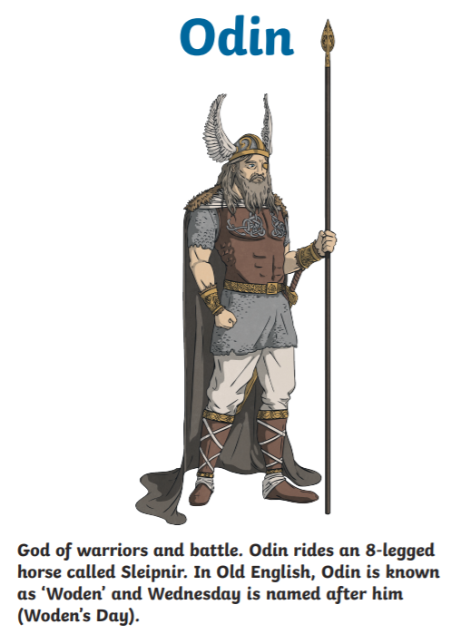
English:
Objective: To create a story board.
https://www.bbc.co.uk/teach/school-radio/english-ks2-viking-sagas-1/zrnd92p
We are going to start looking at Viking myths and legends to link with our topic lessons. Watch the link above about a Viking God called Odin and how he created the world.
Think about the questions below before completing the task…
What was your favourite part?
Did anything surprise you about the story?
Can you think of another story of creation (For example, Christianity etc).
What type of person is Odin? Why do you think this?
What type of person is Loki? Why do you think this?
1* - Answer the questions verbally to someone in your house.
2/3* - Answer the questions in full sentences.
Main task…
On the next slide is a blank story board. After watching the video, map out of the story using the 6 boxes.
Make sure you add as much detail as possible to explain what is happening at each point in the story.

Slide 3
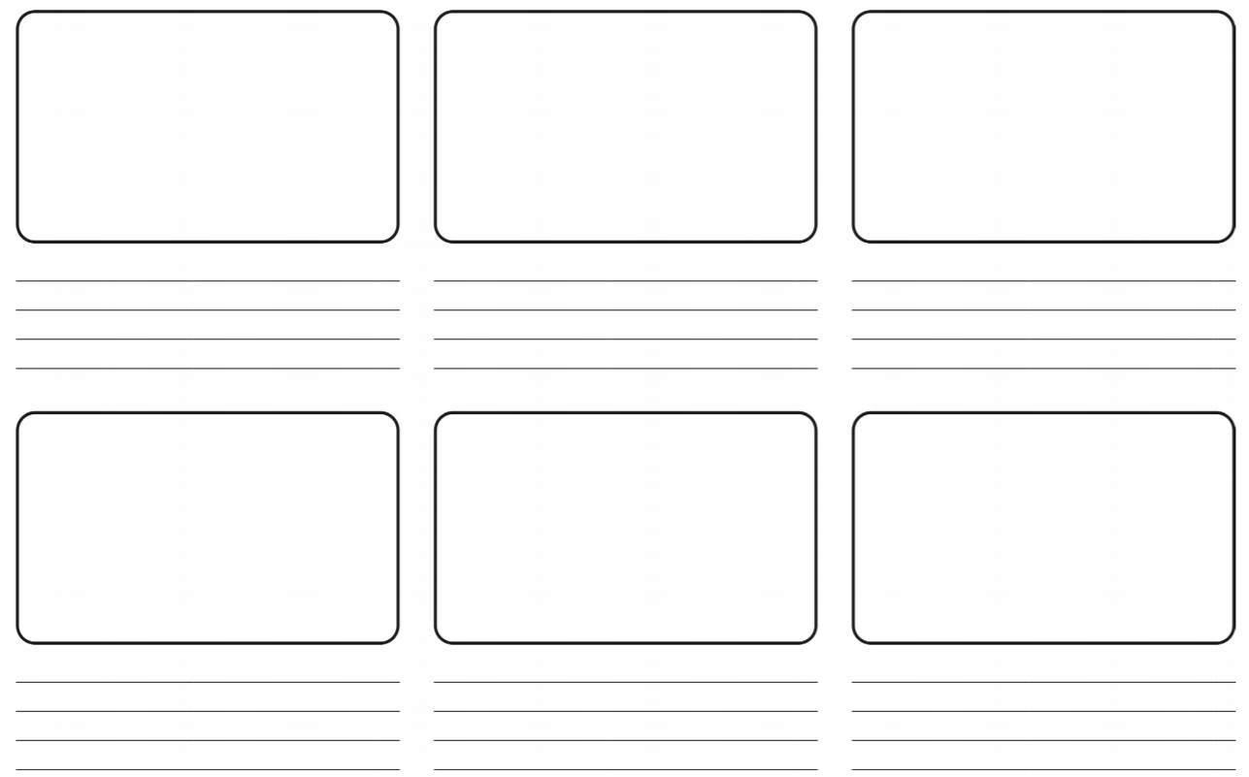

Slide 4
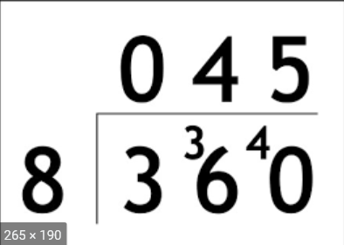
Maths:
Objective: To divide a 2-digit number by a 1-digit
number.
Using short division to divide a 2-digit number by a 1 digit number!
https://www.bbc.co.uk/bitesize/topics/z36tyrd/articles/zgxdfcw
Here is an example
of how we set out a division sum using the
bus stop method.
Write down each number clearly (one digit per square.)
Write the number you are dividing by next to the box and place the numbers you would like to divide in her box.
1* - See next slide for dividing a 2-digit number by a 1 digit number. Remember to use the bus stop method to show your working out.
2*/3* - The children will be dividing a 2-digit number by a 1-digit number and solving the problems using the bus stop method.
Extension task: Solve the problem on the last page.

Slide 5
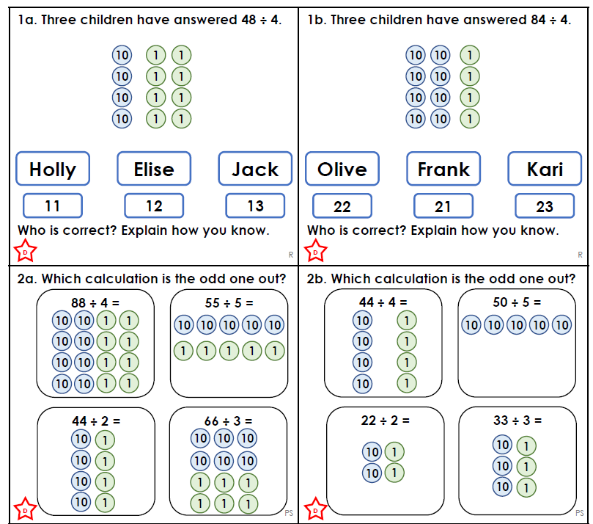
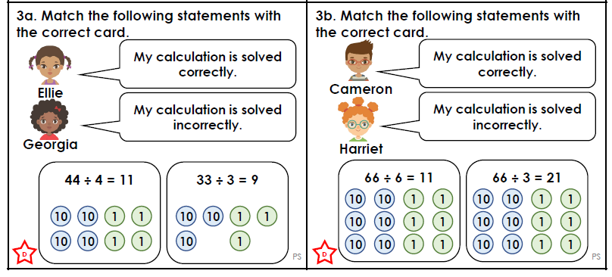
1 STAR TASK!

Slide 6
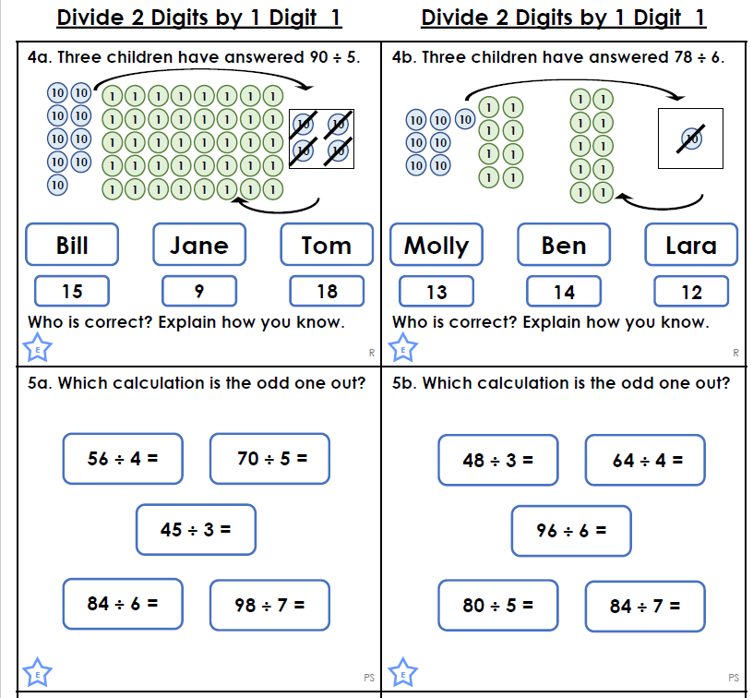
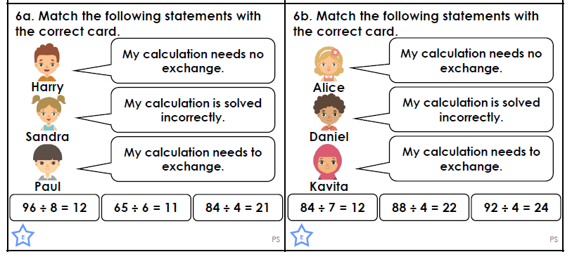
2 STAR TASK!

Slide 7
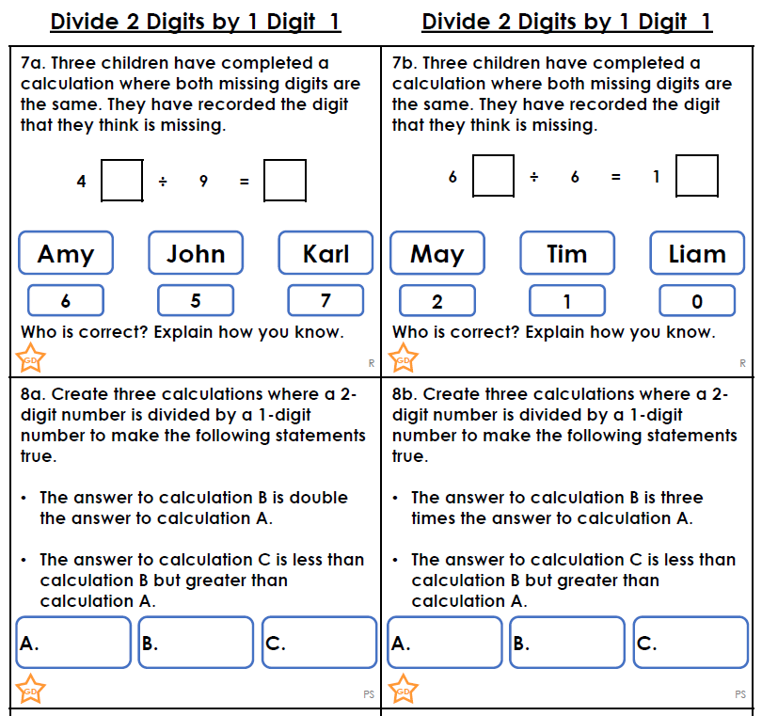
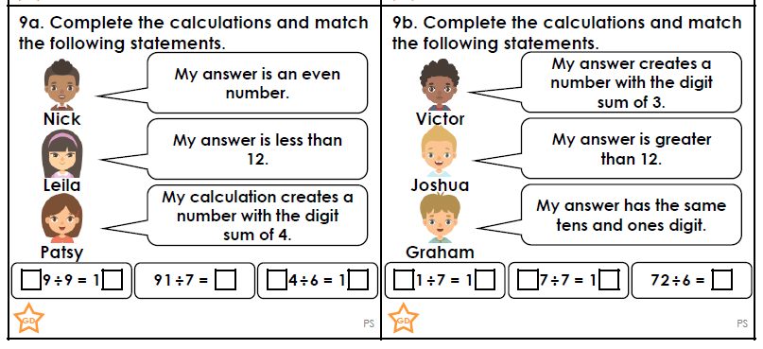
3 STAR TASK!

Slide 8
Extension Task!

Slide 9
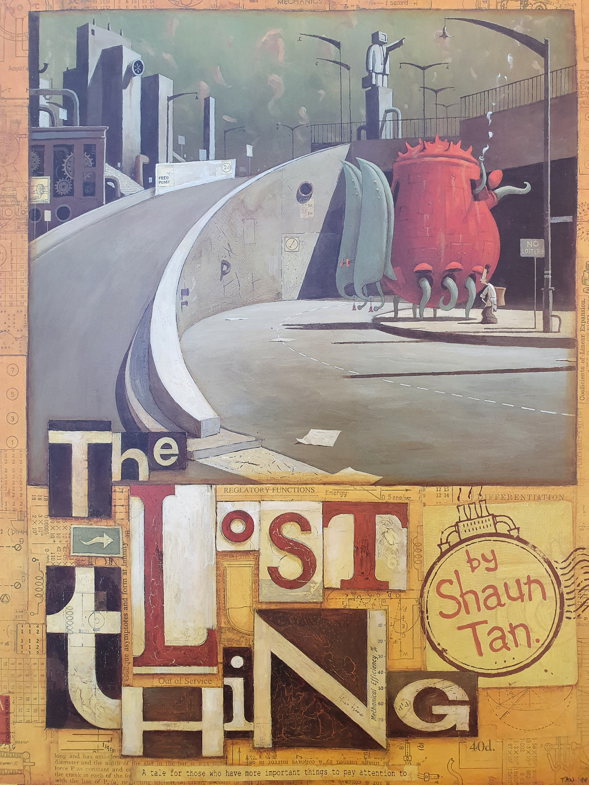
Reading:
Objective: To make a prediction based on a front cover.
This week, we are going to focus on ‘The Lost Thing’ by Shaun Tan.
Use the front cover to answer the questions below…
From the front cover, what do you think this text is going to be about?
What do you think the title means?
Where do you think the story is set? What makes you think this?
What do you think the lost thing might be? Why do you think this?
Who do you think the main character is?
Extra Challenge: Re-design the front cover
based on what you think the story will be
about.

Slide 10
Other Subject: PSHE
Objective: To prepare a positive mindset for Lockdown.
There are lots of activities that can be done to help keep us positive. Below are some ideas, you may have even better ones!?! Create a calendar with your own daily activity. Use the template provided (on the next slide) or make one of your own.

Slide 11
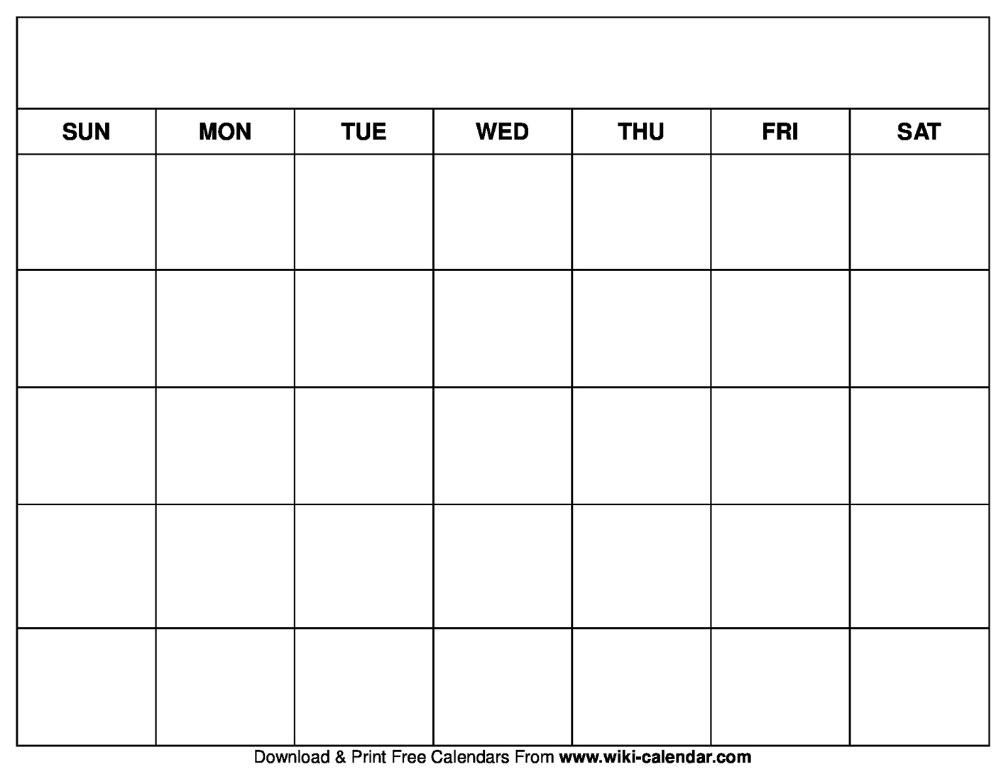
Other Subject: PSHE
Objective: To prepare a positive mindset for Lockdown.

