Slide 1
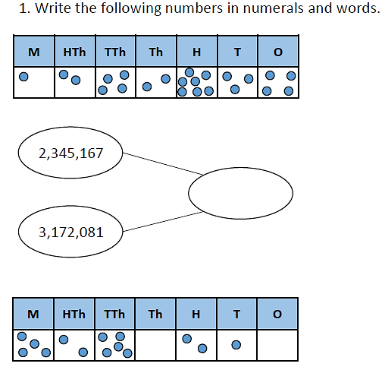
Warm Up – Day 1

Slide 2
Home Learning: Maths – Day 1 (Multiplication)
Video Link: https://vimeo.com/458926418
Children are expected to complete 1 or 2 of these slides… The difficulty gets harder as you move through the slides so if you are unsure, begin on the fluency section.

Slide 3
Home Learning: Maths – Day 1 (Multiplication)

Slide 4
Home Learning: Maths – Day 1 (Multiplication)

Slide 5
Answers coming up…
The next slide will contain the answers – make sure you have finished before you check the next slide. Please feel free to email any questions, queries or examples of work to your class teacher.
Max.jones9@taw.org.uk
Lynne.sherry@taw.org.uk
Jane.kerr@taw.org.uk

Slide 6
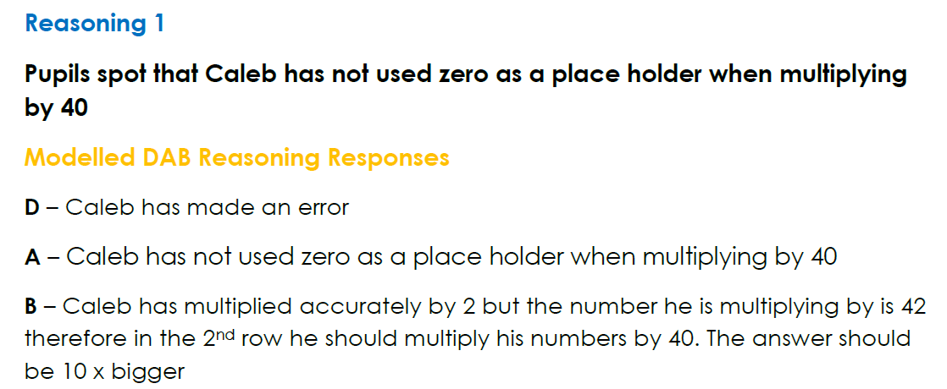
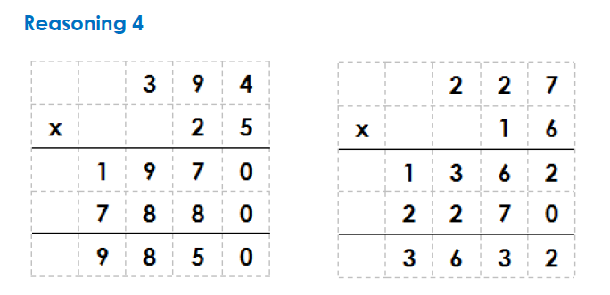

Slide 7
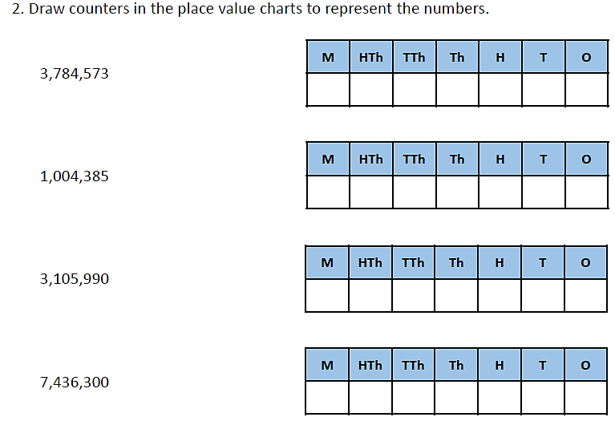
Warm Up – Day 2

Slide 8
Home Learning: Maths – Day 2 (Known Facts) Video Link: https://vimeo.com/466189554
Children are expected to complete 1 or 2 of these slides… The difficulty gets harder as you move through the slides so if you are unsure, begin on the fluency section.

Slide 9
Home Learning: Maths – Day 2 (Known Facts)

Slide 10
Home Learning: Maths – Day 2 (Known Facts)
Try to aim for around 10 calculations for Problem Solving 2.

Slide 11
Answers coming up…
The next slide will contain the answers – make sure you have finished before you check the next slide. Please feel free to email any questions, queries or examples of work to your class teacher.
Max.jones9@taw.org.uk
Lynne.sherry@taw.org.uk
Jane.kerr@taw.org.uk

Slide 12
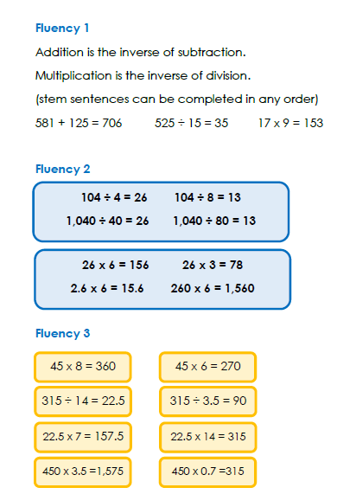
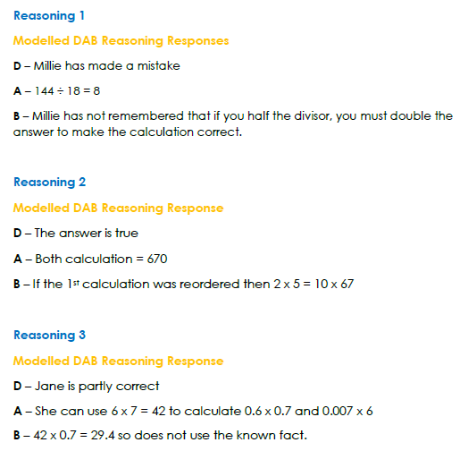
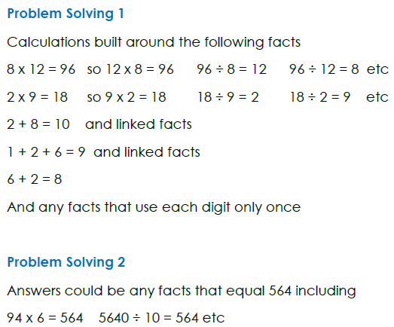

Slide 13
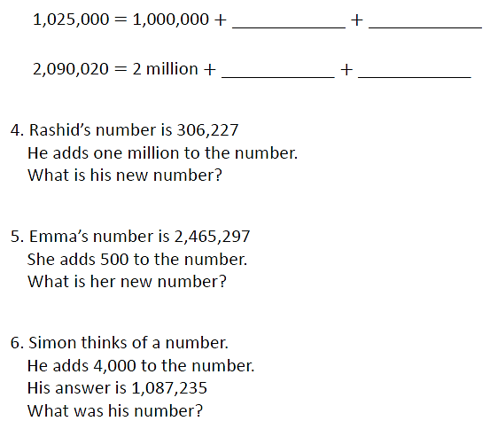
Warm Up – Day 3

Slide 14
Home Learning: Maths – Day 3 (Long Division)
..\September 2020\Maths\Spring\Wk 1 Recap\Long Division Prog.docx
Follow the link (will be available from the school website) to access today’s work on Long Division.
If you don’t feel confident using long division, then have a go at the short division questions on the next slide.
Video Link: https://vimeo.com/461800078 (Video 1)
Video Link: https://vimeo.com/463003643 (Video 2)

Slide 15
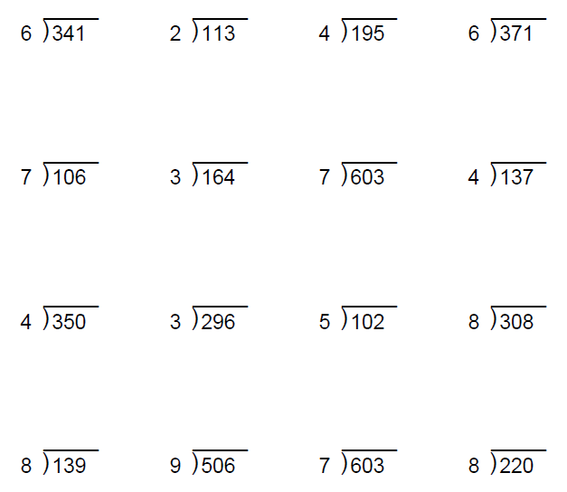
The answers are shown on the next slide, so make sure you have finished before you move on.

Slide 16
