Slide 1
Year 3 Home School Provision Daily Pack-01/02/21
The following slides will be split into 4 separate activities.
They will consist of Maths, English, Reading and one other subject.
Each slide will be daily activities for you and your child to do at home.
We as a Year 3 team, will update these slides daily to the website – please keep an eye out!
Please email NJS.Year3@taw.org.uk with any queries to share any work and one of the Year 3 teachers will get back to you as soon as possible!
Thank you for your understanding and on going support during these times.

Slide 2
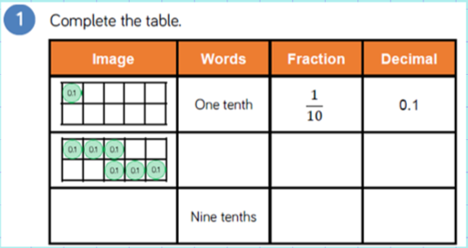
Maths
To count in tenths and recognise the relationship between tenths and decimals.
Introduction

Slide 3
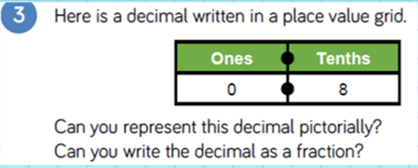
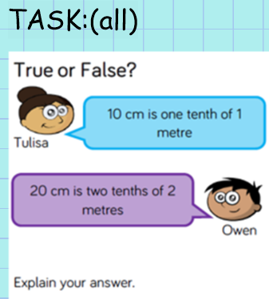
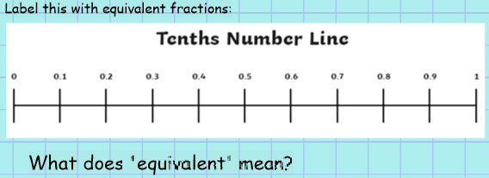

Slide 4
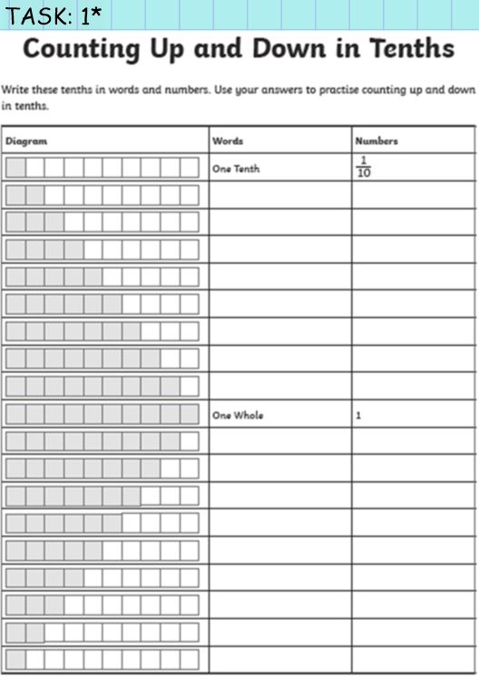

Slide 5
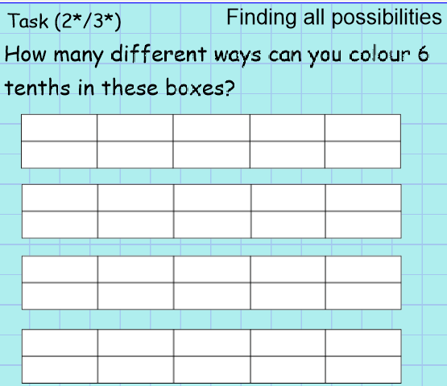
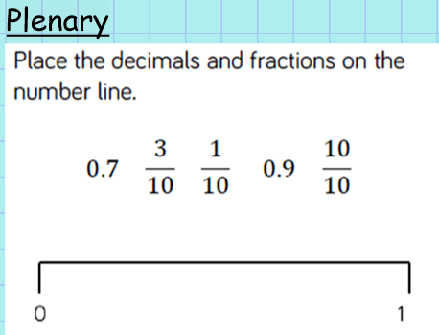
Answer

Slide 6
English -To use our plan and research to write the first part of a diary extract. -To remember and use features of a diary.
Who can remember what are the features of a diary?
Jot them down on a piece of paper and see how many you can remember!

Slide 7
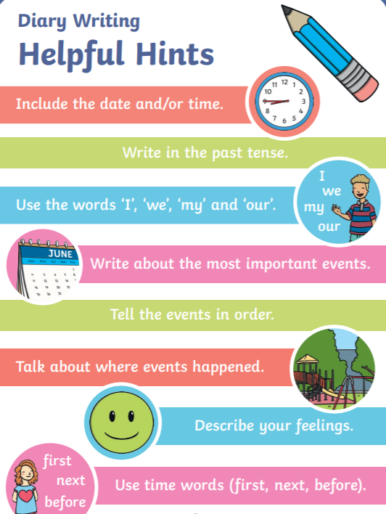
Did you get all of these?

Slide 8
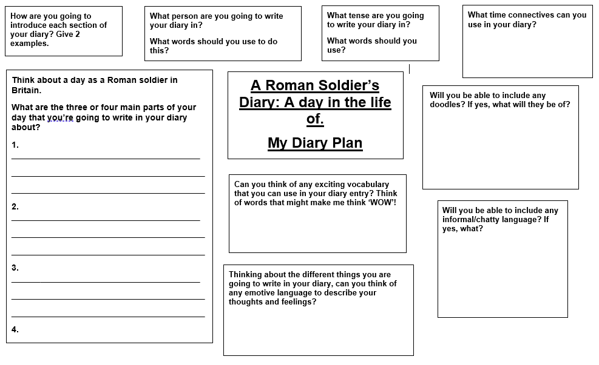
Make sure that you have your plan from Friday to hand.

Slide 9
Now lets write the first part of our diary…
Remember that YOU are the Roman soldier.
Start with the date
Write ‘Dear Diary’
Write in time order- talk about the beginning of your day.
Use a time word.
Use ‘I’, ‘me’, ‘my’, ‘our’, ‘we’ etc.

Slide 10
Reading –
To retrieve information from a text.
To infer and predict answers, using the text to support my ideas.
To find words with similar meanings.
The short extracts on the following pages have several questions each, based on the Reading VIPERS topic areas (Vocabulary, Inference, Prediction, Explanation, Retrieval and Summarising).
Read the texts, taking no more than a minute or so to do this, and then answer the questions about the text, thinking about which type of reading VIPER you are answering.
The following page explains in some more detail what the reading VIPERS are about. Try to use these when reading with your child. These are suggestions, not requirements! Please use them as you see fit.
NB:- Answers are provided, but no peeping until you have attempted the questions yourself!!

Slide 11
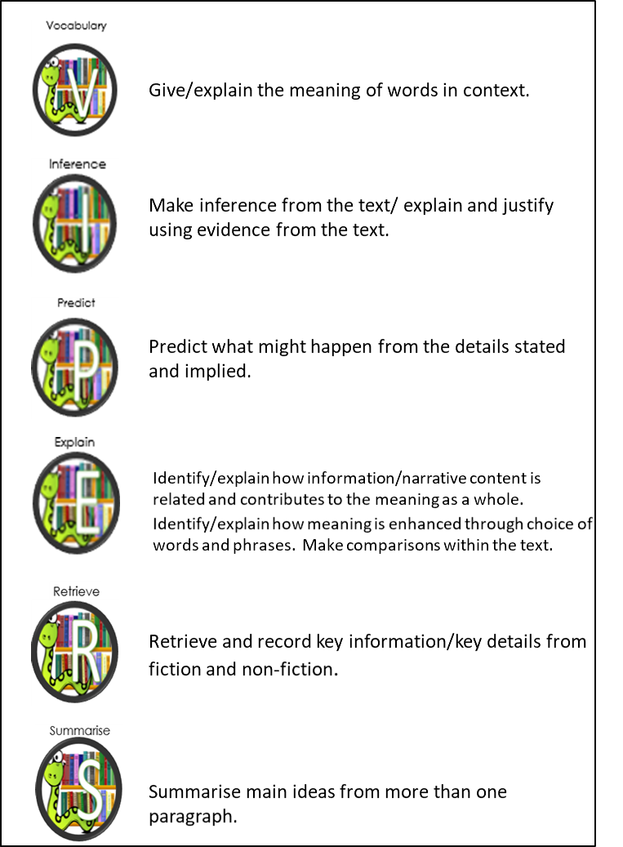
VIPERS
EXAMPLE QUESTIONS
Hunt for clues in the text, try missing the word out and then reading ‘around’ the word. What do words mean? What does this word tell you about the main character?
Working out what isn’t said directly in the text. E.g.: ‘He shivered and the hairs on his neck stood up.’ Is this person cold, or afraid? How do you know? What voice might these characters use? What did the author want us to feel like here?
Read the text and try to make an ‘educated’ guess about what will happen in the next chapter, paragraph, book etc.
What does this paragraph suggest will happen next? Where will the main character go? How do you know?
How does the author engage the reader? What is the purpose of this text feature? What is the author’s point of view? Why is the text organised in this way?
When was the story written? Who afre the main characters? What genre of writing is this? When did the main event happen? Find 2 facts about the main character.
Can you number these events in the order they happened? Summarise the beginning / middle / and end of the story. What would you call this chapter if you had to name it? Why?

Slide 12
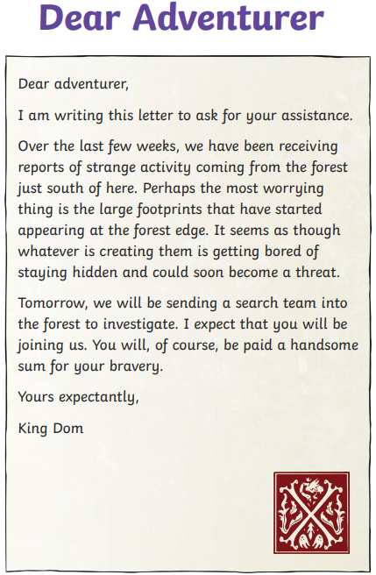
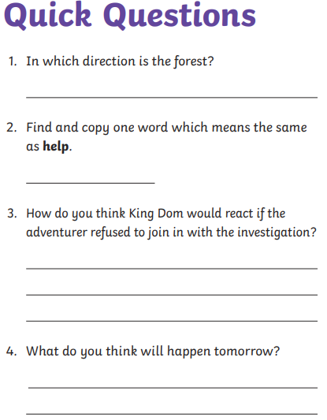

Slide 13
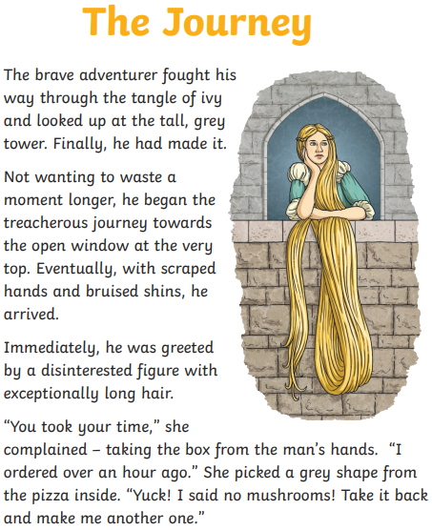
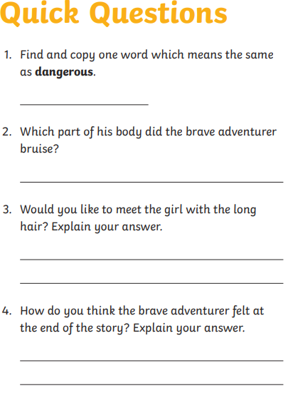

Slide 14
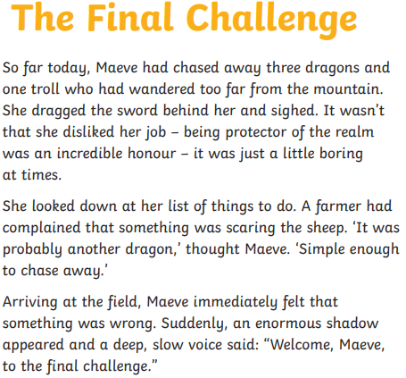
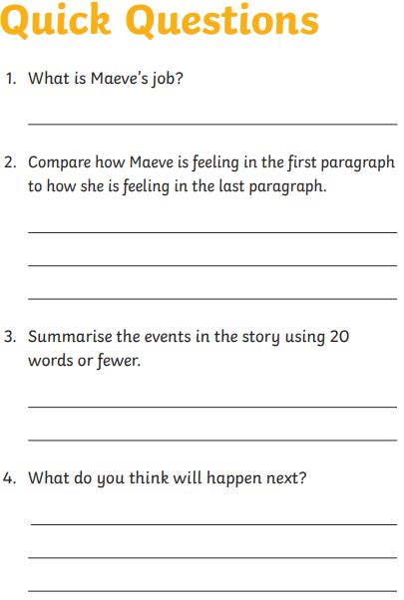
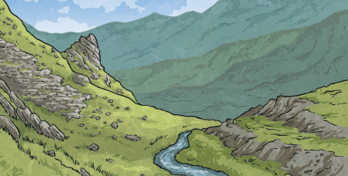

Slide 15
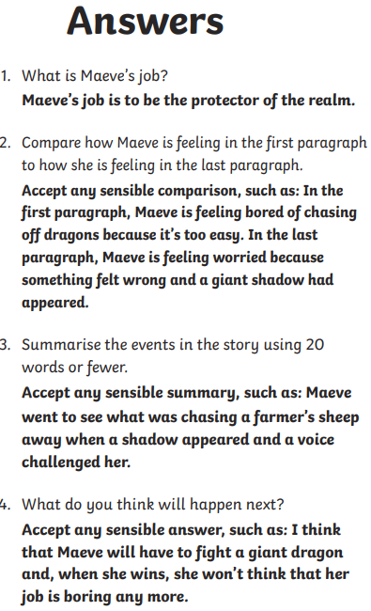
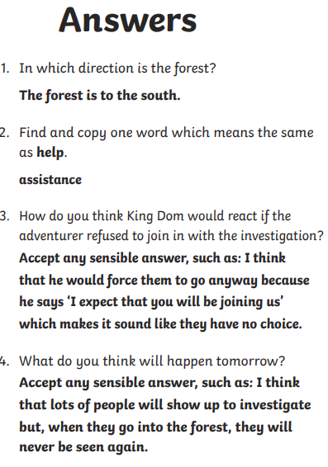
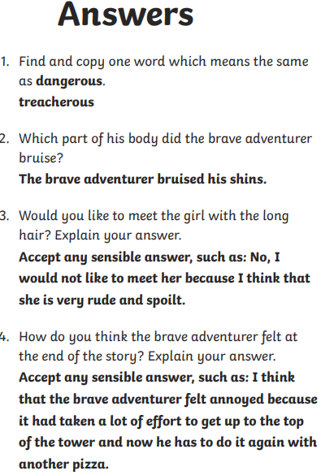

Slide 16
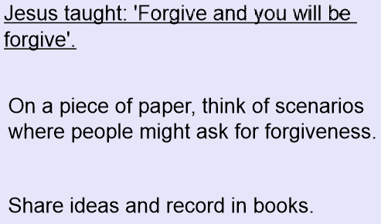
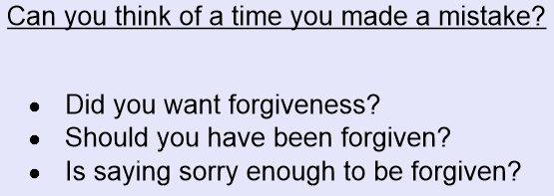
B&V: Should God forgive people who make mistakes?

Slide 17
