Slide 1
Year 3 Home School Provision Daily Pack
The following slides will be split into 4 separate activities.
They will consist of Maths, English, Reading and one other subject.
Each slide will be daily activities for you and your child to do at home.
We as a Year 3 team, will update these slides daily to the website – please keep an eye out!
Please email NJS.Year3@taw.org.uk with any queries to share any work and one of the Year 3 teachers will get back to you as soon as possible!
Thank you for your understanding and on going support during these times.

Slide 2
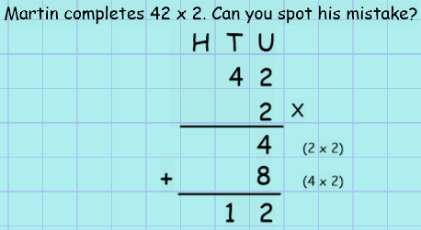
Maths
To use formal written methods to multiply TU x U and solve problems, using reasoning to explain my answers
Introduction:

Slide 3
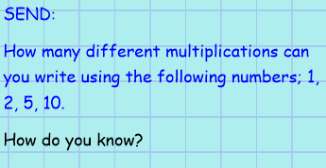
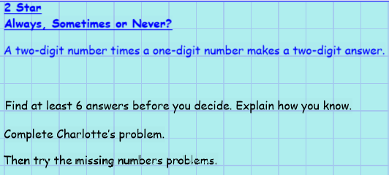
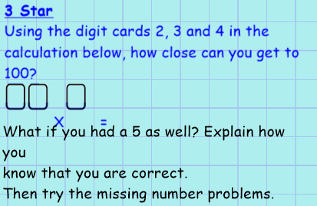
SEND
2 Star
3 Star
1 Star
On following slides as EXT.

Slide 4
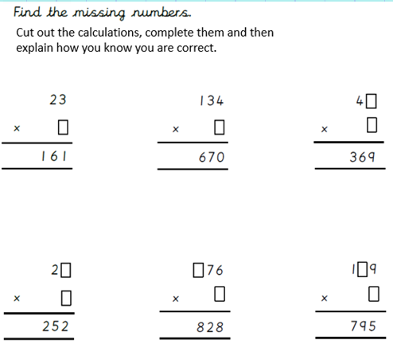
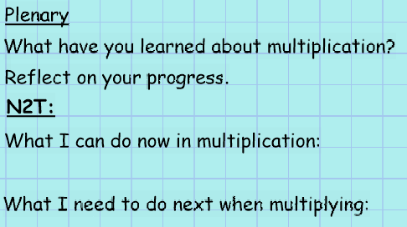
EXT:

Slide 5
English

Slide 6
Wherever you got up to yesterday, please continue from that point and create a poster of your facts ready to share to:
NJS.Year3@taw.org.uk

Slide 7
Reading:
3B your Courageous Advocate is Nelson Mandela.
Read the following pages on Nelson Mandela and answer the question on the following slide. Remember to use words from the question, capital letters and full stops.
Example:
Q:
Where was Nelson Mandela born?
A:
Nelson Mandela was born in…

Slide 8
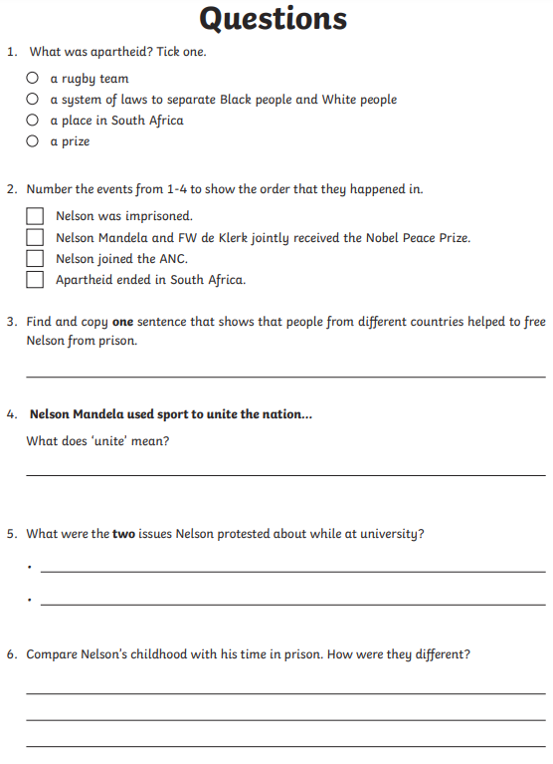

Slide 9
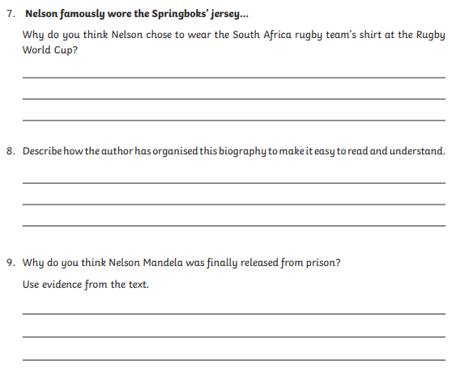

Slide 10
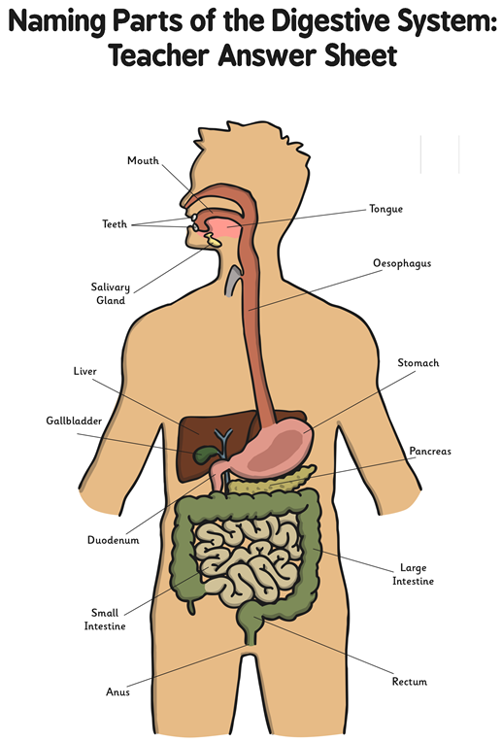
Science:
I can identify and name parts of the human digestive system
Using the labelled image, label all the parts on your sheet (on following slide). If you can’t print it, draw it yourself!
When you have correctly labelled your diagram, pick five different organs. You decide! Research them online or in a book you might have. Record their jobs and how they work in your exercise book.
Can you remember one interesting fact about the five organs you picked?
Miss W’s example; Did you know, you can live without your gallbladder!

Slide 11
